Slide 1

FINAL project
Group B

Slide 2
Group members:
Fozeya Chowdhury
Xing Liu
Edward Parrilla

Slide 3
Step A: Setup Threading and Logging by Xing Liu
The first step of the project.
The stockWatcher.py file was created.
Contains the functions needed to make the stock watcher with simple threading and logging.

Slide 4
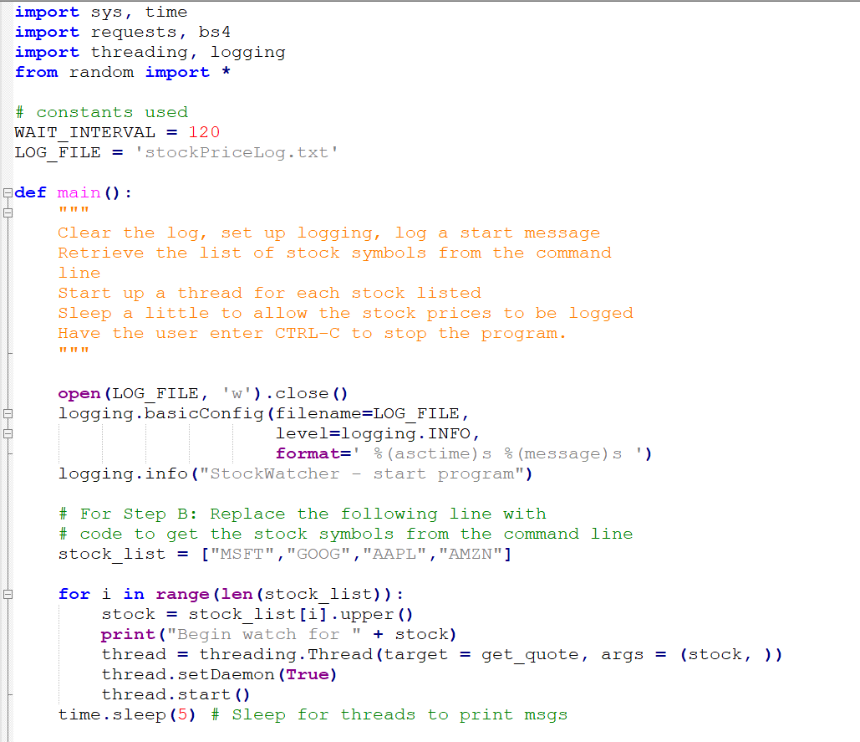
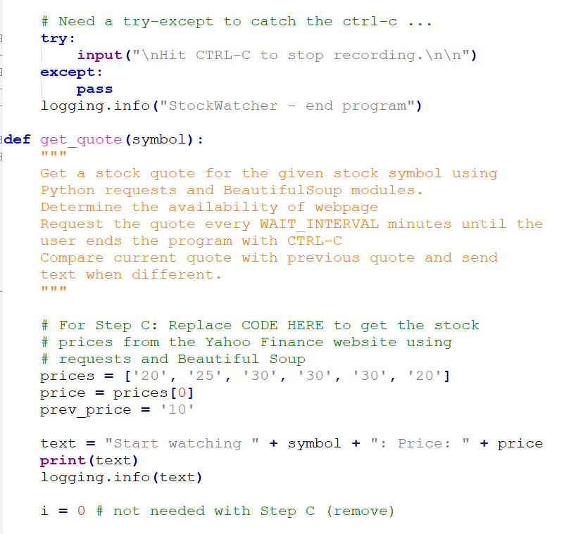
Code:

Slide 5
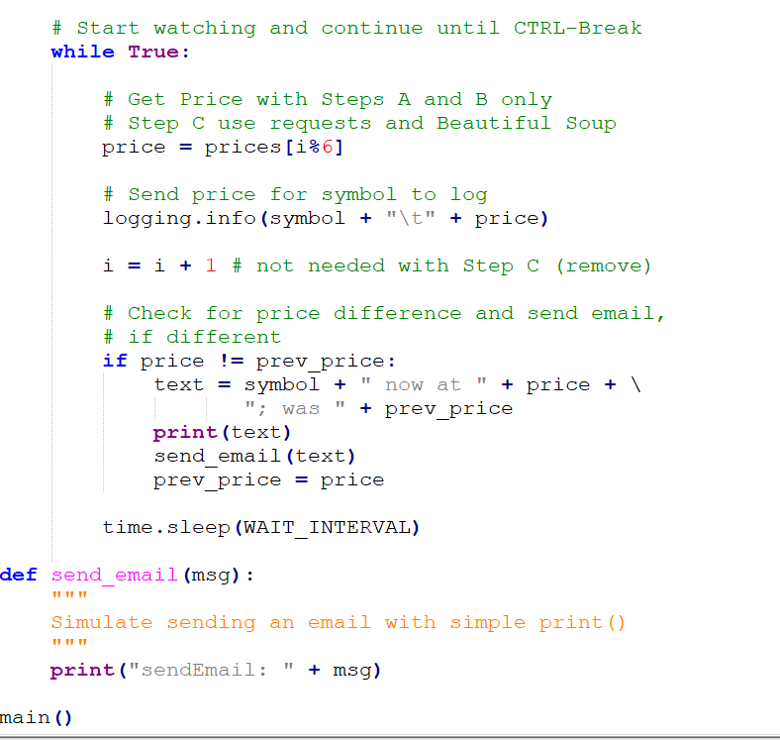

Slide 6
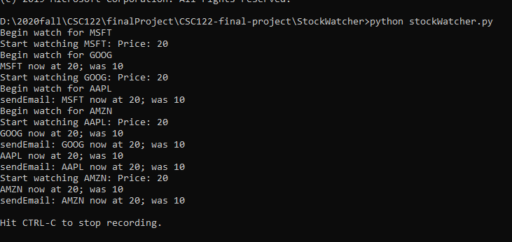
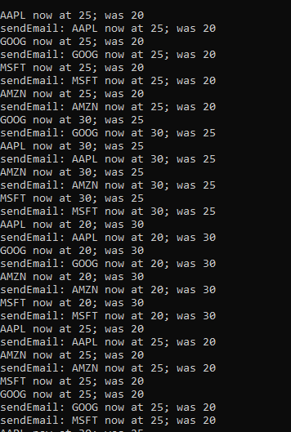
Run the program for 10-12 minutes:

Slide 7
Step B: Get Stock Symbols from the Command Line by Xing Liu
The code was edited to get the stock symbols from the command line
stock_list = ["MSFT","GOOG","AAPL","AMZN"] was replaced by
stock_list = sys.argv[1:]

Slide 8
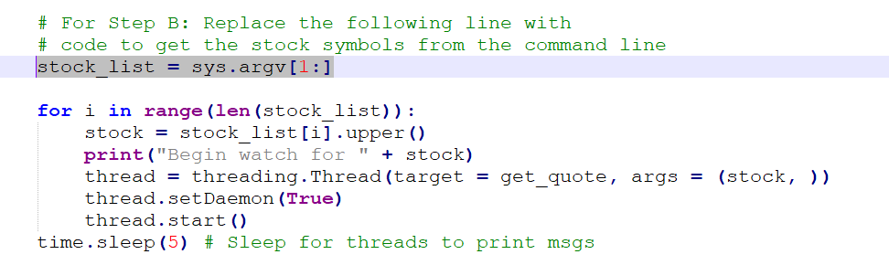
Code updated:

Slide 9
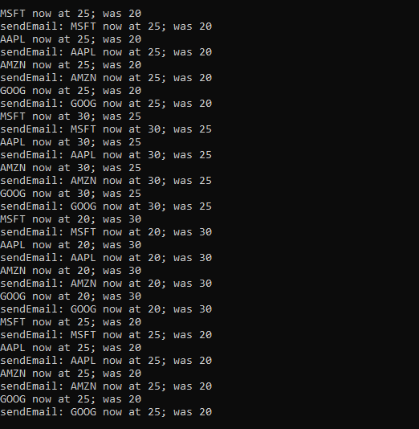
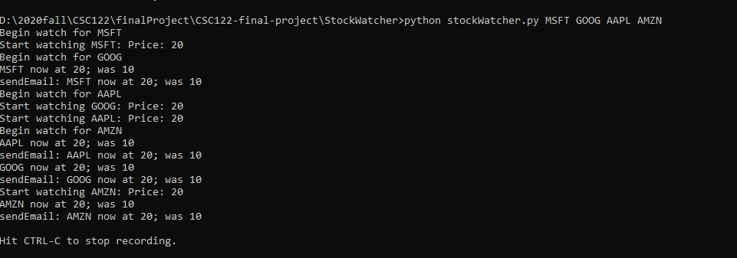
Run the program with the command ...> python stockWatcher.py MSFT GOOG AAPL AMZN

Slide 10
Step c

Slide 11
problems

Slide 12
resolvations

