Slide 1
Dataset – ALS
Participants | Speech <4 (class 1) | Swallowing <4 (class 1) | Bulbar | Phonation (a, e, i, o, u) | Syllables (pa, ta, ka)
100 (37 F) | 52 | 56 | 0: 33 1: 31 2: 13 3: 15 4: 8 | 53 features per task 265 features | 63 features per task 189 features
Analyses
Average values across repetitions
Train: 80 % (20% Validation, 60% Train)
Test: 20%
~ proportions normal/impaired
Target | Feature selection | Number of features selected | Models | Hyperparameters
Speech | mRMR, RFE* | 5 per task, 10%, Free (min 5) | SVM, RF, XGB, KNN, MLP | GridSearchCV (5 fold)
Swallowing | mRMR, RFE* | 5 per task, 10%, Free (min 5) | SVM, RF, XGB, KNN, MLP | GridSearchCV (5 fold)
Bulbar** | RFE* | 5 per task, 10%, Free (min 5) | SVM, RF, XGB, KNN, MLP | GridSearchCV (5 fold)
* LogisticRegression
**LOO

Slide 2
Hyperparameters (Speech & Swallowing)
SVM:
parameters = {
'C': [0.0001, 0.01, 0.02, 0.1, 0.2, 1, 2, 10, 20, 100, 1000],
'kernel': ['linear', 'rbf', 'sigmoid', 'poly'],
'gamma': [0.0001, 0.001, 0.01, 0.1, 1],
'degree': [2, 3, 4],
}
XGB:
parameters = {
'n_estimators': [10, 20, 30, 40, 50, 100, 200],
'max_depth': [2, 3, 5, 7, 9],
'learning_rate': [0.01, 0.1, 0.2, 0.5, 0.7, 1.0],
'subsample': [0.1, 0.2, 0.3, 0.5, 0.7, 1.0],
}
MLP:
parameters = {
'hidden_layer_sizes': [(64,), (32,), (16,), (8,), (64,32), (32, 16), (16, 8)],
'activation': ['relu', 'tanh', 'sigmoid'],
'alpha': [0.0001, 0.001],
'learning_rate': ['constant', 'adaptive'],
}
RF:
parameters = {
'n_estimators': [10, 20, 30, 40, 50, 60, 70, 100],
'max_depth': [None, 10, 20, 30],
'min_samples_split': [2, 5, 10],
'min_samples_leaf': [1, 2, 4],
}
KNN:
parameters = {
'n_neighbors': [2, 3, 4, 5, 6, 7, 8, 9, 10, 15],
'weights': ['uniform', 'distance'],
'metric': ['euclidean', 'manhattan', 'minkowski'],
}

Slide 3
Speech
Feature set | Feature selection | Best models | F1-Train | F1-test | Accuracy | F1 | Recall | Precision | Specificity | Sensitivity
Phonation | RFE | SVM (5) | 1 | 0.57 | 0.68 ± 0.08 | 0.67 ± 0.07 | 0.67 ± 0.09 | 0.68 ± 0.11 | 0.69 ± 0.15 | 0.67 ± 0.09
 |  | RF (5) | 1 | 0.75 | 0.63 ± 0.07 | 0.60 ± 0.09 | 0.58 ± 0.14 | 0.63 ± 0.07 | 0.68 ± 0.12 | 0.58 ± 0.14
 |  | KNN (5) | 1 | 0.76 | 0.64 ± 0.06 | 0.61 ± 0.05 | 0.58 ± 0.08 | 0.67 ± 0.17 | 0.70 ± 0.16 | 0.58 ± 0.08
 | MRMR | RF (10%) | 1 | 0.70 | 0.62 ± 0.09 | 0.61 ± 0.08 | 0.62 ± 0.10 | 0.61 ± 0.10 | 0.62 ± 0.16 | 0.62 ± 0.10
 |  | XGB (Free) | 1 | 0.67 | 0.66 ± 0.05 | 0.67 ± 0.03 | 0.66 ± 0.07 | 0.64 ± 0.07 | 0.62 ± 0.13 | 0.71 ± 0.07
 |  | XGB (Free) | 1 | 0.64 | 0.65 ± 0.13 | 0.64 ± 0.13 | 0.65 ± 0.14 | 0.64 ± 0.13 | 0.65 ± 0.16 | 0.64 ± 0.14
Syllabels | RFE | RF (5) | 1 | 0.74 | 0.71 ± 0.11 | 0.72 ± 0.10 | 0.77 ± 0.10 | 0.69 ± 0.12 | 0.66 ± 0.17 | 0.77 ± 0.10
 |  | XGB (5) | 1 | 0.67 | 0.69 ± 0.06 | 0.68 ± 0.06 | 0.69 ± 0.09 | 0.68 ± 0.06 | 0.69 ± 0.07 | 0.69 ± 0.09
 |  | RF (10%) | 1 | 0.82 | 0.71 ± 0.14 | 0.72 ± 0.13 | 0.77 ± 0.15 | 0.68 ± 0.13 | 0.66 ± 0.17 | 0.77 ± 0.15
 | MRMR | XGB (Free) | 1 | 0.82 | 0.72 ± 0.08 | 0.71 ± 0.07 | 0.73 ± 0.07 | 0.73 ± 0.11 | 0.73 ± 0.15 | 0.71 ± 0.07
 |  | RF (Free) | 1 | 0.74 | 0.68 ± 0.13 | 0.69 ± 0.10 | 0.68 ± 0.09 | 0.68 ± 0.14 | 0.66 ± 0.22 | 0.71 ± 0.09
 |  | RF (5) | 1 | 0.8 | 0.63 ± 0.12 | 0.62 ± 0.14 | 0.61 ± 0.21 | 0.61 ± 0.12 | 0.62 ± 0.19 | 0.65 ± 0.21
Multimodal | RFE | RF (5) | 1 | 0.9 | 0.72 ± 0.15 | 0.71 ± 0,16 | 0.73 ± 0.18 | 0.71 ± 0.15 | 0.71 ± 0.19 | 0.73 ± 0.18
 |  | XGB (5) | 1 | 0.67 | 0.72 ± 0.05 | 0.71 ± 0.05 | 0.71 ± 0.07 | 0.72 ± 0.10 | 0.73 ± 0.12 | 0.71 ± 0.07
 |  | SVM (10%) | 1 | 0.56 | 0.68 ± 0.09 | 0.69 ± 0.06 | 0.73 ± 0.05 | 0.68 ± 0.13 | 0.64 ± 0.20 | 0.73 ± 0.05
 | MRMR | KNN (Free) | 1 | 0.44 | 0.66 ± 0.09 | 0.61 ± 0.09 | 0.56 ± 0.11 | 0.70 ± 0.14 | 0.75 ± 0.17 | 0.56 ± 0.11
 |  | KNN (Free) | 1 | 0.67 | 0.66 ± 0.09 | 0.61 ± 0.09 | 0.56 ± 0.11 | 0.70 ± 0.14 | 0.75 ± 0.17 | 0.56 ± 0.11
 |  | RF (Free) | 1 | 0.74 | 0.72 ± 0.12 | 0.73 ± 0.10 | 0.75 ± 0.08 | 0.72 ± 0.16 | 0.69 ± 0.20 | 0.75 ± 0.08

Slide 4
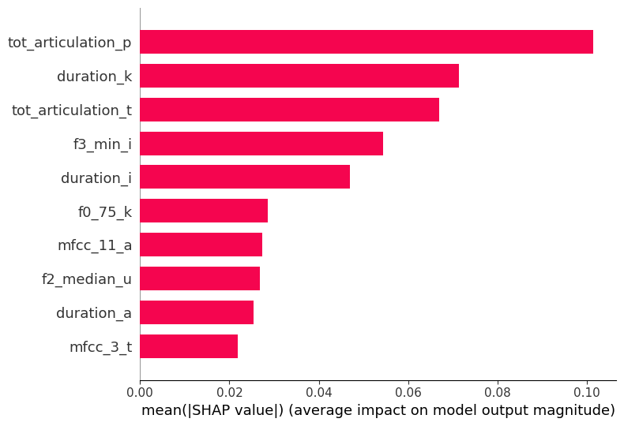
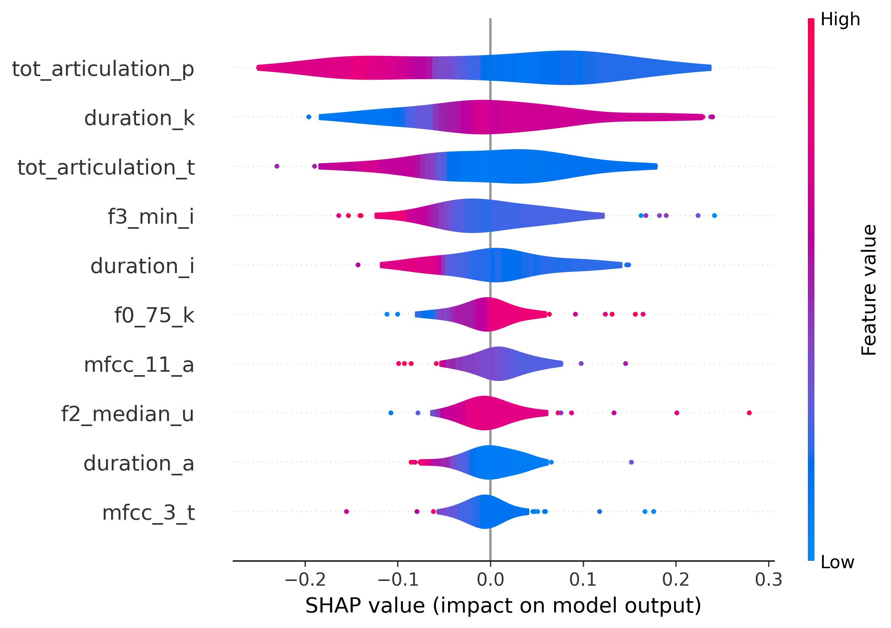
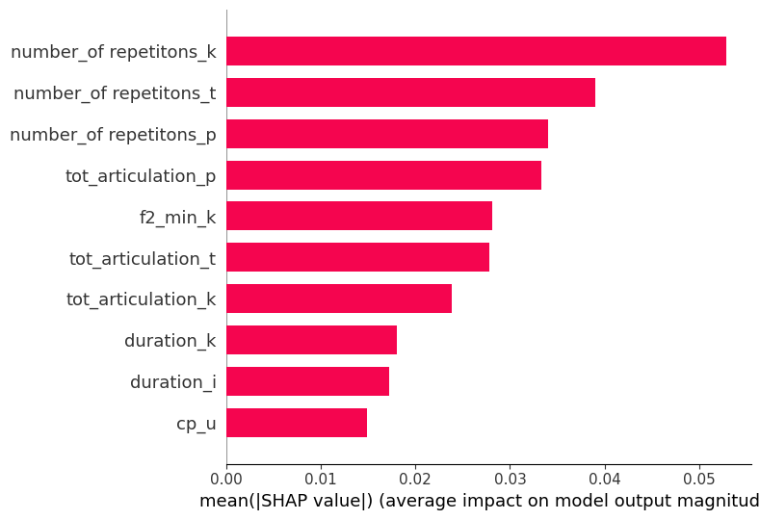
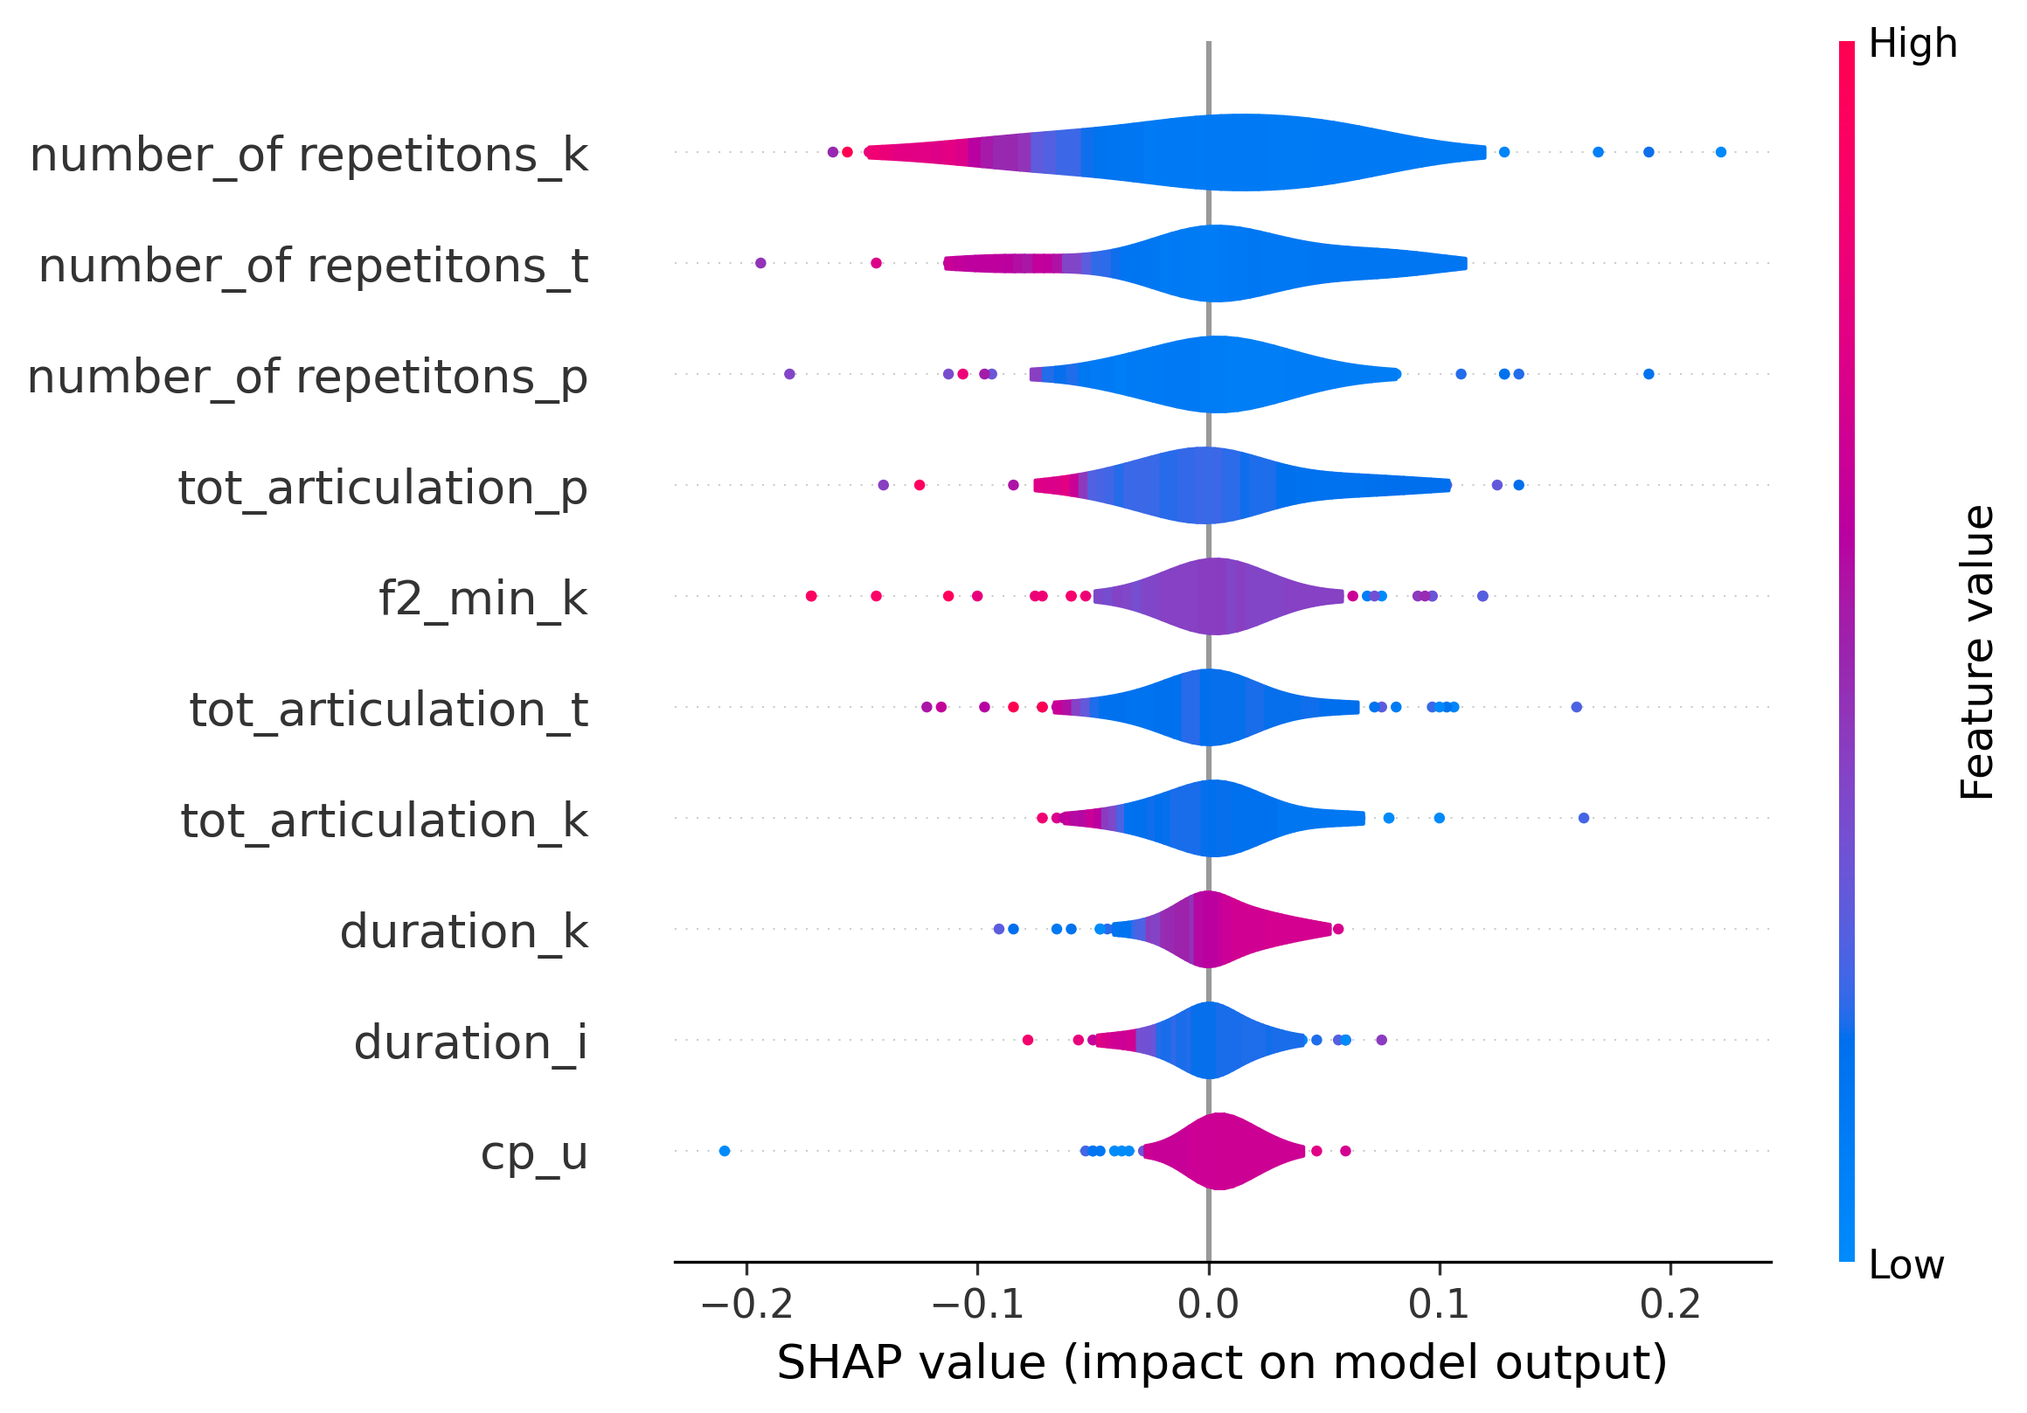
Feature importance (speech)
RFE – Multimodal RF (5)
MRMR – Multimodal RF (Free)

Slide 5
Swallowing
Feature set | Feature selection | Best models | F1-Train | F1-test | Accuracy | F1 | Recall | Precision | Specificity | Sensitivity
Phonation | RFE | RF (10%) | 1 | 0.44 | 0.76 ± 0.12 | 0.72 ± 0.12 | 0.68 ± 0.09 | 0.78 ± 0.17 | 0.82 ± 0.16 | 0.68 ± 0.09
 |  | XGB (Free) | 1 | 0.53 | 0.79 ± 0.07 | 0.76 ± 0.07 | 0.75 ± 0.04 | 0.78 ± 0.10 | 0.82 ± 0.10 | 0.75 ± 0.04
 |  | KNN (Free) | 1 | 0.47 | 0.73 ± 0.10 | 0.66 ± 0.11 | 0.59 ± 0.11 | 0.78 ± 0.19 | 0.84 ± 0.14 | 0.59 ± 0.11
 | MRMR | SVM (Free) | 1 | 0.56 | 0.68 ± 0.09 | 0.64 ± 0.09 | 0.64 ± 0.08 | 0.65 ± 0.11 | 0.72 ± 0.12 | 0.64 ± 0.08
 |  | SVM (Free*) | 1 | 0.75 | 0.74 ± 0.09 | 0.68 ± 0.11 | 0.64 ± 0.15 | 0.75 ± 0.15 | 0.82 ± 0.10 | 0.64 ± 0.15
 |  | XGB (Free) | 1 | 0.60 | 0.69 ± 0.06 | 0.62 ± 0.09 | 0.59 ± 0.12 | 0.66 ± 0.08 | 0.77 ± 0.04 | 0.59 ± 0.12
Syllabels | RFE | KNN (5) | 1 | 0.82 | 0.77 ± 0.05 | 0.73 ± 0.07 | 0.73 ± 0.09 | 0.75 ± 0.07 | 0.80 ± 0.06 | 0.73 ± 0.09
 |  | SVM (10%) | 1 | 0.59 | 0.73 ± 0.07 | 0.68 ± 0.14 | 0.72 ± 0.22 | 0.67 ± 0.05 | 0.73 ± 0.06 | 0.72 ± 0.22
 |  | RF (Free) | 1 | 0.67 | 0.74 ± 0.04 | 0.68 ± 0.06 | 0.64 ± 0.13 | 0.77 ± 0.12 | 0.82 ± 0.12 | 0.64 ± 0.13
 | MRMR | KNN (Free*) | 1 | 0.53 | 0.70 ± 0.07 | 0.63 ± 0.05 | 0.57 ± 0.09 | 0.74 ± 0.16 | 0.80 ± 0.16 | 0.57 ± 0.09
 |  | KNN (Free) | 1 | 0.57 | 0.66 ± 0.09 | 0.59 ± 0.12 | 0.57 ± 0.13 | 0.62 ± 0.13 | 0.73 ± 0.09 | 0.57 ± 0.13
 |  | XGB (Free) | 1 | 0.67 | 0.70 ± 0.05 | 0.65 ± 0.11 | 0.66 ± 0.19 | 0.66 ± 0.06 | 0.73 ± 0.12 | 0.66 ± 0.19
Multimodal | RFE | XGB (5) | 1 | 0.78 | 0.79 ± 0.08 | 0.76 ± 0.06 | 0.75 ± 0.12 | 0.82 ± 0.16 | 0.82 ± 0.20 | 0.75 ± 0.12
 |  | SVM (10%) | 1 | 0.56 | 0.83 ± 0.07 | 0.78 ± 0.10 | 0.72 ± 0.16 | 0.91 ± 0.13 | 0.91 ± 0.14 | 0.72 ± 0.16
 |  | RF (10%) | 1 | 0.71 | 0.75 ± 0.08 | 0.67 ± 0.13 | 0.61 ± 0.20 | 0.81 ± 0.13 | 0.86 ± 0.12 | 0.61 ± 0.20
 | MRMR | RF (Free) | 1 | 0.71 | 0.77 ± 0.10 | 0.73 ± 0.12 | 0.73 ± 0.18 | 0.75 ± 0.09 | 0.80 ± 0.11 | 0.73 ± 0.18
 |  | XGB (Free) | 1 | 0.63 | 0.76 ± 0.08 | 0.72 ± 0.08 | 0.73 ± 0.15 | 0.78 ± 0.15 | 0.78 ± 0.17 | 0.73 ± 0.15
 |  | RF (Free*) | 1 | 0.53 | 0.76 ± 0.09 | 0.70 ± 0.14 | 0.71 ± 0.22 | 0.74 ± 0.06 | 0.80 ± 0.09 | 0.71 ± 0.22

Slide 6
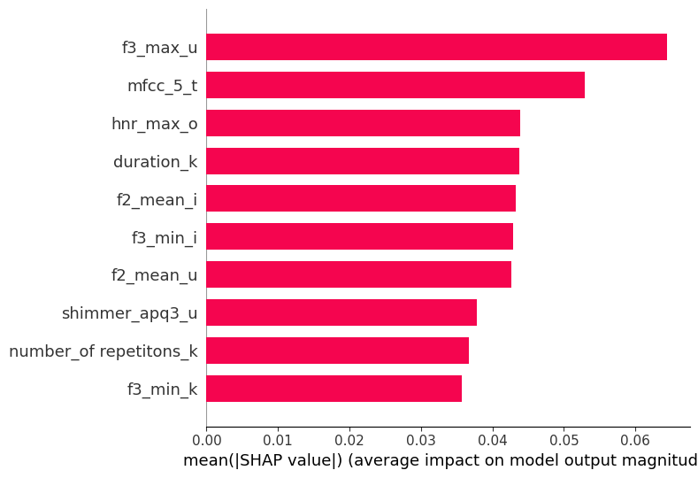
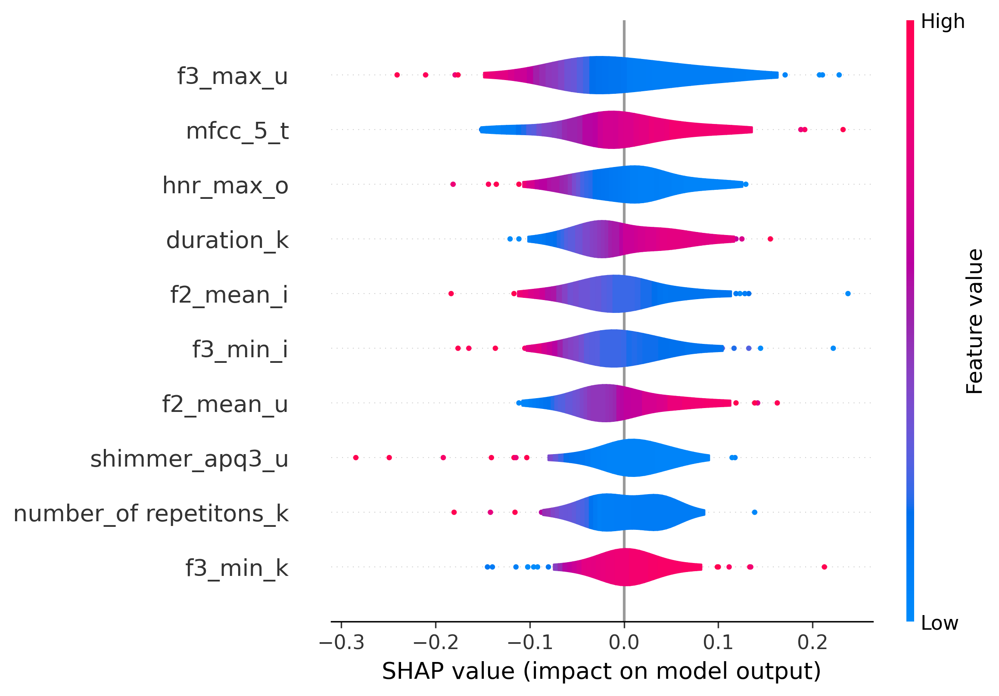
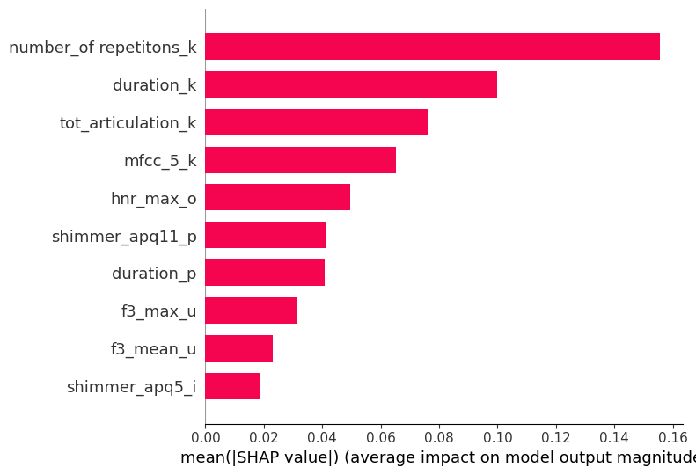
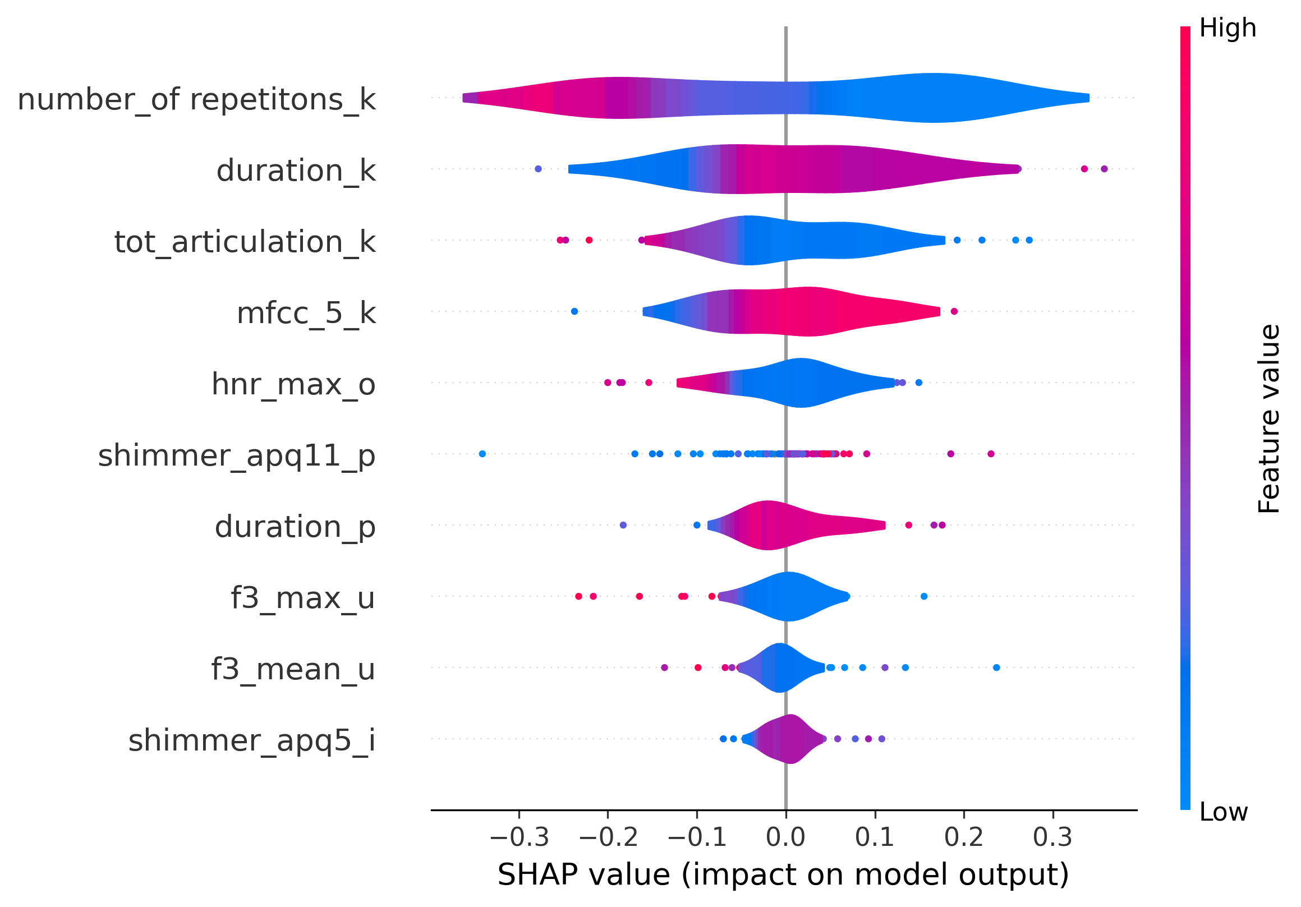
Feature importance (swallowing)
RFE – Multimodal SVM (10%)
MRMR – Multimodal RFE (Free)

Slide 7
Bulbar (only RFE, syllables)
Continuous values
0,1,2,3,4 values
Feature set | Models | Feature selection | RMSE
Syllabels | SVM | 5 | 1.43
 |  | 10% | 1.42
 |  | Free | 1.23
 | RF | 5 | 1.26
 |  | 10% | 1.05
 |  | Free | 1.16
 | XGB | 5 | 1.34
 |  | 10% | 1.13
 |  | Free | 1.16
 | KNN | 5 | 1.43
 |  | 10% | 1.19
 |  | Free | 1.20
 | MLP | 5 | 1.49
 |  | 10% | 1.32
 |  | Free | 1.26
Feature set | Models | Feature selection | RMSE | Mean Error (True – int(Pred))
Syllabels | SVM | 5 | 1.47 | 1.16
 |  | 10% | 1.42 | 1.09
 |  | Free | 1.27 | 0.94
 | RF | 5 | 1.30 | 1.02
 |  | 10% | 1.06 | 0.85
 |  | Free | 1.16 | 0.96
 | XGB | 5 | 1.39 | 1.06
 |  | 10% | 1.15 | 0.89
 |  | Free | 1.17 | 0.92
 | KNN | 5 | 1.51 | 1.26
 |  | 10% | 1.27 | 0.99
 |  | Free | 1.27 | 0.97
 | MLP | 5 | 1,51 | 1.17
 |  | 10% | 1.31 | 1.03
 |  | Free | 1.26 | 0.96

