Slide 1
FEM Computing on the GPU with OpenCL
Francisco Aboim

Slide 2
Introduction
GPU hardware architecture
The OpenCL framework
Matrix Storage Selection
GPU implementations of the FEM in 2 and 3 dimensions and considerations
Sparse Matrix Assembly / Graph Coloring

Slide 3
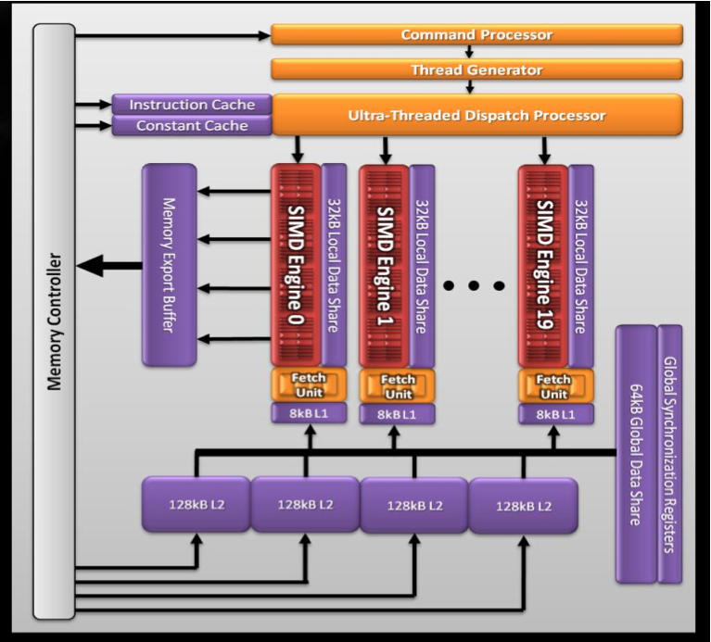
AMD GPU Hardware Architecture
AMD 5870 – Cypress
20 SIMD engines
16 SIMD units per core
5 multiply-adds per functional unit (VLIW processing)
2.72 Teraflops Single Precision
544 Gigaflops Double Precision
Source: Introductory OpenCL SAAHPC2010, Benedict R. Gaster
Notes:
Very AMD specific discussion of low-level GPU architecture

Slide 4

SIMD Engine
One SIMD Engine
A SIMD engine consists of a set of “Stream Cores”
Stream cores arranged as a five way Very Long Instruction Word (VLIW) processor
Up to five scalar operations can be issued in a VLIW instruction
Scalar operations executed on each processing element
Stream cores within compute unit execute same VLIW instruction
The block of work-items that are executed together is called a wavefront.
64 work items for 5870
One Stream Core
Instruction and Control Flow
T-Processing
Element
Branch
Execution Unit
Processing
Elements
General Purpose Registers
Source: AMD Accelerated Parallel Processing OpenCL Programming Guide
Notes:
Very AMD specific discussion of low-level GPU architecture
Discusses a single SIMD engine and the stream cores

Slide 5
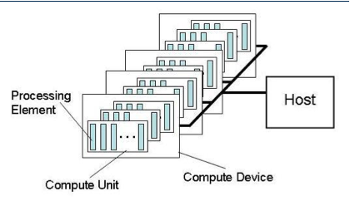
AMD Platform as seen in OpenCL
Individual work-items execute on a single processing element
Processing element refers to a single VLIW core
Multiple work-groups execute on a compute unit
A compute unit refers to a SIMD Engine
Notes:
We converge back to the OpenCL terminology to understand how the AMD GPU maps onto the OpenCL processing elements

Slide 6
AMD GPU Memory Architecture
Memory per compute unit
Local data store (on-chip)
Registers
L1 cache (8KB for 5870) per compute unit (WI register – private in opencl)
L2 Cache shared between compute units (512KB for 5870) – local in OpenCL
Fast path for only 32 bit operations (optimal)*
Complete path for atomics and < 32bit operations
SIMD Engine
LDS, Registers
L1 Cache
Compute Unit to Memory X-bar
L2 Cache
Write Cache
Atomic Path
LDS
Notes:
A brief overview of the AMD GPU memory architecture (As per Evergreen Series)

Slide 7
AMD Memory Model in OpenCL
Subset of hardware memory exposed in OpenCL
Local Data Share (LDS) exposed as local memory
Share data between items of a work group designed to increase performance
High Bandwidth access per SIMD Engine
Private memory utilizes registers per work item
Constant Memory
__constant tags utilize L1 cache.
Private
Memory
Private
Memory
Private
Memory
Private
Memory
Workitem 1
Workitem 1
Workitem 1
Workitem 1
Compute Unit 1
Compute Unit N
Local Memory
Local Memory
Global / Constant Memory Data Cache
Compute Device
Global Memory
Compute Device Memory
Notes:
The mapping of the AMD GPU memory components to the OpenCL terminology.
Architecturally this is similar for AMD and Nvidia except that each ones have their own vendor specific names
Similar types of memory are mapped to local memory for both AMD and Nvidia

Slide 8
SIMT and SIMD
SIMT denotes scalar instructions and multiple threads sharing an instruction stream
HW determines instruction stream sharing across ALUs
E.g. NVIDIA GeForce (“SIMT” warps), AMD Radeon architectures (“wavefronts”) where all the threads in a warp /wavefront proceed in lockstep
Divergence between threads handled using predication
SIMT instructions specify the execution and branching behavior of a single thread
SIMD instructions exposes vector width,
E.g. of SIMD: explicit vector instructions like x86 SSE
Notes:
The SIMT execution model of GPU threads. SIMD specifies vector width as in SSE.
However the SIMT execution model doesn’t necessarily need to know the number of threads in a warp for a OpenCL program.
The concept of a warp / wavefront is not within OpenCL.

Slide 9
SIMT Execution Model
SIMD execution can be combined with pipelining
ALUs all execute the same instruction
Pipelining is used to break instruction into phases
When first instruction completes (4 cycles here), the next instruction is ready to execute
SIMD Width
Add
Mul
Add
Mul
Add
Mul
Add
Mul
Add
Mul
Add
Mul
Add
Mul
Add
Mul
…
Add
Mul
Add
Mul
Add
Mul
Add
Mul
Add
Mul
Add
Mul
Add
Mul
Add
Mul
Add
Mul
Add
Mul
Add
Mul
Wavefront
Add
Mul
Add
Mul
Add
Mul
Add
Mul
Add
Mul
Add
Mul
Add
Mul
Add
Mul
Add
Mul
Add
Mul
Add
Mul
Add
Mul
Add
Mul
Cycle
1 | 2 | 3 | 4 | 5 | 6 | 7 | 8 | 9
…
Notes:
The SIMT Execution mode which shows how different threads execute the same instruction

Slide 10
Nvidia Memory Hierarchy
L1 cache per SM configurable to support shared memory and caching of global memory
48 KB Shared / 16 KB of L1 cache
16 KB Shared / 48 KB of L1 cache
Data shared between work items of a group using shared memory
Each SM has a 32K register bank
L2 cache (768KB) that services all operations (load, store and texture)
Unified path to global for loads and stores
Registers
Thread Block
Shared Memory
L1 Cache
L2 Cache
Global Memory
Notes:
Nvidia specific GPU memory architecture.
Main highlight is the configurable L1 : Shared size ratio
L2 is not exposed in the OpenCL specification

Slide 11
Nvidia Memory Model in OpenCL
Like AMD, a subset of hardware memory exposed in OpenCL
Configurable shared memory is usable as local memory
Local memory used to share data between items of a work group at lower latency than global memory
Private memory utilizes registers per work item
Private
Memory
Private
Memory
Private
Memory
Private
Memory
Workitem 1
Workitem 1
Workitem 1
Workitem 1
Compute Unit 1
Compute Unit N
Local Memory
Local Memory
Global / Constant Memory Data Cache
Compute Device
Global Memory
Compute Device Memory
Notes:
Similar to AMD in the sense that low latency memory which is the shared memory becomes OpenCL local memory

Slide 12
An Optimal GPGPU Kernel
From the discussion on hardware we see that an ideal kernel for a GPU:
Has thousands of independent pieces of work
Uses all available compute units
Allows interleaving for latency hiding
Is amenable to instruction stream sharing
Maps to SIMD execution by preventing divergence between work items
Has high arithmetic intensity
Ratio of math operations to memory access is high
Not limited by memory bandwidth
Note that these caveats apply to all GPUs
Notes:
Discusses an optimal kernel to show how irrespective of the different underlying architecture, an optimum program for both AMD and Nvidia would have similar characteristics

Slide 13
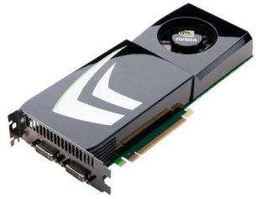
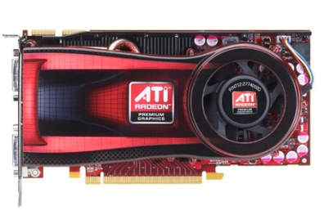
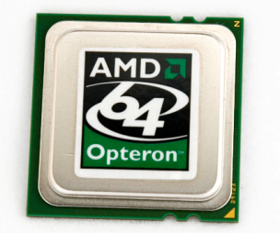
OpenCL Compilation System
LLVM - Low Level Virtual Machine
Kernels compiled to LLVM IR
Open Source Compiler
Platform, OS independent
Multiple back ends
http://llvm.org
OpenCL Compute Program
LLVM Front-end
LLVM IR
Nvidia PTX
AMD CAL IL
x86
Notes:
Explains how platform agnostic OpenCL code is mapped to a device specific Instruction Set Architecture.

Slide 14
OpenCL Framework
OpenCL allows parallel computing on heterogeneous devices
CPUs, GPUs, other processors (Cell, DSPs, etc)
Provides portable accelerated code
Defined in four parts
Platform Model
Execution Model
Memory Model
Programming Model
(We’re going to diverge from this structure a bit)

Slide 15
Platform Model
Each OpenCL implementation (i.e. an OpenCL library from AMD, NVIDIA, etc.) defines platforms which enable the host system to interact with OpenCL-capable devices
Currently each vendor supplies only a single platform per implementation
OpenCL uses an “Installable Client Driver” model
The goal is to allow platforms from different vendors to co-exist
Current systems’ device driver model will not allow different vendors’ GPUs to run at the same time

Slide 16
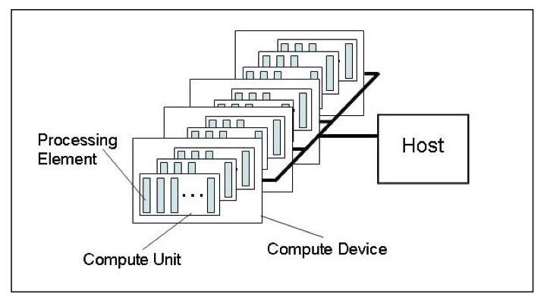
Platform Model
The model consists of a host connected to one or more OpenCL devices
A device is divided into one or more compute units
Compute units are divided into one or more processing elements
Each processing element maintains its own program counter

Slide 17
Host/Devices
The host is whatever the OpenCL library runs on
x86 CPUs for both NVIDIA and AMD
Devices are processors that the library can talk to
CPUs, GPUs, and generic accelerators
For AMD
All CPUs are combined into a single device (each core is a compute unit and processing element)
Each GPU is a separate device

Slide 18

Selecting a Platform
This function is usually called twice
The first call is used to get the number of platforms available to the implementation
Space is then allocated for the platform objects
The second call is used to retrieve the platform objects

Slide 19
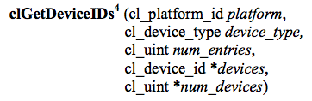
Selecting Devices
Once a platform is selected, we can then query for the devices that it knows how to interact with
We can specify which types of devices we are interested in (e.g. all devices, CPUs only, GPUs only)
This call is performed twice as with clGetPlatformIDs
The first call is to determine the number of devices, the second retrieves the device objects

Slide 20
Contexts
A context refers to the environment for managing OpenCL objects and resources
To manage OpenCL programs, the following are associated with a context
Devices: the things doing the execution
Program objects: the program source that implements the kernels
Kernels: functions that run on OpenCL devices
Memory objects: data that are operated on by the device
Command queues: mechanisms for interaction with the devices
Memory commands (data transfers)
Kernel execution
Synchronization

Slide 21
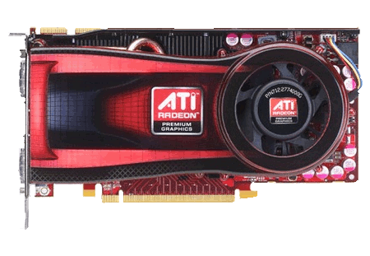
Contexts
When you create a context, you will provide a list of devices to associate with it
For the rest of the OpenCL resources, you will associate them with the context as they are created
Empty context
Context
Notes:
Devices can be associated with multiple contexts if desired

Slide 22
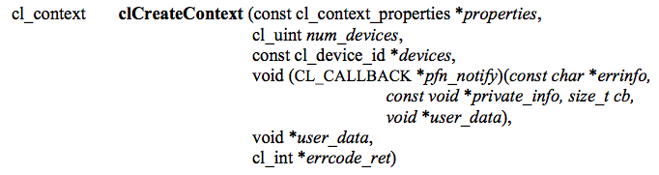
Contexts
This function creates a context given a list of devices
The properties argument specifies which platform to use (if NULL, the default chosen by the vendor will be used)
The function also provides a callback mechanism for reporting errors to the user
Notes:
There is another function called clCreateContextFromType(), which will create a context using all the GPUs, CPUs, etc.

Slide 23
Command Queues
A command queue is the mechanism for the host to request that an action be performed by the device
Perform a memory transfer, begin executing, etc.
A separate command queue is required for each device
Commands within the queue can be synchronous or asynchronous
Commands can execute in-order or out-of-order

Slide 24
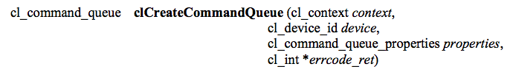
Command Queues
A command queue establishes a relationship between a context and a device
The command queue properties specify:
If out-of-order execution of commands is allowed
If profiling is enabled
Profiling is done using events (discussed in a later lecture) and will create some overhead

Slide 25
Command Queues
Command queues associate a context with a device
Despite the figure below, they are not a physical connection
Context
Command queues

Slide 26
Memory Objects
Memory objects are OpenCL data that can be moved on and off devices
Objects are classified as either buffers or images
Buffers
Contiguous chunks of memory – stored sequentially and can be accessed directly (arrays, pointers, structs)
Read/write capable
Images
Opaque objects (2D or 3D)
Can only be accessed via read_image() and write_image()
Can either be read or written in a kernel, but not both

Slide 27
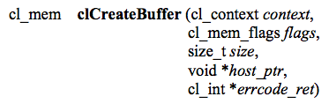
Creating buffers
This function creates a buffer (cl_mem object) for the given context
Images are more complex and will be covered in a later lecture
The flags specify:
the combination of reading and writing allowed on the data
if the host pointer itself should be used to store the data
if the data should be copied from the host pointer

Slide 28

Memory Objects
Memory objects are associated with a context
They must be explicitly transferred to devices prior to execution (covered later)
Uninitialized OpenCL memory objects—the original
data will be transferred later to/from these objects
Context
Original input/output
data
(not OpenCL
memory objects)
Notes:
Even though we show images here, the example will really be working with buffers

Slide 29
Transferring Data
OpenCL provides commands to transfer data to and from devices
clEnqueue{Read|Write}{Buffer|Image}
Copying from the host to a device is considered writing
Copying from a device to the host is reading
The write command both initializes the memory object with data and places it on a device
The validity of memory objects that are present on multiple devices is undefined by the OpenCL spec (i.e. are vendor specific)
OpenCL calls also exist to directly map part of a memory object to a host pointer

Slide 30
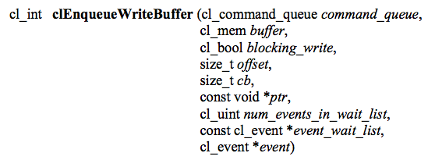
Transferring Data
This command initializes the OpenCL memory object and writes data to the device associated with the command queue
The command will write data from a host pointer (ptr) to the device
The blocking_write parameter specifies whether or not the command should return before the data transfer is complete
Events (discussed in another lecture) can specify which commands should be completed before this one runs

Slide 31
Transferring Data
Memory objects are transferred to devices by specifying an action (read or write) and a command queue
The validity of memory objects that are present on multiple devices is undefined by the OpenCL spec (i.e. is vendor specific)
The images are
redundant here to
show that they are
both part of the
context (on the
host) and
physically on the
device
Context
Images are written to a device
Notes:
If the device were a CPU, it could execute on the memory object in-place.

Slide 32
Programs
A program object is basically a collection of OpenCL kernels
Can be source code (text) or precompiled binary
Can also contain constant data and auxiliary functions
Creating a program object requires either reading in a string (source code) or a precompiled binary
To compile the program
Specify which devices are targeted
Program is compiled for each device
Pass in compiler flags (optional)
Check for compilation errors (optional, output to screen)

Slide 33
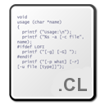
Programs
A program object is created and compiled by providing source code or a binary file and selecting which devices to target
Program
Context

Slide 34
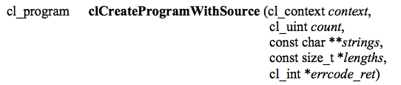
Creating Programs
This function creates a program object from strings of source code
count specifies the number of strings
The user must create a function to read in the source code to a string
If the strings are not NULL-terminated, the lengths fields are used to specify the string lengths

Slide 35
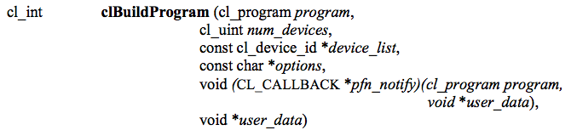
Compiling Programs
This function compiles and links an executable from the program object for each device in the context
If device_list is supplied, then only those devices are targeted
Optional preprocessor, optimization, and other options can be supplied by the options argument

Slide 36
Reporting Compile Errors
If a program fails to compile, OpenCL requires the programmer to explicitly ask for compiler output
A compilation failure is determined by an error value returned from clBuildProgram()
Calling clGetProgramBuildInfo() with the program object and the parameter CL_PROGRAM_BUILD_STATUS returns a string with the compiler output

Slide 37
Kernels
A kernel is a function declared in a program that is executed on an OpenCL device
A kernel object is a kernel function along with its associated arguments
A kernel object is created from a compiled program
Must explicitly associate arguments (memory objects, primitives, etc) with the kernel object

Slide 38

Kernels
Creates a kernel from the given program
The kernel that is created is specified by a string that matches the name of the function within the program

Slide 39
Runtime Compilation
There is a high overhead for compiling programs and creating kernels
Each operation only has to be performed once (at the beginning of the program)
The kernel objects can be reused any number of times by setting different arguments
Read source code into an array
clCreateProgramWithSource
clBuildProgram
clCreateKernel
clCreateProgramWithBinary

Slide 40
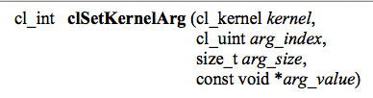
Setting Kernel Arguments
Kernel arguments are set by repeated calls to clSetKernelArgs
Each call must specify:
The index of the argument as it appears in the function signature, the size, and a pointer to the data
Examples:
clSetKernelArg(kernel, 0, sizeof(cl_mem), (void*)&d_iImage);
clSetKernelArg(kernel, 1, sizeof(int), (void*)&a);

Slide 41

Kernel Arguments
Memory objects and individual data values can be set as kernel arguments
Context
Data (e.g. images) are set as kernel arguments

Slide 42
Thread Structure
Massively parallel programs are usually written so that each thread computes one part of a problem
For vector addition, we will add corresponding elements from two arrays, so each thread will perform one addition
If we think about the thread structure visually, the threads will usually be arranged in the same shape as the data

Slide 43
Thread Structure
Consider a simple vector addition of 16 elements
2 input buffers (A, B) and 1 output buffer (C) are required
Array Indices
Vector Addition:
0 | 1 | 2 | 3 | 4 | 5 | 6 | 7 | 8 | 9 | 10 | 11 | 12 | 13 | 14 | 15
A
+
B
=
C

Slide 44
Thread Structure
Create thread structure to match the problem
1-dimensional problem in this case
Thread IDs
Thread structure:
0
1
2
3
4
5
6
7
8
9
10
11
12
13
14
15
Vector Addition:
0 | 1 | 2 | 3 | 4 | 5 | 6 | 7 | 8 | 9 | 10 | 11 | 12 | 13 | 14 | 15
A
+
B
=
C

Slide 45
Thread Structure
Each thread is responsible for adding the indices corresponding to its ID
Thread structure:
0
1
2
3
4
5
6
7
8
9
10
11
12
13
14
15
Vector Addition:
0 | 1 | 2 | 3 | 4 | 5 | 6 | 7 | 8 | 9 | 10 | 11 | 12 | 13 | 14 | 15
A
+
B
=
C

Slide 46
Thread Structure
OpenCL’s thread structure is designed to be scalable
Each instance of a kernel is called a work-item (though “thread” is commonly used as well)
Work-items are organized as work-groups
Work-groups are independent from one-another (this is where scalability comes from)
An index space defines a hierarchy of work-groups and work-items

Slide 47
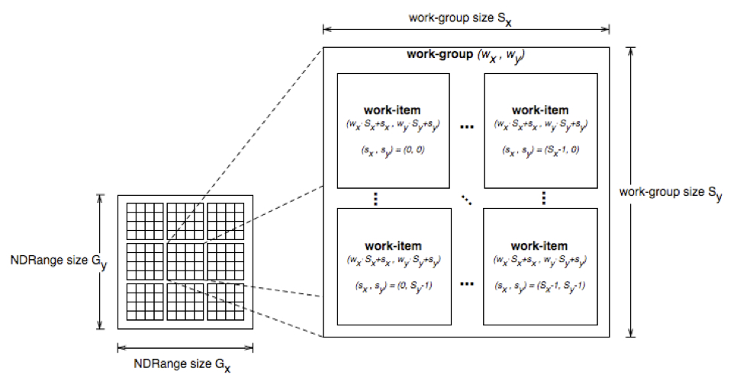
Thread Structure
Work-items can uniquely identify themselves based on:
A global id (unique within the index space)
A work-group ID and a local ID within the work-group

Slide 48
Thread Structure
API calls allow threads to identify themselves and their data
Threads can determine their global ID in each dimension
get_global_id(dim)
get_global_size(dim)
Or they can determine their work-group ID and ID within the workgroup
get_group_id(dim)
get_num_groups(dim)
get_local_id(dim)
get_local_size(dim)
get_global_id(0) = column, get_global_id(1) = row
get_num_groups(0) * get_local_size(0) == get_global_size(0)

Slide 49
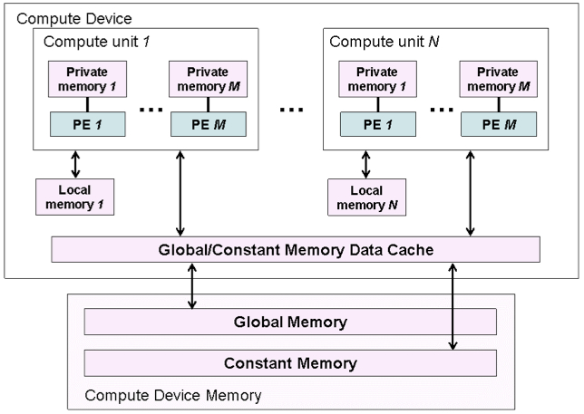
Memory Model
The OpenCL memory model defines the various types of memories (closely related to GPU memory hierarchy)
Memory | Description
Global | Accessible by all work-items
Constant | Read-only, global
Local | Local to a work-group
Private | Private to a work-item

Slide 50
Memory Model
Memory management is explicit
Must move data from host memory to device global memory, from global memory to local memory, and back
Work-groups are assigned to execute on compute-units
No guaranteed communication/coherency between different work-groups (no software mechanism in the OpenCL specification)

Slide 51
Writing a Kernel
One instance of the kernel is created for each thread
Kernels:
Must begin with keyword __kernel
Must have return type void
Must declare the address space of each argument that is a memory object (next slide)
Use API calls (such as get_global_id()) to determine which data a thread will work on

Slide 52
Address Space Identifiers
__global – memory allocated from global address space
__constant – a special type of read-only memory
__local – memory shared by a work-group
__private – private per work-item memory
__read_only/__write_only – used for images
Kernel arguments that are memory objects must be global, local, or constant

Slide 53
Example Kernel
Simple vector addition kernel:
__kernel
void vecadd(__global int* A,
__global int* B,
__global int* C) {
int tid = get_global_id(0);
C[tid] = A[tid] + B[tid];
}

Slide 54
Executing the Kernel
Need to set the dimensions of the index space, and (optionally) of the work-group sizes
Kernels execute asynchronously from the host
clEnqueueNDRangeKernel just adds is to the queue, but doesn’t guarantee that it will start executing

Slide 55
Executing the Kernel
A thread structure defined by the index-space that is created
Each thread executes the same kernel on different data
Context
An index space of
threads is created
(dimensions match
the data)

Slide 56

Executing the Kernel
A thread structure defined by the index-space that is created
Each thread executes the same kernel on different data
Context
Each thread
executes
the kernel

Slide 57
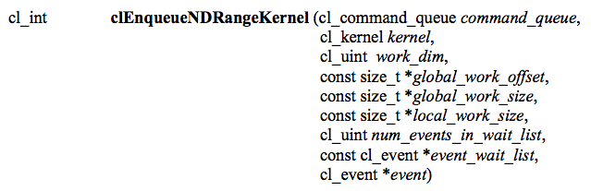
Executing the Kernel
Tells the device associated with a command queue to begin executing the specified kernel
The global (index space) must be specified and the local (work-group) sizes are optionally specified
A list of events can be used to specify prerequisite operations that must be complete before executing

Slide 58
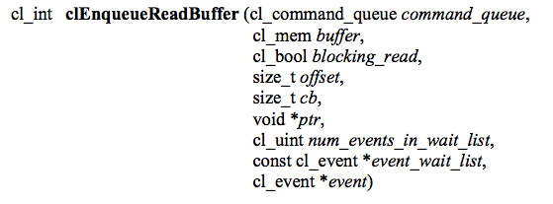
Copying Data Back
The last step is to copy the data back from the device to the host
Similar call as writing a buffer to a device, but data will be transferred back to the host

Slide 59
Copying Data Back
The output data is read from the device back to the host
Context
Copied back
from GPU

Slide 60
Releasing Resources
Most OpenCL resources/objects are pointers that should be freed after they are done being used
There is a clRelase{Resource} command for most OpenCL types
Ex: clReleaseProgram(), clReleaseMemObject()

Slide 61
Error Checking
OpenCL commands return error codes as negative integer values
Return value of 0 indicates CL_SUCCESS
Negative values indicates an error
cl.h defines meaning of each return value
Note: Errors are sometimes reported asynchronously
CL_DEVICE_NOT_FOUND -1
CL_DEVICE_NOT_AVAILABLE -2
CL_COMPILER_NOT_AVAILABLE -3
CL_MEM_OBJECT_ALLOCATION_FAILURE -4
CL_OUT_OF_RESOURCES -5
Notes:
Since kernels are executed asynchronously but return an error value immediately, runtime errors will likely be reported later.

Slide 62
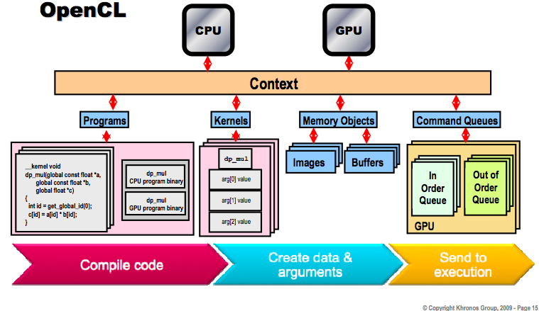
Big Picture

Slide 63
Programming Model
Data parallel
One-to-one mapping between work-items and elements in a memory object
Work-groups can be defined explicitly (like CUDA) or implicitly (specify the number of work-items and OpenCL creates the work-groups)
Task parallel
Kernel is executed independent of an index space
Other ways to express parallelism: enqueueing multiple tasks, using device-specific vector types, etc.
Synchronization
Possible between items in a work-group
Possible between commands in a context command queue

Slide 64
Summary
OpenCL provides an interface for the interaction of hosts with accelerator devices
A context is created that contains all of the information and data required to execute an OpenCL program
Memory objects are created that can be moved on and off devices
Command queues allow the host to request operations to be performed by the device
Programs and kernels contain the code that devices need to execute

Slide 65
OCLwrapper
Singleton created for managing OpenCL states in a more straightforward manner.
Makes many assumptions on device usage, number of devices, memory addressing, etc. to simplify execution
Makes error control less arduous
Automatically retrieves and prints compilation log to ease error identification
Reduces OpenCL related code clutter
Performance data can be easily retrieved by simply passing a flag

Slide 66
OCLwrapper
void loadSource(const char* sourcefile);
void createKernel(const char* kernelname);
void getBuildLog( cl_int err, cl_program* program, cl_device_id device );
cl_mem createBuffer( size_t memsize, cl_mem_flags flag );
void enqueueWriteBuffer( cl_mem buffer, size_t memsize, void* hostData, cl_bool blocking );
void enqueueReadBuffer( cl_mem buffer, size_t memsize, void* hostData, cl_bool blocking );
void setKernelArg(int argnum, size_t argSpecifierSize, const void* argAddress);
void setGlobalWorksize(cl_uint dim, cl_uint value);
void setLocalWorksize(cl_uint dim, cl_uint value);
void enquequeNDRangeKernel(cl_uint ndrange, bool getKernelTime);
void finish();
void ReleaseMem(cl_mem memobj);
void Teardown();
double getKernelExecTime(){return exec_time;}

Slide 67
Sparse Matrices
Efficient sparse matrix operations are largely dependent on underlying memory architecture.
Best sparse linear algebra libraries GOTO / BLAS / Eigen manipulate registers and cache on instruction language level to achieve optimal performance
OpenCL exposes the memory architecture and vector operations enabling the developer to write efficient code without having to deal with IL code (for GPU or CPU).
Traditional sparse matrix formats are not optimal for GPU computing, which lead to the development of hierarchical and blocked sparse matrix formats that take advantage of the diferent memory level hierarchies.

Slide 68
SPR Sparse Matrix Interface
Sparse Matrices controlled through interfaced design pattern with common functions:
creatematrix
binSearchInt
linSearchInt
Virtual functions (interface per se)
addElem
setElem
getElem
getMatSize
getNNZ

Slide 69
SPR Sparse Matrix Interface
The CSR (Compressed Sparse Row)
The the sparse data structure consists of a dynamically allocated vector of pointers to compressed row data, each entry representing a column:
typedef struct ROWdata
{
fem_float* val;
unsigned int* col;
unsigned int nNZ;
unsigned int maxSz;
} ROWdata;
unsigned int m_matdim; /* sq. matrix dimension */
ROWdata* m_ROWdata; /* matrix data vector */

Slide 70
SPR Sparse Matrix Interface
Dense matrices stored as a vector of a vector of pointers to floats
Direct implementation

Slide 71
SPR Sparse Matrix Interface
Diagonal matrix format stores diagonals and offsets
Useful for banded matrices
Inefficient for matrices with nonzero elements scattered (the whole diagonal with zeros included is stored)

