Slide 1
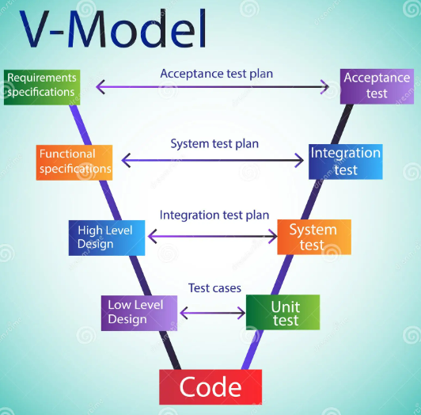
SOFTWARE DEVELOPMENT LIFECYCLE

Slide 2

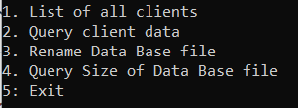
FUNCTIONAL SPECIFICATIONS
APPLICATION
It is a bank that manages very basic operations at administrator and user level.
USER INTERFACE
ADMIN INTERFACE

Slide 3
DESING HIGH LEVEL
Data Base
Application

Slide 4
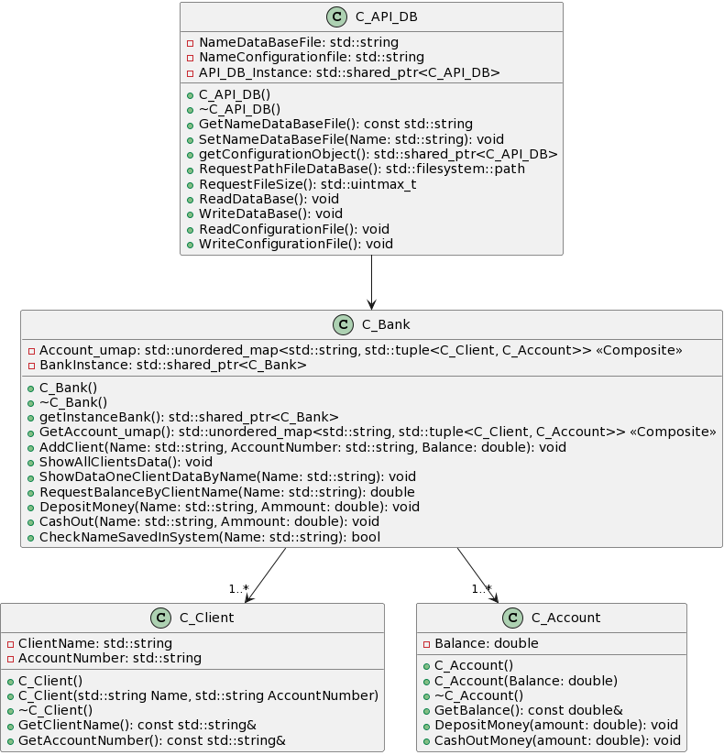
DESING LOW LEVEL: UML

Slide 5
CODING
LANGUAGE: C++
Containers
Filesystem
Smart Pointer
Algorithm
Excepciones – Custom Error System
Tuple
Lambda
BUILDING
CMake
VERSION CONTROL + REPOSITORY
Git
Bitbucket
DOC
Doxygen
DATA BASE
NoSQL: JSON (nlohmann)

Slide 6
UNIT TEST
Google Test
Parameterised tests

Slide 7
EXTRAS
APPLICATION
Remove a client of the system
Modify data of a client
Transactions with income, average saved, date of entry into the system, etc.
UNIT TEST
Unit test in order to test the Data Base
BUILDING
Conan
DOC
Launch Doxygen by file.bat

Slide 8
PROBLEMS
UNIT TEST
Experience
Custom System Erros + Unit Test
set(gtest_force_shared_crt ON CACHE BOOL "" FORCE)
BUILDING
Name Project + Compile.bat

