Slide 1
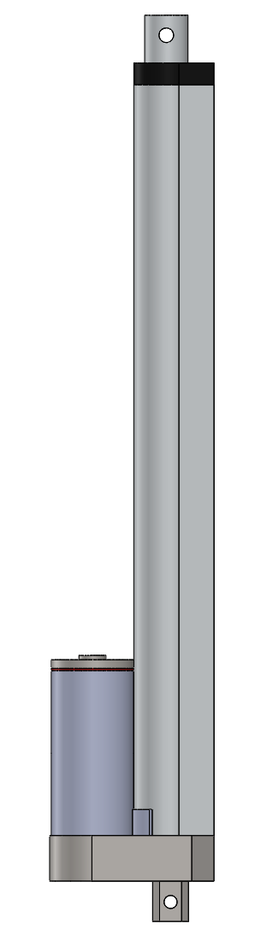
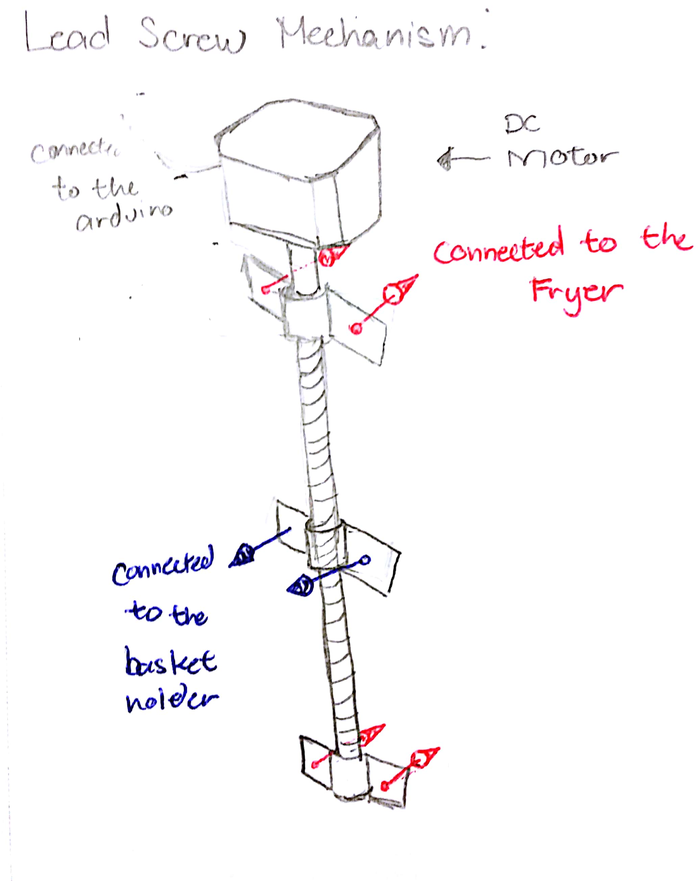
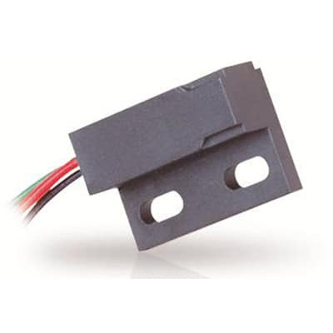
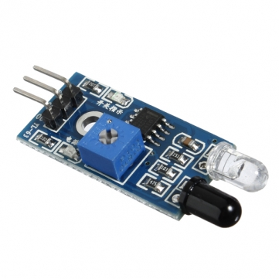


FERMix Francis Amadeo, Erick Estrada, Rami Muhammed, Meshal Alsaeed, Advisor: Dr. Wejing Rao
Engineering Requirements
Abstract
Final Design
The project aims to create an affordable system for all commercial-grade fryers. In regards to cook-time management, we wish to ease the cooks’ workload by automating the deep frying process. However, we do not want our project to interfere with their normal operation while frying. Our project would just be a failsafe so that the food does not get overcooked. To solve these objectives, we opted to go for a modular design, which will include the main system and extensions. The main system will be chain-driven. The extensions can be customized depending on the user’s needs and space. Also, this design will feature pre-set and configurable user settings. Thus, giving the cooks a less stressful environment, making them free to do more things in the kitchen. The system is designed primarily as a way to simplify and reduce the complexity of frying food for restaurants by taking into account the FDA’s regulations.
The device should be able to operate from a 12V source
The system should move the frying basket up and down in a range of 1.5 ft
No part of the system should ever be dipped in the oil
System should be easily disassembled with the use of handheld tools.
The system will have a 4x4 keypad user-interface
Project Overview
Design Alternatives
Testing & Results
Mechanisms:
Actuator
Lead Screw
Sensors:
Conclusion
Acknowledgements
Magnetic switch
Infrared
Proximity

