Slide 1
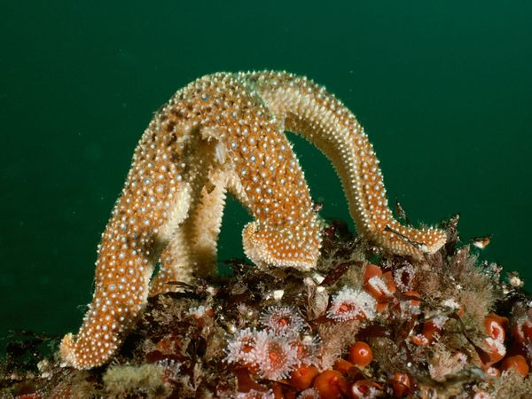
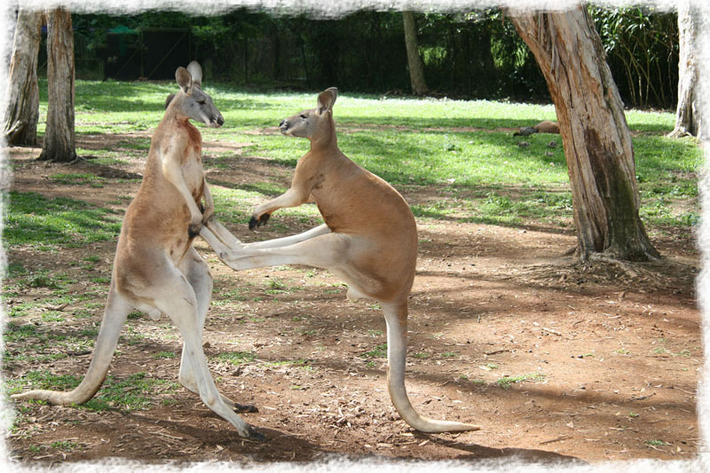
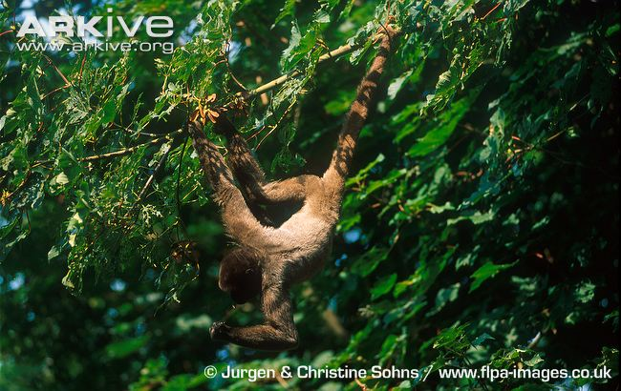
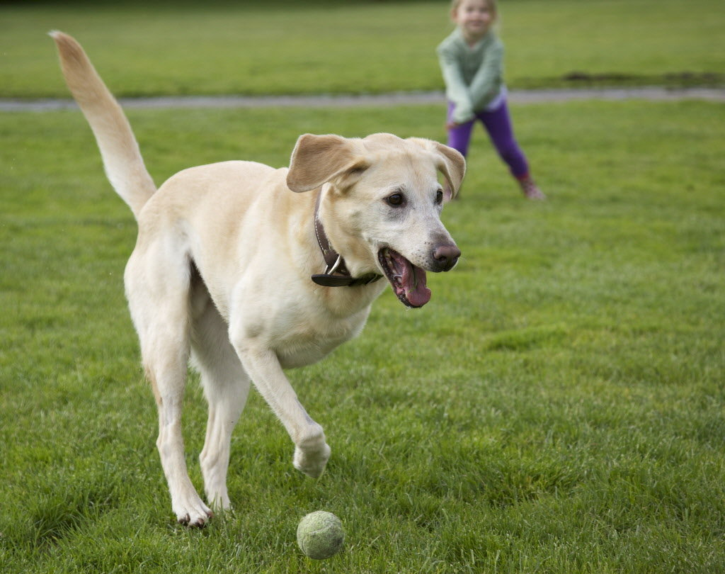
Animal Gaits with CPG in semi-symmetrical systems
Computational Neuroscience
Final Presentation
Francesco Pancaldi

Slide 2
Outline
Background on animal gaits
Gaits symmetry and non-linearity
Coupled oscillators, ODEs CPG network model
Bipedal, quadruped, hexapodal
  Example equations and simulation
Extensions to other networks
  Loss of symmetry, radially symmetric and semi-symmetric systems
Conclusions

Slide 3
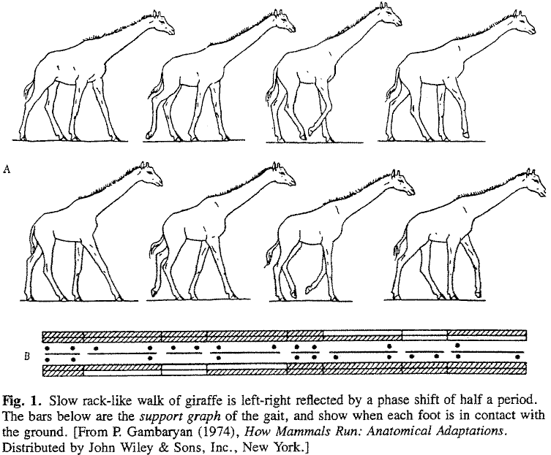
Animal gaits
“Several distinct periodic patterns of leg movements in animal locomotion”
“Animals typically employ their limbs in a number of periodic modes”
Typical symmetries:
Bilateral
Front-rear
Walk symmetry
Etc,..
Humans: walk, run, hop;
Horses: walk, run, canter, gallop;
Others: pace, trot, bound, jump, pronk,etc ...

Slide 4
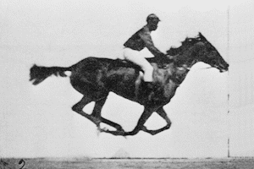
Animal Gaits
Gait analysis is an ancient Science
Aristotle describing the movement of a horse: “The back legs move diagonally in relation to the front legs;for after the right fore leg animals move the left hind leg, then the left fore leg, and after it the right hind leg.”
Modern Gait analysis also started with a horse:
According to legend in the 1870s Leland Standfor (ex-governor of California) had a bet with Frederick MacCrellish about the placement of the feet of a galloping horse.

Slide 5
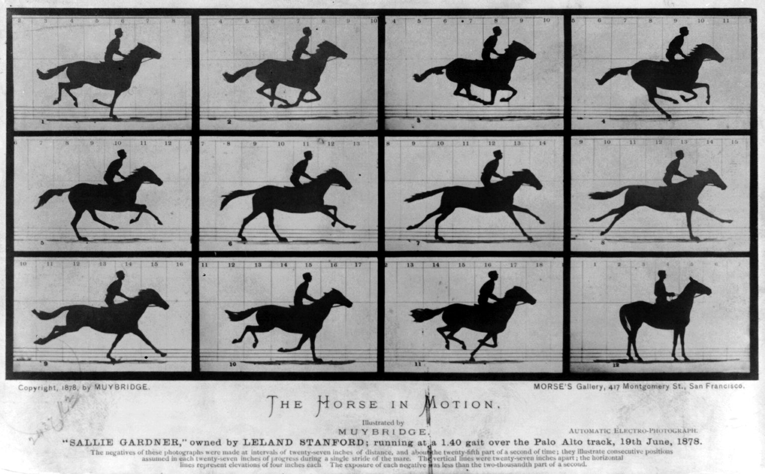

Slide 6
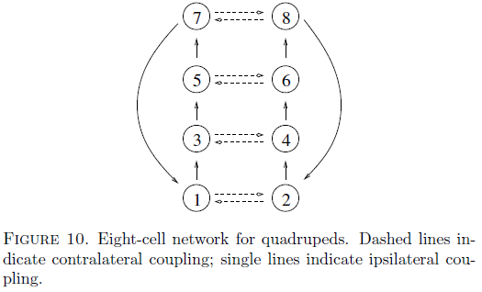
Central Patterns Generators (CPG) as a Network model
CPGs are networks of neurons in the central nervous system which produce cyclic patterns

Slide 7
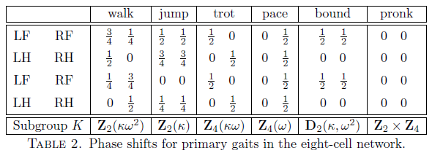
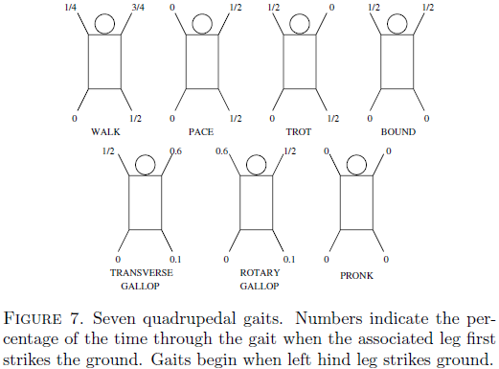
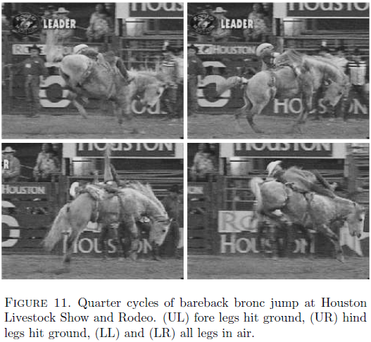
Gaits Symmetry

Slide 8
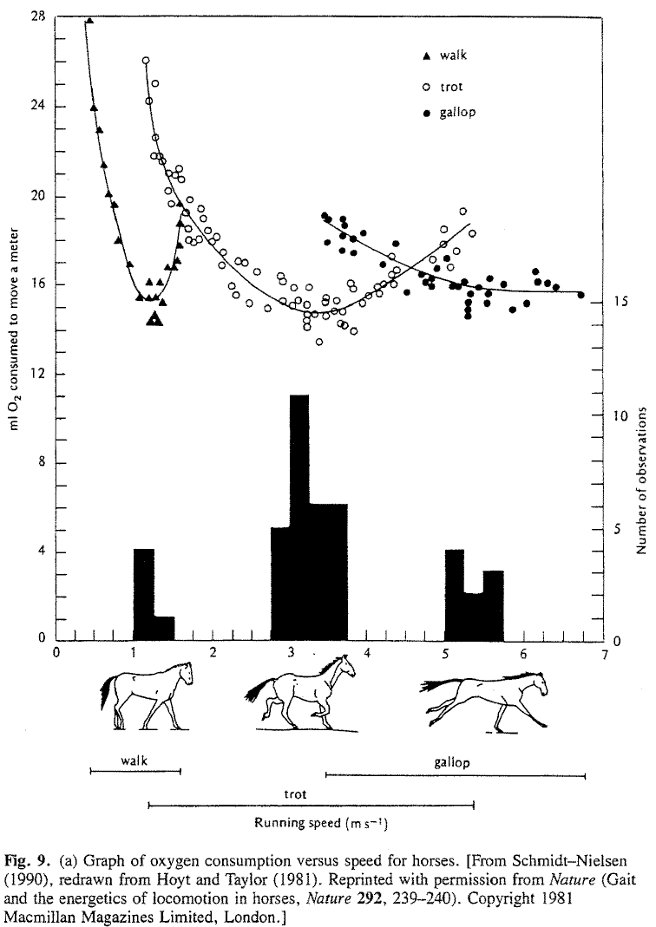
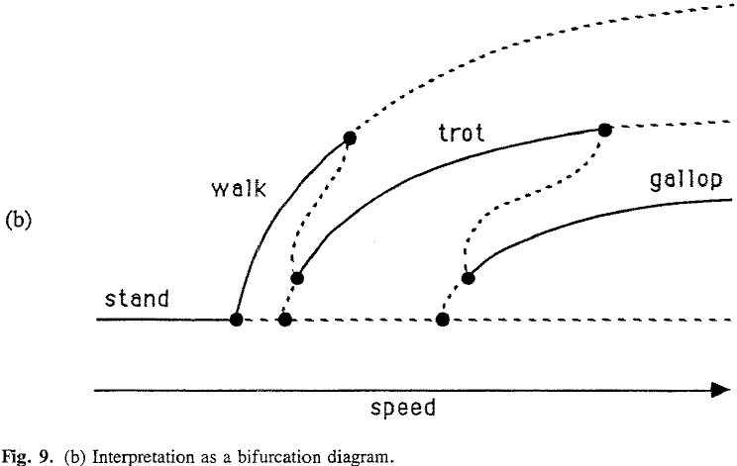
Non-linearity

Slide 9
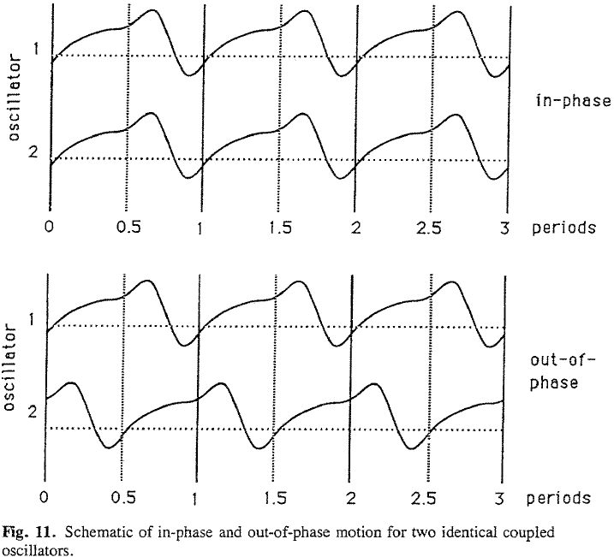
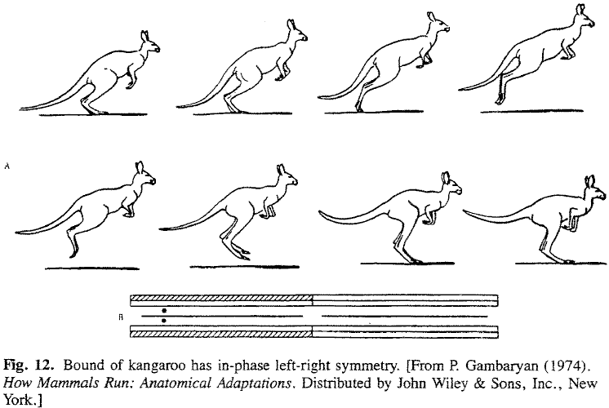
Coupled oscillators

Slide 10
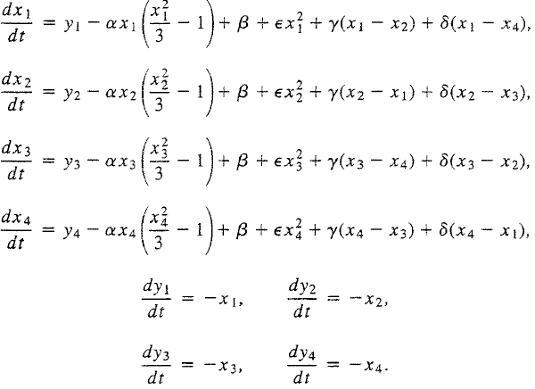
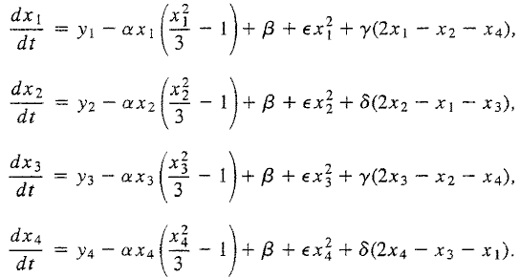
Quadruped example equations

Slide 11
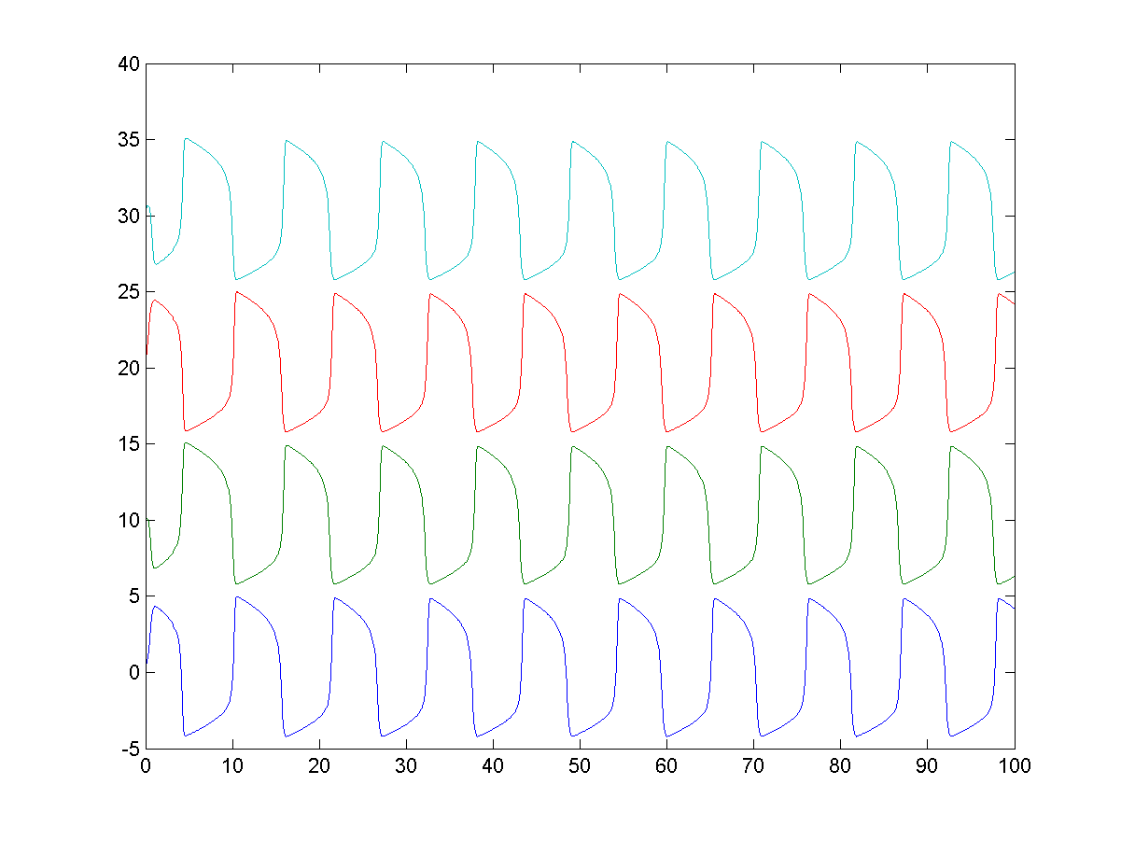
Example plot for system 1

Slide 12
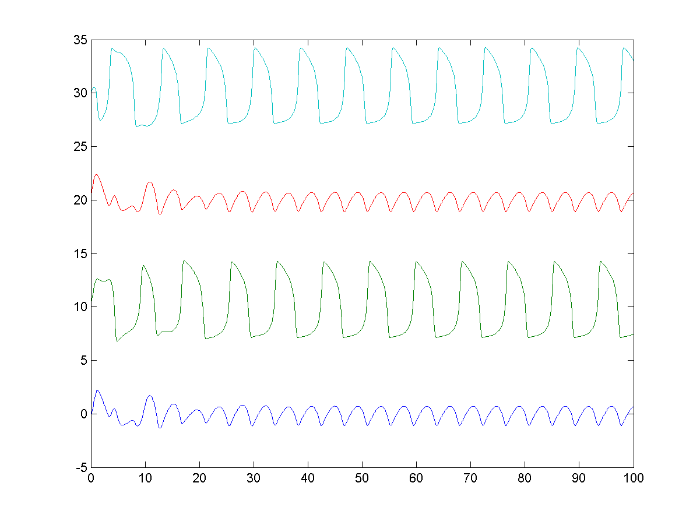
Example plot for system 2

Slide 13
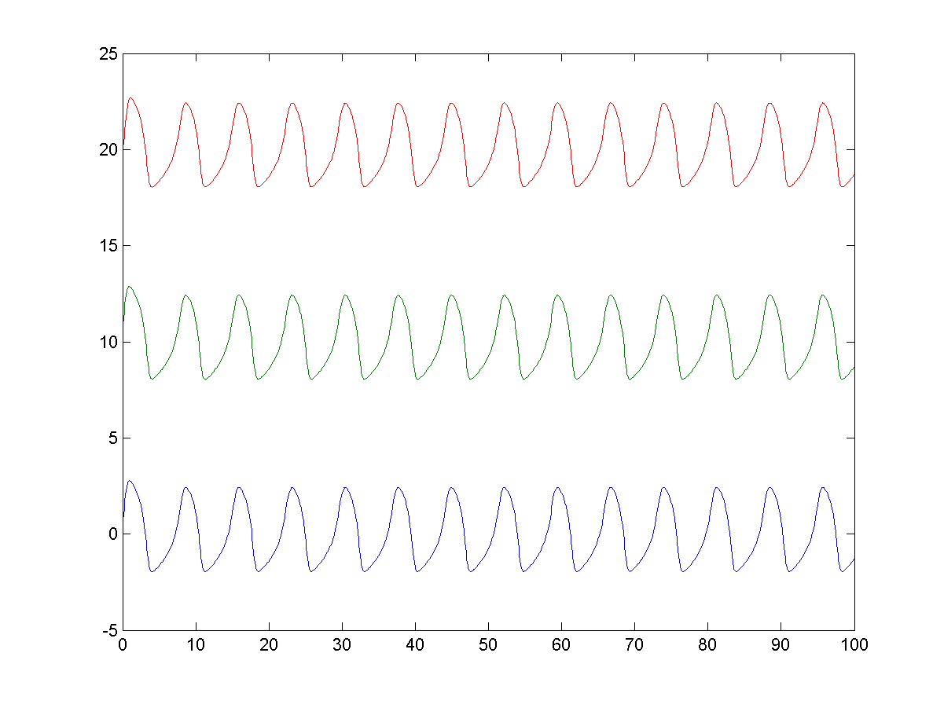
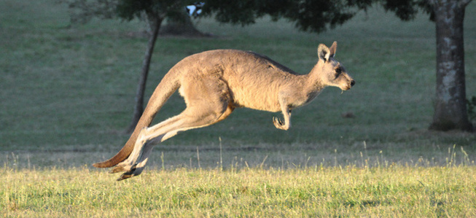
Kangaroo jump

Slide 14
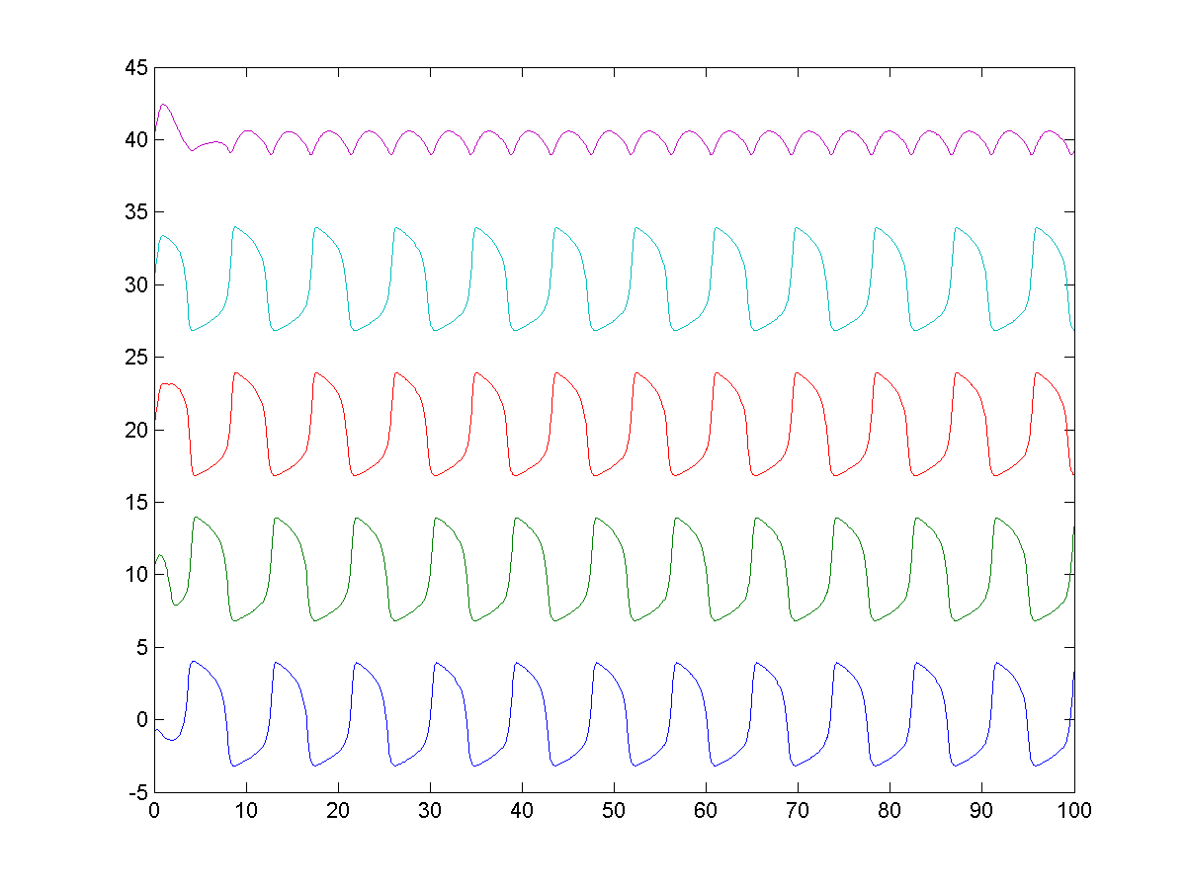
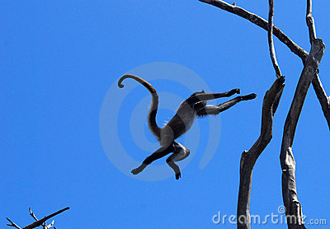
Mokey Arms-Tail-Legs-Tail leap

Slide 15
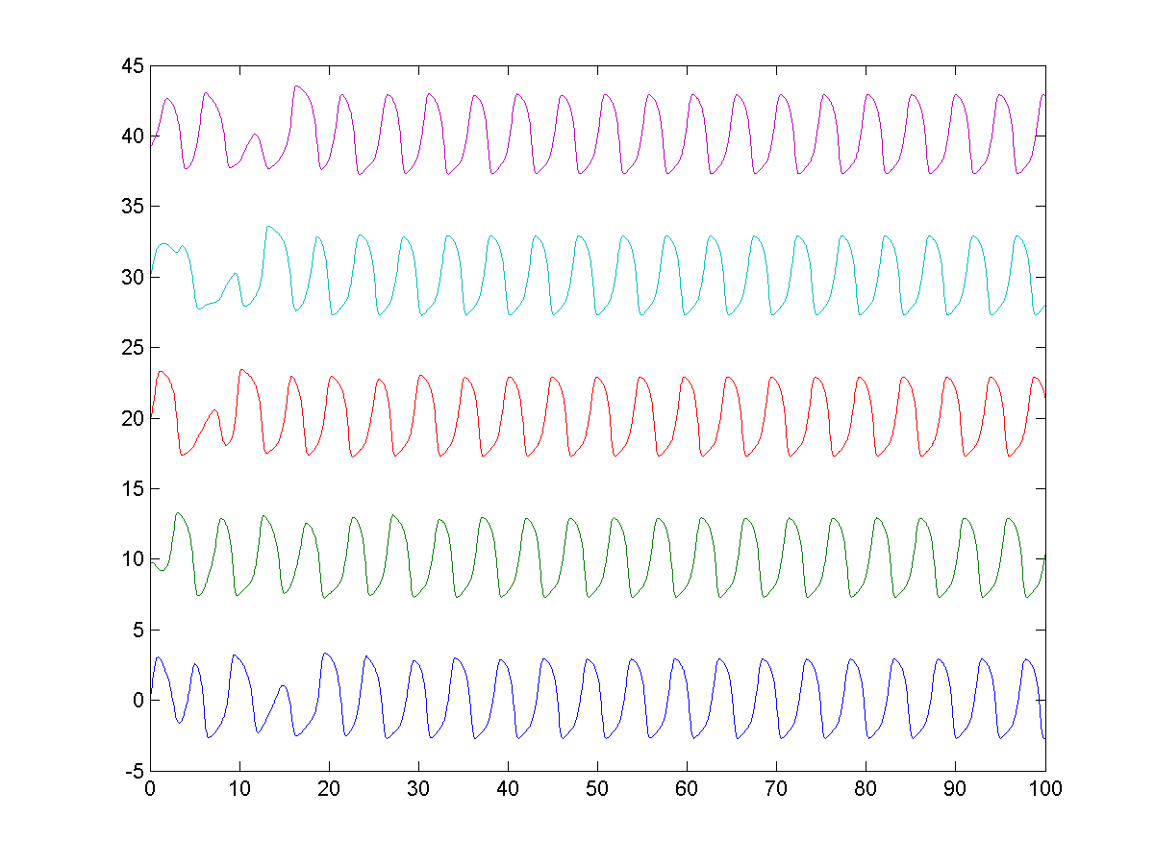
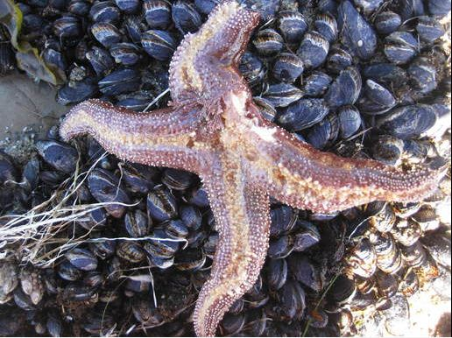
Starfishes crawl

Slide 16
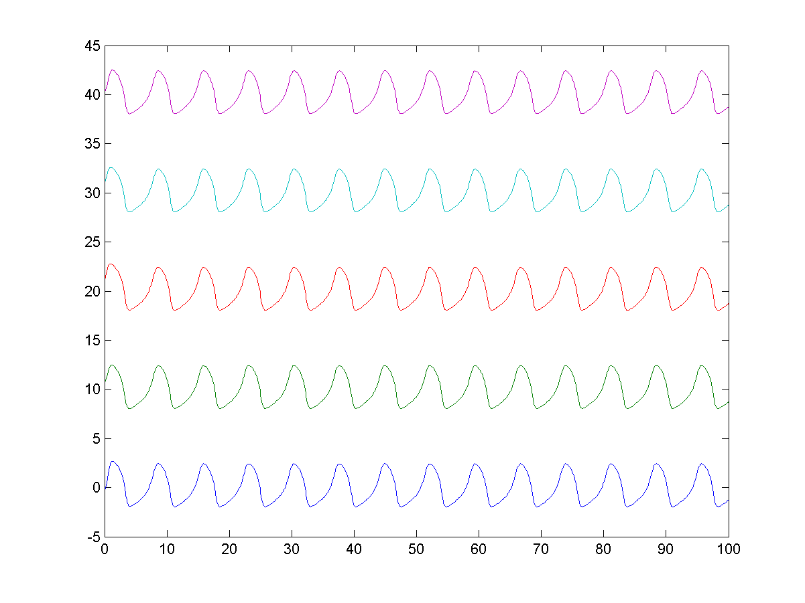
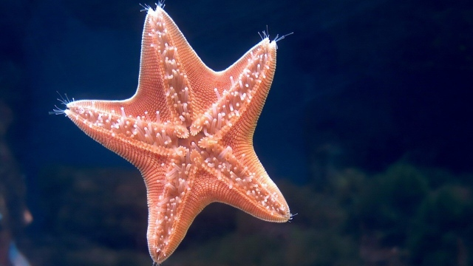
Starfishes pace-swim

Slide 17
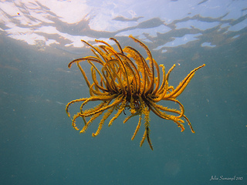
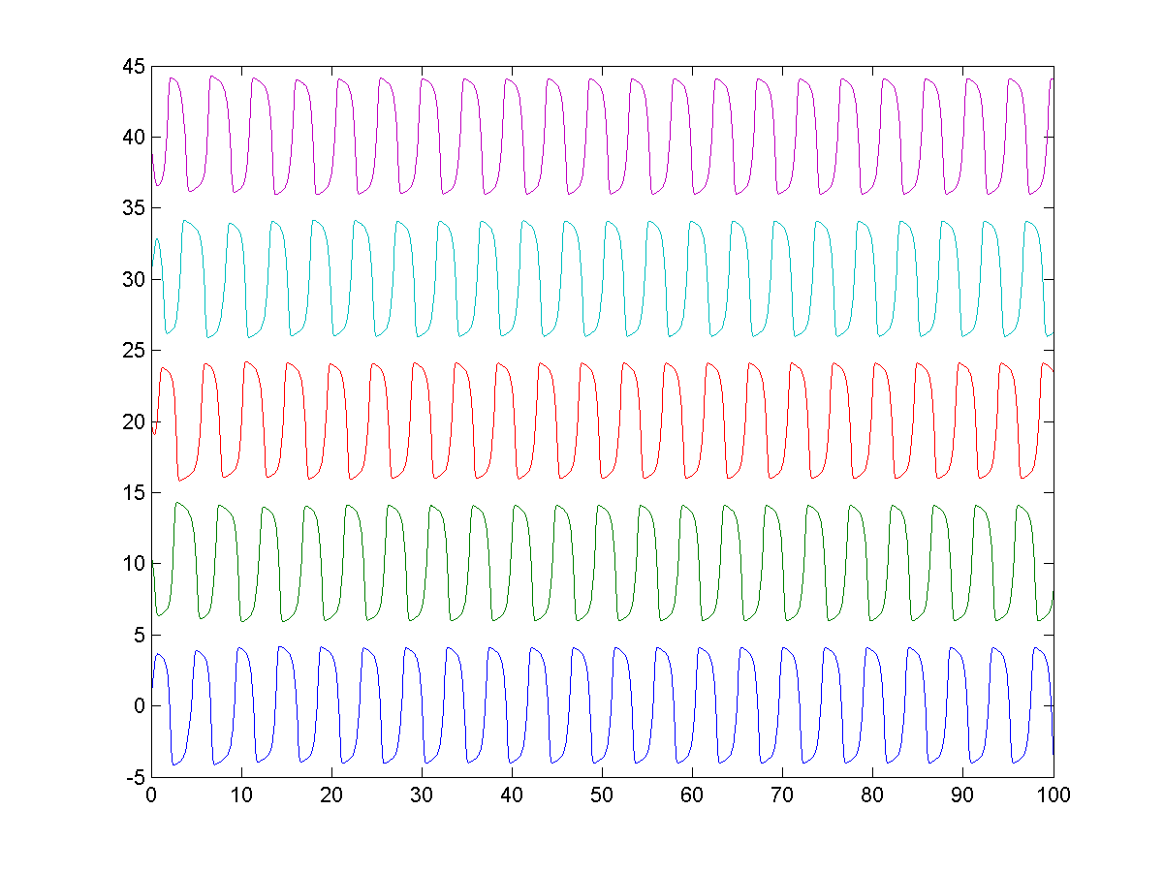
Starfishes swim-run

Slide 18
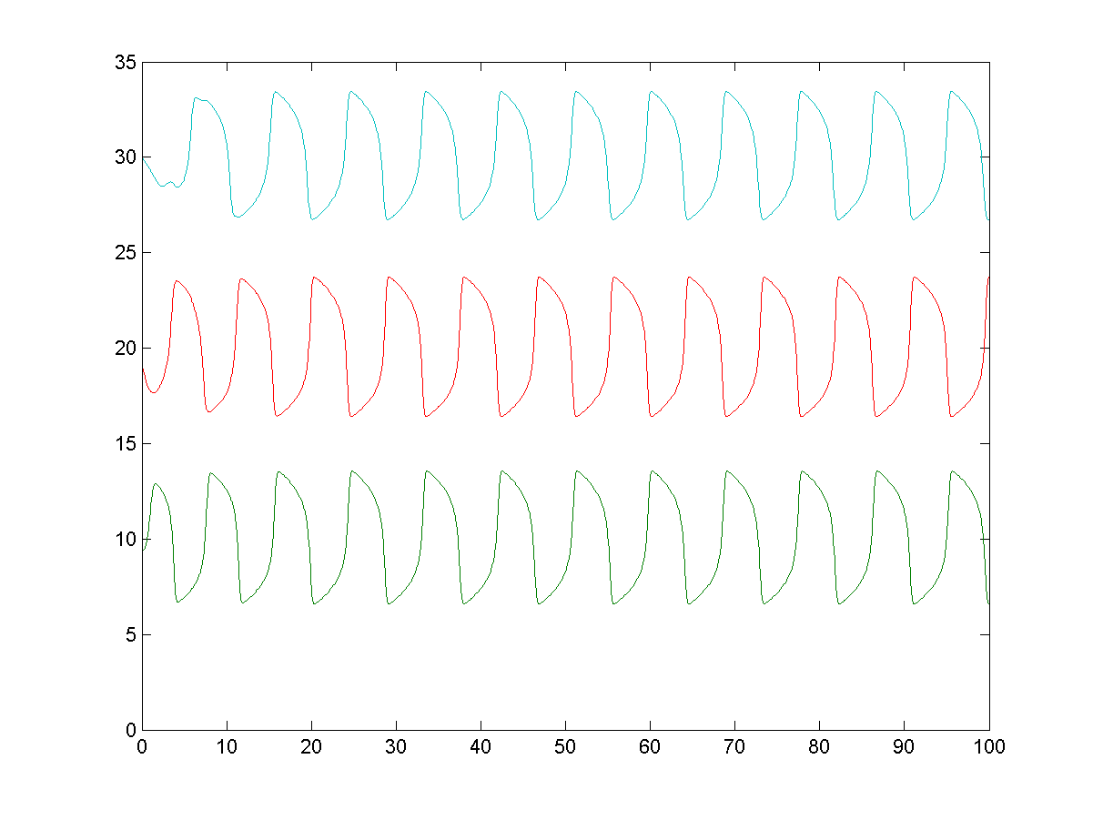
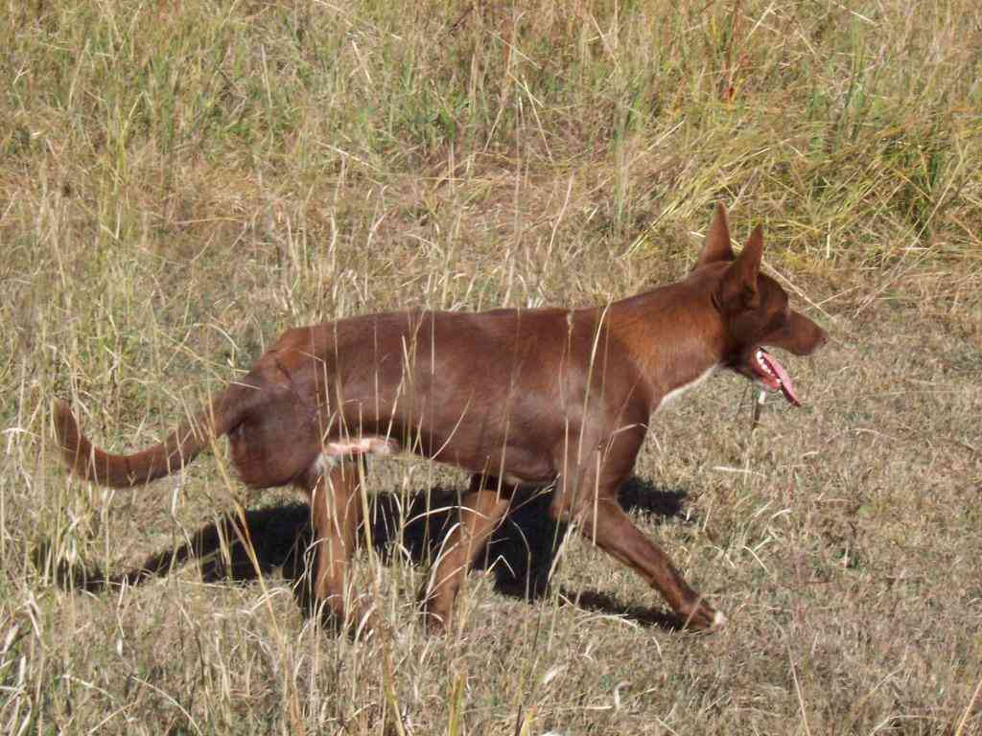
3-legged dog can walk and pace...

Slide 19
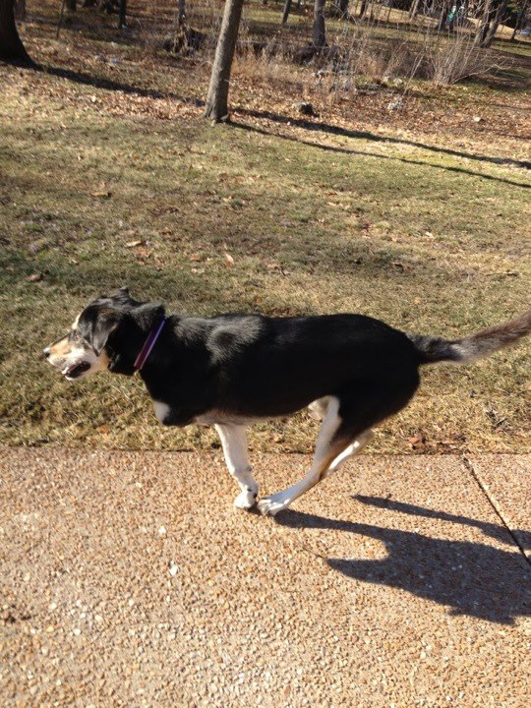
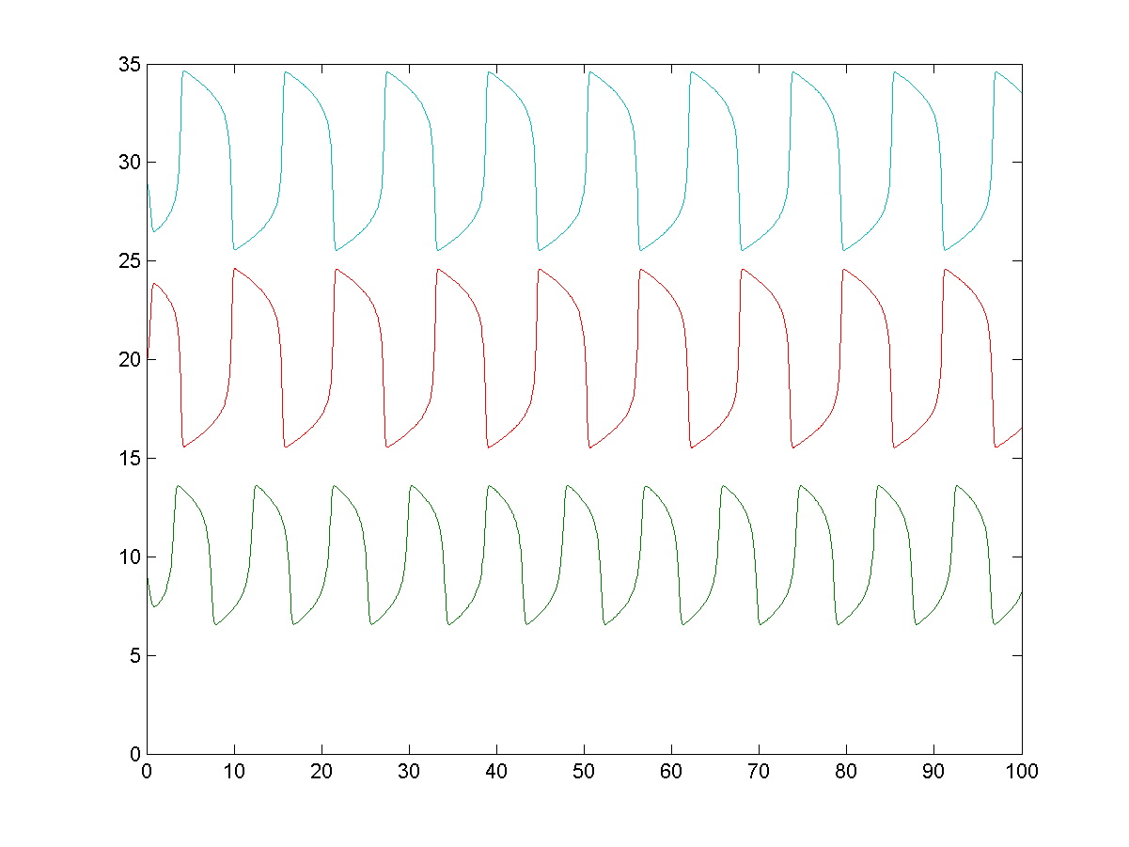
3-legged dog can trot and run...

Slide 20
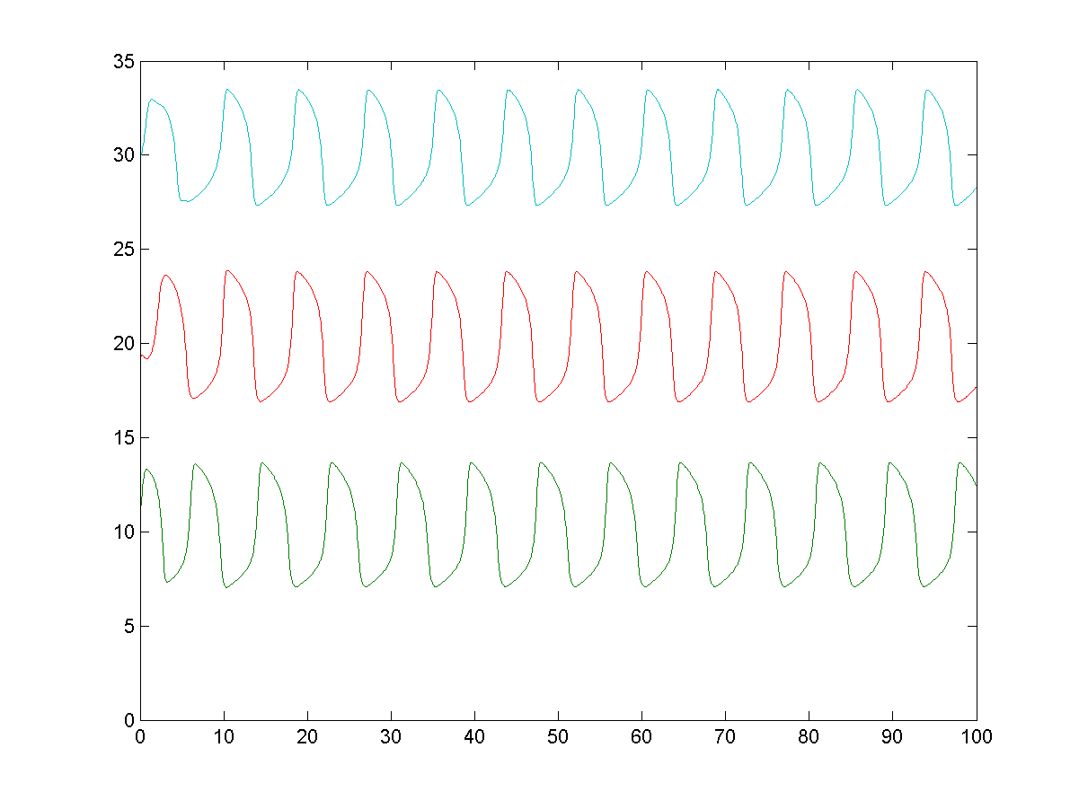
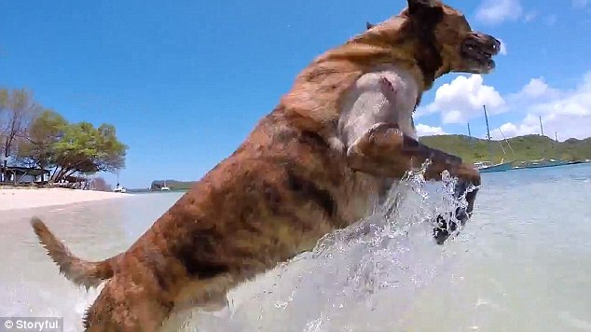
3-legged dog can bound (front-back jump)...

Slide 21
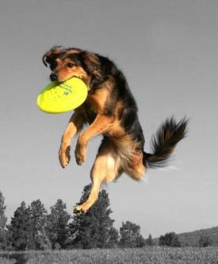
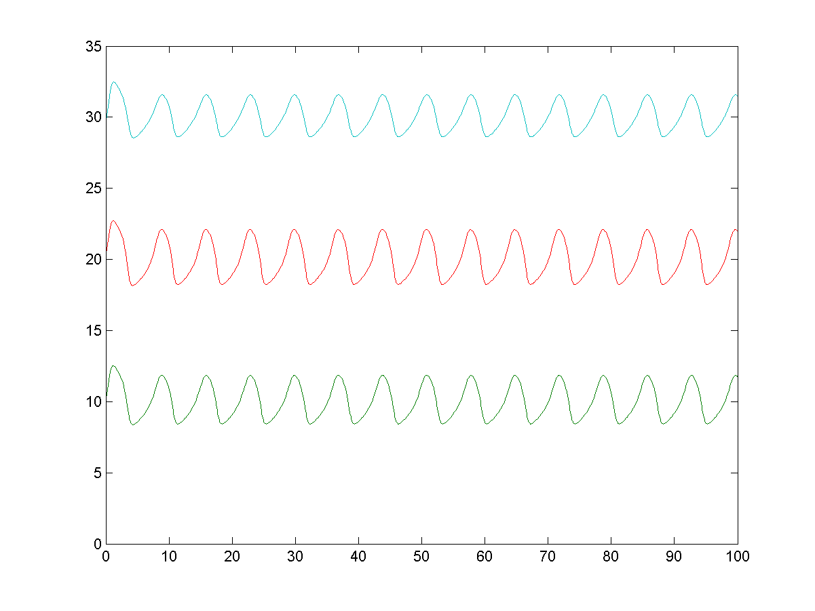
3-legged dog can even pronk (all legs jump)

Slide 22
Conclusions
Coupled oscillators reflects well the idea of CPG and the natural emergence of multiple gaits (in the same animal)
Network symmetry determines the possible gaits
Also when considering networks with weaker symmetries is still possible to obtain a significant number of gaits
CPG networks can be robust enough to allow functional gaits also when a limb is lost (example 3 legged dog)

Slide 23
Future directions
Consider different coupling networks
Analise more specifically the parameter space for different gaits
Find other interesting less symmetric network, or with different symmetries
Determine biologically meaningful equations for coupled oscillators ODEs
Couple with model for gait optimization

Slide 24
References
Evaluation of gait symmetry after stroke: a comparison of current methods and recommendations for standardization. Patterson KK1, Gage WH, Brooks D, Black SE, McIlroy WE.
Optimal Gait and Form for Animal Locomotion. Kevin Wampler Zoran Popovic. University of Washington
Symmetry in locomotor central pattern generators and animal gaits. Martin Golubitsky, Ian Stewart, Pietro-Luciano Buono & J. J. Collins
Animal gaits website:http://vanat.cvm.umn.edu/gaits
Coupled nonlinear oscillators and the symmetries of animal gaits. J. J. Collins, I. N. Stewart
NONLINEAR DYNAMICS OF NETWORKS: THE GROUPOID FORMALISM. MARTIN GOLUBITSKY AND IAN STEWART
Octopus Research Group: http://www.octopus.huji.ac.il/site/index.html

Slide 25
