Slide 1
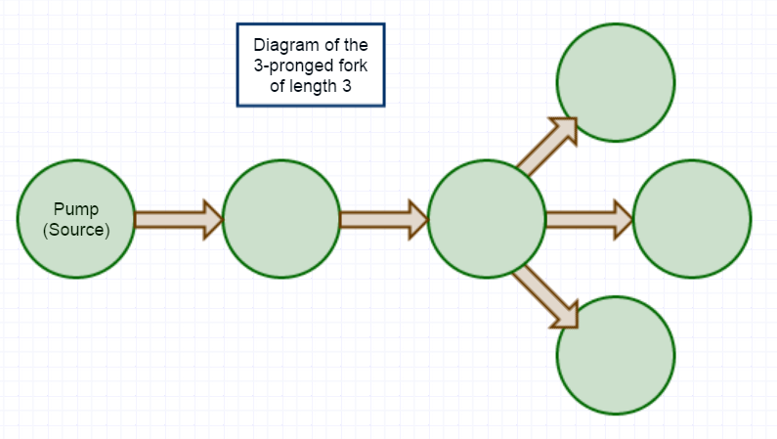
A network model for multicellularity
Christopher Ebsch
Francesco Pancaldi

Slide 2
Outline
Summary of previous direction
Assumptions of the updated model
Two canonical networks
Critical energy
Example
Extensions to other networks
Robustness
Example
Recursive formulation of critical energy (in progress)
Future directions

Slide 3
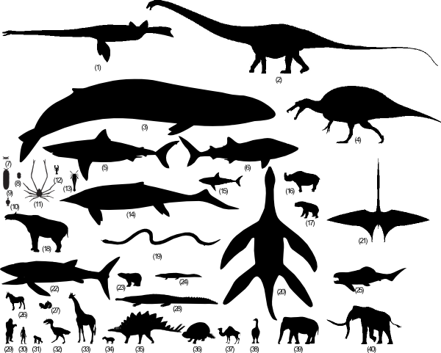
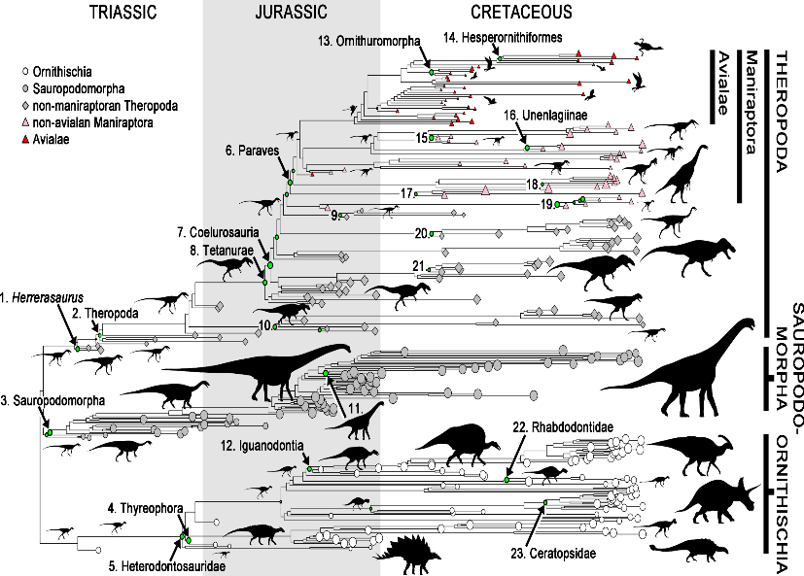
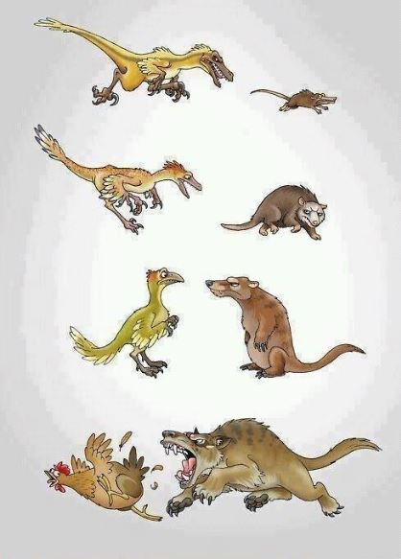
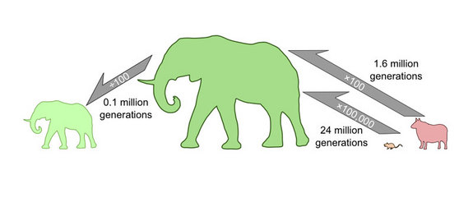
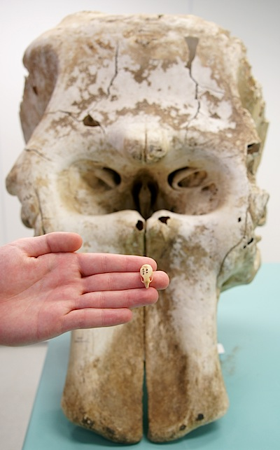
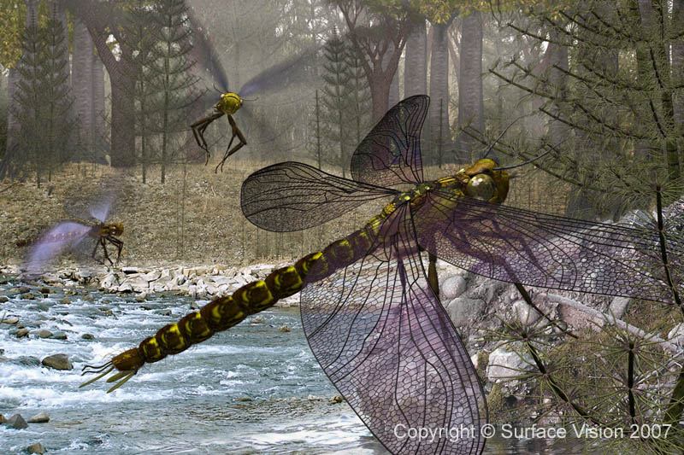
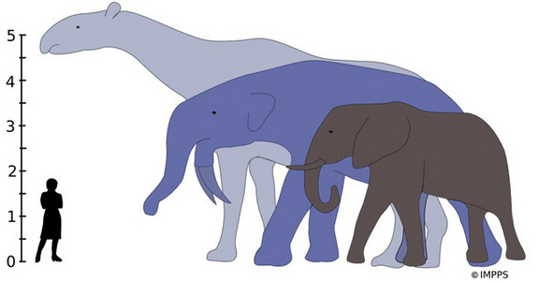
Summary of previous direction
Previous Goal: Model evolution of animal size.
New Goal: Model of optimal sizes and structures for energy transport in biological networks.

Slide 4
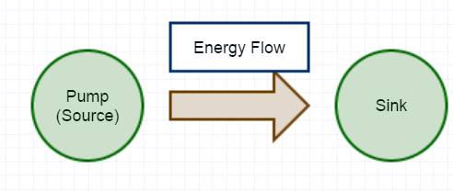
Basic network structure
Begin with a connected, directed network of N nodes with energy source (pump).
Energy, E(N), is gathered by the pump
Each node (including the pump) consumes a fixed amount of energy, C, that it receives.
The remaining energy at that node, E(N)-C, is divided equally to its outgoing edges.
A portion, 1-p, of the energy being transported is lost to the environment (with 0<p≤1).
Repeat until all nodes have consumed C energy or the energy remaining in the system is less than amount needed to sustain any unfed nodes. Unfed nodes at the end of a feeding cycle will be considered dead. A dead cell no longer consumes energy, but maintains connections.

Slide 5
Assumptions of the model
Energy gathered at a given time step is monotonically increasing in the number of surviving nodes and is bounded by Ē.
The parameters of the energy function, E(N), and the bound Ē can fluctuate with a certain random distribution (ex: Gaussian)
After N feeding cycles, the network can reproduce and mutate at random, then the process is repeated (in progress).

Slide 6
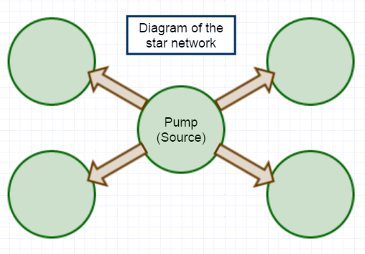
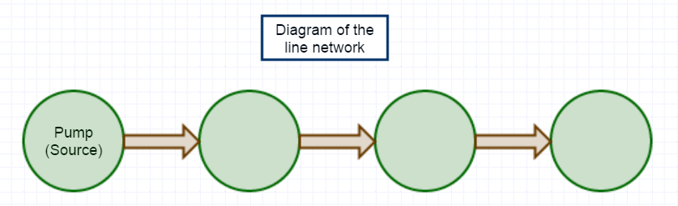
Two canonical topologies
The star connects the pump to all other nodes in the network and there are no other connections
The line connects each node sequentially with the next one in a list.

Slide 7
Critical energy
The critical energy, E*(N,T), is defined as the minimum energy needed to keep all nodes in the network alive with T being the structure of the network.
In general, we calculate the critical energy by taking the maximum value of the energies needed for survival along every path leaving the pump.

Slide 8
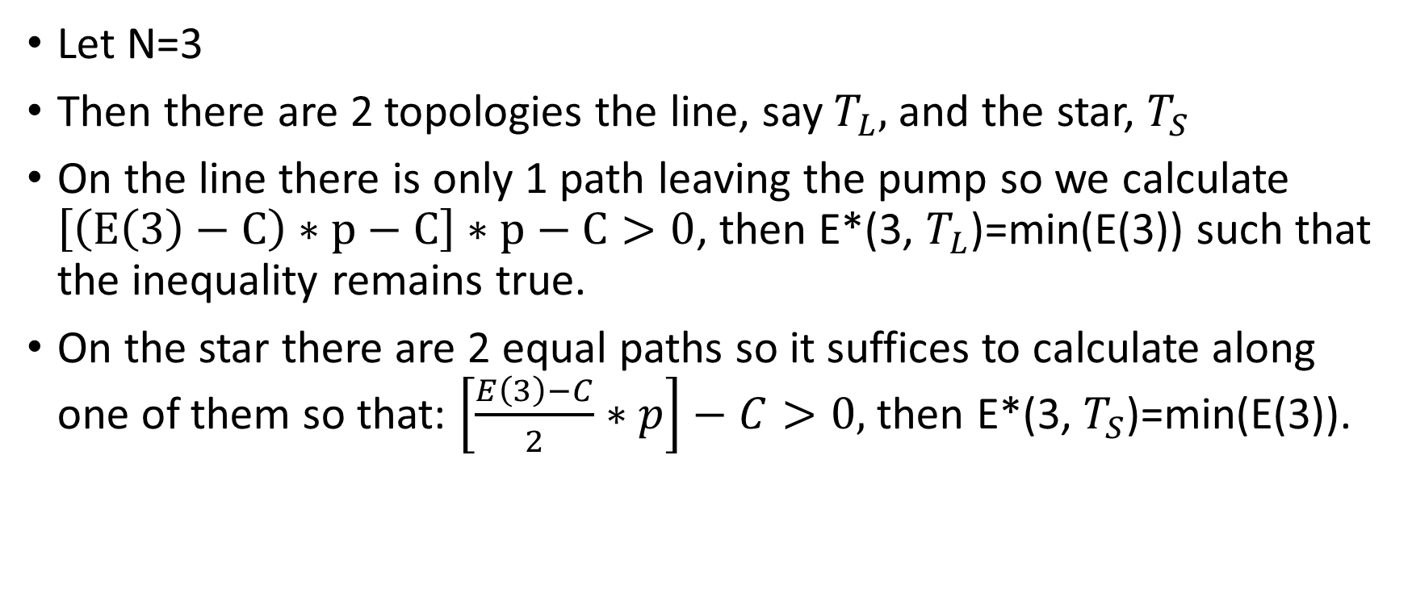
Example: Calculating critical energy
Let N=3
Then there are 2 topologies the line, say $T_{L},$ and the star, $T_{S}$
On the line there is only 1 path leaving the pump so we calculate $\left[\left(E\left(3\right)−C\right)∗p−C\right]∗p−C>0$, then E*(3, $T_{L}$)=min(E(3)) such that the inequality remains true.
On the star there are 2 equal paths so it suffices to calculate along one of them so that: $\left[\frac{E\left(3\right)−C}{2}∗p\right]−C>0,$then E*(3, $T_{S}$)=min(E(3)).

Slide 9
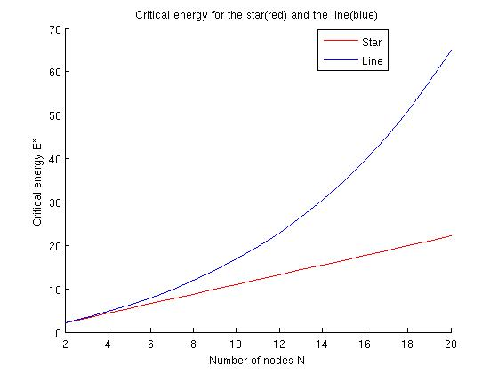
Critical energies by varying N
In this graph we use C=1 and p=0.9

Slide 10

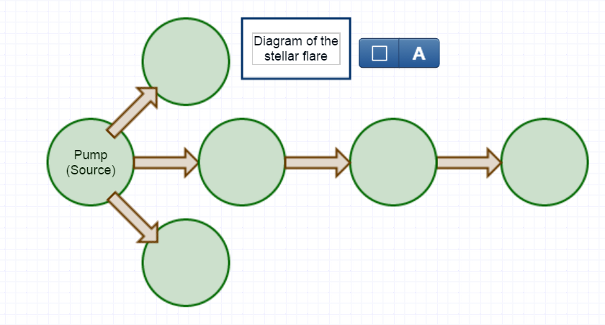
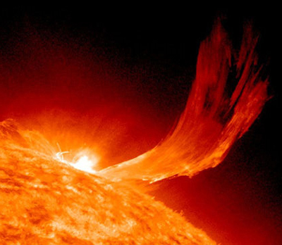
Extending to other networks
We define two quantities, S and L with S+L=N, where S and L go from 1 to N-1. S is the number of points in the star-like part. L is the length of the longest path without counting the center of the star.

Slide 11
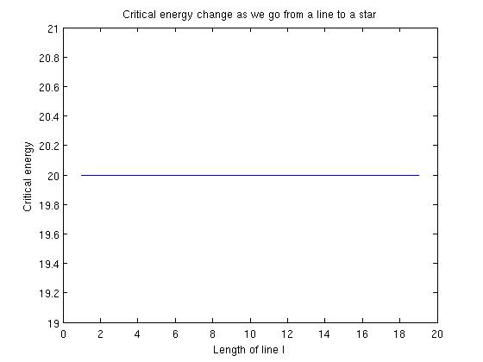
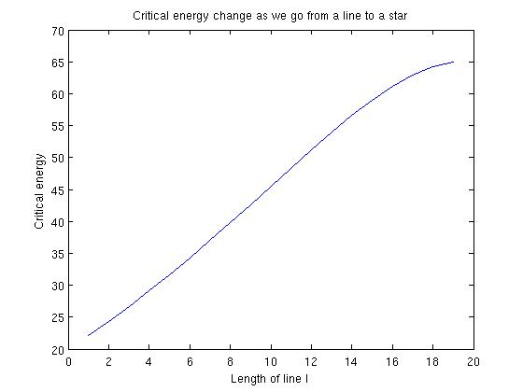
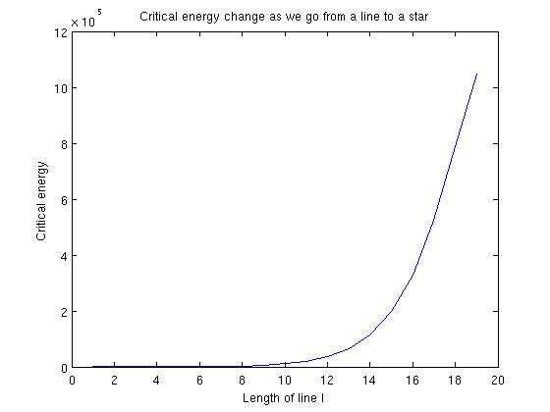
Plot of critical energy for N=20 of the fork
p=1 p=0.9 p=0.5

Slide 12
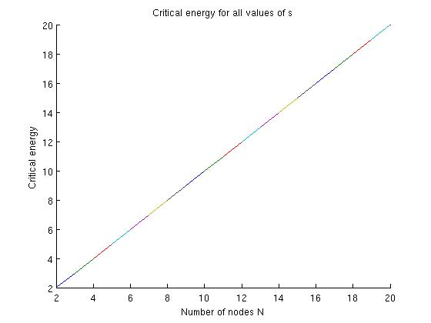
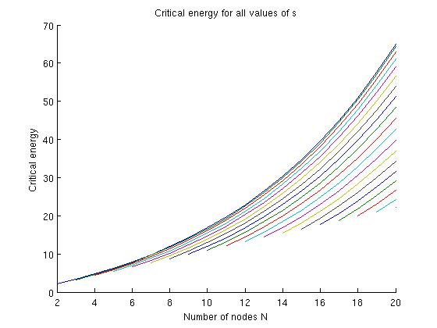
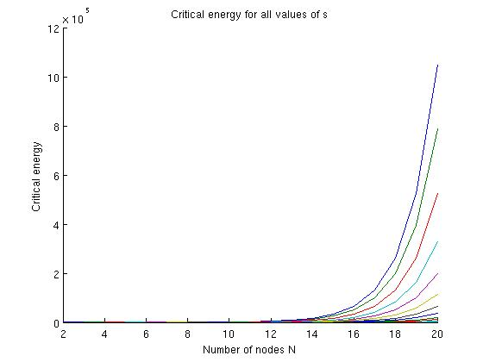
Plots of critical energy for fork varying N plotting S in the range 1 to N-1
p=1 p=0.9 p=0.5

Slide 13
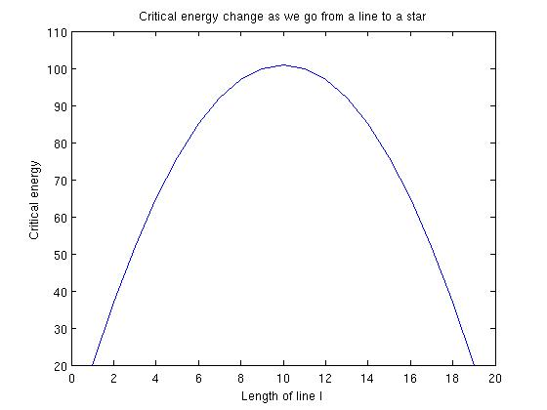
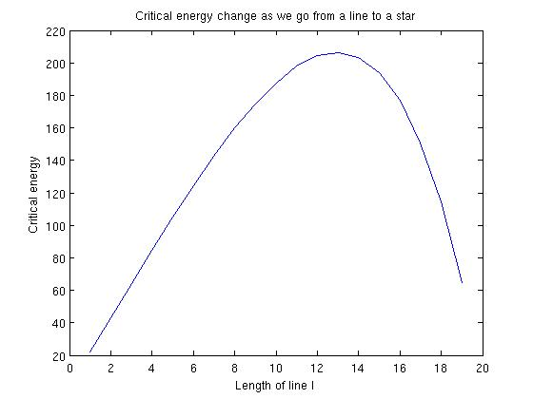
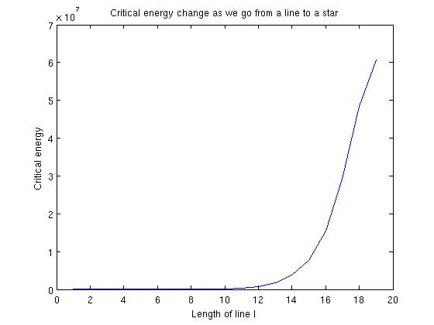
Critical energy for the stellar flare with constant N=20
p=1 p=0.9 p=0.4

Slide 14
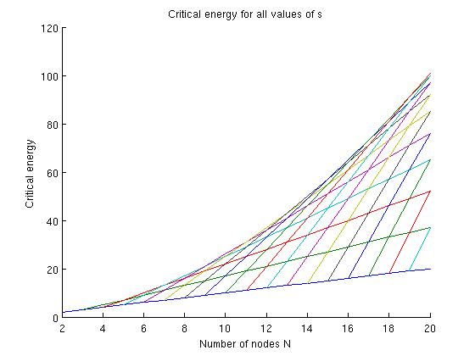
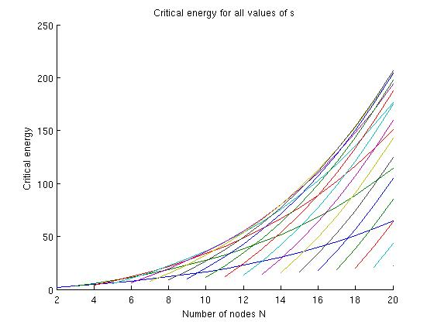
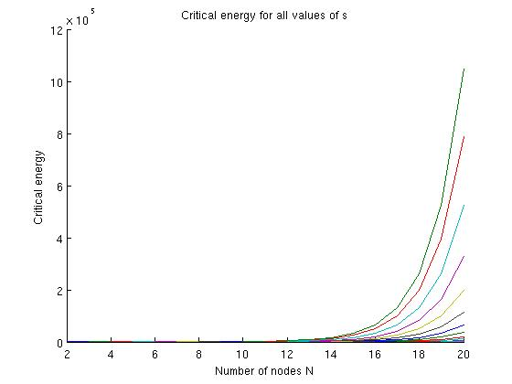
Critical energy of the stellar flare varying N and plotting S in the range 1 to N-1
p=1 p=0.9 p=0.5

Slide 15
Robustness
A robust system is one that loses a small proportion of its total cells when it first drops below the critical energy.
More robust
Least robust

Slide 16
Recursive formula for critical energy (in progress)
Idea: Develop a recursive formula dependent on the energy function and the branching factor at each node.

Slide 17
Future directions
Additional topologies analyzed
Verification of simulation
Exploring other possible fitness metrics
Evolutionary simulations

Slide 18


