Slide 1
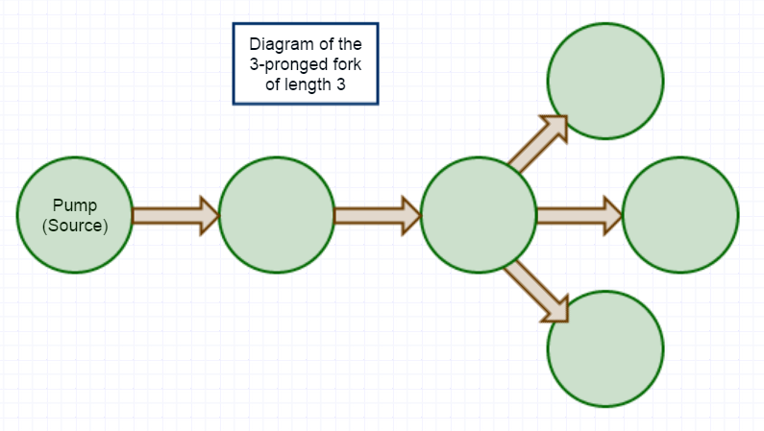
Analyzing topologies for energy distribution in a biological network
Christopher Ebsch
Francesco Pancaldi

Slide 2
Outline
Summary of previous direction
Assumptions of the updated model
Two canonical networks
Critical energy
Example
Extensions to other networks
Robustness
Example
Recursive formulation of critical energy (in progress)
Future directions
Verification of simulation
Evolutionary simulations

Slide 3
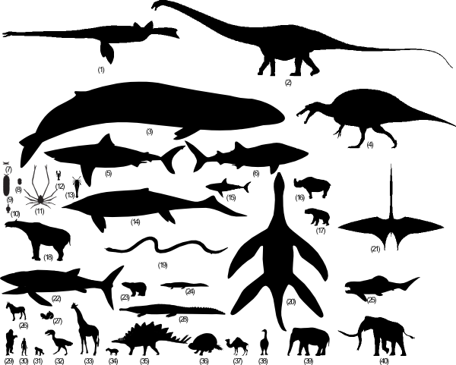
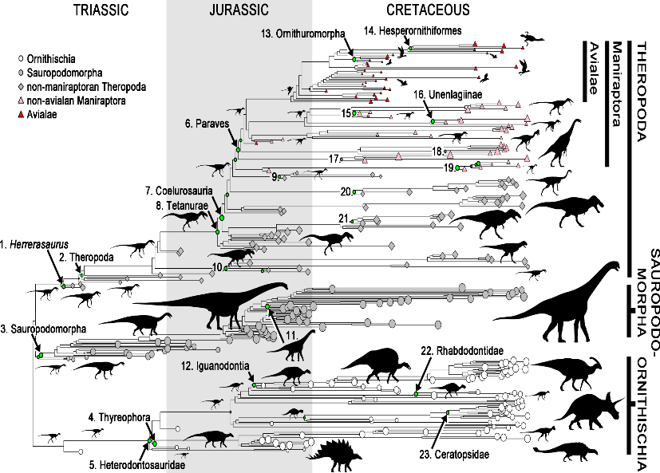
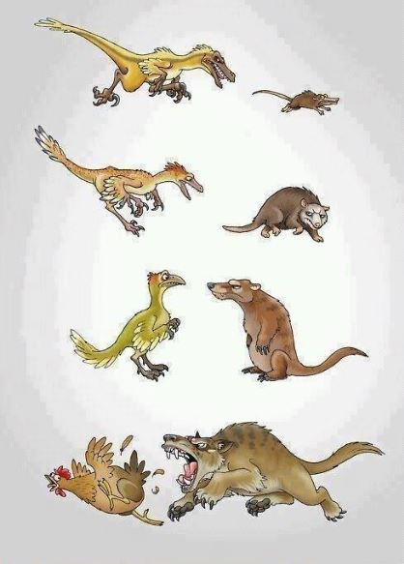
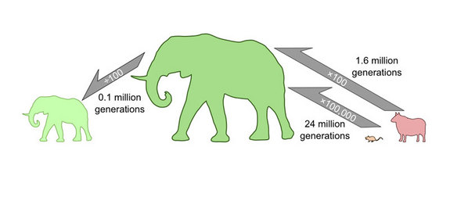
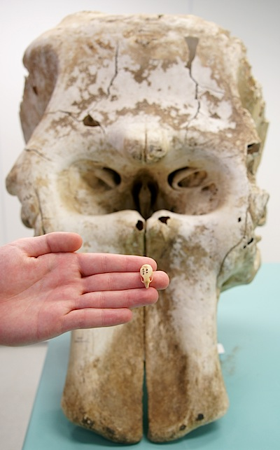

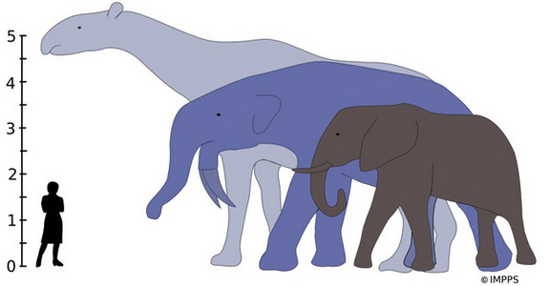
Summary of previous direction
Previous Goal: Model evolution of animal size.
New Goal: Model of optimal sizes and structures for energy transport in biological networks.

Slide 4
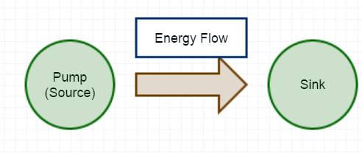
Basic network structure
Begin with a connected, directed network of N nodes with energy source (pump).
Energy, E(N), is gathered by the pump
Each node (including the pump) consumes a fixed amount of energy, C, that it receives.
The remaining energy at that node, E(N)-C, is divided equally to its outgoing edges.
A portion, 1-p, of the energy being transported is lost to the environment (with 0<p≤1).
Repeat until all nodes have consumed C energy or the energy remaining in the system is less than amount needed to sustain any unfed nodes. Unfed nodes at the end of a feeding cycle will be considered dead. A dead cell no longer consumes energy, but maintains connections.

Slide 5
Assumptions of the model
Energy gathered at a given time step is monotonically increasing in the number of surviving nodes and is bounded by Ē.
The parameters of the energy function, E(N), and the bound Ē can fluctuate with a certain random distribution (ex: Gaussian)
After N feeding cycles, the network can reproduce and mutate at random, then the process is repeated (in progress).

Slide 6
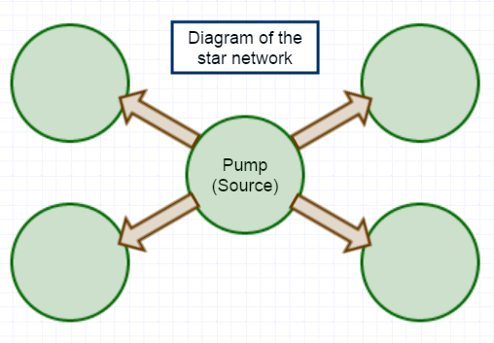
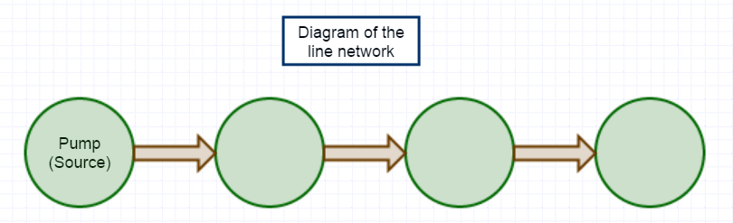
Two canonical topologies
The star connects the pump to all other nodes in the network and there are no other connections
The line connects each node sequentially with the next one in a list.

Slide 7
Critical energy
The critical energy, E*(N,T), is defined as the minimum energy needed to keep all nodes in the network alive with T being the structure of the network.
In general, we calculate the critical energy by taking the maximum value of the energies needed for survival along every path leaving the pump.

Slide 8
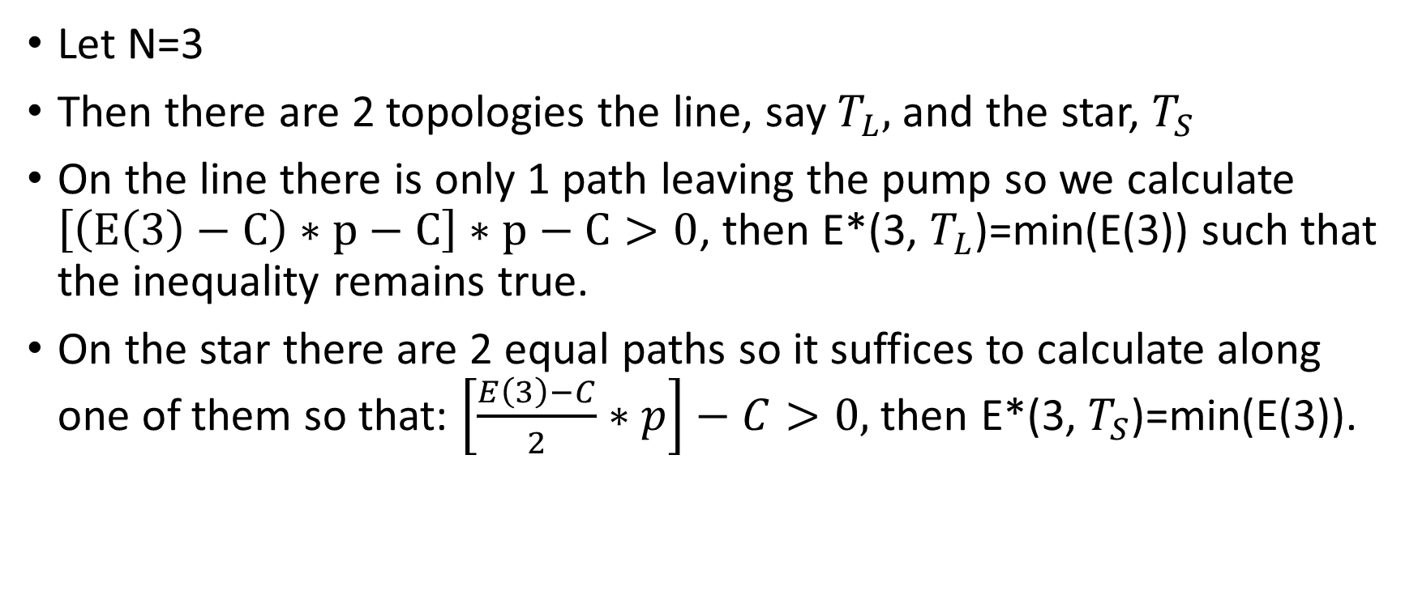
Example: Calculating critical energy
Let N=3
Then there are 2 topologies the line, say $T_{L},$ and the star, $T_{S}$
On the line there is only 1 path leaving the pump so we calculate $\left[\left(E\left(3\right)−C\right)∗p−C\right]∗p−C>0$, then E*(3, $T_{L}$)=min(E(3)) such that the inequality remains true.
On the star there are 2 equal paths so it suffices to calculate along one of them so that: $\left[\frac{E\left(3\right)−C}{2}∗p\right]−C>0,$then E*(3, $T_{S}$)=min(E(3)).

Slide 9
Combining topologies

