Slide 1
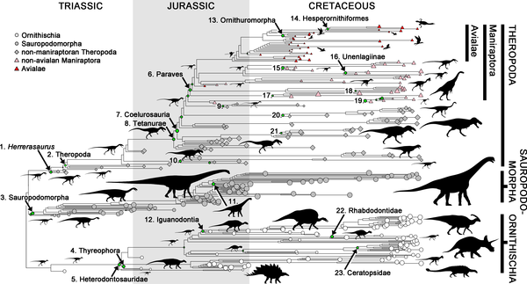

Figure 3. Dinosaur phylogeny showing nodes with exceptional rates of body size evolution.
Benson RBJ, Campione NE, Carrano MT, Mannion PD, et al. (2014) Rates of Dinosaur Body Mass Evolution Indicate 170 Million Years of Sustained Ecological Innovation on the Avian Stem Lineage. PLoS Biol 12(5): e1001853. doi:10.1371/journal.pbio.1001853
http://www.plosbiology.org/article/info:doi/10.1371/journal.pbio.1001853

