Slide 1
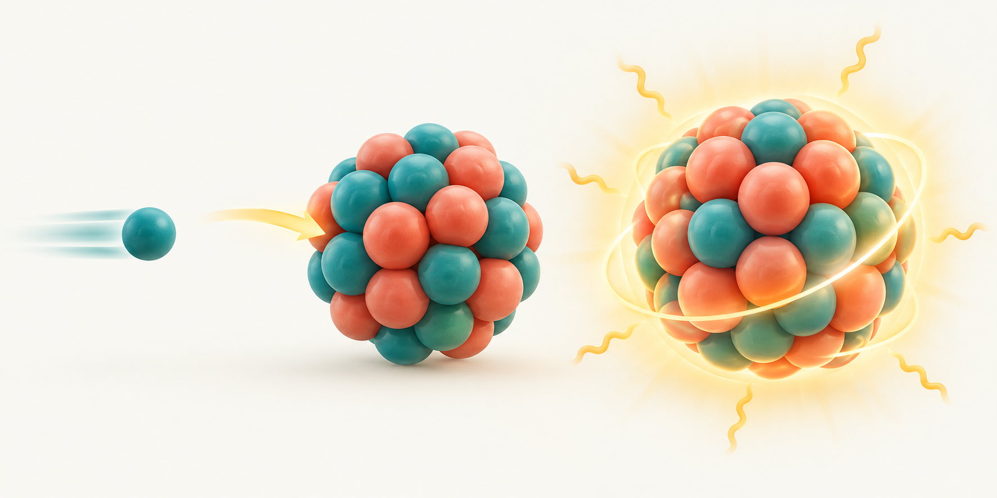
01
Neutron absorption
A neutron enters U-235. It has no charge, so the protons don’t repel it; the strong force pulls it in, making excited U-236.
n + ²³⁵U → ²³⁶U*
“Excited” means the nucleus, not its electrons: the ~6.5 MeV binding energy goes into the nucleons’ motion.
Conceptual illustration • not to scale
FISSION ENERGY RELEASE
1 / 15
Notes:
Source: supplied fission_energy_release.pdf, step 1. Text condensed for teaching. Numbers are approximate ensemble averages. Illustrations are conceptual, not to scale.
Background fission reference: https://www.nrc.gov/education-regulatory-research/glossary/fission-fissioning

Slide 2
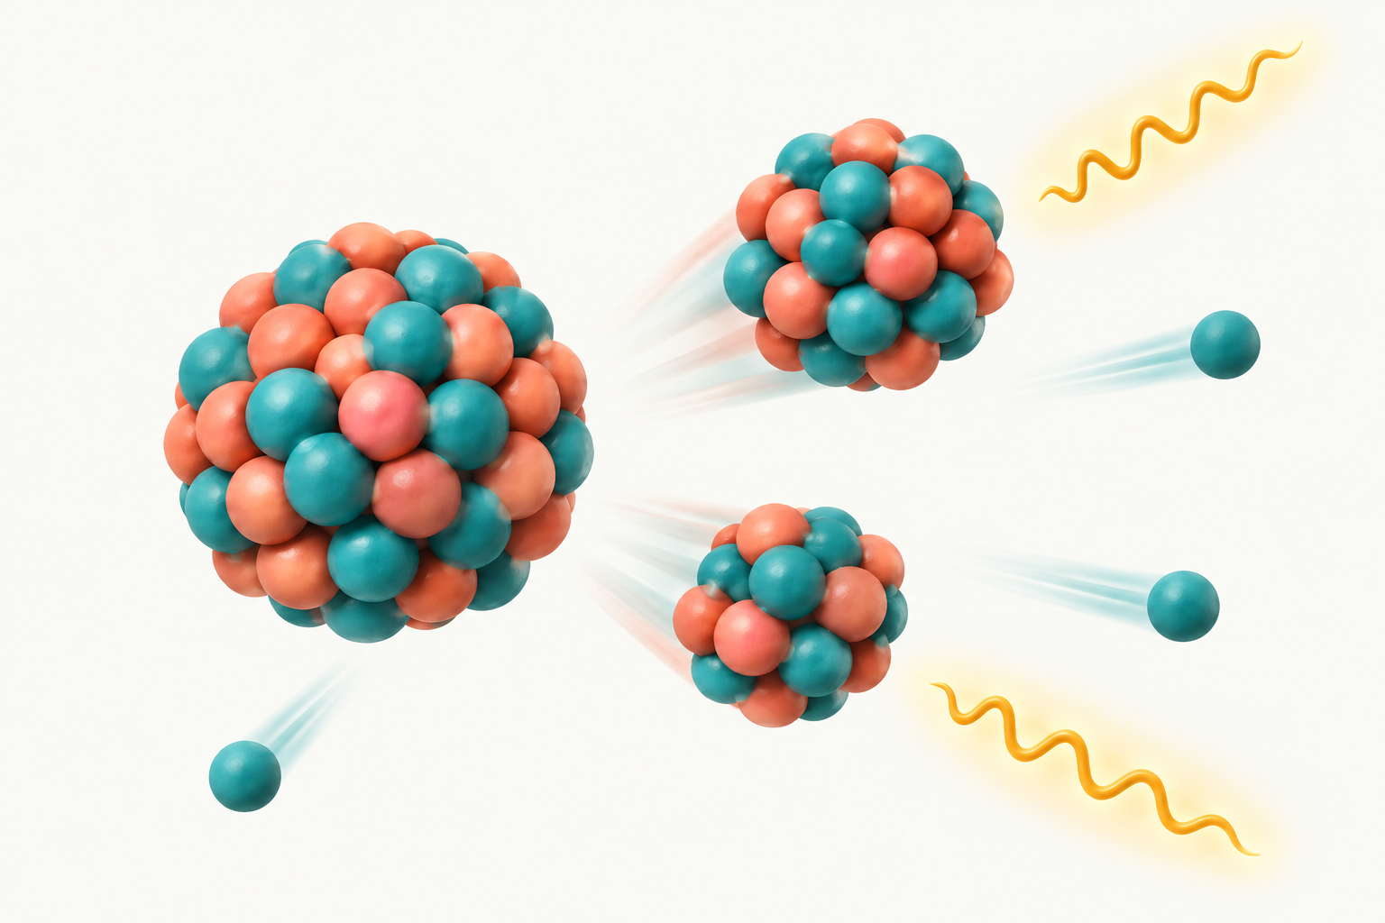
02
The nucleus splits
With extra energy, nucleons move farther apart. The short-range strong force fades, but the long-range Coulomb push stays, so Coulomb wins.
²³⁶U* → ¹⁴¹Ba + ⁹²Kr + 3n + γ
Prompt neutrons and gammas emerge at the split. Coulomb does not grow; the strong force just loses more.
Conceptual illustration • not to scale
FISSION ENERGY RELEASE
2 / 15
Notes:
Source: supplied fission_energy_release.pdf, step 2. Text condensed for teaching. Numbers are approximate ensemble averages. Illustrations are conceptual, not to scale.
Background fission reference: https://www.nrc.gov/education-regulatory-research/glossary/fission-fissioning

Slide 3
03
One shared energy budget
Q is the rest-mass energy lost: mass before minus mass after. It counts only energy beyond the products’ rest masses.
About 200 MeV per fission
Most of it, ~168 MeV, is Ba and Kr flying apart. Values are averages over many fissions.
Approximate energy shares (MeV)
FISSION ENERGY RELEASE
3 / 15
Notes:
Source: supplied fission_energy_release.pdf, step 3. Text condensed for teaching. Numbers are approximate ensemble averages. Illustrations are conceptual, not to scale.
Background fission reference: https://www.nrc.gov/education-regulatory-research/glossary/fission-fissioning

Slide 4
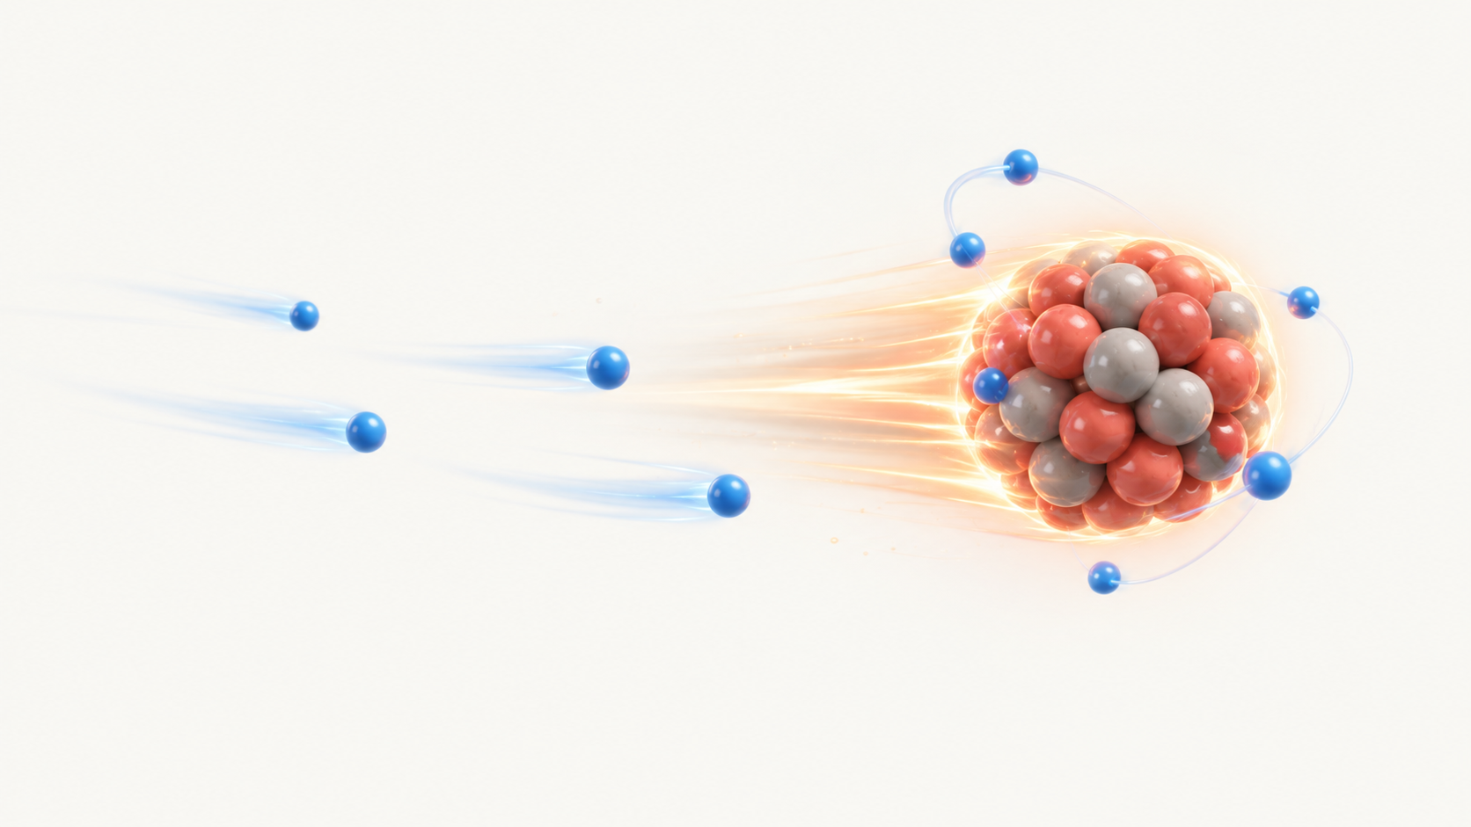
04
Fragments become positive ions
Ba and Kr move so fast that they cannot keep their outer electrons. Each becomes a positive ion with about +20e.
Speed ≈ 10⁷ m/s
Inner electrons stay attached. The charge changes along the track.
Conceptual illustration • not to scale
FISSION ENERGY RELEASE
4 / 15
Notes:
Source: supplied fission_energy_release.pdf, step 4. Text condensed for teaching. Numbers are approximate ensemble averages. Illustrations are conceptual, not to scale.
Background fission reference: https://www.nrc.gov/education-regulatory-research/glossary/fission-fissioning

Slide 5
05
Why the outer electrons are stripped
An electron stays attached only if it orbits faster than the fragment moves. Inner electrons are fast enough; outer ones are not.
Electron | Ba (Z = 56) | Kr (Z = 36)
Innermost (1s): stays | 1.2×10⁸ m/s | 7.9×10⁷ m/s
Middle shells: the cutoff | ~1×10⁷ m/s | ~1.5×10⁷ m/s
Outermost: stripped | ~2×10⁶ m/s | ~2×10⁶ m/s
Fragment speed | 1.0×10⁷ m/s | 1.4×10⁷ m/s
≈20 electrons lost per fragment
Bohr estimate: v ≈ (Z_eff/n)·αc, with αc ≈ 2.2×10⁶ m/s. The ~40 stripped electrons stay at the fission site.
Inner electrons orbit 5–10× faster than the fragment; outer ones 5–7× slower.
FISSION ENERGY RELEASE
5 / 15
Notes:
Source: supplied fission_energy_release.pdf, step 4 (electron-speed table). Bohr-model estimates: v ≈ (Z_eff/n)·αc. The cutoff falls in the middle shells, so about 20 electrons are lost from each fragment. The lighter Kr fragment moves faster and ends up slightly more stripped. The ~40 left-behind electrons recombine with ionized atoms in the fuel (next slide).

Slide 6
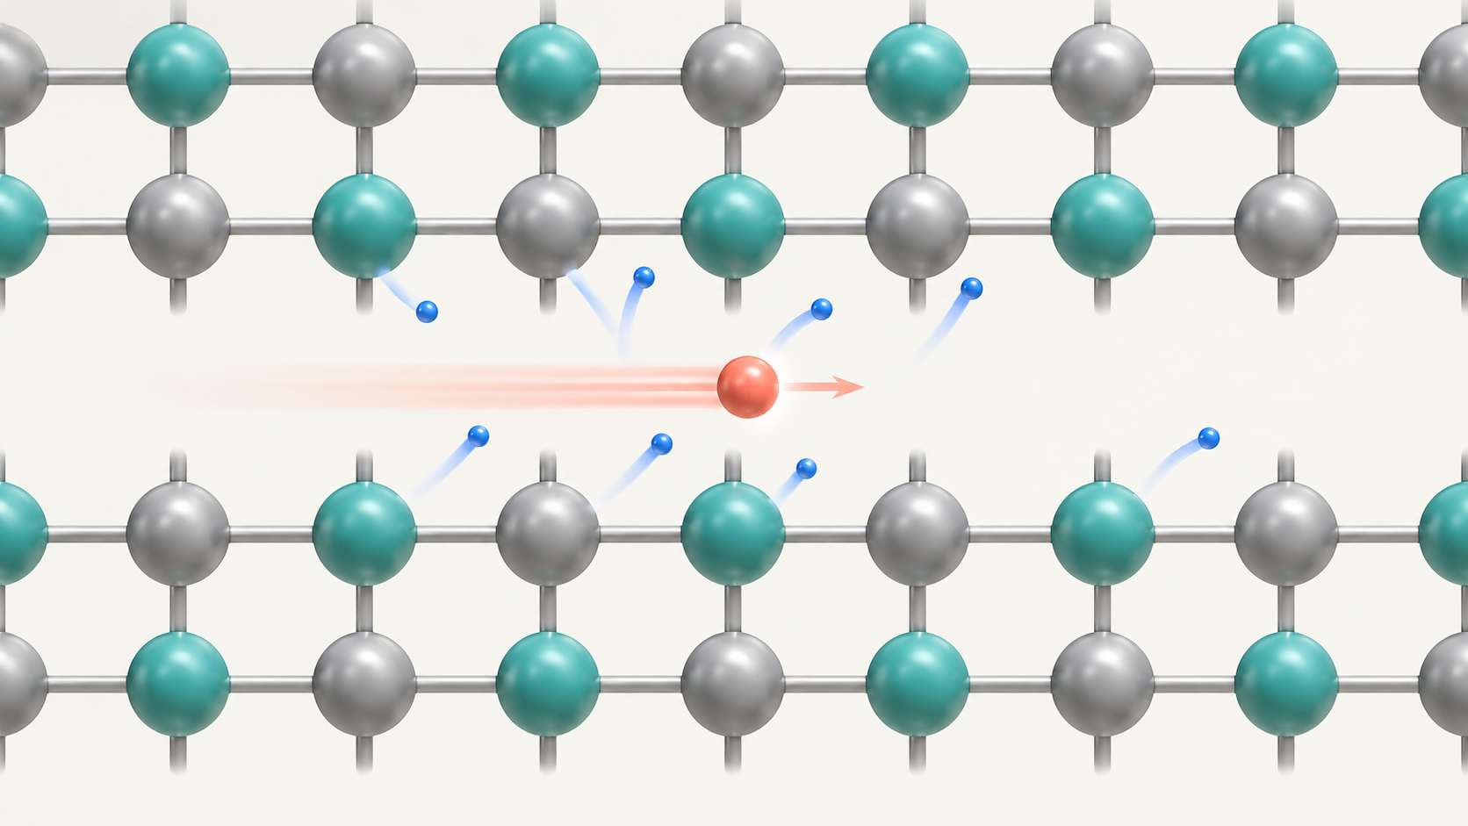
06
Positive ions strip the fuel’s electrons
Their positive charge pulls electrons off the U and O atoms they pass. They knock them free and don’t keep them; each costs ~30 eV.
≈3 million electrons freed per fragment
Millions of these small losses stop the fragment within a few microns.
Conceptual illustration • not to scale
FISSION ENERGY RELEASE
6 / 15
Notes:
Source: supplied fission_energy_release.pdf, step 5. Text condensed for teaching. Numbers are approximate ensemble averages. Illustrations are conceptual, not to scale.
Correction: the solid is not a collection of neutral U and O atoms. Source: https://www.osti.gov/pages/servlets/purl/1545569
Background fission reference: https://www.nrc.gov/education-regulatory-research/glossary/fission-fissioning

Slide 7
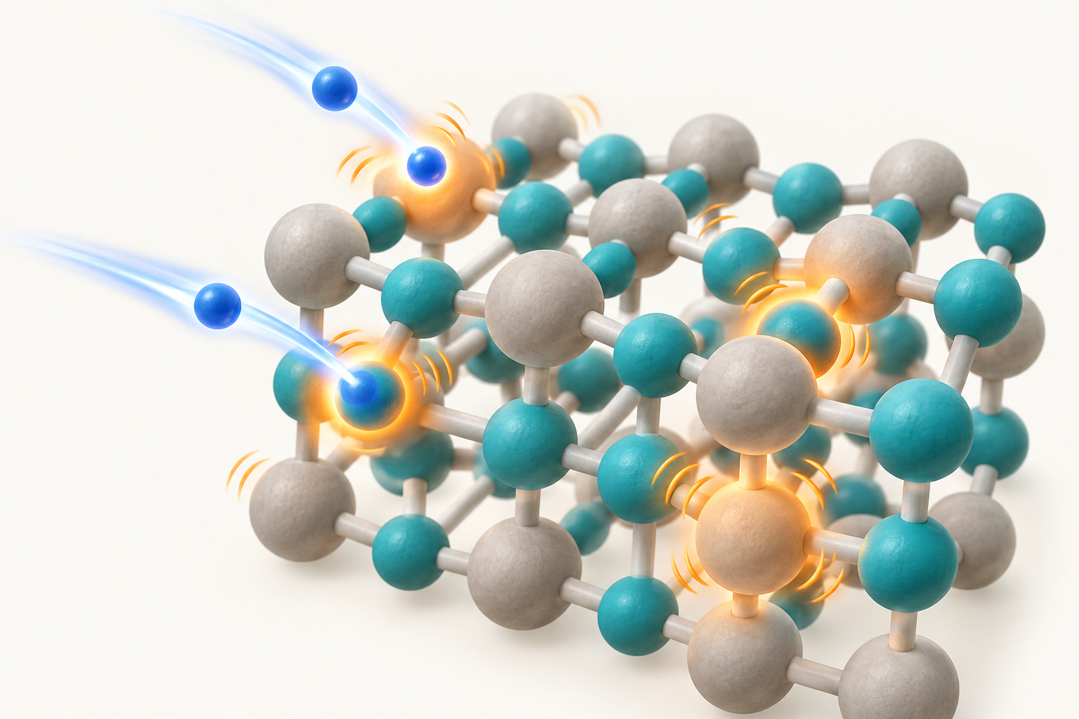
07
Electronic energy becomes fuel heat
The fragment’s energy goes into the freed electrons. As they slow down and fall back into the holes, they hand that energy to the atoms, which vibrate.
Lattice vibrations = thermal energy
Electrons are only middlemen: the fragment slows, the crystal heats. The ~40 stripped electrons also recombine here.
Conceptual illustration • not to scale
FISSION ENERGY RELEASE
7 / 15
Notes:
Source: supplied fission_energy_release.pdf, step 6. Why does a round trip make heat? The electron's trip out and back is not the point; it only carries energy from the fragment to the crystal. The fragment does work to pull the electron off and slows down; the electron then bumps into atoms and drops back into a hole, handing that energy to the atoms, which vibrate. For the electron the round trip nets to zero, but the fragment is slower and the crystal is hotter. Like rubbing your hands: nothing leaves, yet motion becomes warmth. The ~40 electrons stripped from the fragments also recombine with these holes.

Slide 8
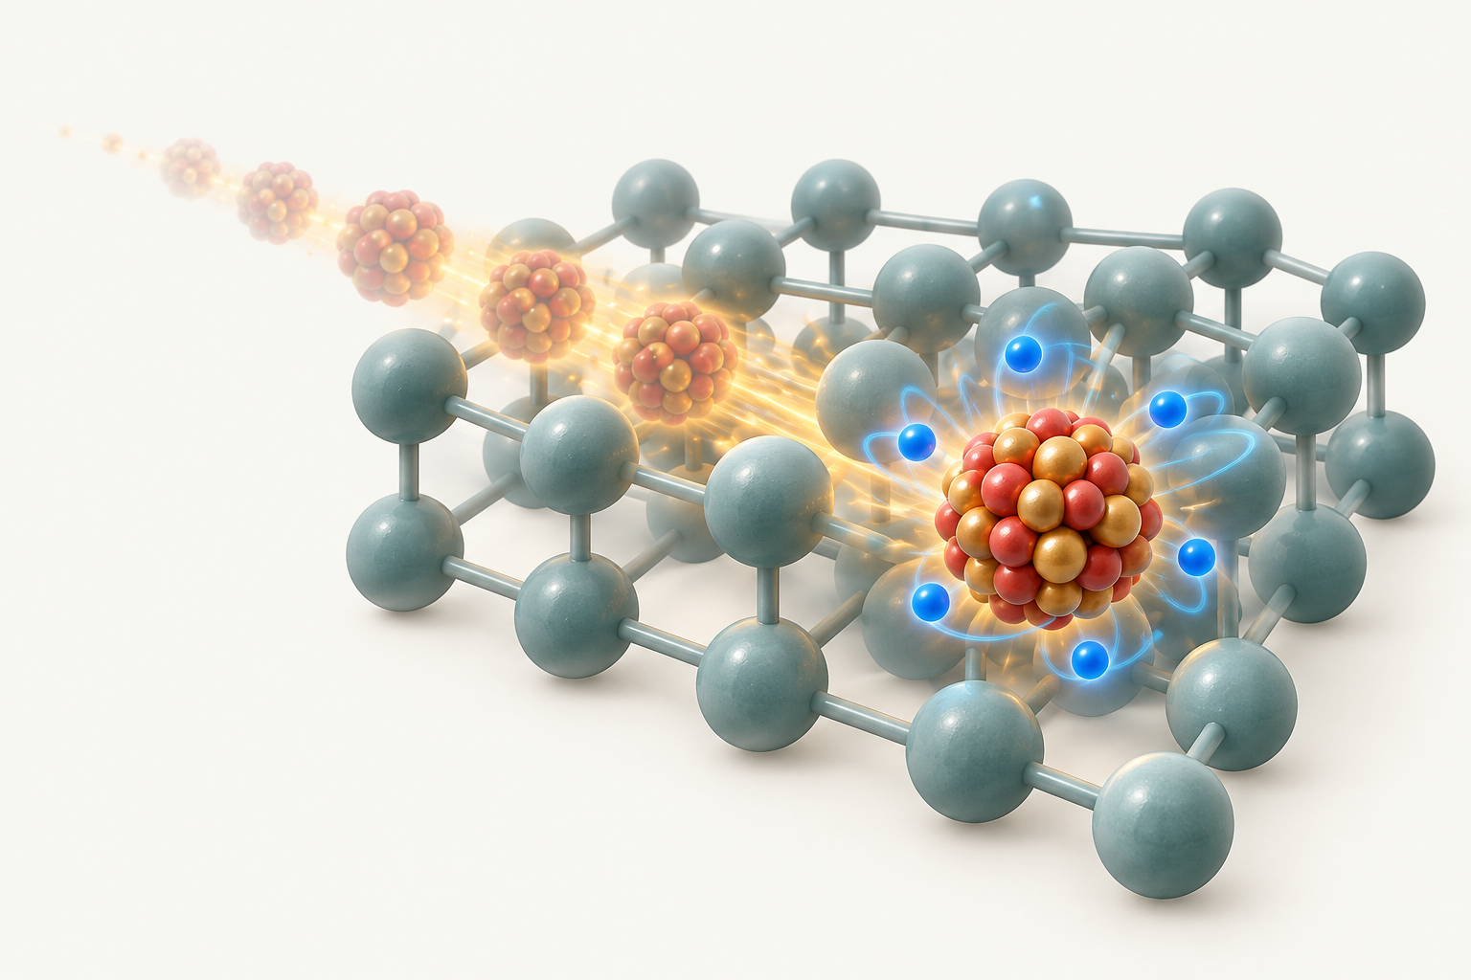
08
The fragment comes to rest
Within a few micrometers, the fragment loses its kinetic energy and captures about 20 electrons as it slows. It remains in the fuel as a fission product.
A track only a few μm long
Its final charge depends on the surrounding solid. A neutral atom is a simplified picture.
Conceptual illustration • not to scale
FISSION ENERGY RELEASE
8 / 15
Notes:
Source: supplied fission_energy_release.pdf, step 7. Text condensed for teaching. Numbers are approximate ensemble averages. Illustrations are conceptual, not to scale.
Background fission reference: https://www.nrc.gov/education-regulatory-research/glossary/fission-fissioning

Slide 9
09
Why the fragments are radioactive
The fragments are neutron rich compared with stable nuclei of similar mass. Beta-minus decay converts a neutron into a proton.
¹⁴¹Ba
⁹²Kr
56 protons
85 neutrons
36 protons
56 neutrons
n → p + e⁻ + ν̄ₑ
Stable comparison
¹³⁸Ba: 82 neutrons
⁸⁶Kr: 50 neutrons
In beta-minus decay, Z increases by 1 and A stays the same.
FISSION ENERGY RELEASE
9 / 15
Notes:
Source: supplied fission_energy_release.pdf, step 8. Text condensed for teaching. Numbers are approximate ensemble averages. Illustrations are conceptual, not to scale.
Background fission reference: https://www.nrc.gov/education-regulatory-research/glossary/fission-fissioning

Slide 10
10
When and how the fragments decay
Successive beta-minus decays change the element while preserving the mass number. Excited daughter nuclei can also emit gamma rays.
Barium chain (A = 141)
Ba → La → Ce → Pr
56 57 58 59 (Z)
Each arrow represents β⁻ decay
Krypton chain (A = 92)
Kr → Rb → Sr → Y → Zr
Decay is random (Kr-92 ~1.8 s, Ba-141 ~18 min). The fragment stops in ~10⁻¹² s, so decay comes after.
36 37 38 39 40 (Z)
Pr-141 and Zr-92 are stable.
FISSION ENERGY RELEASE
10 / 15
Notes:
Source: supplied fission_energy_release.pdf, step 8. Text condensed for teaching. Numbers are approximate ensemble averages. Illustrations are conceptual, not to scale.
Background fission reference: https://www.nrc.gov/education-regulatory-research/glossary/fission-fissioning

Slide 11
11
Beta particles deposit energy
Beta particles are electrons. Their electric charge lets them transfer energy to other electrons, which then heat nearby material.
e⁻
Beta electron
About 8 MeV per fission
Ionization and excitation
Their range is longer than the fragment range and depends on energy and material.
Energy enters the lattice
as thermal motion.
FISSION ENERGY RELEASE
11 / 15
Notes:
Source: supplied fission_energy_release.pdf, step 9. Text condensed for teaching. Numbers are approximate ensemble averages. Illustrations are conceptual, not to scale.
Background fission reference: https://www.nrc.gov/education-regulatory-research/glossary/fission-fissioning

Slide 12
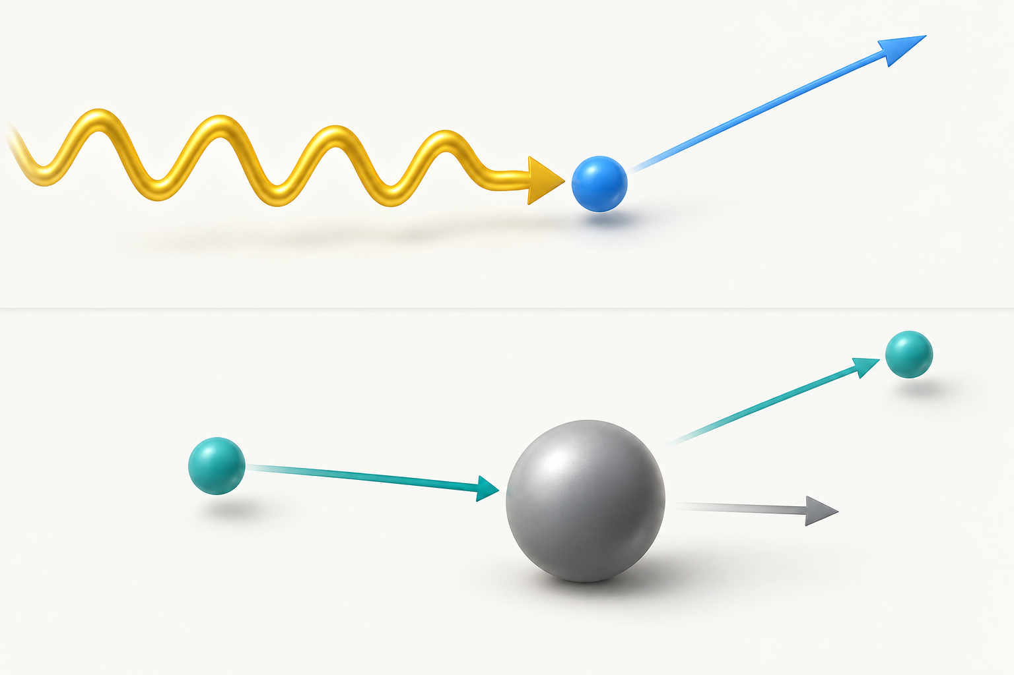
12
Neutral carriers travel farther
Gamma rays transfer energy to electrons. Neutrons transfer energy to recoiling nuclei, or are absorbed in reactions that release radiation.
Centimeters rather than micrometers
Charged secondary particles ultimately deposit the energy as heat. Distances vary.
Conceptual illustration • not to scale
FISSION ENERGY RELEASE
12 / 15
Notes:
Source: supplied fission_energy_release.pdf, step 10. Text condensed for teaching. Numbers are approximate ensemble averages. Illustrations are conceptual, not to scale.
Background fission reference: https://www.nrc.gov/education-regulatory-research/glossary/fission-fissioning

Slide 13
13
Antineutrinos carry energy away
Antineutrinos interact very weakly and escape the reactor. Their share of the energy does not become useful reactor heat.
≈193 MeV
becomes heat
200 − 12 ≈ 193 MeV
≈12 MeV
In SI units: 193 MeV × 1.602×10⁻¹³ J/MeV ≈ 3.1 × 10⁻¹¹ J per fission.
escapes in antineutrinos
This budget excludes additional neutron-capture heat.
FISSION ENERGY RELEASE
13 / 15
Notes:
Source: supplied fission_energy_release.pdf, step 11. About 200 MeV is released per fission; antineutrinos carry about 12 MeV out of the reactor, so about 193 MeV is recovered as heat. In SI units: 193 × 1.602e-13 J ≈ 3.1e-11 J per fission. Additional neutron-capture heat is outside this budget.

Slide 14
14
Neutrons sustain the chain reaction
Some emitted neutrons slow down and cause more U-235 fissions. Others are absorbed without fission or escape from the reactor.
absorbed
leaks out
One continuing fission per fission
Each fission: one neutron causes the next fission; the rest are lost.
k = 1
k < 1 reaction decreases
k > 1 reaction increases
A steady chain reaction has an average effective multiplication factor k = 1.
A steady chain reaction
FISSION ENERGY RELEASE
14 / 15
Notes:
Source: supplied fission_energy_release.pdf, step 12. Text condensed for teaching. Numbers are approximate ensemble averages. Illustrations are conceptual, not to scale.
Background fission reference: https://www.nrc.gov/education-regulatory-research/glossary/fission-fissioning

Slide 15
15
Timeline of one fission
0 s
Neutron absorbed
U-235 becomes excited U-236*
~10⁻¹⁰ s
Prompt gammas heat fuel
Over centimeters
~10⁻²⁰ s
Nucleus splits
Ba + Kr fly apart
~10⁻⁴ s
Neutrons cause next fission
Chain reaction continues
≲10⁻¹⁴ s
Prompt neutrons and gammas
2–3 neutrons, gamma rays
~1.8 s
Kr-92 beta-decays
Kr → Rb → Sr → Y → Zr
~10⁻¹² s
Fragments stop in a few μm
Ions strip fuel electrons, slow down
~18 min
Ba-141 beta-decays
Ba → La → Ce → Pr
~10⁻¹² s
Fuel heats, fragments neutral
Electrons recombine, lattice vibrates
≤33 days
Stable Pr-141 and Zr-92
Betas heat fuel, antineutrinos escape
Coral: fission · gray: energy becomes heat · teal: radioactive decay. Times are orders of magnitude; spacing is not to scale.
FISSION ENERGY RELEASE
15 / 15
Notes:
Timeline of one U-235 fission, from neutron absorption (0 s) to stable products (up to about a month). Times are orders of magnitude. It puts steps 1-12 of the notes in time order.

