Slide 1
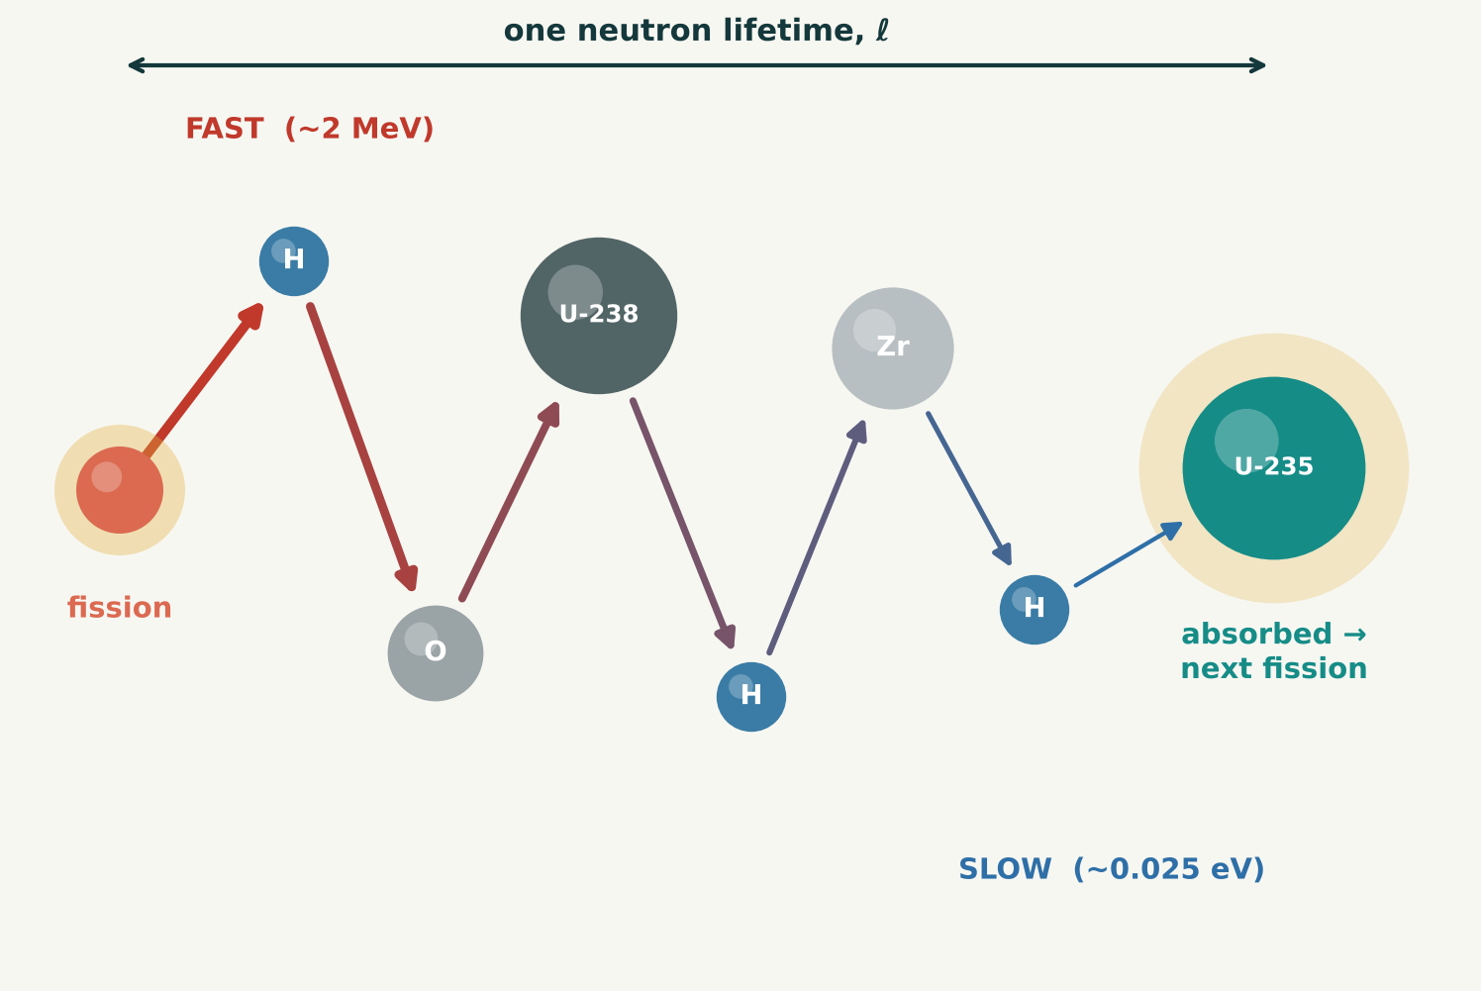
01
The life of a neutron
A fission releases 2–3 fast neutrons: generation zero. Most do not cause fission right away: each bounces off nuclei many times, slowing down, until it is absorbed.
One trip = one neutron lifetime, ℓ
If U-235 absorbs it, a new fission starts the next generation, and the story repeats.
Conceptual illustration • not to scale
NEUTRON MULTIPLICATION
1 / 17
Notes:
A U-235 nucleus splits and 2 to 3 fast neutrons fly out, at about 2 MeV. These are generation zero. Most of them do not cause fission right away. A neutron can be absorbed at its first collision, but usually it first bounces off nuclei many times, about 18 to 20 times off hydrogen, slowing down, until it is finally absorbed. This whole journey, from birth in a fission, through the bouncing, to absorption, is one neutron lifetime, written ell. Then the story repeats with the new generation.

Slide 2
02
Why slow down first?
A slow neutron is much more likely to make U-235 fission. It spends more time near the nucleus, so it has more chance of being absorbed.
U-235 fission cross section
1 b
585 b
fast neutron
~2 MeV, just born
slow (thermal) neutron
after bouncing
Slow: about 500× more likely
Cross section: the effective target area the nucleus presents to the neutron. Bigger means more likely.
1 barn (b) = 10⁻²⁴ cm², about the size of a uranium nucleus.
A few fast neutrons do cause fission before slowing down, but this adds only about 3% more fissions.
NEUTRON MULTIPLICATION
2 / 17
Notes:
Why do neutrons slow down before causing fission? Because a slow neutron is much more likely to make U-235 fission than a fast one. A slow neutron spends more time near the nucleus, so it has more chance of being absorbed. This chance is measured by the cross section: the effective target area the nucleus presents to the neutron, in barns. One barn is 10 to the minus 24 square centimeters, about the actual cross-sectional area of a uranium nucleus. For U-235 fission, a fast neutron of about 2 MeV sees about 1 barn; a slow, thermal neutron sees about 585 barns. So a slow neutron is about 500 times more likely to cause fission. A few fast neutrons do cause fission before slowing down, in U-235 or U-238, but this adds only about 3 percent more fissions.

Slide 3
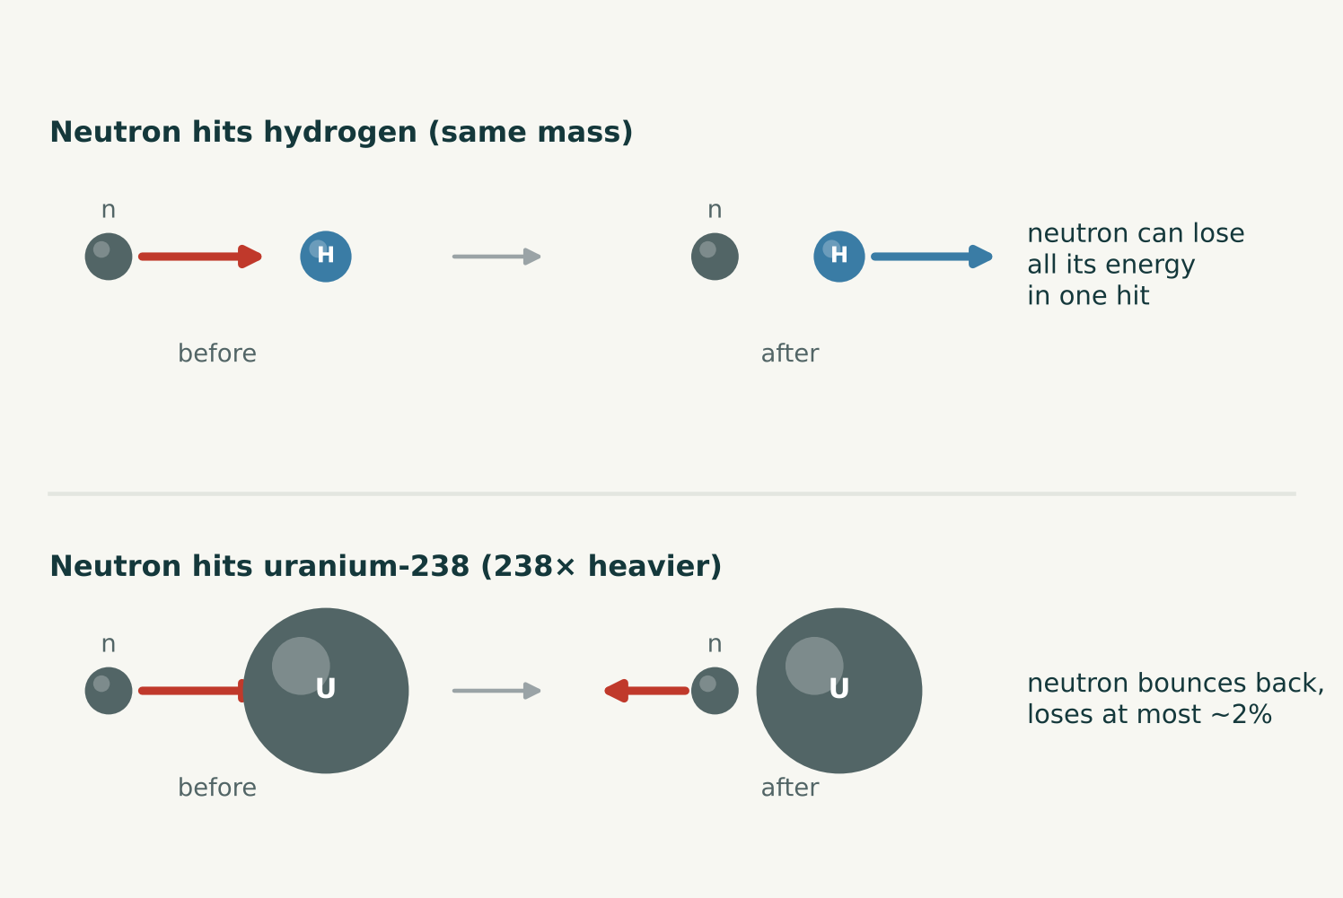
03
Why water slows neutrons
A neutron loses the most energy when it hits a nucleus of its own mass. The proton in hydrogen is exactly that, so water slows neutrons best.
Hydrogen: the main moderator
Neutrons also bounce off O, U-238, U-235, Zr cladding, steel, fission products and control rods.
Conceptual illustration • not to scale
NEUTRON MULTIPLICATION
3 / 17
Notes:
Think of billiard balls. When a ball hits another ball of the same mass head-on, it can stop dead and hand over all its energy. That is the neutron hitting hydrogen. When it hits something much heavier, like a uranium nucleus 238 times its mass, it just bounces back with almost all its speed; it loses at most about 2 percent. The nuclei a neutron can bounce off in a light-water reactor are: hydrogen in the water, the main one; oxygen in the water and in the UO2; uranium-238 and uranium-235 in the fuel; zirconium in the cladding tubes; and other materials such as fission products, structural steel and control rods.

Slide 4
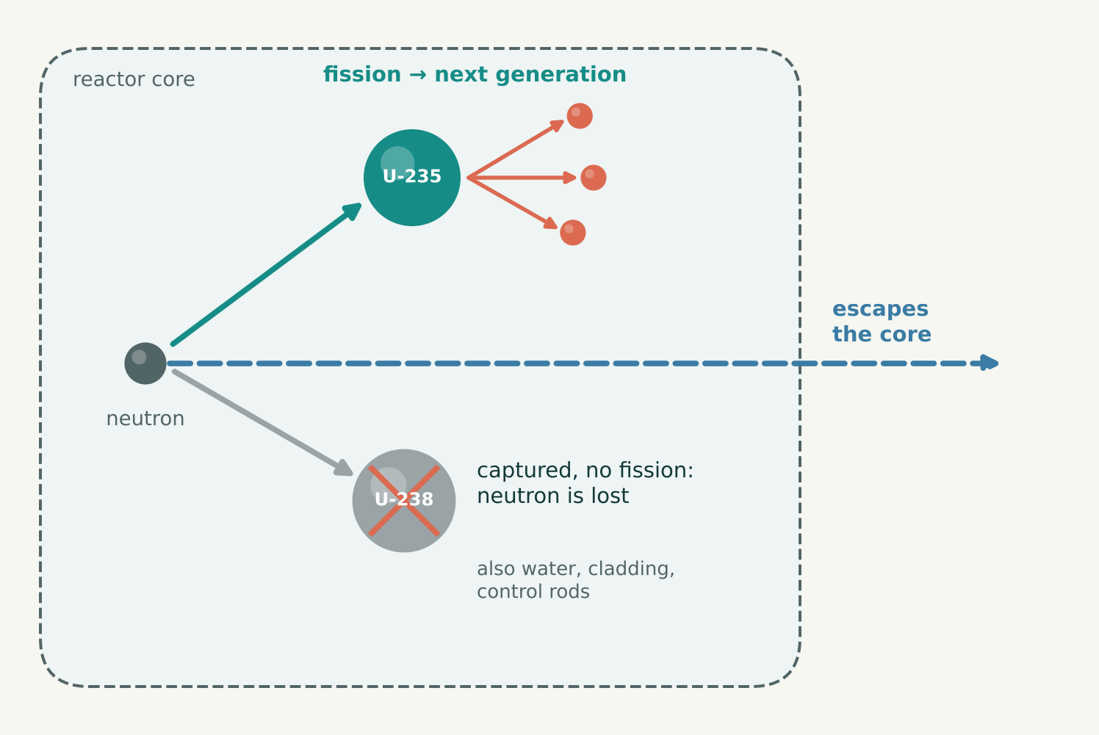
04
Where the neutron ends up
Its final stop decides what happens next. Only absorption in U-235 can continue the chain reaction.
Fission, loss, or escape
Captured by U-238, water, cladding or a control rod, the neutron joins that nucleus, often making it radioactive.
Conceptual illustration • not to scale
NEUTRON MULTIPLICATION
4 / 17
Notes:
There are three possible endings. First, the neutron is absorbed by U-235, which may fission and release new neutrons: the next generation. Second, it is captured by something else: U-238, water, the cladding or a control rod. It stops being a free neutron and becomes part of that nucleus, which is now one neutron heavier. It can no longer cause a fission, so it does not count toward the next generation, and the heavier nucleus is often radioactive. Examples: U-238 becomes U-239, which decays to Np-239 and then Pu-239; hydrogen becomes stable deuterium; boron-10 splits into lithium-7 and an alpha particle; zirconium and steel become activated. Third, the neutron escapes out of the core entirely. Only the first ending keeps the chain going.

Slide 5
05
Neutrons per fission
Each fission releases a whole number of neutrons, usually 2 or 3, and occasionally 0, 1, 4 or 5.
Average ≈ 2.4 (we use 2.5)
We round it to 2.5 to keep the arithmetic simple.
U-235 thermal fission, approximate
NEUTRON MULTIPLICATION
5 / 17
Notes:
No fission releases 2.4 neutrons; each one releases a whole number. Most give 2 or 3, a few give 0, 1, 4 or 5. Averaged over many fissions of U-235, the mean is about 2.4. The chart shows approximate probabilities for thermal fission of U-235. We round the average to 2.5 to keep the arithmetic simple.

Slide 6
06
The multiplication factor k
The key question: how many neutrons does each generation produce for the next one?
k =
neutrons born in the next generation
neutrons in this generation
k counts the new neutrons born
k > 1
k = 1
k < 1
each generation
is bigger
same number
every generation
each generation
is smaller
Wasted neutrons (absorbed elsewhere or leaked) are already included, because they lower k.
NEUTRON MULTIPLICATION
6 / 17
Notes:
The multiplication factor k is the ratio of the neutrons born in the next generation to the neutrons in this generation. It counts the new neutrons born from fissions, not the neutrons that hit uranium. The neutrons that are wasted, absorbed elsewhere or leaked out, are already accounted for, because they lower k. The next slide shows how to count this in two rounds.

Slide 7
07
Counting in two rounds
To find k, count the neutrons in two rounds: this generation, then the next.
Round 1: this generation
Count the neutrons. Each one is either
wasted or causes a U-235 fission.
k = round 2 ÷ round 1
↓
Round 2: next generation
Each fission releases ~2.5 new neutrons:
new neutrons = fissions × 2.5
Wasted means absorbed by water, U-238, etc., or leaked out of the core.
NEUTRON MULTIPLICATION
7 / 17
Notes:
Think of it as counting neutrons in two rounds. Round 1 is this generation: count the neutrons and see what each one does. It is either wasted, absorbed by water, U-238 and so on, or leaked out, or it causes a U-235 fission. Round 2 is the next generation: each fission releases about 2.5 new neutrons, so the new neutrons equal the number of fissions times 2.5. Then k is round 2 divided by round 1.

Slide 8
08
Generation by generation
Start with n₀ neutrons. By the definition of k, each generation is k times the one before it.
Generation 0
n₀
Generation 1
n₁ = k n₀
Generation 2
n₂ = k n₁ = k² n₀
nᵢ = k^{i} n₀
Generation 3
n₃ = k n₂ = k³ n₀
Generation 4
n₄ = k n₃ = k⁴ n₀
⋮
Each step adds one more factor of k, so after i generations there are i factors of k.
Generation i
nᵢ = k nᵢ₋₁ = k^{i} n₀
NEUTRON MULTIPLICATION
8 / 17
Notes:
Start with n0 neutrons. By the definition of k, each generation is k times the one before it: n next equals k times n this. Apply this again and again. Generation 1 is k n0. Generation 2 is k times n1, which is k times k n0, or k squared n0. Generation 3 is k times n2, or k cubed n0. Generation 4 is k to the fourth n0. Each step adds one more factor of k, so after i generations there are i factors of k: n i equals k to the i times n0.

Slide 9
09
From generations to time
Each generation lives for one neutron lifetime ℓ before the next one is born.
Generation 0
born at t = 0
Generation 1
born at t = ℓ
Generation 2
born at t = 2ℓ
i = t / ℓ
Generation 3
born at t = 3ℓ
⋮
Generation i
born at t = iℓ
t/ℓ is the number of generations that have passed by time t.
NEUTRON MULTIPLICATION
9 / 17
Notes:
Each generation lives for one neutron lifetime ell before the next one is born. Generation 0 is born at t equals 0, generation 1 at ell, generation 2 at 2 ell, generation 3 at 3 ell, and generation i at i times ell. Solving the last line for i gives i equals t over ell: the number of generations that have passed by time t.

Slide 10
10
Neutron population in time
Put i = t/ℓ into nᵢ = k^{i} n₀. The generation number is replaced by the time.
n(t)
number of neutrons at time t
n₀
number of neutrons at t = 0
k
multiplication factor
n(t) = n₀ k^{t/ℓ}
ℓ
neutron lifetime
t/ℓ
generations passed by time t
Now we can plug in a time directly, without counting generations.
NEUTRON MULTIPLICATION
10 / 17
Notes:
Put i equals t over ell into n i equals k to the i n0. The generation number i is replaced by the time t, so i no longer appears: n of t equals n0 times k to the power t over ell. Here n of t is the number of neutrons in the reactor at time t; n0 is the number at t equals zero, the zeroth generation; k is the multiplication factor; ell is the neutron lifetime, so t over ell is the number of generations that have passed by time t. Now we can plug in a time directly, without counting generations.

Slide 11
11
k is an average
Each generation is random: a fission releases 2 or 3 neutrons (sometimes 0, 1, 4 or 5), and each neutron may cause fission, be captured, or leak out.
One neutron
Billions
random:
cannot predict
what it will do
predictable:
the same share causes
fission every time
Many neutrons average out
Like flipping a coin: one flip cannot be predicted, but in a million flips almost exactly half are heads.
So k wobbles a little each generation, but behaves like a fixed number.
k = 1 means that, on average, each generation exactly replaces the previous one.
NEUTRON MULTIPLICATION
11 / 17
Notes:
Two things change from one fission to the next. The number of neutrons released: sometimes 2, sometimes 3, occasionally 0, 1, 4 or 5. And what each neutron does: causes fission, gets captured, or leaks out. So if we counted exactly, k would wobble a little from one generation to the next. But with many neutrons the randomness averages out. It is like flipping a coin: one flip cannot be predicted, but in a million flips almost exactly half are heads. With billions of neutrons the wobbles cancel: on average each fission gives 2.4 neutrons, and the same share of neutrons causes fission every generation. So k behaves like a fixed number. k equal to 1 does not mean every neutron behaves the same way; it means that, on average, each generation exactly replaces the previous one.

Slide 12
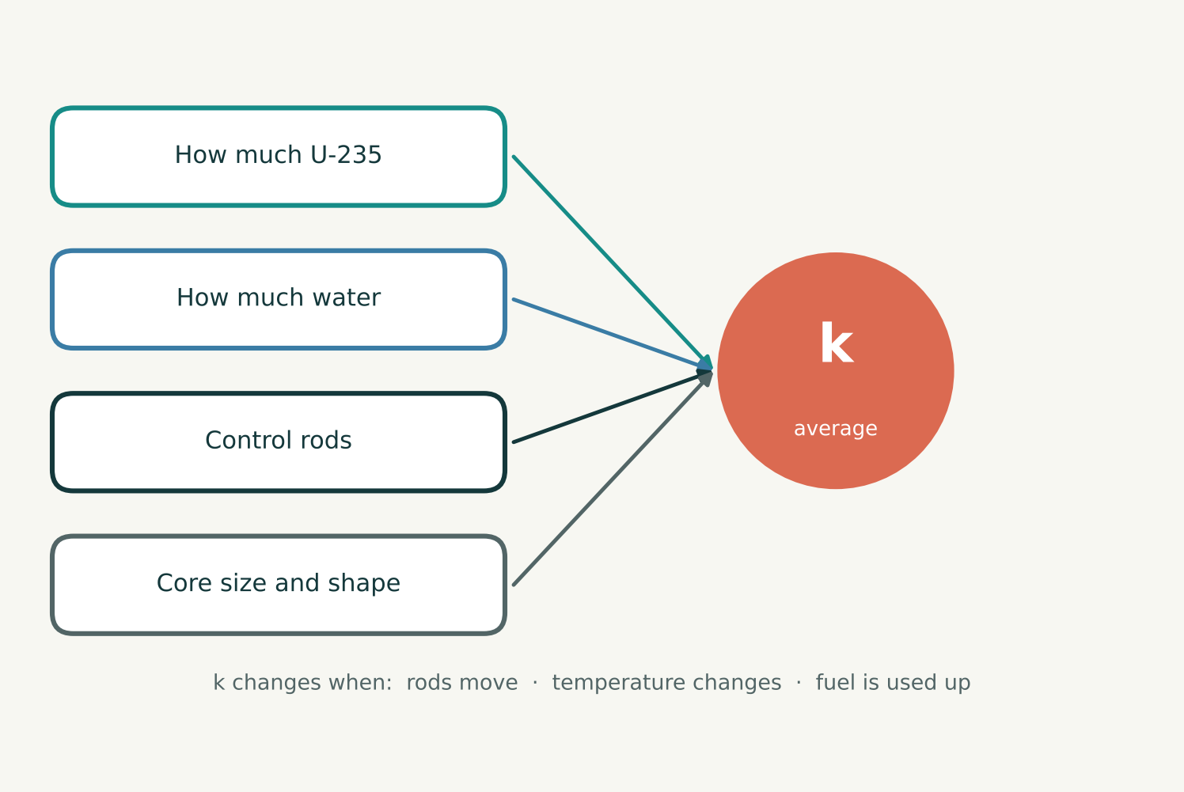
12
What sets k, and when it changes
The share of neutrons that cause fission is set by the reactor: U-235, water, control rods, and the core’s size and shape.
k changes when the reactor changes
Rods in → k down. Fuel used up → k down. Temperature changes k too.
What sets k
NEUTRON MULTIPLICATION
12 / 17
Notes:
The share of neutrons that cause fission is set by the reactor itself: how much U-235 there is, how much water, where the control rods are, and the size and shape of the core. k stays fixed only while the reactor stays the same. If the reactor changes, the share changes, and so does k. Control rods pushed in absorb more neutrons, so k goes down; pulled out, k goes up. When the temperature changes, the materials behave differently, which changes k. As fuel is used up there is less U-235 and more fission products absorbing neutrons, so k goes down. This is why the book treats k as constant only over a short time, when nothing changes. These changes are covered in later chapters.

Slide 13
13
Three possible outcomes
k > 1 supercritical: grows
k = 1 critical: steady
k < 1 subcritical: dies out
Reactors normally run at k = 1
Neutron population, fission rate and heat all follow the same curve.
Neutron population vs. time
NEUTRON MULTIPLICATION
13 / 17
Notes:
If k is greater than 1, the reactor is supercritical: each generation is bigger, so the neutron population, and with it the fission rate and the heat, grows exponentially. If k equals 1, it is critical: each generation exactly replaces the previous one, giving a steady population and steady power. This is how a reactor normally operates. If k is less than 1, it is subcritical: each generation is smaller, and the chain reaction dies out. Compare Figure 1.3 in Lewis.

Slide 14
14
When do we want each k?
Power is set by how many neutrons there are. k only says whether that number is rising, steady or falling.
Case | We want it… | We avoid it…
k = 1 critical | for normal operation: steady heat, steady electricity | —
k > 1 supercritical | briefly and slightly, to raise power (start-up, more demand) | if large or long: power runs away, fuel can overheat and melt
k < 1 subcritical | to lower power, shut down, refuel or for maintenance | when we need power: the chain reaction dies out
k = 1 holds power, k > 1 raises it, k < 1 lowers it
Keep k − 1 tiny (well under 0.0065), so any change is slow enough to control.
NEUTRON MULTIPLICATION
14 / 17
Notes:
k equal to 1 is normal operation. A power plant needs steady heat to make steady electricity, so it runs at k equal to 1 almost all the time. k slightly above 1 is wanted only briefly, to raise power: at start-up or when more power is needed. Operators pull the rods out a little, power rises, and then they bring k back to 1 at the new level. A large or long-lasting k above 1 is dangerous: power keeps rising exponentially, the fuel overheats and can melt. The 1986 Chernobyl accident was such a power excursion. That is why k minus 1 is kept tiny, well below about 0.0065, the delayed-neutron fraction of U-235, so the rise is slow enough for operators and control systems to follow. k below 1 is wanted to lower power or shut down: inserting rods, an emergency scram that drops all rods at once, refueling and maintenance. A shut-down reactor is kept well below 1, which is called the shutdown margin. k below 1 is not wanted while the plant is trying to produce power, because the chain reaction dies out.

Slide 15
15
Reactor vs. atomic bomb
Both use a chain reaction, but they are built to behave in completely different ways.
 | Reactor | Bomb
Goal | steady heat for years | all energy in an instant
k | kept at 1 | about 2
Fuel | 3–5% U-235, rest U-238 | over 90% U-235, or Pu
Neutrons | slowed down by water | fast, nothing slows them
Time per generation | ~10⁻⁴ s, plus delayed neutrons | ~10⁻⁸ s
Reactor fuel cannot explode like a bomb
Too high a k overheats the fuel: it can melt or cause a steam explosion (Chernobyl, 1986), not a nuclear explosion.
NEUTRON MULTIPLICATION
15 / 17
Notes:
Both a reactor and a bomb use a chain reaction, so it is natural to ask: if k rises above 1 in a reactor, does it become a bomb? No. A reactor is built for steady heat for years; it keeps k at 1, at most slightly above. Its fuel is 3 to 5 percent U-235, the rest U-238; its neutrons are slowed down by water; each generation takes about 10 to the minus 4 seconds, plus delayed neutrons; and it has control rods and operators. A bomb releases all its energy in an instant, with k about 2, fuel over 90 percent U-235 or plutonium, fast neutrons, about 10 to the minus 8 seconds per generation, and no control. Reactor fuel cannot explode like a bomb: most of it is U-238, which captures many neutrons instead of fissioning, keeping k low; the chain reaction relies on slow neutrons, and slowing down takes time; and delayed neutrons make any rise in power slow enough to control. If k rises too much in a reactor, the power climbs until the fuel overheats. This can melt the fuel or cause a steam explosion, as at Chernobyl in 1986. It is serious, but it is not a nuclear explosion. In short: a reactor is a slow, controlled chain reaction with k about 1; a bomb is a fast, uncontrolled one with k about 2.

Slide 16
16
Why k ≈ 1 matters so much
ℓ is well under a millisecond, so there are thousands of generations every second. Near k = 1, ln k ≈ k − 1:
n(t) ≈ n₀ e^{(k−1)t/ℓ}
Even a tiny difference from 1 makes the population change quickly. That is why operators control k so carefully.
Prompt neutrons only (no delayed neutrons)
NEUTRON MULTIPLICATION
16 / 17
Notes:
Even a tiny difference from 1 matters. Because ell is very short, well under a millisecond, there are thousands of generations every second. Using x equals exp of ln x, the population is n0 times exp of t over ell times ln k. When k is close to 1, ln k is approximately k minus 1, so n of t is approximately n0 times exp of (k minus 1) t over ell, and the population changes quickly. The chart compares k slightly above 1 with k equal to 1. That is why operators control k so carefully.

Slide 17
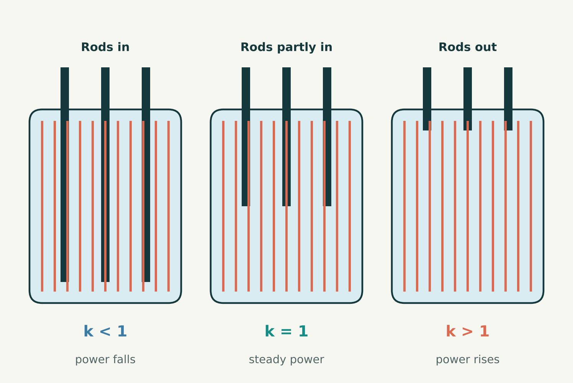
17
Keeping k at exactly 1
Operators control k with control rods, which absorb neutrons, and with the fuel design.
Rods in → k down; rods out → k up
The rest of the book is about how to calculate k and how to keep it at exactly 1.
Conceptual illustration • not to scale
NEUTRON MULTIPLICATION
17 / 17
Notes:
Because the population changes so quickly away from k equal to 1, operators control k carefully. Control rods absorb neutrons: pushing them in wastes more neutrons and lowers k; pulling them out raises k. The fuel design, how much U-235 and how it is arranged with the water, sets the starting point. The rest of the book is about how to calculate k and how to keep it at exactly 1.

