Slide 1
Supporting Wilbur Wright College Students in STEM through Argonne National Laboratory
Fatma Aslan
May 8, 2026

Slide 2
Student Profile: Wilbur Wright College
Wilbur Wright College, part of the City Colleges of Chicago (CCC) system, serves a student body that is approximately 62.9% Hispanic or Latino.
This demographic reality is coupled with significant economic challenges; approximately 50% of the student population reports a household income of less than $30,000 annually.
Indicator | Statistic
Hispanic/Latinx Majority https://content.ccc.edu/wrighthsi/ | 63%
Low-Income Student Population https://carnegieclassifications.acenet.edu/institution/city-colleges-of-chicago-wilbur-wright-college/ | 47%
Structural barriers and economic challenges have historically impeded access to STEM careers.

Slide 3
Student Outcomes
Normal associate degree time = 2 years
150% time = 3 years
Status at 150% Time | Percentage
Associate Degree | 31
Transfer Out | 15
Dropped Out | 40.42
Still Enrolled | 13.52
The largest group of students, over 40%, leave without completing.
What affects students’ ability to persist ?
Academic challenges (such as limited preparation for college-level coursework)
OR
External constraints (such as work, financial pressure, and family obligations)?

Slide 4

Retention Rates by Enrollment Status
Retention Rate: The percentage of first-time students who return to the same institution in the next academic term or year.
Enrollment Status | Retention Rate
Full time | 72%
Part time | 51%
Part-time students are at significantly higher risk of leaving.
This pattern points to structural constraints rather than differences in ability.
The retention gap shows that part-time students are significantly less likely to persist compared to full-time students. This suggests that the main challenge is not academic ability, but the structural constraints many students face while balancing work, family, and education.
How big is this problem?

Slide 5
Student Challenges and Potential Supports
Challenge: Students face significant financial and family responsibilities, requiring them to work while attending school, which limits the time and energy they can devote to their studies.
Support: Providing access to internships and paid opportunities can help align their financial needs with their academic and career development.
Challenge: Students often experience disengagement and a lack of motivation, rooted in a limited scientific identity.
Support: Meaningful exposure to scientists, engineers, and real-world applications can help strengthen connection and interest.

Slide 6
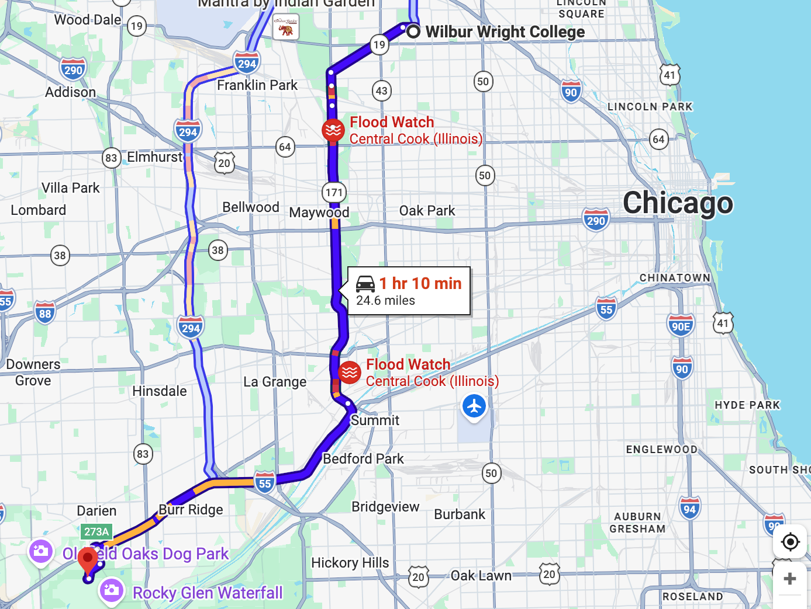
ARGONNE NATIONAL LAB CAN HELP!
Argonne is a DOE multidisciplinary science and engineering research center that solves grand challenges in energy, the environment, and national security.
Less than 25 miles away from Wilbur Wright College
Total budget for Fiscal Year 2024: $1.2 billion.
Argonne fulfills its mission through five primary areas of impact
Scientific Discoveries
Energy and Climate Solutions
Global Security
Research Facilities
STEM Workforce Development
Undergraduate education is a core mission component
(DOE 2024 budget: $46.1 million)

Slide 7
Argonne Opportunities Available to Wilbur Wright College Students
Science Undergraduate Laboratory Internship (SULI) – $16 million budget in 2024.
10‑ to 16‑week paid internships at Argonne for undergraduate students. $650/week stipend+ Travel & housing support. Part-time students are eligible. https://science.osti.gov/wdts/suli
Community College Internship Program (CCI) – $2.3 million budget in 2024.
10‑week summer internships at Argonne designed specifically for community‑college students. $650/week stipend+ Travel & housing support. Part-time students are eligible. https://science.osti.gov/wdts/cci
Visiting Faculty Program (VFP) – $2.1 million budget in 2024.
10‑week summer appointment for faculty from colleges that emphasize teaching with at least two undergraduate students. $650/week stipend+ Travel & housing support. Only for full-time students.https://science.osti.gov/wdts/vfp
Reference: DOE Office of Science, "FY 2025 Congressional Budget Justification: Workforce Development for Teachers and Scientists. https://science.osti.gov/-/media/budget/pdf/sc-budget-request-to-congress/2025/Workforce-Development-for-Teachers-and-Scientists-3_15_24---Final.pdf

Slide 8
Beyond these programs, the real opportunity is…

Slide 9
Building a long-term institutional partnership between
Argonne National Laboratory and Wilbur Wright College
A partnership between a community college and a national laboratory is not only possible but already supported through established agreements and programs.
Some examples of official DOE lab community-college agreements
Argonne National Laboratory & City Colleges of Chicago – Partners in the Community Research on Climate and Urban Science (CROCUS) project. Funded by the DOE’s Office of Science, this Urban Integrated Field Laboratory brings together Argonne, City Colleges of Chicago and other universities to study urban climate impacts. It engages students from community colleges and minority‑serving institutions in field data collection and model development, offering hands‑on research experiences and workforce‑relevant training\
https://colleges.ccc.edu/2022/09/06/city-colleges-of-chicago-partners-with-argonne-in-research-and-education/
Oak Ridge National Laboratory (ORNL) and Pellissippi State Community College signed a Memorandum of Understanding ORNL scientists taught two of the new classes, students visited the lab, and the path was designed to lead to internships and jobs.
https://www.ornl.gov/news/partnership-offers-direct-career-path-pellissippi-state-ornl
Savannah River National Laboratory and Augusta Technical College signed an MOU for workforce development, practical learning opportunities, career pathways, and apprenticeship/internship programs.
https://www.srnl.gov/news-releases/srnl-augusta-tech/
Sandia National Laboratories and Mesalands Community College signed an MOU to enhance technician training and jointly research wind-energy technologies.
https://newsreleases.sandia.gov/sandia-mesalands-community-college-sign-agreement-to-jointly-research-new-wind-energy-technologies/
.
.
.
As a Hispanic-Serving Institution, Wilbur Wright College is a primary candidate for such programs.

Slide 10
Roadmap to Building a Sustainable Partnership between
Wilbur Wright College and Argonne National Lab.
1. Exposure and Engagement
2. Preparation and Support
3. Bringing Student Challenges to Argonne’s Attention
4. Establishing Institutional Partnerships

Slide 11
Exposure and Engagement
Goal: Help students see themselves in STEM careers (build scientific identity)—showing students what careers exist, how their classroom learning is used in real research, and what a future in science actually looks like.
Steps:
Organize field trips to Argonne National Laboratory
Invite Argonne scientists for guest lectures and career talks
Create student–scientist interaction through lab visits
2. Preparation and Support
Goal: Build a pipeline—helping students apply for and succeed in internships and other paid opportunities at Argonne
Steps:
Guide students through CCI / SULI / VFP application process
Offer workshops on resumes, statements, and interviews
Mentor students in basic skills for possible projects

Slide 12
3. Bringing Student Challenges to Argonne’s Attention
Goal: Raising awareness at Argonne National Lab. about the real challenges students face, including financial pressure and unequal access to opportunities.
Steps:
Bring Argonne into the classroom- Invite Argonne scientists and leaders for conversations where they hear directly from our students about their challenges and goals.
Integrate Student Realities into Scientific Talks- I will use research talks at Argonne to briefly present student data and highlight the challenges they face.
4. Establishing Institutional Partnerships
Goal: Moving from individual opportunities to a stable system that continuously supports Wilbur Wright students.
Step:
Work toward formal agreements that support long-term collaboration and student access
The goal is reducing the dropout rates and empowering them to become scientists, engineers, role models, and contributors to their communities.

Slide 14
Science Undergraduate Laboratory Internships (SULI) https://science.osti.gov/wdts/suli
Paid 10‑week summer or semester internships at Argonne for undergraduates. Participants engage in research, attend seminars and present their work. Applicants must be undergraduate students from two‑year or four‑year institutions, must be U.S. citizens or permanent residents at least 18 years old.
How WWC students qualify: WWC students majoring in STEM fields can apply if they are U.S. citizens/permanent residents, at least 18 years old, enrolled at least half‑time. Applications open three times per year; strong letters of recommendation and a personal statement are essential.
Stipend: $650/week for the 10‑week appointment.
Travel & housing support: One round‑trip domestic travel reimbursement for participants living >50 miles from the lab; private auto travel reimbursed at the federal rate up to $500 or cost of lowest airfare; air travel reimbursed at the cost of the lowest commercial airfare. Housing support is provided—either onsite/near‑site housing or a housing allowance when the lab cannot provide housing

Slide 15
Community College Internships (CCI) https://science.osti.gov/wdts/cci
10‑week summer internships at Argonne designed specifically for community‑college students. CCI is part of DOE’s workforce‑development suite and mirrors SULI’s structure; participants conduct research or technical projects under a lab mentor. CCI applicants must be U.S. citizens or permanent residents, at least 18 years old and currently enrolled at a community college.
How WWC students qualify: WWC students qualify because WWC is a community college. CCI can serve as a bridge to a four‑year degree transfer. Students must be enrolled full‑time or part‑time at a community college
Stipend: $650/week for the 10‑week appointment.
Travel & housing support: Same travel policy as SULI: one round‑trip domestic travel reimbursement; private automobile reimbursement up to $500 or lowest airfare; air travel reimbursed at cost of lowest commercial airfare. Housing support or an allowance is provided when the host laboratory cannot supply housing.

Slide 16
Visiting Faculty Program(VFP)
https://science.osti.gov/wdts/vfp
Provides full‑time faculty from colleges and universities that serve under‑represented students with a 10‑week summer research appointment at the laboratory. Faculty invites up to two students to work with them. Eligibility requires U.S. citizenship or permanent residency, full‑time employment at an accredited U.S. degree‑granting institution, and a research proposal that aligns with a host lab’s mission.
How WWC students & faculty qualify: Tenure‑track or full‑time WWC faculty can apply. Because WWC is a Hispanic‑serving community college, its faculty are considered a target audience for VFP. Faculty must contact an Argonne (or other DOE lab) mentor, co‑develop a research proposal, secure institutional approval and submit an application by the VFP deadline.
Student stipend: $650/week for the 10‑week appointment.
Faculty stipend: Equals 1/9 of their academic‑year salary, capped at $1 600 per week during the 10‑week
VFP appointment.
Travel & housing support: Students are reimbursed for one round‑trip domestic travel (same reimbursement rules as SULI/CCI) and are offered onsite housing or a housing allowance if housing is not provided. Faculty receive the same travel reimbursement and housing support as students.

