Slide 1
CROSS PLATFORM
MOBILE APP DEVELOPMENT
WITH PHONEGAP BUILD
AND GITHUB

Slide 2
WORKING ENVIRONMENT
DREAMWEAVER IDE
FIND THE DEVELOPMENT ENVIRONMENT THAT SUITS YOU! :
ADOBE BRACKETS.IO (FREE/OPENSOURCE)
TEXTWRANGLER (FREEWARE)
SUBLIMETEXT – GOOD BUT COSTS
EMACS, VIM (FREE/OPENSOURCE)
POWERFULL BUT COMPLEX

Slide 3
WORKFLOW
LOCAL CODE
GITHUB
PHONEGAP BUILD
DEPLOY TO DEVICE

Slide 4
What is GIT?
VERSION CONTROL
COLABORATIVE TOOL
ONLINE CODE REPOSITORY
HTTP://GITHUB.COM
PHONEGAP PLUGIN
GIT = WIDESPREAD IN INDUSTRY
OPENSOURCE / CROSSPLATFORM

Slide 5
PHONEGAP
Adobe PhoneGap is a standards-based, open-source development framework for building cross-platform mobile apps with HTML, CSS and JavaScript for iOS, Android™, Windows® Phone, webOS, BlackBerry® and more.
OPENSOURCE DISTRIBUTION OF CORDOVA
JAVASCRIPT LIBRARY PROVIDING LINK BETWEEN HTML5 CSS JAVASCRIPT AND THE NATIVE DEVICE APIS
EVERYTHING NEEDED TO CREATE AN APP WITH ACCESS TO EVENTS AND SENSORS OF THE DEVICE
EACH PLATFORM HAS DIFFERENT .JS

Slide 6
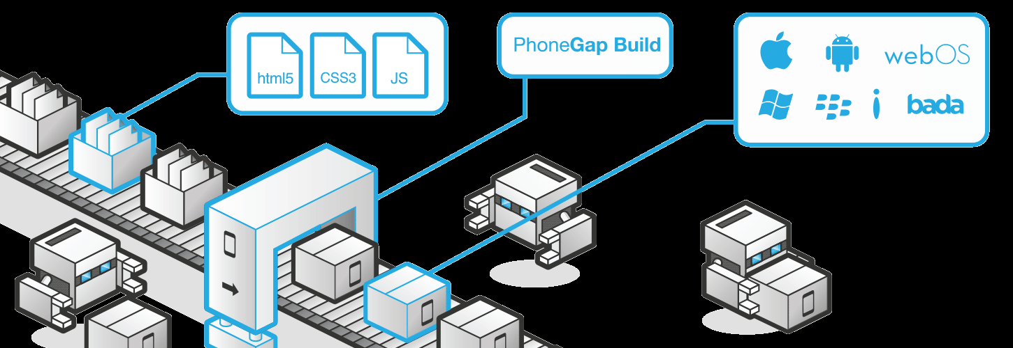
PHONEGAP BUILD
  HTTP://BUILD.PHONEGAP.COM

Slide 7
WHAT IS PHONEGAP BUILD?
  HTTP://BUILD.PHONEGAP.COM
ONLINE BUILD ENVIRONMENT
  (CLOUD SERVICE)
MULTI PLATFORM BUILDS
  injects appropriate phonegap.js serverside
ONLINE DEVICE SIMULATION
GITHUB INTEGRATION

Slide 8
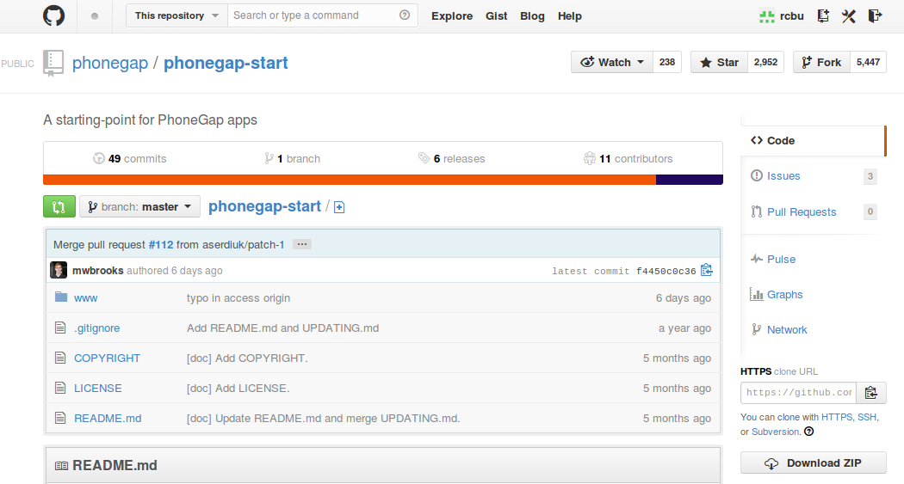
Make a GitHub Account
Login and “Fork” this project template:
http://github.com/phonegap/phonegap-start.git

Slide 10
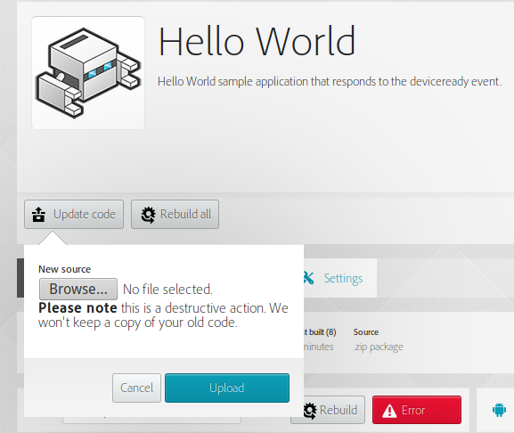
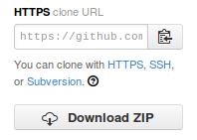
“Clone” a copy to your computer
In a terminal: git clone https://github.com/rcbu/phonegap-start.git
OR if git is not yet installed download the .zip:
UNZIP AND MAKE MODIFICATIONS TO LOCAL COPY
ZIP DIRECTORY AND REUPLOAD TO PHONEGAP

Slide 11
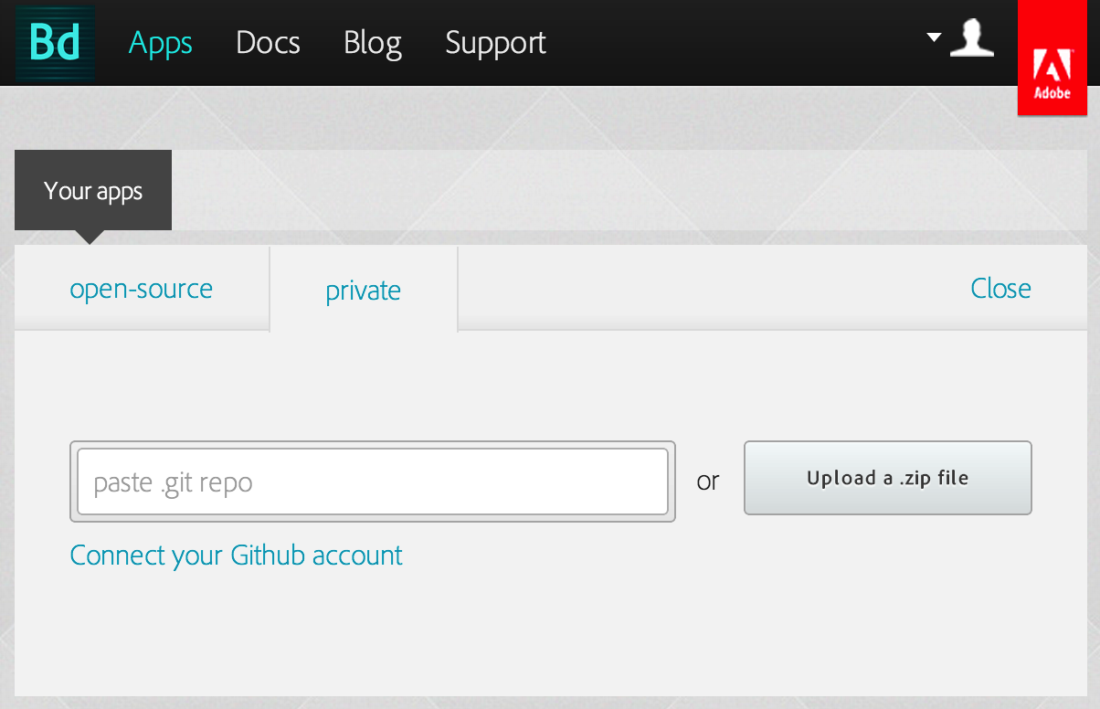
build.phonegap.com
Login to build.phonegap.com with git account
“Create new app” (Private)
Upload Zip File

Slide 12
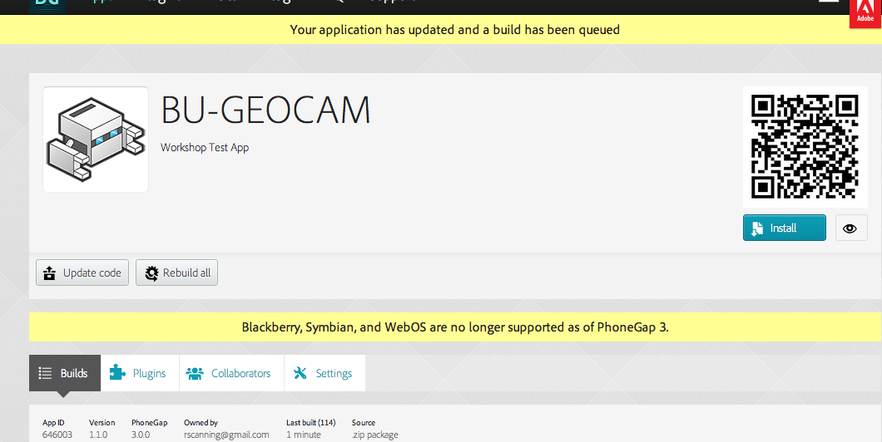
BUILDS – PLUGINS - QRCODE

Slide 13
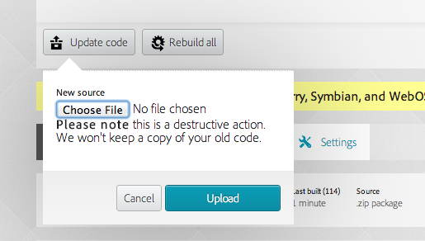
Upload Modifications

Slide 14
Config.xml
Examine the config.xml file from
  https://github.com/phonegap/phonegap-start
  This where we define permissions and plugins
  As well as app name, author details, icons, splash etc.

Slide 15
Injected phonegap.js
We dont need to include specific plugin and cordova references
phonegap does all this work from a generalised config.xml
We do need to reference this phonegap.js
in our <head></head>
<script type="text/javascript"src="phonegap.js"></script>

Slide 16
Plugins
Plugins also need to be referenced in the <head>
As well as in the config.xml plugin .js files need to be linked in the .html
<script type="text/javascript" src="phonegap.js"></script>
<script type="text/javascript" src="geolocation.js"></script>
<script type="text/javascript" src="camera.js"></script>

Slide 17
EMULATION
Ripple Extension for Chrome
Allows in browser emulation of multiple devices
  http://emulate.phonegap.com
Install from the Chrome Web Store

Slide 18
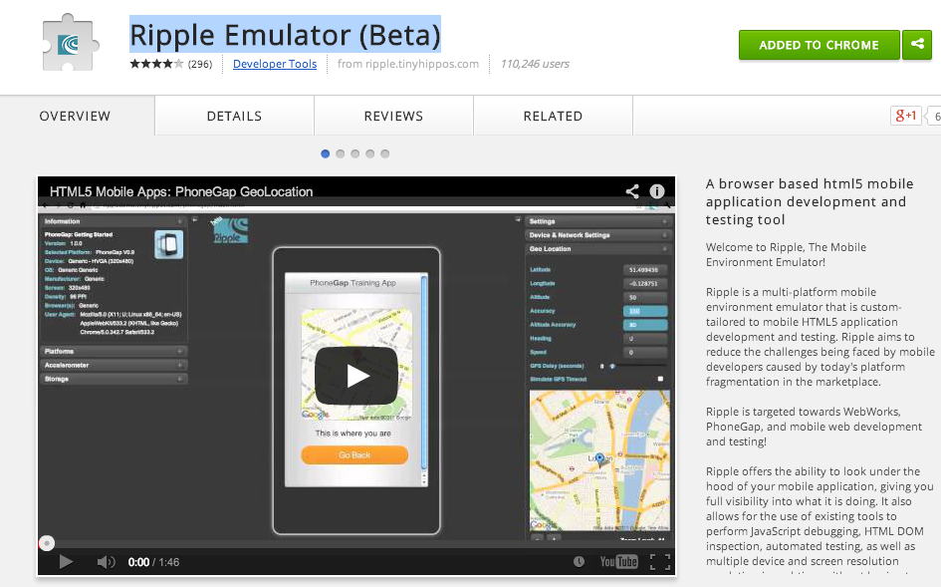
Ripple Emulator (Beta)

Slide 19

Ripple Emulator (Beta)
Enable extension in Chrome
Multiple device/platform emulation
Can emulate Accelerometer and GeoData
Cordova-2.0.0.js must be present
Can't emulate from file system
  Must be from a http://localhost or external site.

Slide 20
ALREADY COVERED
HTML5, CSS3, JAVASCRIPT, JQUERY
JQUERY MOBILE / UI
PHONEGAP (LOCAL BUILD for iOS)
GEOLOCATION API
navigator.geolocation.watchPosition(); etc.
GOOGLE MAPS API
http://maps.googleapis.com

Slide 21
NEXT...
PHONEGAP BUILD + GITHUB
ACCELEROMETER (DEVICE-MOTION)
GEODATA (GEOLOCATION)
MEDIA CAPTURE (AUDIO)
LOCAL STORAGE

Slide 22
NONHEGEMONIC MEDIA CHANNELS?
THERE IS LIFE BEYOND GOOGLE!
OPENSTREET MAPS API
  COMMUNITY DRIVEN / DISTRIBUTED
GOOGLE GETS JOB DONE BUT:
SOCIO/TECHNO/POLITICAL
WORTHY OF CONSIDERATION

Slide 23
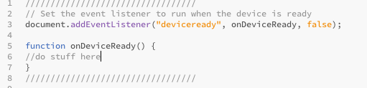
Usual PhoneGap Setup

Slide 24
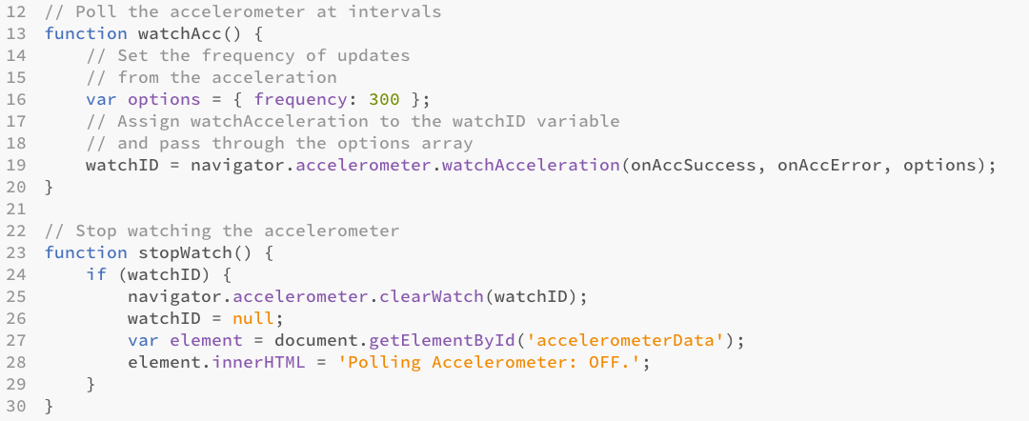
ACCELEROMETER
Start and Stop Functions:

Slide 25
ACCELEROMETER

Slide 26
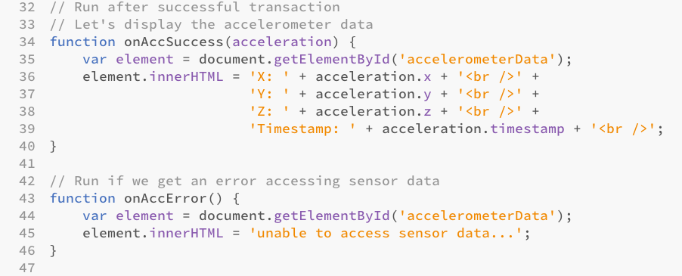
Success / Error Functions

Slide 27
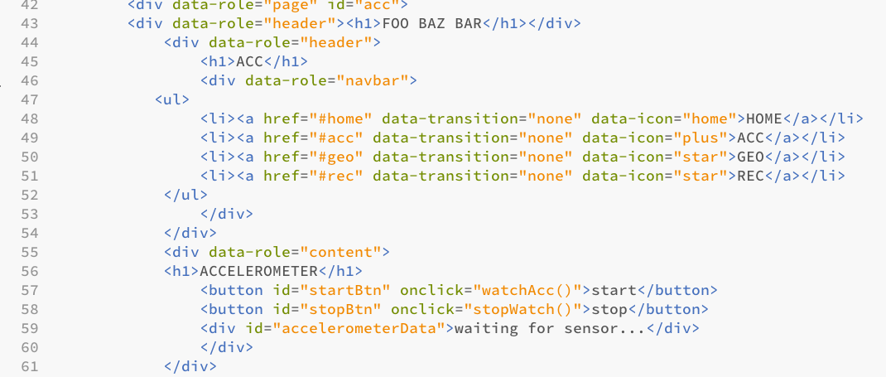
Accelerometer HTML section

Slide 28
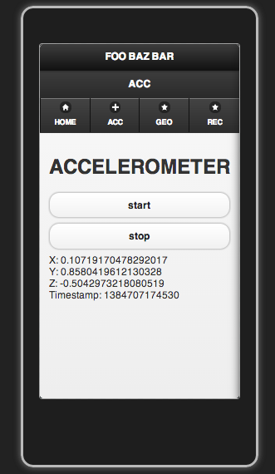
Get it working!
Put accelerometer functions into a .js file
In your index.html reference the .js file in the <head>
In index.html create start and stop buttons and the accelerometerData <div>
Code snippets are in code.txt

Slide 29
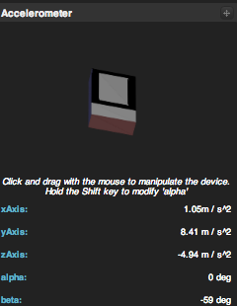
EMULATE
Point the Chrome Browser to your index.html
  (must be in a localhost server address)
  Enable Ripple
  Experiment with device orientation

Slide 30
BUILD IT!
Compress the www directory to a .zip
Upload to phonegap via web interface

Slide 31
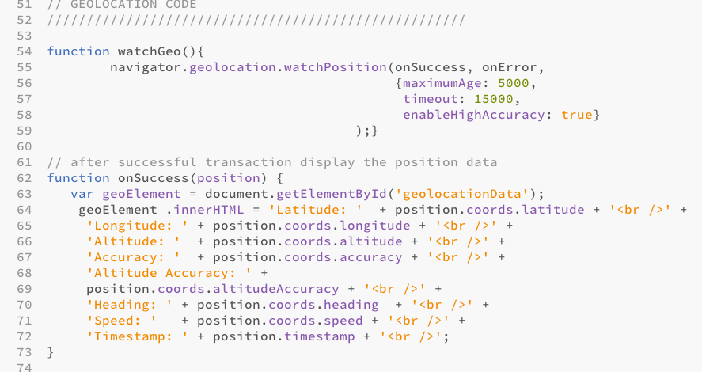
GeoLocation

Slide 32
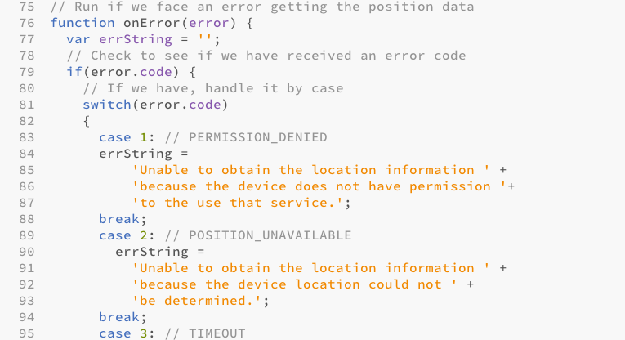
GEO – ERROR HANDLING

Slide 33
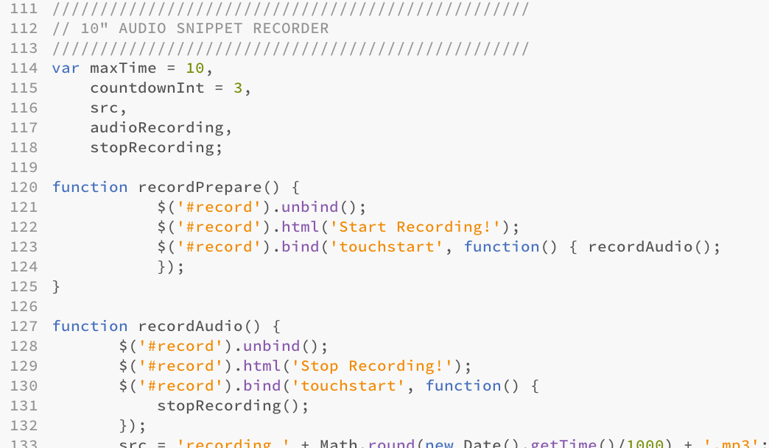
AUDIO CAPTURE
Setup initial variables and bind record button to function

Slide 34
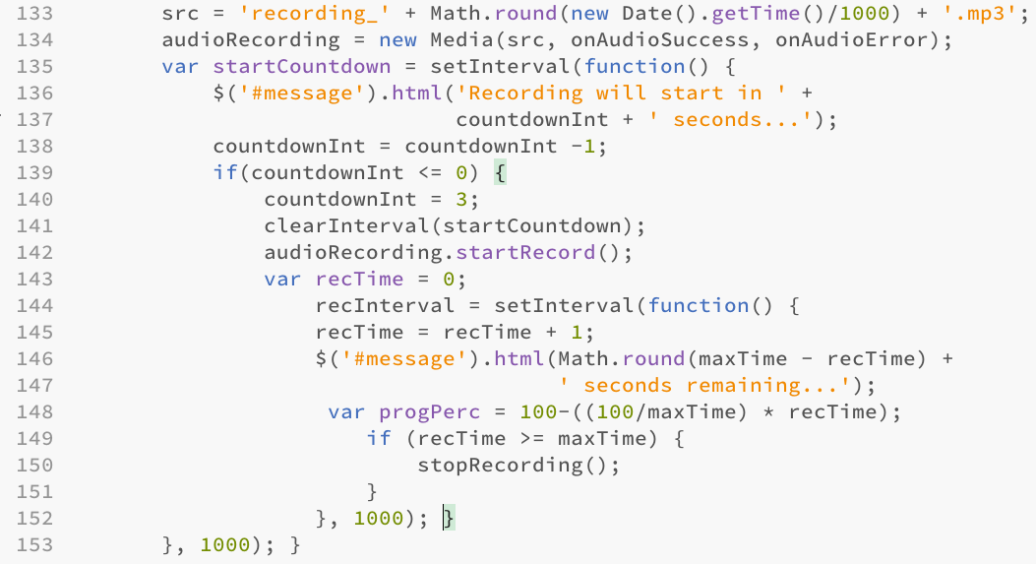
Recording and Countdown timer
RecordAudio() function continued:

Slide 35
AUGMENT MAP WITH MEDIA
NEED GOOGLE ACCOUNT
MY MAPS: CREATE NEW MAP
PLACE MARKERS / ROUTES / TEXT
LINK TO URL SO <AUDIO/><VIDEO/><IMG/>
MANUAL PROCESS BUT USEFUL IF YOU HAVE MEDIA YOU NEED TO GEOTAG
JURASIC COAST BRIEF?

