Slide 1
STANDARD OPERATING PROCEDURE
Progressive Belt Sanding: Part 690
Document No.
QWI 422.142
Revision
A
Effective Date
09/01/2026
Process Owner
Ali Mohamadi
Approved By
Ray Kolocek, Joseph Bolden
Department
Engineering

Slide 2
Purpose and Scope
Purpose
Define the process steps, quality checkpoints, and acceptance/rejection criteria for manual progressive belt sanding (80/120/180 grit) of part 690 prior to electropolish at the Kiel ED-Vac station.
Scope
Applies to part number 690 only. Part 242 is covered by a separate SOP.
Covers manual progressive belt sanding from 80 through 180 grit, ending at hand-off to wash prior to electropolish.
Roles and Responsibilities
Trained Operator: Performs all sanding passes, tests Ra after each grit stage to monitor belt health, and delivers finished parts to wash.
Quality Personnel: Checks a sample of parts every 100 pieces to verify parts are made correctly, and takes a sample Ra reading from a random part.

Slide 3
Safety Requirements
Proper PPE required for handling rotating parts and sharp metal edges.
Hearing protection required. Operation exceeds 70 dBA.
Operator must be trained on lockout/tagout (LOTO) for this machine.

Slide 4
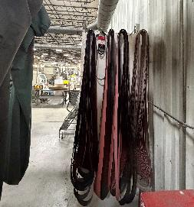
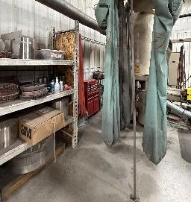
Equipment and Process Parameters
Equipment and Consumables
Item | Spec / Note
Manual belt sanding machine | Dedicated station for progressive 80/120/180 grit sanding
80 grit belt | 2" Cubitron preferred; 1" standard belt acceptable if 2" unavailable
120 grit belt/wheel | 2" only. No substitution
180 grit belt/wheel | 2" only. No substitution
Profilometer | For Ra spot-checks by operator and quality
Process Parameters
Parameter | Target
Belt life | Maximum 20 parts per belt, then replace
Passes per grit stage | 2 passes on the side and 2 passes on the dome, at every grit stage
80 grit dome center | Intentionally skipped. Do not sand; polished over during 120/180 grit stages
Ra spec (finished part) | <= 70 Ra

Slide 5
Process Steps (1 of 2)
Stage part at the manual belt sanding (MBS) station.
Sand at 80 grit: 2 passes on the side, 2 passes on the dome. Intentionally skip the very center of the dome. Do not sand this area at 80 grit.
Operator tests Ra once every 20 parts (at belt change) after the 80 grit stage to monitor belt health.
Sand at 120 grit (2" belt/wheel only): 2 passes on the side, 2 passes on the dome, including the center of the dome that was skipped at 80 grit.
Operator tests Ra once every 20 parts (at belt change) after the 120 grit stage to monitor belt health.
Sand at 180 grit (2" belt/wheel only): 2 passes on the side, 2 passes on the dome.

Slide 6
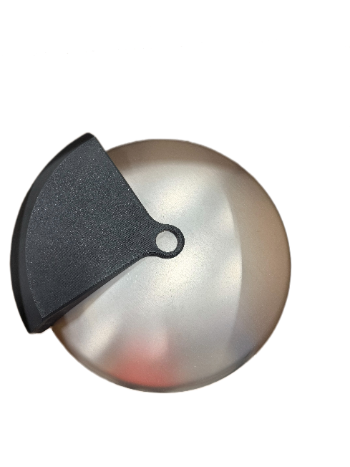
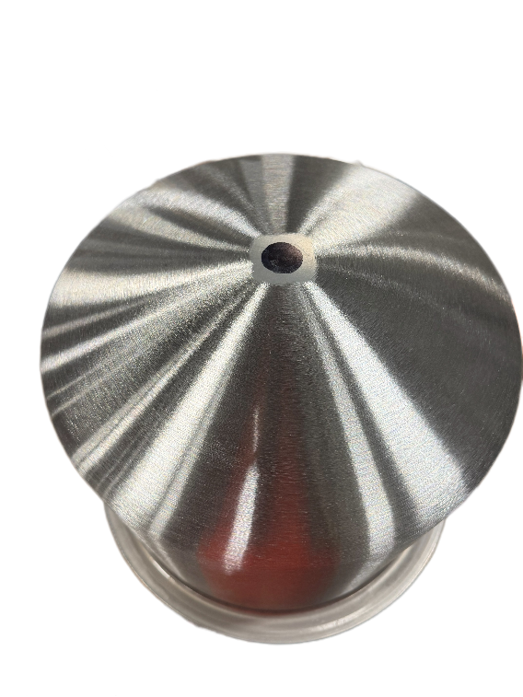
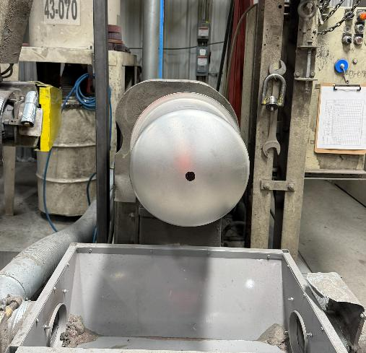
The center of the dome should be skipped and appear as raw metal after the 80 grit belt sanding
Place the center locator and mark the center
Center mark should appear as a 1 inch diameter dot on the raw part and should be skipped by 80 grit belt

Slide 7
Process Steps (2 of 2)
Operator tests Ra once every 20 parts (at belt change) after the 180 grit stage to monitor belt health.
Visually inspect every part after 180 grit: dome must be consistent with no dimples or burn marks and no spiral pattern; sides must show no barber pole effect.
Every 100 parts, Quality Personnel checks a sample of parts to verify they are made correctly.
Quality takes a sample Ra reading from a random part. Must be <= 70 Ra.
Send parts through wash. The person delivering parts to wash is responsible for confirming wash personnel have adjusted machine height so the tops of the domes are NOT struck during washing.
Replace the belt after 20 parts. Do not exceed the belt life limit.

Slide 8
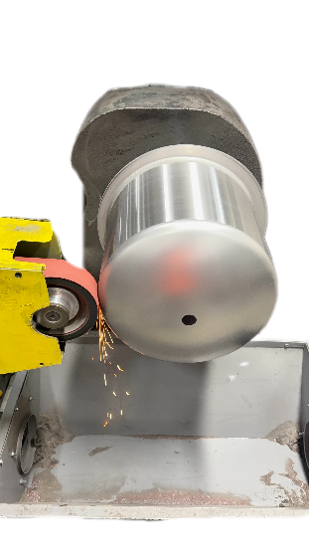
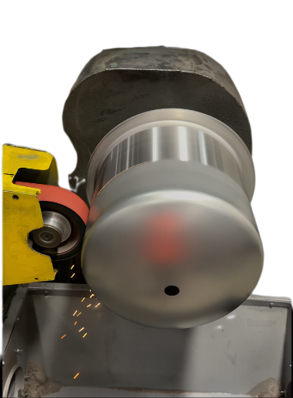
Side Sanding
1. Start at the flange side and sand outward to the edge of the dome, exiting the belt as shown below.
Note: Do this step and Dome Sanding (next slide) back-to-back, then repeat both for 2 total passes.
Flange-side starting pass
Sanding off the dome edge

Slide 9
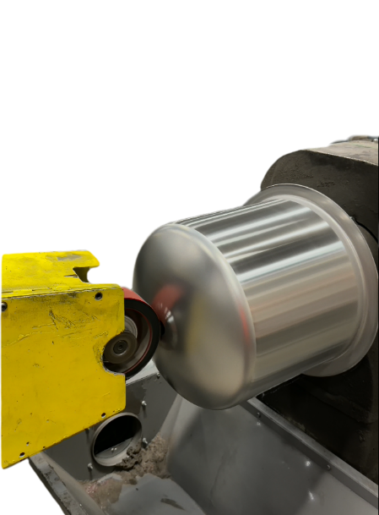
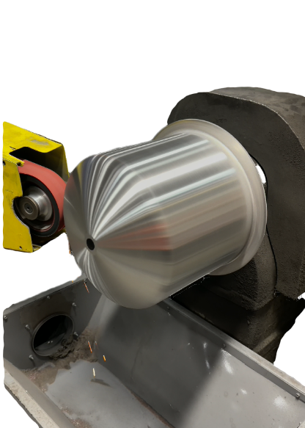
Sanding the dome with 80 grit
Start dome sanding at or passed the center mark
Finish sanding of the dome on the side

Slide 10
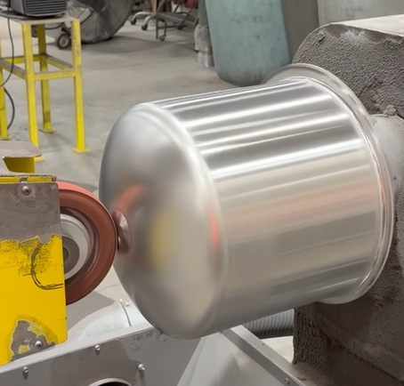
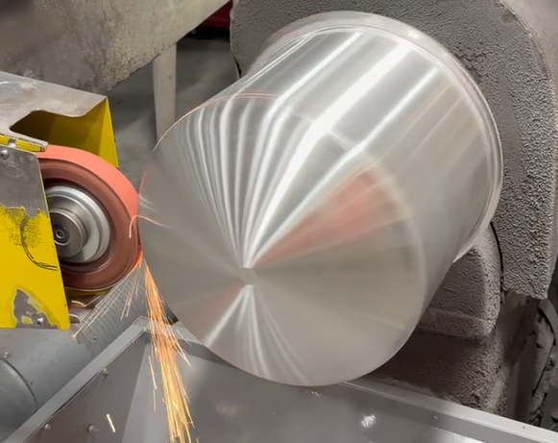
Dome Sanding
2. Move the belt to the center of the dome, then work outward to the edge.
Finish sanding here
Note: Do this step right after Side Sanding, then repeat both steps for 2 total passes.
Belt centered, sanding toward the edge
Reference: finished sanding pattern

Slide 11
Acceptance Criteria: Passing
Characteristic | Pass Criteria | Method
Surface roughness (Ra) | <= 70 Ra | Profilometer. Operator checks after each grit stage; Quality samples after 180 grit
Dome condition | Consistent finish, no dimples, no burn marks, no spiral pattern | Visual
Side condition | No barber pole effect from side sanding | Visual
Belt usage | Belt used for 20 parts or fewer before replacement | Operator tracking

Slide 12
Rejection Criteria: Failing
Defect | Description
Dimple in dome | Localized depression in the dome surface
Burn mark | Discoloration on the part from excess heat during sanding
Spiral pattern on dome | Visible spiral/swirl marks on the dome surface
Barber pole effect (side) | Alternating banding pattern on the side from sanding passes
Ra out of spec | Reading above 70 Ra at final check
Any one of the above defects is sufficient grounds for rejection.

Slide 13
Good Part vs. Bad Part
Accept
Reject
Consistent dome finish. No dimples, burn marks, or spiral pattern
No barber pole effect on the sides
Ra at or below 70 across sample checks
Dimple or burn mark on the dome
Spiral pattern visible on the dome
Barber pole effect on the side
Ra reading above 70
Dent and scratches

Slide 14
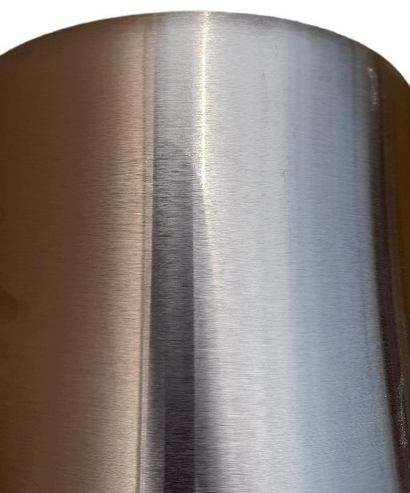
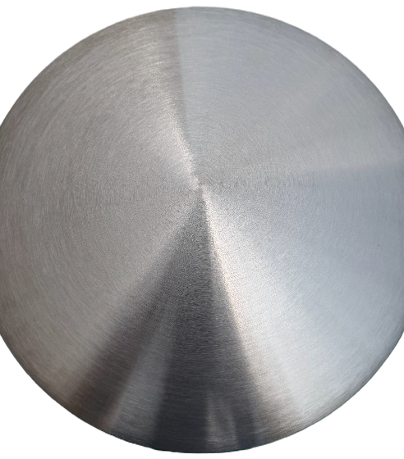
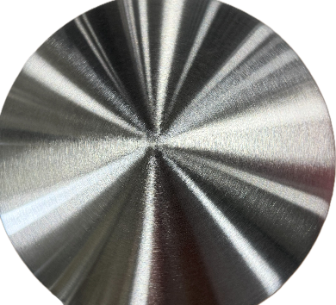
Good Part vs. Bad Part: Reference Photos
Accept
Perfect side polish after 180 grit.
No barber poling.
Perfect polish on the dome: no dimple, no burn mark, no spiral.

Slide 15
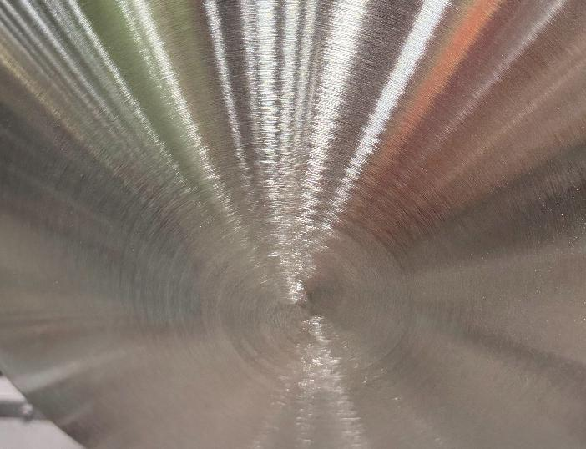
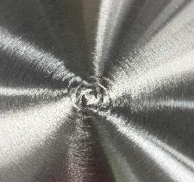
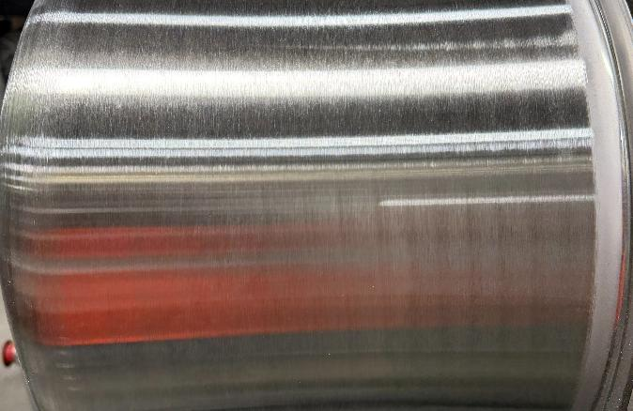
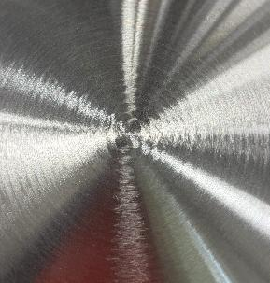
Rejection Examples (1 of 2)
Spiral effect due to a fast belt pass over the dome.
Barber pole effect.

Slide 16
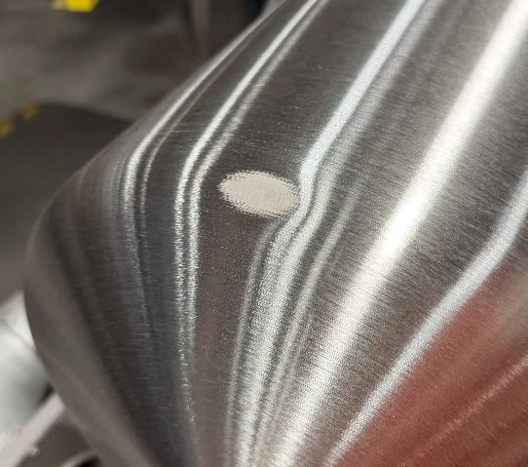
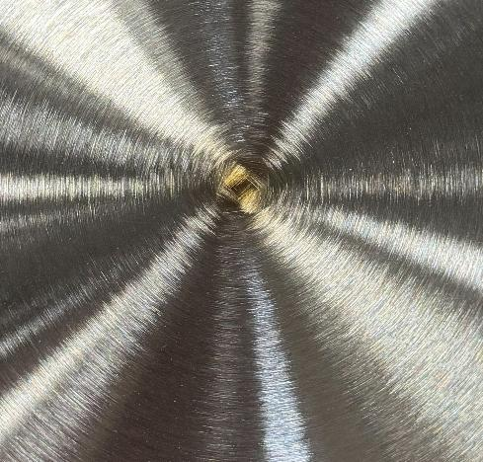
Rejection Examples (2 of 2)
Dent that cannot be removed with an 80 grit pass.
Burn mark after 180 grit sanding due to a slow pass on the dome.

Slide 17
Inspection Method
Visual Inspection
Inspect every part after 180 grit for dome consistency (no dimples, burn marks, or spiral) and side condition (no barber pole effect).
Quality personnel visually check a sample of parts every 100 pieces, and with profilometer.
Measurement
Operator tests Ra once every 20 parts (at belt change) at each grit stage (80/120/180) to monitor belt health.
Quality takes a sample Ra reading from a random part after 180 grit. Must be <= 70 Ra.
Inspection Frequency
Operator: Ra check once every 20 parts (at belt change) at each grit stage. Quality: sample check once every 100 parts.

Slide 18
Revision History and Approval
Rev | Date | Description of Change | Author
A | 7/23/2026 | Initial release | Ali Mohamadi
Approvals
Tool and Product Engineering
Signature / Date
Manufacturing Engineering
Signature / Date

Slide 19
PFMEA Summary: High-Risk Items
Process Step | Failure Mode | Effect | RPN | Key Control
80 Grit | Not enough material removed | Frosting | 224 | Marker check: all marks gone after 80 grit
80 Grit | Missed spots near flange | Frosting | 224 | Visual check sides. Pay attention at edges.
120 Grit | Flat spot/divot on dome apex | Geometry defect | 140 | Dome gage every part at 120 grit
80 Grit | Gouging (too much material removed) | Aesthetic defect | 128 | No dwell, light pressure. Mark first part of batch.
180 Grit | Cross-hatching on apex | Aesthetic/visual defect | 108 | Visual check for cross-hatching after 180 grit

Slide 20
Control Plan: Characteristics and Methods
Characteristic | Control Method | Sampling Plan | Measurement Device
Surface Roughness (Ra) | Measurement | Every 20 parts at each grit; Random after 180 grit | Profilometer
Dome Finish Quality | Visual + Dome Gage | Every part after 180 grit; Dome gage at 120, 180 | Visual + Dome gage
Side Condition | Visual inspection | Every part after 180 grit | Visual inspection
Belt wear | Operator tracking | Every part; Replace after 20 parts | Counter/log
Overall defects | Quality sampling | Every 100 pieces | Visual inspection checklist

Slide 21
Control Plan: Reaction Plan
Issue | Trigger | Reaction | Responsibility
Ra out of spec | Reading > 70 Ra | Stop, inspect belt, measure again. Replace if worn. Re-sand affected parts. | Operator/Quality
Dimples found | Visual or gage check | Stop sanding, review pressure and dwell. Re-gage next part. Rework if necessary. | Operator/Mfg Engineer
Frosting observed | Visual or marker check | Review 80 grit passes. Confirm marker check followed. Rework affected parts. | Operator/Mfg Engineer
Burn marks | Visual inspection | Reduce sanding speed and increase belt travel. Review cooling. Rework parts. | Operator/Mfg Engineer
Barber pole effect | Visual inspection | Confirm machine centering. Adjust sander height if needed every 40 parts. | Production Supervisor
Belt exceeds 20 parts | Operator count | Replace belt immediately. Do not sand further parts on worn belt. | Operator/Supervisor

