Slide 1

자바 웹을 다루는 기술
7장 총정리

Slide 2
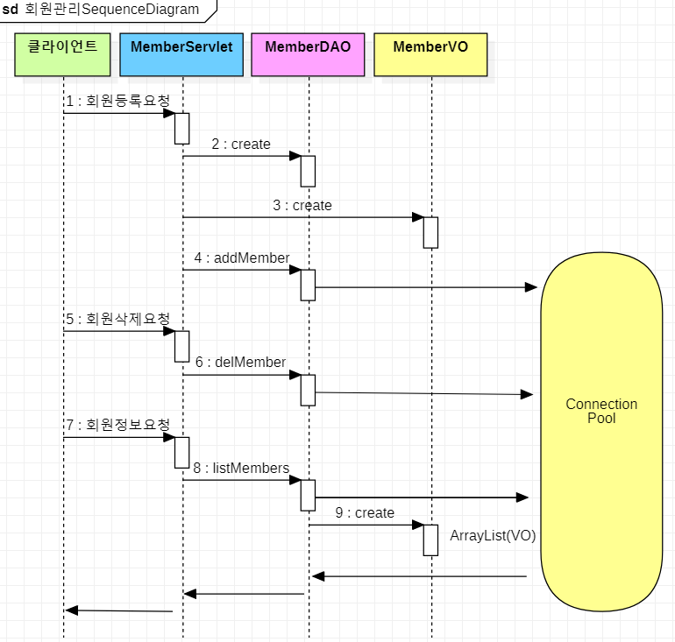
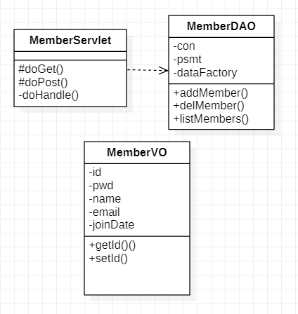
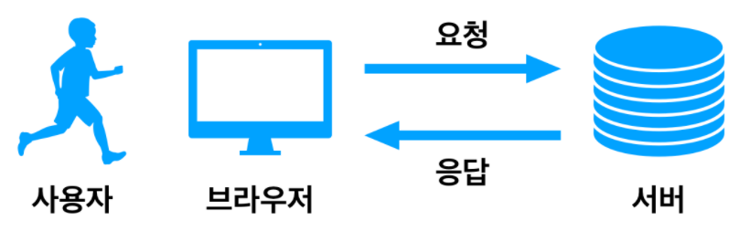
Sequence & Class Diagram

Slide 3
MemberServlet 1/3
package sec02.ex02;
import java.io.IOException;
import java.io.PrintWriter;
import java.sql.Date;
import java.sql.Timestamp;
import java.util.ArrayList;
import java.util.List;
import javax.servlet.ServletException;
import javax.servlet.annotation.WebServlet;
import javax.servlet.http.HttpServlet;
import javax.servlet.http.HttpServletRequest;
import javax.servlet.http.HttpServletResponse;
@WebServlet("/member3")
public class MemberServlet extends HttpServlet {
protected void doGet(HttpServletRequest request, HttpServletResponse response) throws ServletException, IOException {
doHandle(request, response);
}
protected void doPost(HttpServletRequest request, HttpServletResponse response) throws ServletException, IOException {
doHandle(request, response);
}
private void doHandle(HttpServletRequest request,HttpServletResponse response) throws ServletException, IOException {

Slide 4
MemberServlet 2/3
request.setCharacterEncoding("utf-8");
response.setContentType("text/html;charset=utf-8");
MemberDAO dao=new MemberDAO();
PrintWriter out=response.getWriter();
String command=request.getParameter("command");
if(command!= null && command.equals("addMember")){
String _id=request.getParameter("id");
String _pwd=request.getParameter("pwd");
String _name=request.getParameter("name");
String _email=request.getParameter("email");
MemberVO vo=new MemberVO();
vo.setId(_id);
vo.setPwd(_pwd);
vo.setName(_name);
vo.setEmail(_email);
dao.addMember(vo);
}else if(command!= null && command.equals("delMember")) {
String id = request.getParameter("id");
dao.delMember(id);
}
List list=dao.listMembers();
out.print("<html><body>");
out.print("<table border=1><tr align='center' bgcolor='lightgreen'>");
out.print("<td>아이디</td><td>비밀번호</td><td>이름</td><td>이메일</td><td>가입일</td><td >삭제</td></tr>");

Slide 5
MemberServlet 3/3
for (int i=0; i<list.size();i++){
MemberVO memberVO=(MemberVO) list.get(i);
String id=memberVO.getId();
String pwd = memberVO.getPwd();
String name = memberVO.getName();
String email =memberVO.getEmail();
Date joinDate = memberVO.getJoinDate();
out.print("<tr><td>"+id+"</td><td>"
+pwd+"</td><td>"
+name+"</td><td>"
+email+"</td><td>"
+joinDate+"</td><td>"
+"<a href='/pro07/member3?command=delMember&id="+id+"'>삭제 </a></td></tr>");
}
out.print("</table></body></html>");
out.print("<a href='/pro07/memberForm.html'>새 회원 등록하기</a");
}
}

Slide 6
MemberDAO 1/4
package sec02.ex02;
import java.sql.Connection;
import java.sql.Date;
import java.sql.PreparedStatement;
import java.sql.ResultSet;
import java.util.ArrayList;
import java.util.List;
import javax.naming.Context;
import javax.naming.InitialContext;
import javax.sql.DataSource;
public class MemberDAO {
private Connection con;
private PreparedStatement pstmt;
private DataSource dataFactory;
public MemberDAO() {
try {
Context ctx = new InitialContext();
Context envContext = (Context) ctx.lookup("java:/comp/env");
dataFactory = (DataSource) envContext.lookup("jdbc/oracle");
} catch (Exception e) {
e.printStackTrace();
}
}

Slide 7
MemberDAO 2/4
public List<MemberVO> listMembers() {
List<MemberVO> list = new ArrayList<MemberVO>();
try {
con = dataFactory.getConnection();
String query = "select * from t_member ";
System.out.println("prepareStatememt: " + query);
pstmt = con.prepareStatement(query);
ResultSet rs = pstmt.executeQuery();
while (rs.next()) {
String id = rs.getString("id");
String pwd = rs.getString("pwd");
String name = rs.getString("name");
String email = rs.getString("email");
Date joinDate = rs.getDate("joinDate");
MemberVO vo = new MemberVO();
vo.setId(id);
vo.setPwd(pwd);
vo.setName(name);
vo.setEmail(email);
vo.setJoinDate(joinDate);
list.add(vo);
}
rs.close();
pstmt.close();
con.close();
} catch (Exception e) {
e.printStackTrace();
}
return list;
}

Slide 8
MemberDAO 3/4
public void addMember(MemberVO memberVO) {
try {
con = dataFactory.getConnection();
String id = memberVO.getId();
String pwd = memberVO.getPwd();
String name = memberVO.getName();
String email = memberVO.getEmail();
String query = "insert into t_member";
query += " (id,pwd,name,email)";
query += " values(?,?,?,?)";
System.out.println("prepareStatememt: " + query);
pstmt = con.prepareStatement(query);
pstmt.setString(1, id);
pstmt.setString(2, pwd);
pstmt.setString(3, name);
pstmt.setString(4, email);
pstmt.executeUpdate();
pstmt.close();
} catch (Exception e) {
e.printStackTrace();
}
}

Slide 9
MemberDAO 4/4
public void delMember(String id) {
try {
con = dataFactory.getConnection();
String query = "delete from t_member" + " where id=?";
System.out.println("prepareStatememt:" + query);
pstmt = con.prepareStatement(query);
pstmt.setString(1, id);
pstmt.executeUpdate();
pstmt.close();
} catch (Exception e) {
e.printStackTrace();
}
}
}

Slide 10
MemberVO
package sec02.ex02;
import java.sql.Date;
public class MemberVO {
private String id;
private String pwd;
private String name;
private String email;
private Date joinDate;
public MemberVO() {
System.out.println("MemberVO 생성자 호출");
}
public String getId() {
return id;
}
public void setId(String id) {
this.id = id;
}
:
}

Slide 11
Project 환경설정 체크
1. Build Path - Libraries - Classpath - servlet.api
2. context.xml - <resource>
3. ojdbc6.jar / tomcat-dbcp-7.0.30.jar

Slide 12
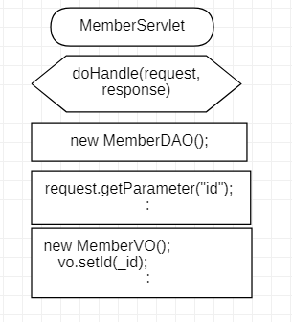

@WebServlet("/member3")
public class MemberServlet extends HttpServlet {
:
private void doHandle(HttpServletRequest request,HttpServletResponse response) throws ServletException, IOException {
:
MemberDAO dao=new MemberDAO();
:
String command=request.getParameter("command");
if(command!= null && command.equals("addMember")){
String _id=request.getParameter("id");
:
MemberVO vo=new MemberVO();
vo.setId(_id);
:
dao.addMember(vo);
}else if(command!= null && command.equals("delMember")) {
String id = request.getParameter("id");
dao.delMember(id);
}
List list=dao.listMembers();
out.print("<html><body>");
:
for (int i=0; i<list.size();i++){
MemberVO memberVO=(MemberVO) list.get(i);
String id=memberVO.getId();
:
out.print("<tr><td>"+id+"</td><td>"
:
+"<a href='/pro07/member3?command=delMember&id="+id+"'>삭제 </a></td></tr>");
}
out.print("</table></body></html>");
out.print("<a href='/pro07/memberForm.html'>새 회원 등록하기</a");
}
}
코딩해보기

