Slide 1
Avances por Carencia
SEDESOL
Carencia | Avances
Alimentación | 90,142.0
Educación | 53,732.0
Salud | 0
Seguridad Social | 0
Vivienda | 43,503.0
TOTAL | 187,377.0
1 / 1

Slide 2
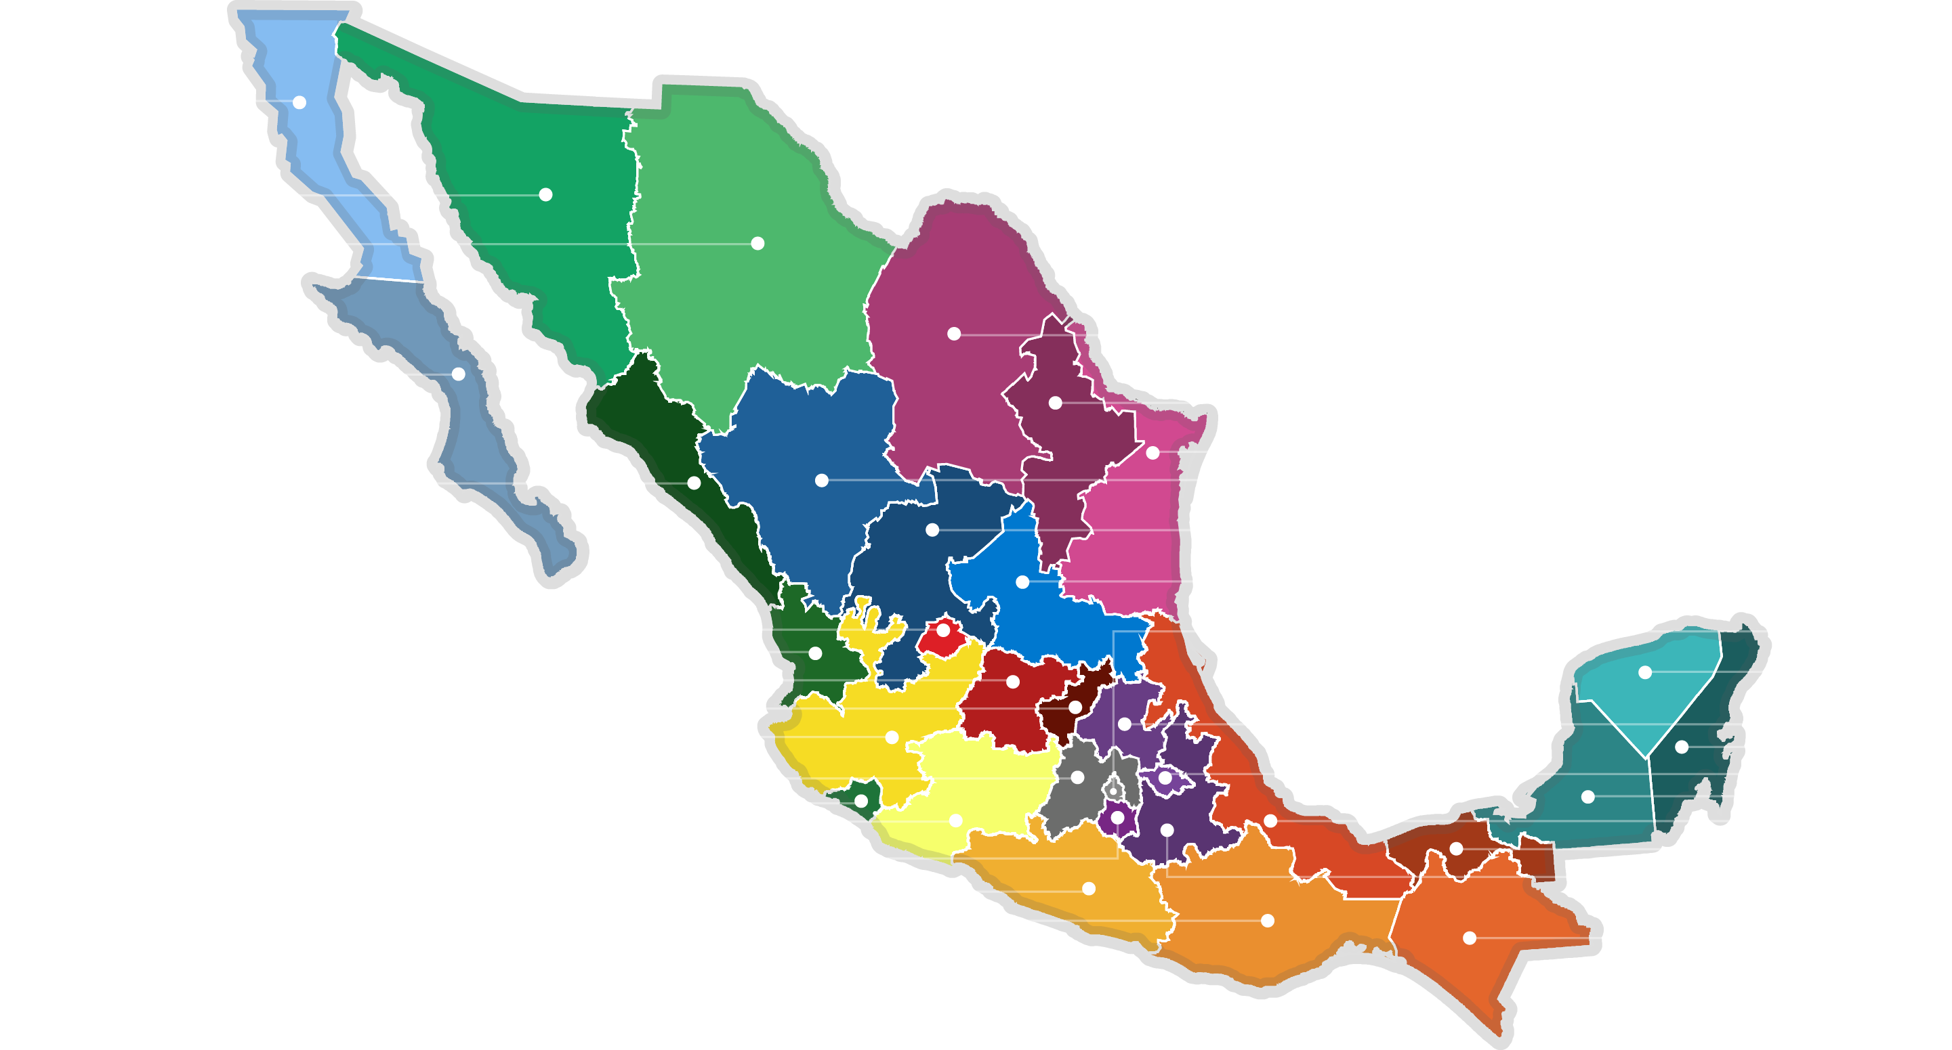
Avances por Entidad
SEDESOL
3,338.0
5,622.0
5,821.0
5,070.0
3,412.0
2,551.0
6,167.0
10,213.0
6,687.0
3,236.0
3,966.0
9,720.0
2,958.0
2,679.0
2,884.0
5,748.0
4,034.0
3,738.0
5,435.0
3,395.0
8,391.0
2,656.0
4,448.0
2,453.0
4,179.0
6,573.0
4,461.0
3,047.0
3,851.0
3,430.0
7,001.0
40,213.0
1 / 1

Slide 3
Avances y Metas por Entidad
SEDESOL
Entidad | Alimentación Avance / Meta |  | Vivienda Avance / Meta |  | Educación Avance / Meta |  | Salud Avance / Meta |  | Seguridad Social Avance / Meta
Aguascalientes | 5,614.0 | 10,799.0 | 3,377.0 | 6,790.0 | 0 | 500.0 | 0 | 192,339.66 | 729.0 | 716.35
Baja California | 1,907.0 | 3,833.0 | 1,192.0 | 2,430.0 | 0 | 500.0 | 0 | 241,294.02 | 239.0 | 248.3
Baja California Sur | 1,996.0 | 3,963.0 | 1,167.0 | 2,275.0 | 0 | 500.0 | 0 | 193,821.82 | 249.0 | 263.85
Campeche | 867.0 | 1,749.0 | 566.0 | 1,116.0 | 0 | 500.0 | 0 | 129,831.78 | 1,020.0 | 1,051.5
Chiapas | 2,338.0 | 4,607.0 | 1,533.0 | 2,804.0 | 0 | 500.0 | 0 | 451,367.84 | 1,199.0 | 1,126.65
Chihuahua | 2,592.0 | 5,371.0 | 1,529.0 | 2,904.0 | 0 | 500.0 | 0 | 409,362.66 | 327.0 | 366.05
Ciudad de México | 19,000.0 | 38,488.0 | 10,601.0 | 21,729.0 | 0 | 3,200.0 | 0 | 4,326,128.82 | 10,612.0 | 11,454.15
Coahuila de Zaragoza | 2,997.0 | 5,891.0 | 1,907.0 | 3,677.0 | 0 | 500.0 | 0 | 440,285.94 | 917.0 | 636.2
Colima | 1,546.0 | 3,097.0 | 935.0 | 1,774.0 | 0 | 500.0 | 0 | 106,524.26 | 477.0 | 471.6
Durango | 2,543.0 | 5,060.0 | 1,441.0 | 2,889.0 | 0 | 500.0 | 0 | 468,316.18 | 2,703.0 | 2,979.65
Guanajuato | 3,037.0 | 6,033.0 | 1,714.0 | 3,454.0 | 0 | 500.0 | 0 | 613,376.84 | 997.0 | 1,161.2
Guerrero | 2,072.0 | 4,080.0 | 1,257.0 | 2,711.0 | 0 | 500.0 | 0 | 733,125.2 | 522.0 | 455.6
Hidalgo | 1,994.0 | 3,984.0 | 1,285.0 | 2,466.0 | 0 | 500.0 | 0 | 394,303.68 | 459.0 | 443.9
Jalisco | 2,994.0 | 5,951.0 | 1,693.0 | 3,183.0 | 0 | 800.0 | 0 | 513,219.54 | 748.0 | 754.1
México | 2,107.0 | 3,177.0 | 1,308.0 | 1,847.0 | 0 | 800.0 | 0 | 1,401,346.2 | 4,976.0 | 5,346.45
Michoacán de Ocampo | 2,439.0 | 4,837.0 | 1,464.0 | 3,007.0 | 0 | 800.0 | 0 | 539,128.32 | 276.0 | 280.7
Morelos | 2,168.0 | 4,269.0 | 1,432.0 | 2,947.0 | 0 | 500.0 | 0 | 299,732.72 | 861.0 | 863.1

Slide 4
Avances y Metas por Entidad
SEDESOL
Entidad | Alimentación Avance / Meta |  | Vivienda Avance / Meta |  | Educación Avance / Meta |  | Salud Avance / Meta |  | Seguridad Social Avance / Meta
Nayarit | 1,136.0 | 2,248.0 | 750.0 | 1,549.0 | 0 | 500.0 | 0 | 247,930.72 | 793.0 | 815.4
Nuevo León | 1,460.0 | 2,962.0 | 726.0 | 1,460.0 | 0 | 500.0 | 0 | 349,581.84 | 365.0 | 399.3
Oaxaca | 3,869.0 | 7,578.0 | 2,679.0 | 5,310.0 | 0 | 500.0 | 0 | 554,466.12 | 453.0 | 330.2
Puebla | 1,362.0 | 2,683.0 | 781.0 | 1,573.0 | 0 | 500.0 | 0 | 468,474.36 | 1,287.0 | 1,332.7
Querétaro | 2,364.0 | 4,700.0 | 1,412.0 | 2,915.0 | 0 | 500.0 | 0 | 190,853.58 | 258.0 | 260.75
Quintana Roo | 1,251.0 | 2,417.0 | 758.0 | 1,443.0 | 0 | 500.0 | 0 | 213,305.28 | 1,386.0 | 1,377.8
San Luis Potosí | 2,176.0 | 4,238.0 | 1,363.0 | 2,636.0 | 0 | 500.0 | 0 | 378,952.92 | 427.0 | 527.45
Sinaloa | 4,718.0 | 9,390.0 | 2,849.0 | 5,827.0 | 0 | 500.0 | 0 | 525,341.42 | 2,646.0 | 2,662.95
Sonora | 3,291.0 | 6,331.0 | 1,792.0 | 3,361.0 | 0 | 500.0 | 0 | 324,430.34 | 539.0 | 629.45
Tabasco | 1,145.0 | 2,237.0 | 763.0 | 1,652.0 | 0 | 500.0 | 0 | 234,755.88 | 1,139.0 | 1,066.4
Tamaulipas | 3,417.0 | 6,876.0 | 2,049.0 | 3,937.0 | 0 | 500.0 | 0 | 540,744.06 | 701.0 | 671.6
Tlaxcala | 747.0 | 1,489.0 | 464.0 | 919.0 | 0 | 500.0 | 0 | 174,499.16 | 1,445.0 | 1,492.25
Veracruz de Ignacio de la Llave | 2,314.0 | 4,522.0 | 1,533.0 | 3,092.0 | 0 | 800.0 | 0 | 707,512.08 | 2,726.0 | 2,820.35
Yucatán | 767.0 | 1,508.0 | 401.0 | 772.0 | 0 | 500.0 | 0 | 228,386.32 | 1,716.0 | 1,883.0
Zacatecas | 1,914.0 | 3,795.0 | 1,011.0 | 2,167.0 | 0 | 500.0 | 0 | 221,651.06 | 311.0 | 247.1

