Slide 1



Cities for VET Mobility & Innovation
Supported by:

Slide 2
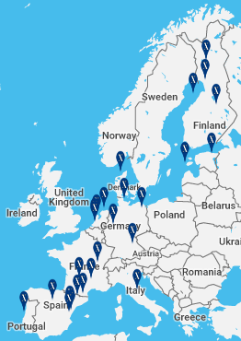
Antwerp | Alcoi | Barcelona | Berlin | Breda | Brussels | Gandia | Hamburg | Kokkola Kuopio | Lisbon | Lyon | Madrid | Mislata | München | Oulu | Reus | Roma Rovaniemi | Sète | Tartu | Toulouse I Ventspils | Viborg | Westerburg | Zwolle
XARXA FP is a European non-profit association created in 1999 gathering 26 cities from 11 countries working together on VET Mobility & Innovation
Xarxa FP aims to improve the quality of Vocational Education and Training (VET) across Europe by:
Developing common mobility strategies among cities aimed at VET students and professionals
Developing strategic partnerships through international VET projects
Contributing to the design of EU VET policies
Supported by:

Slide 3

Antwerp | Alcoi | Barcelona | Berlin | Breda | Brussels | Gandia | Hamburg | Kokkola Kuopio | Lisbon | Lyon | Madrid | Mislata | München | Oulu | Reus | Roma Rovaniemi | Sète | Tartu | Toulouse I Ventspils | Viborg | Westerburg | Zwolle
Organisation
Barcelona
Roma
XARXA FP is a non-for-profit association gathering several European cities that was created in 1999 by the Education Department of Barcelona’s City Council.
The budget of the association comes from 3 main sources: Barcelona’s City Council budget, membership fees and other funds/grants from the European Commission (Erasmus+) and other European institutions.
The Secretariat is permanently located in Barcelona whereas the Presidency is rotating (currently is located in Munich, Germany).
XARXA FP is the only European network of its kind that guarantees that the management of mobility actions adhere to ISO quality standards (ISO 9001:2008)
The Executive Committee is composed by the Secretary General and 7 representatives of the member cities, including the cities where both the Presidency and Treasury are located.
Berlin
Rovaniemi
Lisbon
Supported by:
Lyon

Slide 4
Antwerp | Alcoi | Barcelona | Berlin | Breda | Brussels | Gandia | Hamburg | Kokkola Kuopio | Lisbon | Lyon | Madrid | Mislata | München | Oulu | Reus | Roma Rovaniemi | Sète | Tartu | Toulouse I Ventspils | Viborg | Westerburg | Zwolle
Strategic Plan 2016-2020
SL1. Improve the quality and quantity of VET MOBILITY
  SO1. Enhance VET mobility quality procedures and methodologies
  SO2. Increase the number of mobility actions for both students and staff/professionals
  SO3. Development of a proactive strategy to incorporate new Xarxa FP members
SL2. Stimulate and promote VET INNOVATION
  SO4. Develop strategic partnerships through international VET projects
SL3. Contribute to the design of EU VET POLICIES
  SO5. Build up Xarxa FP’s public affairs profile and work towards its recognition as a European stakeholder
  SO6. Develop an expertise on EU VET policies
Supported by:
Notes:
SL1. Improve the quality and quantity of VET MOBILITY
SO1. Enhance VET mobility quality procedures and methodologies
ISO, ECVET, Impact Study
SO2. Increase the number of mobility actions for both students and staff/professionals
Technical support Secretariat
SO3. Development of a proactive strategy to incorporate new Xarxa FP members
COMM strategy, reception int visits
SL2. Stimulate and promote VET INNOVATION
SO4. Develop strategic partnerships through international VET projects
KA2 projects: Qualification profile for VET teachers and Trainers, ESL
KA3: Coop SMEs to bridge skills gap – VET attractiveness
SL3. Contribute to the design of EU VET POLICIES
SO5. Build up Xarxa FP’s public affairs profile and work towards its recognition as a European stakeholder
European policy events, consultations, Coop European stakeholders
SO6. Develop an expertise on EU VET policies within the Secretariat General
COMM members on EU VET policies, funding, events, research

Slide 5
Antwerp | Alcoi | Barcelona | Berlin | Breda | Brussels | Gandia | Hamburg | Kokkola Kuopio | Lisbon | Lyon | Madrid | Mislata | München | Oulu | Reus | Roma Rovaniemi | Sète | Tartu | Toulouse I Ventspils | Viborg | Westerburg | Zwolle
“Mobility Managers”:
a sign of identity
Mobility Managers are designated by each city and their tasks are:
Coordination of the students’ mobility (sent and received) with other cities’ Mobility Managers
Management of work placements – liaison with
companies, VET centres and Chambers of Commerce
Welcoming and monitoring foreign students (e.g. accommodation, introduction to local culture, monitoring work placement, documentation).
Supported by:
Notes:
To be responsible of all incoming and outgoing mobilities managed between the sending and the hosting city.
To liaise with VET schools and organisations of their own city willing to participate in international mobilities and international projects with Xarxa FP members.
To find companies in their cities for work placements according to the needs and preferences of the incoming apprentices.
To facilitate accommodation for incoming apprentices.
To introduce apprentices into the national and local culture.
To manage the work placements in companies with the collaboration of other organisations involved in VET.
To monitor and evaluate the stays of the apprentices.
To manage the overall documentation required for the work placement.

Slide 6
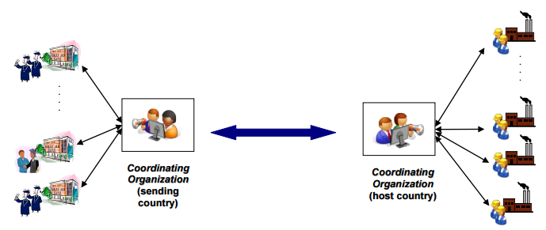
Antwerp | Alcoi | Barcelona | Berlin | Breda | Brussels | Gandia | Hamburg | Kokkola Kuopio | Lisbon | Lyon | Madrid | Mislata | München | Oulu | Reus | Roma Rovaniemi | Sète | Tartu | Toulouse I Ventspils | Viborg | Westerburg | Zwolle
1. Work placement
2. Accommodation
3. Follow up
4. Documentation
Supported by:
Q-PLACEMENTS HANDBOOK For the Quality of International Workplace Training For Initial Vocational Training Students

Slide 7
Antwerp | Alcoi | Barcelona | Berlin | Breda | Brussels | Gandia | Hamburg | Kokkola Kuopio | Lisbon | Lyon | Madrid | Mislata | München | Oulu | Reus | Roma Rovaniemi | Sète | Tartu | Toulouse I Ventspils | Viborg | Westerburg | Zwolle
Partnership approach
Vocational
& Educational
Training
Centres
Every city should cooperate with:
Chambers
of Commerce, Industry, Crafts & other business organisations (Guilds, Trade Unions,..)
Companies
Supported by:

Slide 8
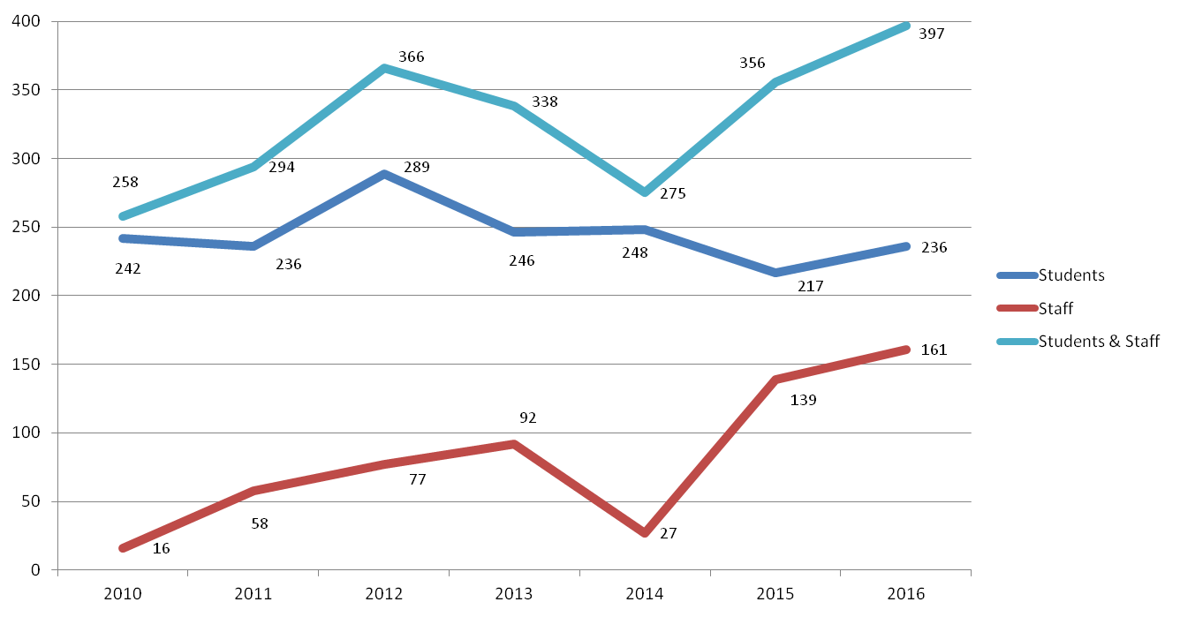
Antwerp | Alcoi | Barcelona | Berlin | Breda | Brussels | Gandia | Hamburg | Kokkola Kuopio | Lisbon | Lyon | Madrid | Mislata | München | Oulu | Reus | Roma Rovaniemi | Sète | Tartu | Toulouse I Ventspils | Viborg | Westerburg | Zwolle
Evolution of the mobility flows among Xarxa FP cities between 2010 and 2016
Supported by:

Slide 9
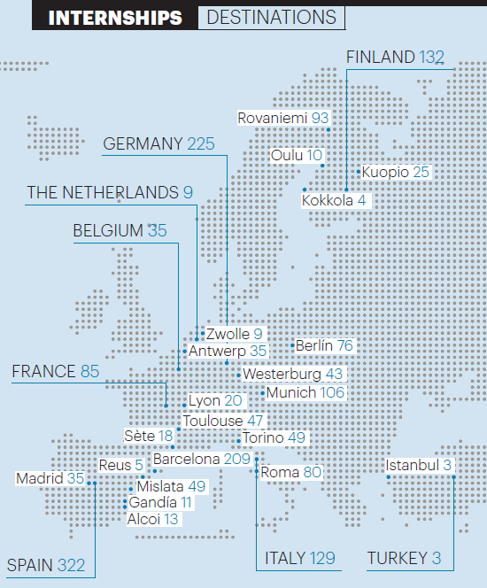
Antwerp | Alcoi | Barcelona | Berlin | Breda | Brussels | Gandia | Hamburg | Kokkola Kuopio | Lisbon | Lyon | Madrid | Mislata | München | Oulu | Reus | Roma Rovaniemi | Sète | Tartu | Toulouse I Ventspils | Viborg | Westerburg | Zwolle
Internships destinations 2012 -2015
Supported by:

Slide 10
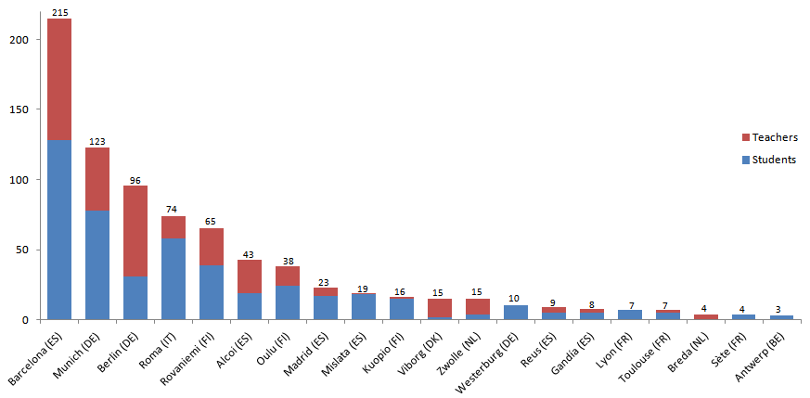
Antwerp | Alcoi | Barcelona | Berlin | Breda | Brussels | Gandia | Hamburg | Kokkola Kuopio | Lisbon | Lyon | Madrid | Mislata | München | Oulu | Reus | Roma Rovaniemi | Sète | Tartu | Toulouse I Ventspils | Viborg | Westerburg | Zwolle
Total number of students and teachers sent and received by Xarxa FP cities in 2016
Supported by:

Slide 11
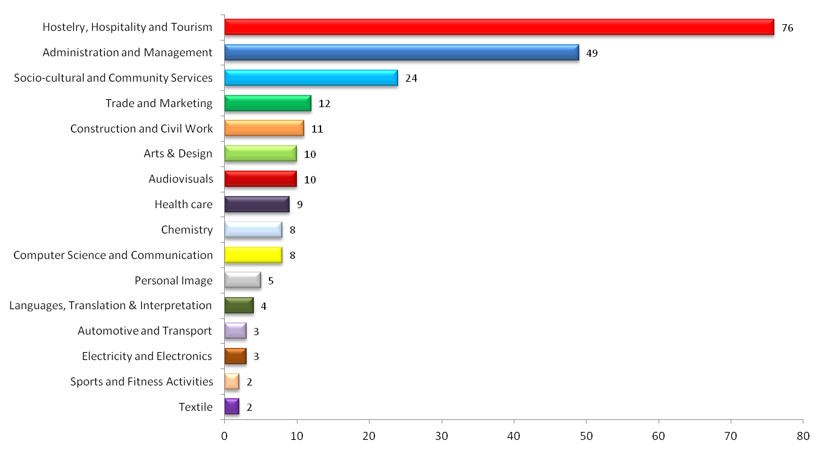
Antwerp | Alcoi | Barcelona | Berlin | Breda | Brussels | Gandia | Hamburg | Kokkola Kuopio | Lisbon | Lyon | Madrid | Mislata | München | Oulu | Reus | Roma Rovaniemi | Sète | Tartu | Toulouse I Ventspils | Viborg | Westerburg | Zwolle
Number of students sent by Xarxa FP cities by field of specialisation (2016)
Supported by:

Slide 12
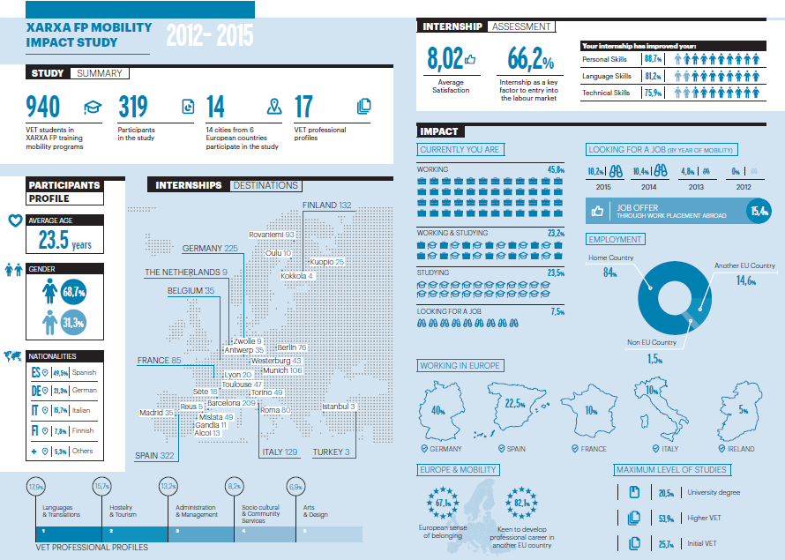
Antwerp | Alcoi | Barcelona | Berlin | Breda | Brussels | Gandia | Hamburg | Kokkola Kuopio | Lisbon | Lyon | Madrid | Mislata | München | Oulu | Reus | Roma Rovaniemi | Sète | Tartu | Toulouse I Ventspils | Viborg | Westerburg | Zwolle
Supported by:

Slide 13

Antwerp | Alcoi | Barcelona | Berlin | Breda | Brussels | Gandia | Hamburg | Kokkola Kuopio | Lisbon | Lyon | Madrid | Mislata | München | Oulu | Reus | Roma Rovaniemi | Sète | Tartu | Toulouse I Ventspils | Viborg | Westerburg | Zwolle
Network’s added value
Every year Xarxa FP arranges around 400 mobility actions including internships for VET students and trainings for VET teachers in European cities members of the network.
Participation in a variety of international projects to improve VET training methodologies, exchange of good practices and knowledge & innovation transfer.
Know-how on EU projects and use of standard mobility procedures and documentation in all participating cities (Agreement, Evaluation, Certificate).
“Spin-off” effect: Xarxa FP can be a platform for local administrations to work beyond VET projects
Partnerships based on mutual trust and more than 15 years of experience on internationalisation strategies.
Supported by:

Slide 14
Antwerp | Alcoi | Barcelona | Berlin | Breda | Brussels | Gandia | Hamburg | Kokkola Kuopio | Lisbon | Lyon | Madrid | Mislata | München | Oulu | Reus | Roma Rovaniemi | Sète | Tartu | Toulouse I Ventspils | Viborg | Westerburg | Zwolle
CONTACT US
Jordi Castillo
Secretary General
Xarxa FP
Barcelona City Council
jcastillog@bcn.cat
Plaça d'Espanya 5 1st floor
08014 Barcelona
Tel. + 34 93 413 21 01
www.xarxafp.org
Supported by:

