Slide 1
TPL Algorithm
A Thermal Based Placement Algorithm

Slide 2
Contents
Designs
Data Structures
Thermal Placement Algorithm

Slide 3
Program Diagram
algorithm
data
structure
net
force
target
Parsers
move
force
target
Generators

Slide 4
1. Parsers
Read and write .nodes, .net and .pl files
NodesParser
PlParser
NetParser
Implemented using Boost.Spirit
In-memory Database design
Use Circuit related data structure
Use algorithm friendly counterpart

Slide 5
2.Circuit Related Data Structures
TplModule
from .nodes and .pl file to x,y coordinates and widths and heights
TplModules
chipwidth, _num_free, _modules …
TplDB
static TplDB *instance // singleton pattern
read_file()
initialize_modules() // BookshelfNodes & BookshelfPls
initialize_nets() // BookshelfNets

Slide 6
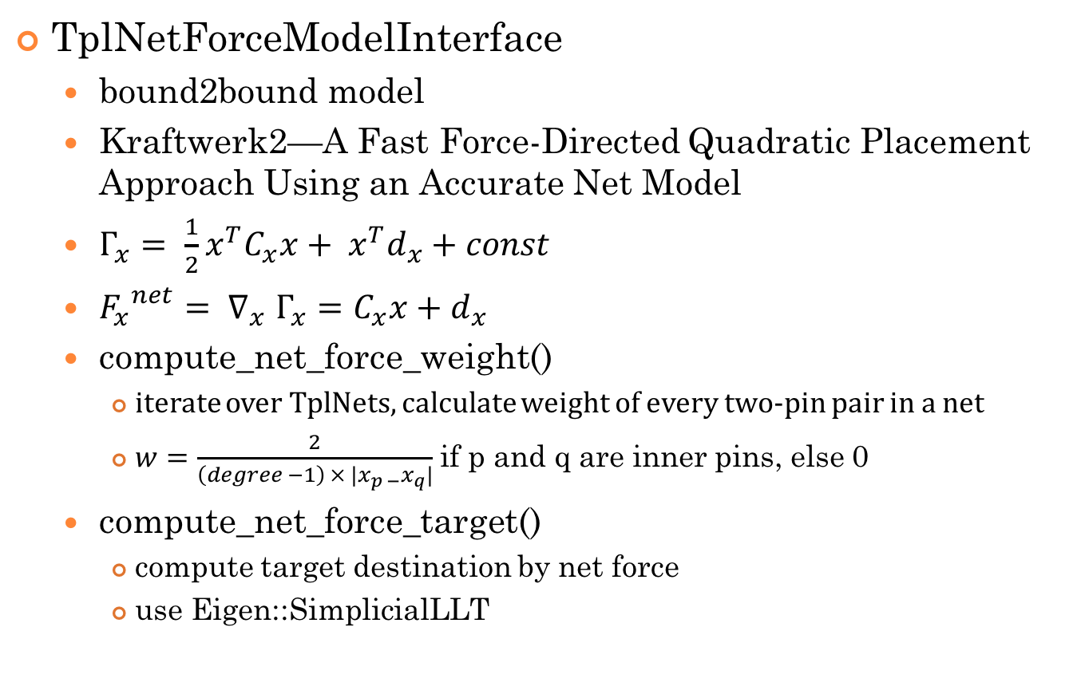
3. netforce placement algorithm
TplNetForceModelInterface
bound2bound model
Kraftwerk2—A Fast Force-Directed Quadratic Placement Approach Using an Accurate Net Model
$Γ_{x}= \frac{1}{2}x^{T}C_{x}x+ x^{T}d_{x}+const$
${F_{x}}^{net}{= ∇}_{x}Γ_{x}=C_{x}x+d_{x}$
compute_net_force_weight()
iterate over TplNets, calculate weight of every two-pin pair in a net
$w=\frac{2}{\left(degree −1\right) × {|x}_{p −}x_{q}|}$ if p and q are inner pins, else 0
compute_net_force_target()
compute target destination by net force
use Eigen::SimplicialLLT

Slide 7

3. netforce placement algorithm
TplNetForceModelInterface
compute_net_force_weight()
iterate over TplNets, calculate weight of every two-pin pair in a net
$w=\frac{2}{\left(degree −1\right) × {|x}_{p −}x_{q}|}$ if p and q are inner pins, else 0

Slide 8
3. netforce placement algorithm
TplNetForceModelInterface
compute_net_force_matrix()
compute matrix C and d
if module[i] and module[j] are movable:
C[i, i], C[j, j] += weight
C[i, j], C[j, i] -= weight
d[i] += weight * (pin[i] – pin[j])
d[j] += weight * (pin[j] – pin[i])
else if module[i] is fixed and module[j] is movable:
C[j, j] += weight
d[j] += weight * (pin[j] – pin[i] – module[i])
else if module[i] is movable and module[j] is fixed:
same as previous
else:
continue

Slide 9
3. netforce placement algorithm
TplNetForceModelInterface
compute_net_force_target()
compute target destination by net force
use Eigen::SimplicialLLT

Slide 10
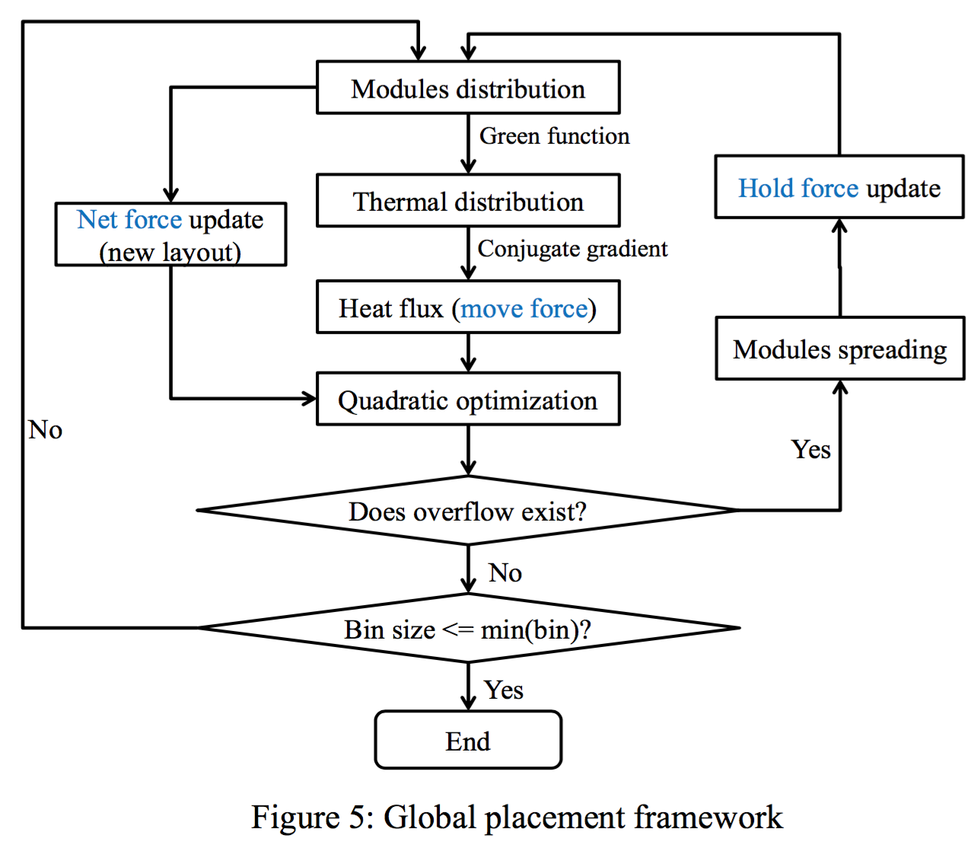
Global Placement Diagram

Slide 11
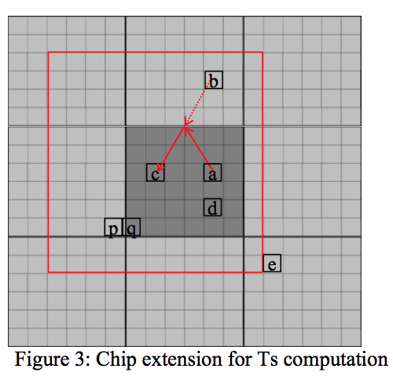
Modules distribution
Partition into grids
Extend chip to nine regions

Slide 12

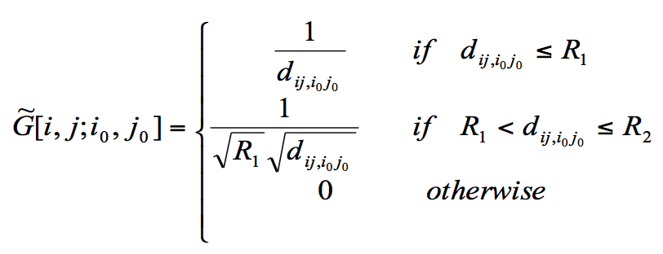
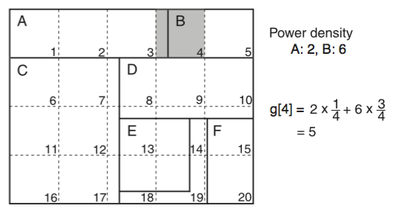
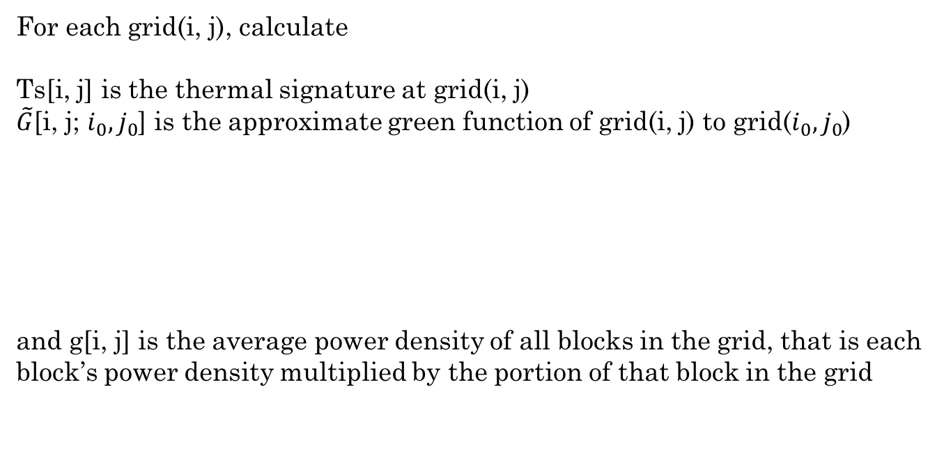
Modules distribution
Thermal distribution
For each grid(i, j), calculate
Ts[i, j] is the thermal signature at grid(i, j)
$\tilde{G}$[i, j; $i_{0}, j_{0}$] is the approximate green function of grid(i, j) to grid($i_{0}, j_{0}$)
and g[i, j] is the average power density of all blocks in the grid, that is each block’s power density multiplied by the portion of that block in the grid

Slide 13
Thermal distribution
Heat flux
For each grid(i, j), calculate
This is the heat vector in every grid. To get the heat vector for each block, we add the heat vector of all grids that this block covers(need further discuss)
Heat flux
move force target

Slide 14
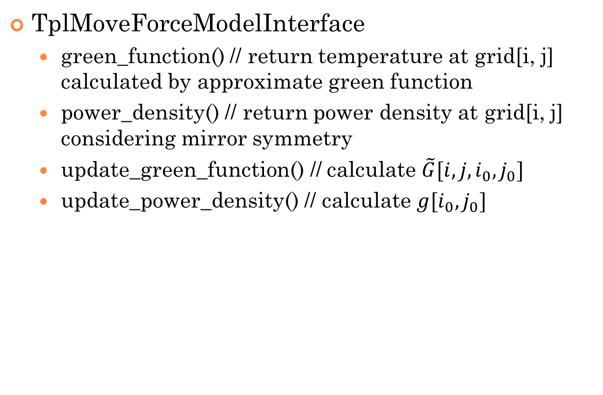
4. Thermal Placement Algorithm
TplMoveForceModelInterface
green_function() // return temperature at grid[i, j] calculated by approximate green function
power_density() // return power density at grid[i, j] considering mirror symmetry
update_green_function() // calculate $\tilde{G}[i, j, i_{0}, j_{0}]$
update_power_density() // calculate $g[i_{0}, j_{0}]$

Slide 15

4. Thermal Placement Algorithm
Problem in TplMoveForceM
update_green_function = $Ο(n^{4})$, n = grid_size
grid_size | chip_width / grid_size <= min{module_width}
grid_size | chip_height / grid_size <= min{module_height}
need to make this function faster

