Slide 1
TPL Algorithm
A Thermal Based Placement Algorithm

Slide 2
Contents
Designs
Data Structures
Thermal Placement Algorithm

Slide 3
Program Diagram
algorithm
data
structure
net
force
target
Parsers
move
force
target
Generators

Slide 4
1. Parsers
Read and write .nodes, .net and .pl files
NodesParser
PlParser
NetParser
Implemented using Boost.Spirit
In-memory Database design
Use Circuit related data structure
Use algorithm friendly counterpart

Slide 5
1. Parsers - Nodeparser
BookshelfNode
Id id // typedef std::string Id
int width
int height
bool fixed
BookshelfNodes
int num_nodes // total modules
int terminals // fixed modules
vector<BookshelfNode> data

Slide 6
1. Parsers - Plparser
BooshelfPl
Id id
Coordinate x // typedef double Coordinate
Coordinate y
bool fixed
BookshelfPls
vector<BookshelfPl> data

Slide 7
1. Parsers - Netparser
BooshelfPin
Id id
IOtype io // enum IOtype {Input, Output}
Distance dx //shift of the pin from the center of the module
Distance dy
BookshelfNet
Id id
unsigned int degree // number of pins attached on this net
vector<BookshelfPin> data
BookshelfNets
unsigned int num_nets // total nets
unsigned int num_pins // total pins
vector<BookshelfNet> data

Slide 8
2.Circuit Related Data Structures
TplModule
Block
Ternimal
from .nodes and .pl file to x,y coordinates and widths and heights
TplModules
double chipwidth, chipheight
size_t _num_modules, _num_free
vector<TplModule> _modules
functions operating _modules // etc. [ ], at, begin()

Slide 9
2.Circuit Related Data Structures
TplDB
constructors
static TplDB *instance // singleton pattern
read_file()
initialize_modules() // construct TplModules using BookshelfNodes & BookshelfPls
initialize_nets() // construct TPlNets using BookshelfNets

Slide 10

3. netforce placement algorithm
TplNetForceModelInterface
// $Γ_{x}= \frac{1}{2}x^{T}C_{x}x+ x^{T}d_{x}+const$
compute_net_force_weight()
compute_net_force_matrix() // compute matrix C and d
compute_net_force_target() // compute target destination by net force

Slide 11
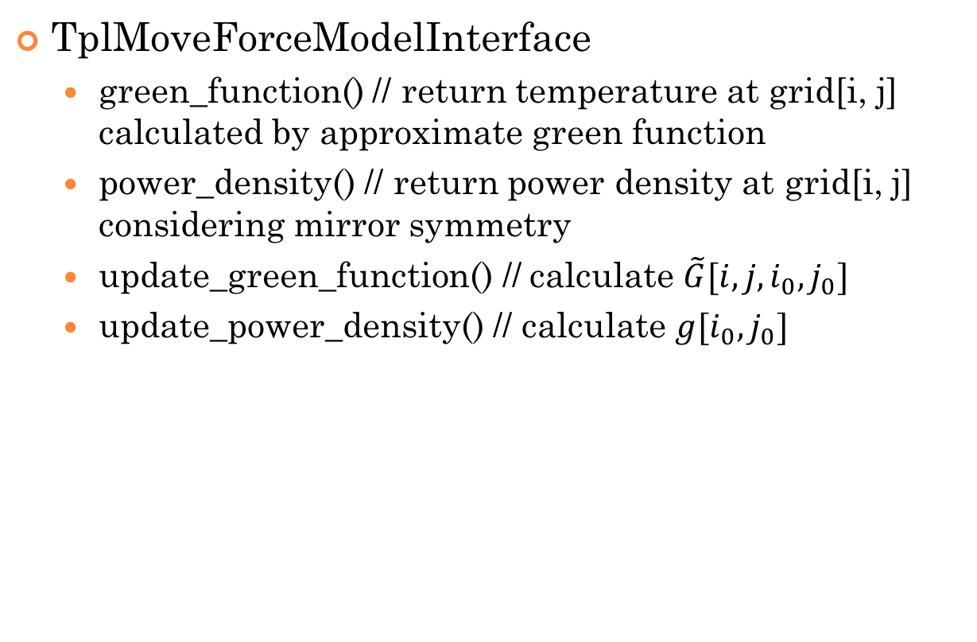
4. Thermal Placement Algorithm
TplMoveForceModelInterface
green_function() // return temperature at grid[i, j] calculated by approximate green function
power_density() // return power density at grid[i, j] considering mirror symmetry
update_green_function() // calculate $\tilde{G}[i, j, i_{0}, j_{0}]$
update_power_density() // calculate $g[i_{0}, j_{0}]$

Slide 12

4. Thermal Placement Algorithm
Problem in TplMoveForceM
update_green_function = $Ο(n^{4})$, n = grid_size
grid_size | chip_width / grid_size <= min{module_width}
grid_size | chip_height / grid_size <= min{module_height}
need to make this function faster

Slide 13
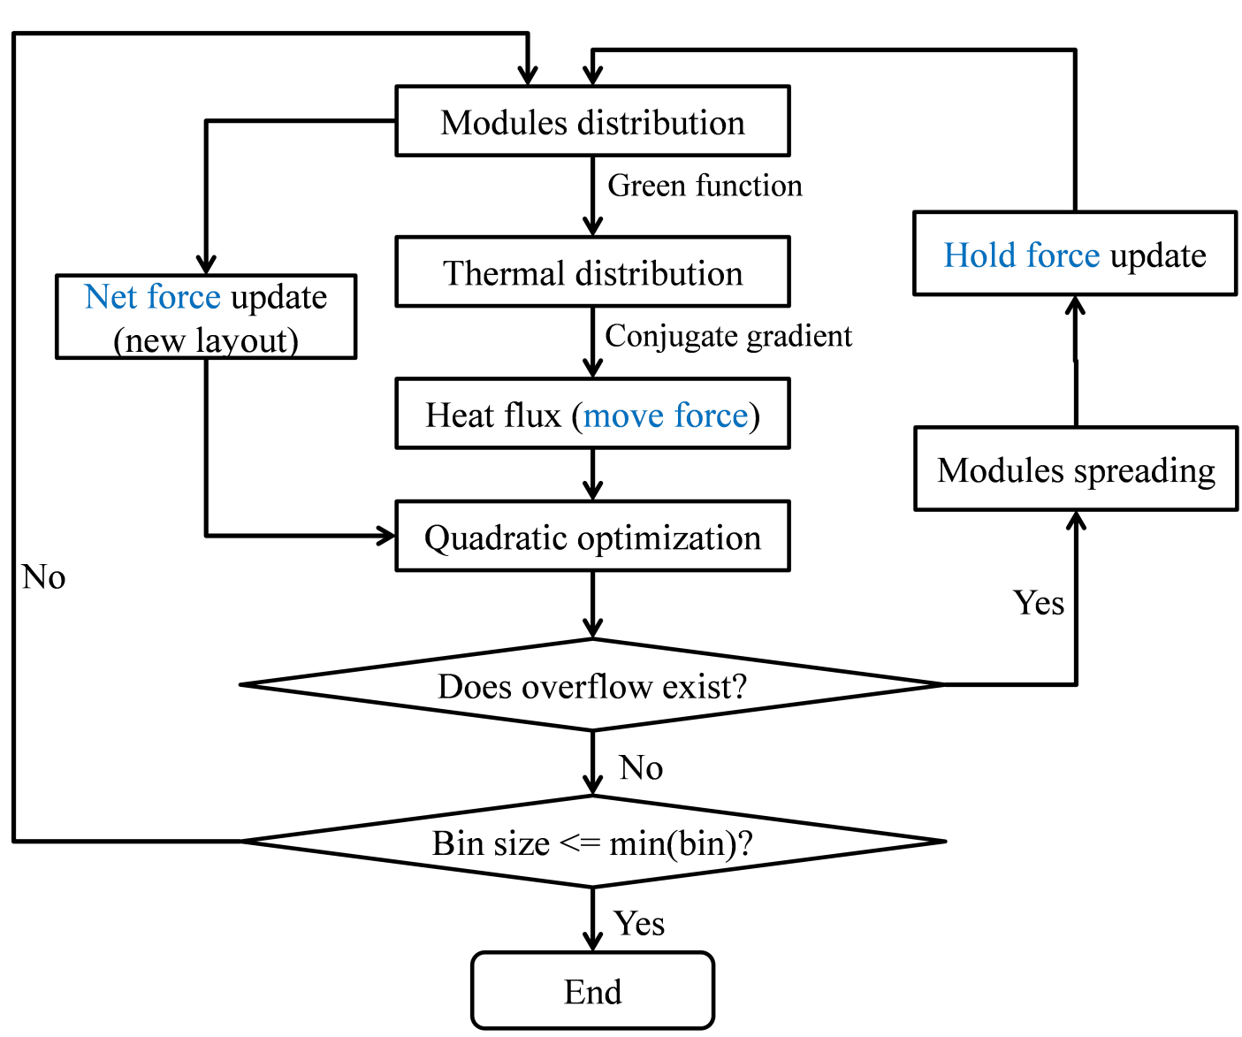
Global Placement Diagram
Now we don’t have a given net
Hold force := - net force
When to re-partition into grids?

Slide 14
Modules distribution
Partition into grids
Extend chip to nine regions

Slide 15
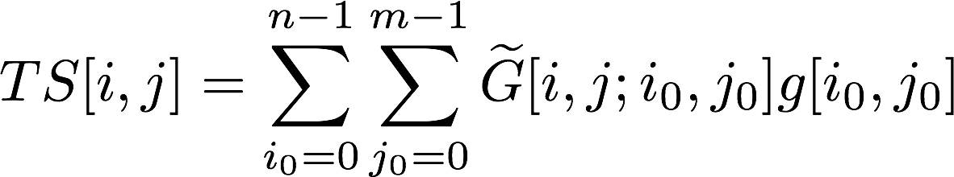
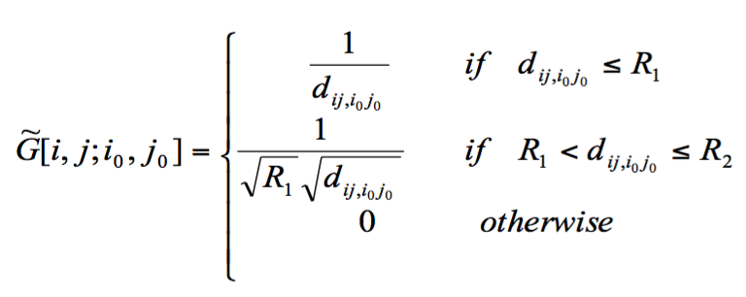
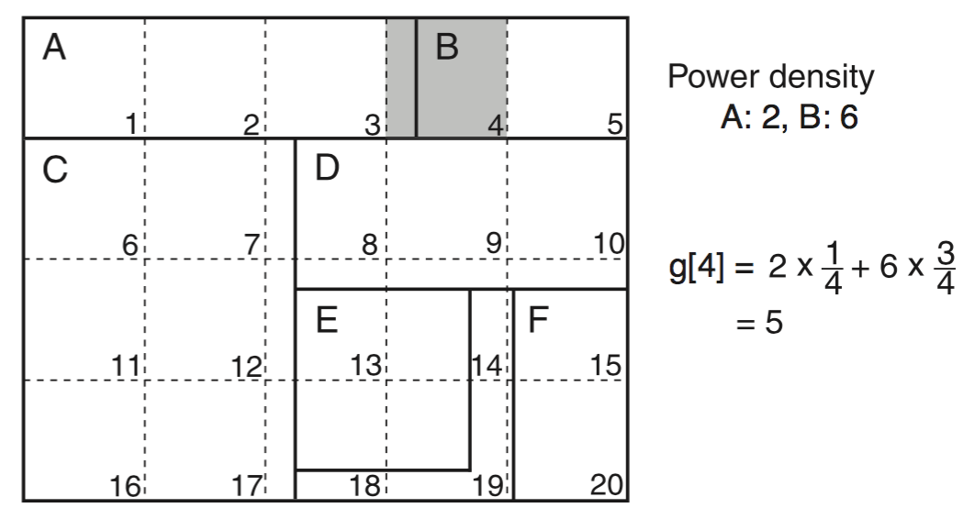
Modules distribution
Thermal distribution
For each grid(i, j), calculate
where
and g[i, j] is the average power density of all blocks in the grid, that is each block’s power density multiplied by the portion of that block in the grid

Slide 16
Thermal distribution
Heat flux
For each grid(i, j), calculate
This is the heat vector in every grid. To get the heat vector for each block, we add the heat vector of all grids that this block covers(need further discuss)
Heat flux
Quadratic optimization

