Slide 1

Jupyter.org
@ProjectJupyter

Slide 2
Evolved from IPython...

Slide 3
“Why is it called IPython,
if it can do Julia, R, Haskell, Ruby, … ?”

Slide 4
IPython
Interactive Python shell at the terminal
Kernel for this protocol in Python
Tools for Interactive Parallel computing
Network protocol for interactive computing
Clients for protocol
  Console
  Qt Console
  Notebook
Notebook file format & tools (nbconvert...)
Nbviewer

Slide 5

IPython … Jupyter
Interactive Python shell at the terminal
Kernel for this protocol in Python
Tools for Interactive Parallel computing
Network protocol for interactive computing
Clients for protocol
  Console
  Qt Console
  Notebook
Notebook file format & tools (nbconvert...)
Nbviewer
Language Agnostic

Slide 6
What's in a name?
Inspired by the open languages of science:
  Julia, Python & R
  not an acronym: all languages equal class citizens.
Astronomy and Scientific Python:
  A long and fruitful collaboration
Galileo's notebooks:
  the original, open science, data-and-narrative papers
  Authorea: “Science was Always meant to be Open”

Slide 7
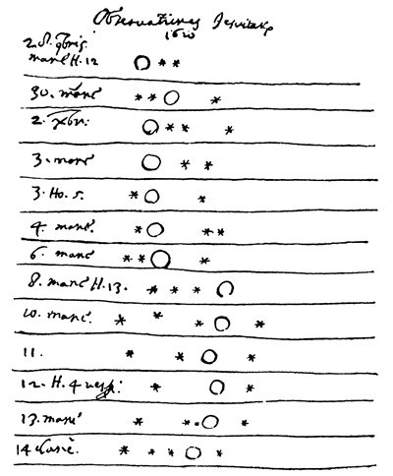
Galileo's Notebook

Slide 8
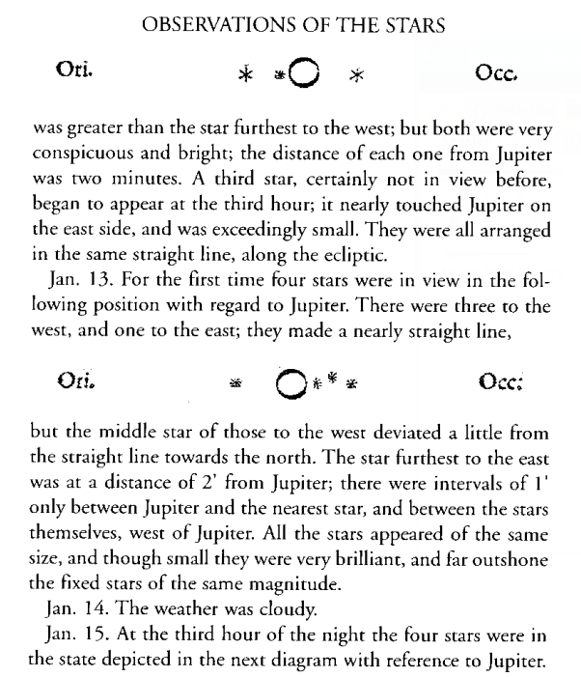
Galileo's Sidereal Messenger: 1610

