Slide 1
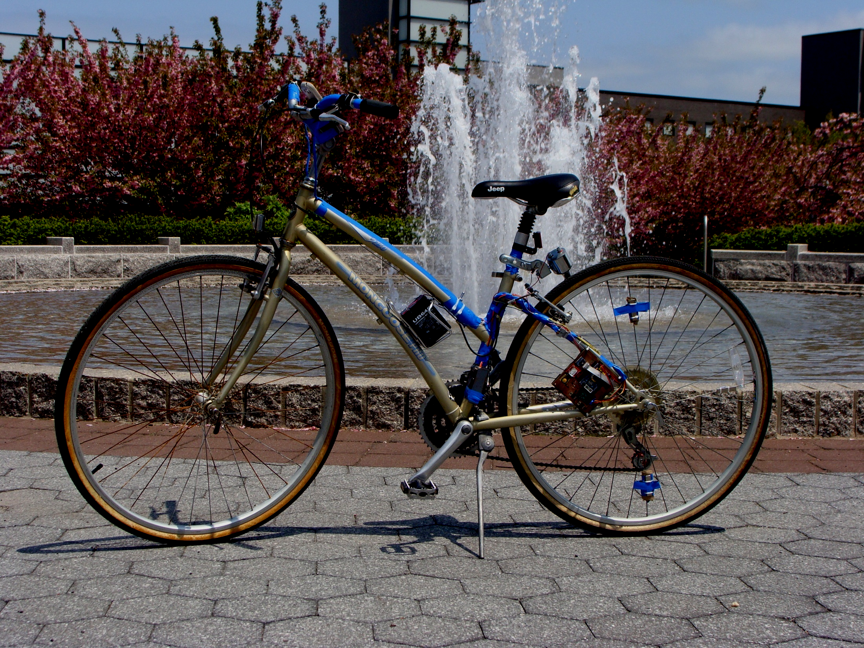
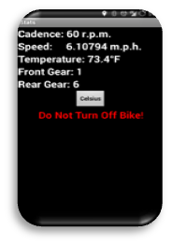
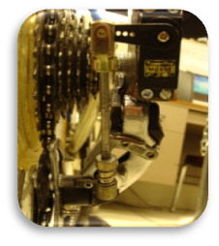
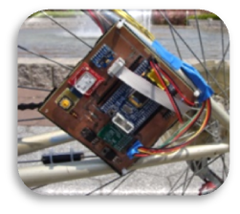

Electrical and Computer Engineering, Fall 2013-Spring 2014
Project Title: SmartBike: an Automatically Shifting Bicycle with Other Embedded Features
Students: Frank Pernice, Dylan Dreisch
Advisor: Kenneth Short
Project Objectives: | Significant Results: Full manual shifting was implemented in a way which prevents cross-chaining: a problem which plagues novice riders and causes premature chain wear. It does this by ensuring proper gear ratios before making the desired shift. Full automatic shifting was implemented by monitoring true speed and pedaling cadence. The microcontroller makes an intelligent decision and shifts into a proper gear ratio relative to the current speed and cadence. An Android application was developed to monitor system vitals such as speed, cadence, gear ratio, and temperature.
Approach Ethical Issues/Impact on Society:
 | Graphics:
The goal of this project was to modernize the bicycle riding experience for the 21st century. That is, we strived to replace the mechanical shifters on a multi-speed bicycle with a microcontroller-based electronic system which allows for both manual and automatic shifting while eliminating the issue of cross-chaining
The design was implemented with an ATmega128, two servos, two digital Hall-effect sensors, a servo controller, a Bluetooth module, and a power system (which itself consisted of a battery, bottle dynamo, and voltage rectification and regulation circuitry). Code was developed to implement both manual and automatic shifting and an Android application was developed to display information to the user.
Include color picture or graphic.
The project aims to bring modern technology to the Great Outdoors. The computer age has given birth to a generation of people who spend their entire lives indoors; we wish to
change that.
Printed Circuit Board
Android App
Rear Derailleur

