Slide 1
每周总结

Slide 2
01.
视频学习
02.
代码练习
CATALOG
03.
论文学习
04.
下周计划

Slide 3
NeighborEmbedding
PCA
Manifold Learning
Locally Linear Embedding
Laplacian Eigenmaps
t-SNE
PCA算法的数学推导过程
PCA的神经网络实现方式
Unsupervised Learning
WordEmbedding
Auto-encoder
Count based
Prediction based
Auto-encoder本质上就是一个自我压缩和解压的过程。

Slide 4
通过Sin预测Cos
語句分類
ShuffleNetv2
循环神经网络由于其的特殊结构，十分十分擅长处理时间相关的数据，下面我们就来通过输入sin函数，输出cos函数来实际使用
Step1：pytorch实现
Step2：c++实现
Step3：HLS实现参数量化
数据处理？
Word Embedding?

Slide 5

ShuffleNet V2: Practical Guidelines for Efficient CNN Architecture Design
准则
架构

Slide 6
FLOPs is an indirect metric
speed, also depends on the other factors such as memory access cost （MAC）
Equal channel width minimizes memory access cost (MAC)
Excessive group convolution increases MAC
Network fragmentation reduces degree of
parallelism
Element-wise operations are non-negligible
1
2
3
4
Practical guidelines for efficient network

Slide 7
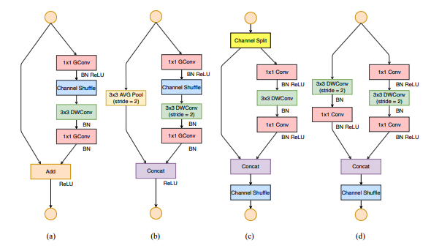
Channel split
1X1CONV
Not group
DW conv

Slide 8
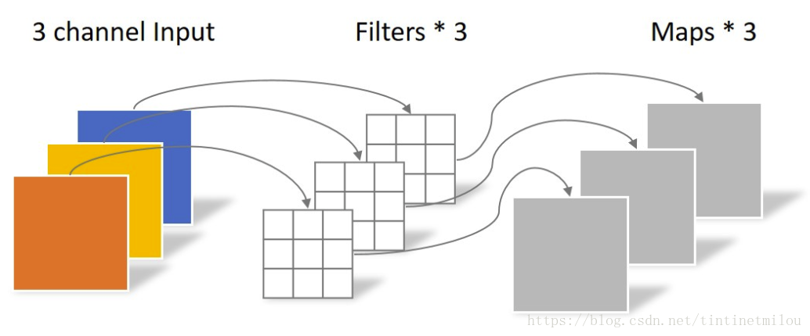
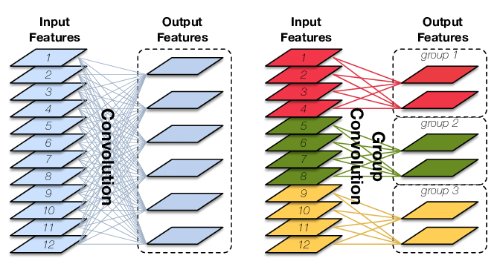
Depthwise Convolution
Group Convolution

Slide 9
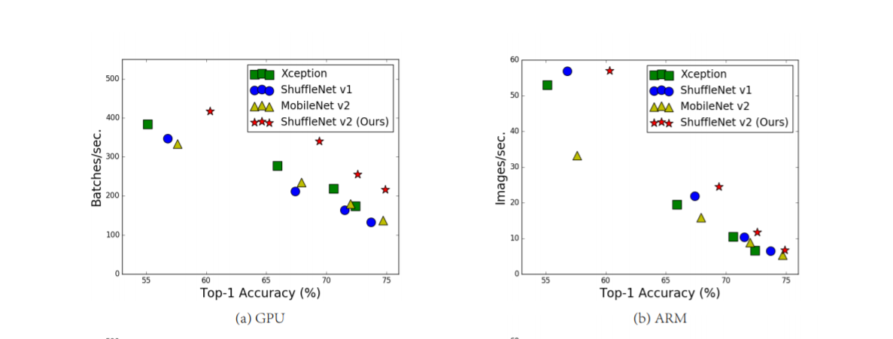

Slide 10
理论
实践
SVM
Transfer Learning
GAN
作业9和12
C++实现ShuffleNetv2

