Slide 1

FPGA PROFESSIONAL ASSOCIATION · AI-AUGMENTED SYSTEMS ENGINEERING
WEEK 1
The AI-Augmented Systems Problem
Framing: two dualities — AI as a tool for doing engineering, and AI as a component the engineer must engineer.
FPGA Professional Association · AI-Augmented Systems Engineering · Week 1
1

Slide 2
WEEK 1 · SESSION PLAN
Today's Agenda & Objectives
Session agenda
By the end of this session, you can
1
What Makes Something a System
Distinguish “AI-for-SE” from “SE-for-AI” and explain why both reshape the discipline.
Characterize an AI-augmented system and identify its non-classical properties (probabilistic behavior, opacity, distribution dependence).
Propose a candidate project system from your own discipline and frame it in these terms.
Relate the problem to INCOSE / SEBoK framings of complexity and emergence.
Explain how AI raises the engineer's altitude — from implementor toward systems engineer — and why managing complexity becomes the core skill.
2
The Two Dualities of AI
3
Why Learned Components Are Different
4
The Engineer's Question
5
From implementor to systems engineer
6
Studio, deliverables & wrap
FPGA Professional Association · AI-Augmented Systems Engineering · Week 1
2

Slide 3
WEEK 1 · CONCEPT 1 OF 4
What Makes Something a System
1.1
1.2
1.3
A system is a set of interacting elements whose combined behavior exceeds what any element does alone — value and failure both live in the interactions.
Hierarchy, interfaces, and environment define the system boundary; drawing that boundary is the first engineering decision, not a formality.
Emergence is the reason systems engineering exists: properties like safety, throughput, and cost appear only at the whole-system level.
FPGA Professional Association · AI-Augmented Systems Engineering · Week 1
3

Slide 4

WEEK 1 · CONCEPT 2 OF 4
The Two Dualities of AI
2.2
SE-for-AI: a learned model shipped inside the product is a component with a datasheet no one fully wrote — it must be specified, verified, and owned.
AI-for-SE: models that draft requirements, explore design spaces, predict schedules, and screen defects — the engineer's work, accelerated.
2.3
Most real programs now face both at once, and confusing the two is the most common source of muddled AI strategy.
FPGA Professional Association · AI-Augmented Systems Engineering · Week 1
4

Slide 5
WEEK 1 · CONCEPT 3 OF 4
Why Learned Components Are Different
3.1
3.2
3.3
They are probabilistic: identical inputs and conditions can bound behavior only statistically, not by a closed-form guarantee.
They are distribution-dependent: performance is a claim about the data seen in training and test — leave that envelope and the claim is void.
They are opaque: internal structure rarely explains behavior, so evidence must come from external testing, monitoring, and argument.
FPGA Professional Association · AI-Augmented Systems Engineering · Week 1
5

Slide 6
WEEK 1 · CONCEPT 4 OF 4
The Engineer's Question
4.2
That allocation decision recurs in every module of this course — requirements, architecture, V&V, risk, management, certification.
For every function the system performs, someone must decide: human, classical algorithm, or learned model — and who holds authority over the result.
4.3
The goal is not maximal automation; it is a defensible allocation you can verify, afford, and sign your name to.
FPGA Professional Association · AI-Augmented Systems Engineering · Week 1
6

Slide 7
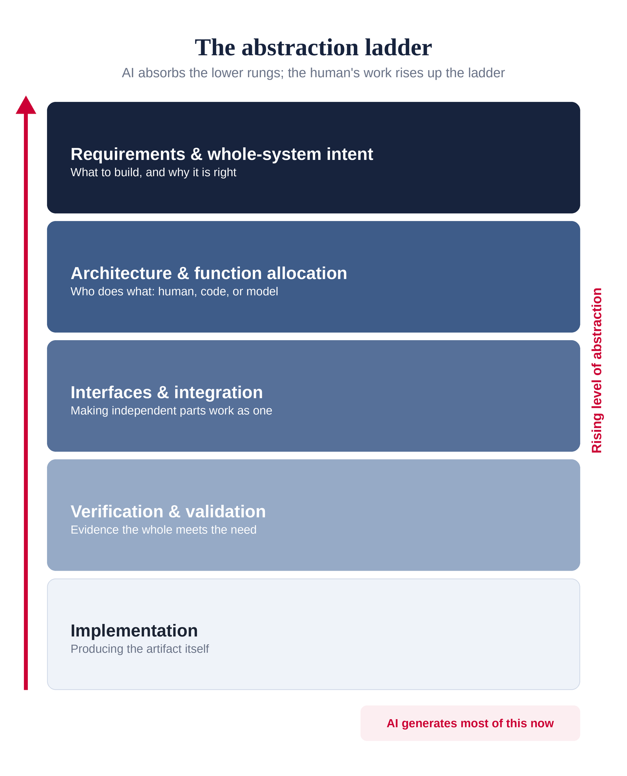
WEEK 1 · THE SHIFT
From Implementor to Systems Engineer
Directing AI is a promotion, not just a speed-up.
For most of engineering's history, most engineers were implementors: given a specification, they produced the artifact — the code, the RTL, the drawing, the analysis.
A model now drafts that artifact in seconds. What stays scarce is everything above it: deciding what to build, defining the interfaces, allocating each function, and proving the whole meets the need.
That upper region is systems engineering. Using AI to generate work faster pushes every engineer, at least in part, into the systems engineer's role — and hands them its harder problem: managing the complexity that speed creates.
Where this course lives. The weeks ahead are a guided tour of that upper region — requirements, architecture, verification, risk, and the human role that keeps it accountable.
FPGA Professional Association · AI-Augmented Systems Engineering · Week 1
7

Slide 8
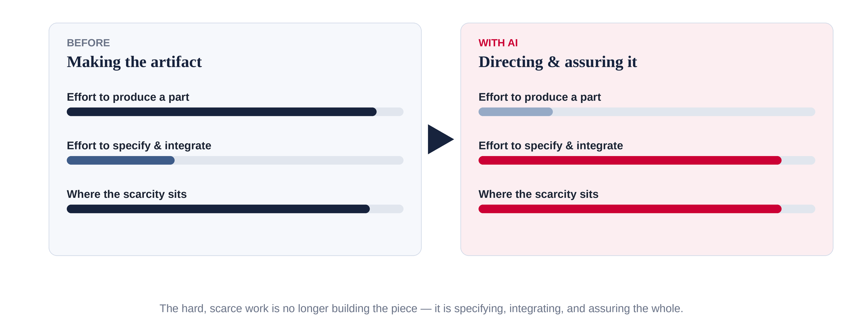
WEEK 1 · THE NEW BOTTLENECK
When Making Is Cheap, Managing Is the Job
AI removes much of the cost of producing a part. That does not remove the work — it relocates it to where the difficulty now lives.
FPGA Professional Association · AI-Augmented Systems Engineering · Week 1
8

Slide 9
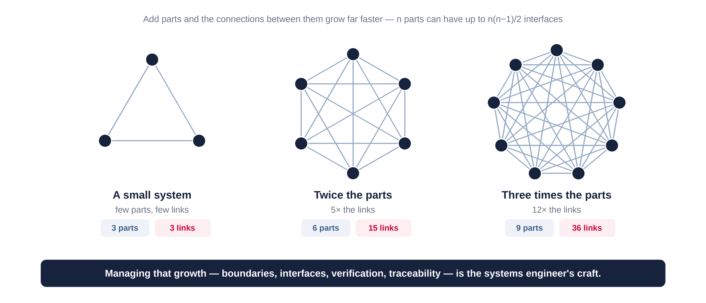
WEEK 1 · THE COMPLEXITY TAX
More Parts, Many More Interfaces
Every part you add multiplies the interfaces someone must define, verify, and keep consistent. Volume of output buys a rising tax in complexity.
FPGA Professional Association · AI-Augmented Systems Engineering · Week 1
9

Slide 10








WEEK 1 · THE SE CRAFT
Managing Complexity Is the Systems Engineer's Craft
Boundaries & interfaces
Requirements & traceability
Draw the system boundary and define how the parts connect, so independently generated pieces still fit together.
Turn intent into verifiable requirements and trace each one to the parts and tests that satisfy it.
Verification & validation
Function allocation & risk
Show by evidence that the whole meets the need — not merely that any single generated part looks right.
Decide who does what — human, classical code, or learned model — and manage the risk each choice creates.
FPGA Professional Association · AI-Augmented Systems Engineering · Week 1
10

Slide 11
WEEK 1 · THE CATCH
Higher Altitude, Same Accountability
01
Same accountability. AI can draft the artifact, but it cannot hold the requirement, sign the review, or carry the consequence. That stays human.
Your altitude rises. You spend less time producing parts and more on intent, interfaces, integration, and proof — the whole-system view that used to belong to a few.
02
The catch: if AI does the junior work, teams must deliberately build the judgment that senior systems engineers still need — a pipeline risk we return to in the human-systems module.
FPGA Professional Association · AI-Augmented Systems Engineering · Week 1
11

Slide 12



WEEK 1 · THE AI LENS
Where AI Enters This Week
As a Tool
As a Component
The Human Residual
Drafting stakeholder-need summaries, generating candidate concepts, mining lessons-learned databases for similar past systems.
A perception, prediction, or advisory model inside the delivered product — behavior specified as an envelope, not a formula.
Choosing the system boundary, the project itself, and which functions are even candidates for automation.
One question, every week: which mode is this — and what human role does it leave behind?
FPGA Professional Association · AI-Augmented Systems Engineering · Week 1
12

Slide 13
WEEK 1 · APPLICATIONS
Across the Disciplines
Aerospace
Biomedical
Package-delivery drone: onboard perception is a component; generative layout tools assist the design.
Smart infusion pump with a dosing-advisory model — clinical safety rides on a statistical component.
Civil
Industrial
Instrumented bridge whose anomaly detector turns strain data into maintenance calls.
Robotic warehouse fleet: routing optimization as tool, vision picking as embedded component.
FPGA Professional Association · AI-Augmented Systems Engineering · Week 1
13

Slide 14


WEEK 1 · STUDIO
In-Class Activity & Discussion
Studio activity
Seminar discussion
Team formation studio: pick a candidate project system from your discipline. Identify one function you would hand to AI and one you would keep human — and defend both choices in two minutes.
Q1
Which properties of your discipline's systems make learned components attractive — and which make them frightening?
Q2
Is “the model works” an engineering statement? What would you need to add to make it one?
FPGA Professional Association · AI-Augmented Systems Engineering · Week 1
14

Slide 15



WEEK 1 · WRAP
Before Next Week
Read
INCOSE Hdbk ch.1–2; SEBoK “What is Systems Engineering?”, “Emergence”; NIST AI RMF (overview).
Due
PS-1 released. Project teams formed; system proposals due.
Next week
Week 2 — Systems Thinking & Lifecycle Models. The Vee and ISO/IEC/IEEE 15288 lifecycle processes; iterative variants; how AI-in-the-loop workflows compress and stress the Vee.
FPGA Professional Association · AI-Augmented Systems Engineering · Week 1
15

