Slide 1
Advanced Verification Methodology
ECE 4280/5280
Wed 4:30pm-7:05pm
Greg Tumbush, PhD

Slide 2









A little about me
B.S. from Wright State University in Dayton, OH 1991
M.S from Ohio State in Columbus, OH 1993
Ph.D. from University of Cincinnati, 1998
Air Force Research Labs 1991-1993, 1998-1999
Astek Corp 2000-2002
Starkey Labs 2003-2005
AMI Semiconductor 2006-2007
ON Semiconductor 2008
Formed Tumbush Enterprises, LLC in June 2008
½ time instructor at UCCS Fall Semester 2008
Notes:
My Ph.D. dissertation was a partitioning algorithm based on combinatorial optimization
At AFRL worked on dynamically reconfigurable computing
At Astek worked mostly as a contractor to LSI Logic where I designed and verified disk drive controllers. Very fast, large, power hungry.
At Starkey designed and verified hearing aids. Low clock speeds, small, very low power. Was one of the first companies to work with SystemC.
Starkey’s IC design center in Colorado Springs was bought by AMI. We branched out into glucose monitors.
All of AMI was purchased by ON. Similar product line.
Quit ON in Aug of 08 to form a consulting company with the inventive name of Tumbush Enterprises
I had previously taught as an adjunct at UCCS and accepted a ½ time instructor position with them in Fall/08

Slide 3
Course Description
Advanced Verification Methodology. Verification of electronic systems consumes 70% of the development cycle. This course teaches students how to develop high-quality verification environments with SystemVerilog and how to use advanced verification techniques such as assertions and coverage for digital systems.
Prerequisite: ECE 4242/5242.

Slide 4
Assumptions
Prerequisite is Advanced Digital Design Methodology (4242/5242) or equivalent
Strong knowledge of Verilog
Familiarity with a simulator (preferrably QuestaSim)
Object oriented exposure helpful but not required

Slide 5

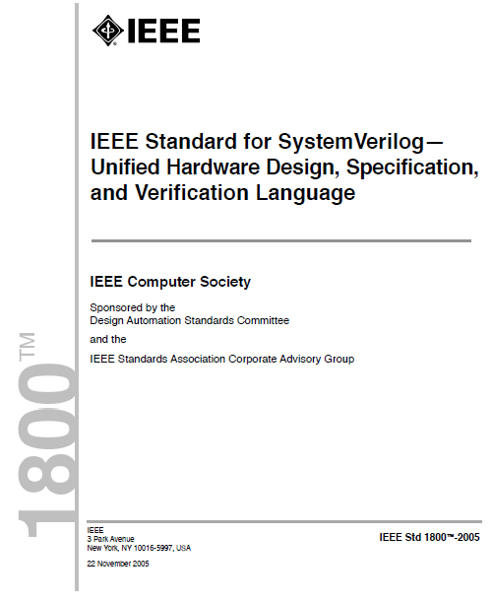
References
Spear, C. and Tumbush, G., SystemVerilog for Verification: A Guide to Learning the Testbench Language Features, 3rd Edition
IEEE, IEEE Standard for SystemVerilog— Unified Hardware Design, Specification, and Verification Language, 2009
Notes:
Check out the errata page for Spear’s book at http://chris.spear.net/systemverilog/errata.htm It’s updated rapidly.
Lots of great examples in LRM. The most current is 2009. Download it from the library.
http://www.uccs.edu/~library/
In the Select a Database section select Engineering and Applied Science from the pull-down
Click on IEEE Xplore
In the browse section click on Standards
In Option 1 (Browse by Keyword) fill in SystemVerilog.
You are looking for Std 1800-2009. Click on it.
The full text PDF is available for download in the left hand pane.
You either need to be in the library or connected to the library VPN.

Slide 6
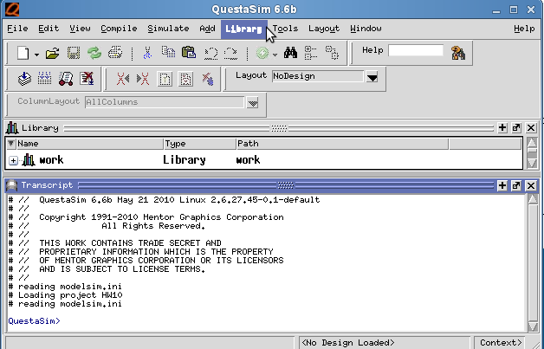
Tools
QuestaSim 10.0b 64-bit
Notes:
Questasim is an advanced version of modelsim. It looks and works very similar to modelsim but has more features.
Many of the features we will use in this class are not available in the student version of modelsim.
Questasim is hosted on the unix server LATS and windows server RATS.
You may use the windows version or the unix version. I would highly recommend using the unix version for a number of reasons:
Most large verification projects are developed in a linux environment to take advantage of the scripting, stability, and tool support.
LATS is a very powerful but lightly used server
Prior to this semester RATS and LATS were the same physical machine but the virtual machine software that made this one server look like a windows and a linux server is now gone and we have 2 dedicated servers.
If you have issue accessing these 2 machines e-mail the issue to Sean Staples at sstaples@eas.uccs.edu

Slide 7
Semester Topics
Introduction to Verification
SystemVerilog Language Constructs
Test Bench Environments
Interfaces
Clocking blocks and programs
Basic OOP
Randomization
Threads and Interprocess Communication
Advanced OOP
Functional Coverage
Advanced Interfaces
Interfacing with C/C++
Notes:
Introduction to Verification – What is verification
SystemVerilog Language Constructs – Language improvements that make testbench improvements quicker and easier.
Test Bench Environments – You’ll be developing many verification environments in this class.
Interfaces – Used to encapsulate related signals, for example, a PCE bus.
Clocking blocks and programs – Methods to alleviate, or at least reduce, the chance of race conditions.
Basic OOP – SystemVerilog is object oriented.
Randomization – SystemVerilog improves greatly on the simple randomization provided in Verilog 2001 using $random
Threads and Interprocess Communication – Testbench components run in parallel and independently. How are proceeses spawned in parallel and how do the processes communicate?
Advanced OOP – Advanced concepts like inheritance, composition, callbacks, and parameterized classes.
Functional Coverage – Technique to prove that a condition in the design was tested. For example, for a CPU, has an ADD instruction been tested or for an ADD instruction has max pos and max neg been added together.
Advanced Interfaces like parameterized interfaces and Virtual Interfaces
Interfacing with C++- Might have models or a legacy testbench in C or C++. SystemVerilog can communicate with C/C++ through the DPI.

Slide 8
Class 1 Topics
What is verification?
Why verify?
The verification process
Verification plan exercise
Directed testing
Testbench exercise
Randomization
Functional coverage
Testbench components
Black/white/gray box verification methods
HW 1

Slide 9
What is verification?
Verification ensures that the RTL performs the correct function.
What defines the correct function of the RTL?
Verification
Specification
Design
What is the format of the specification?
paper document
Executable spec
SystemC
C++
Matlab
etc.
Notes:
The key for successful verification is independence of the designer/verifier. Both the design engineer and the verification engineer read and interpret the spec. There is always ambiguity in the spec. An executable spec is a description of the desired function that can be run with a software tool. There is still ambiguity, however, in an executable spec. For example, when is an output valid? Also, all of the functionality might not be modeled. Typically an exectuable spec cannot model asynchronous events like external inputs and reset. Best used for verification of data manipulation.

Slide 10
Why Verify?
The later in the product cycle a bug is found the more costly it is.
Notes:
A bug found at the block level has very little cost to fix. A bug found in the field is very expensive, pariticularly if it involves product recalls. Even more so if those product are in a body! The curve is a little flatter for FPGA based systems because there is no post silicon product phase.

Slide 11
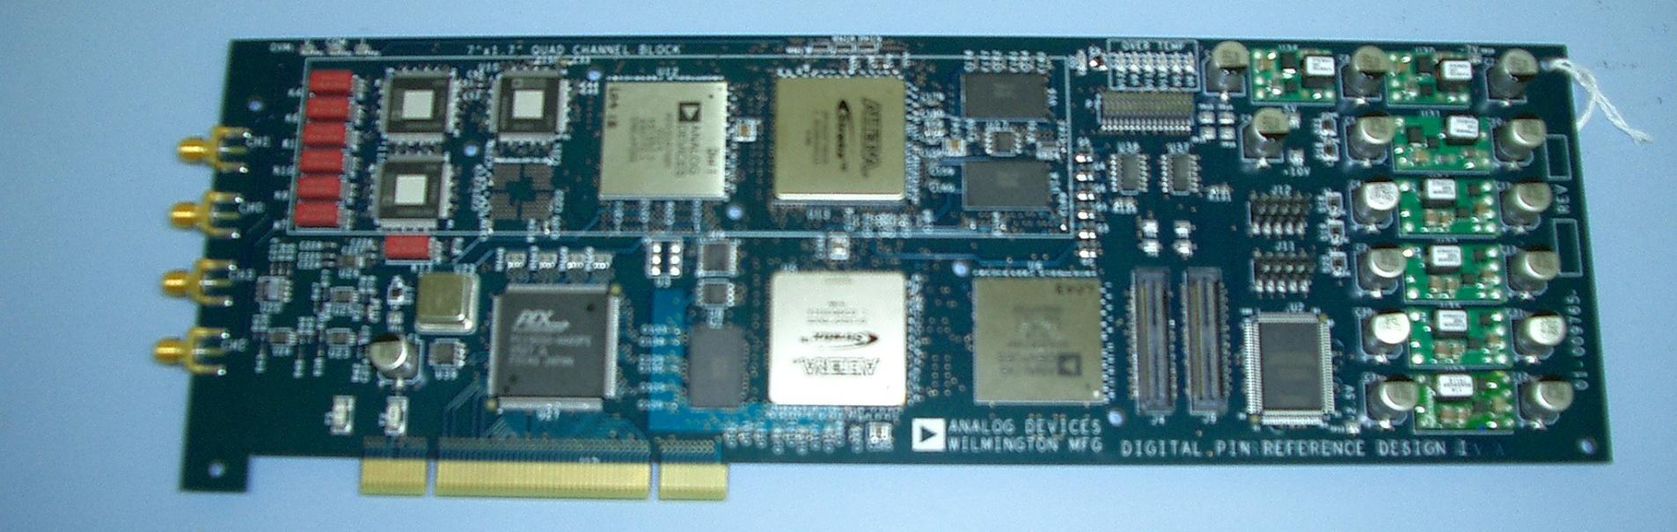
FPGAs Need Verification!
Case Study 1:
LOA Technology
2 fully custom FPGA’s
45 man weeks of verification effort
131 bugs found
10 man-weeks of lab debug
9 bugs found
100% statement coverage
Al Czamara, FPGA Verification Panel, 2008 Synopsys Users Group (SNUG), Boston, MA.
Notes:
The first case study of an FPGA design is from LOA Technology, a startup concentrating on High Performance Low Cost silicon test.
The design contained two custom FPGA’s, a PCI-33 bridge, and a timing generator. Had no dedicated verification engineers so the same people did design and verification.
Using assertions they found 131 bugs in 45 man weeks of effort which is about 0.4 bugs/day
Then went into lab. Found 9 bugs in 10 man-weeks of debug, which is about 0.125 bugs/day
Total of 55 man-weeks
If all debug in lab would have taken 160 man weeks.
Much easier to parallelize simulation, just need another simulator license. Much harder to parallelize lab debug, need more DUT’s and lab equipment.

Slide 12
FPGAs Need Verification (cont)
Case Study 2:
Fore River Group
Hardware acceleration for network security.
Existing testbench with 100 directed tests.
Shipping to customers.
7 man-months of effort.
Using random verification found 40 bugs
Case Study 3:
Fore River Group
Packet Switching device
Verification considered complete
6 man-months of effort.
Using random verification found 42 bugs
Jay Brown, FPGA Verification Panel, 2008 Synopsys Users Group (SNUG), Boston, MA.
Notes:
The second case study of an FPGA design is from Fore River Group, a consulting company specializing in Front-end Chip Development Services
Product was relatively simple so perfect for directed/lab testing, right?
After shipping to customers, found 40 new bugs.
The third case study of an FPGA design is again from Fore River Group.
The product did packet switching, 10/100/1000 MAC cores, PCI, DDIR SDRAM, etc
Verification considered complete because about 200 directed tests written.

Slide 13
1.1 The Verification Process
Specification
Verifier interprets the spec
Designer interprets the spec
Verifier creates a verification plan
Designer creates a design spec
Verifier creates tests
Designer creates the logic
BUGS!
Notes:
By having more than 1 person interpret the spec there is redundancy in the process.
The designer may not need to create a design spec. It depends on if he/she can write code directly from the spec.
Bugs are good! If you are not finding any bugs your testing is not thorough enough.

Slide 14
1.1.1 Testing at Different Levels
Block Level
Maximum control
Need to emulate peripheral blocks
Might need to emulate DUT I/O
Easiest to debug
Highest simulation performance
System Level
Minimum control
Need to emulate system I/O
Hardest to debug
Lowest simulation performance
Notes:
Maximum control since we have full ability to drive/observe a blocks I/O. For example a corner case involving the uC in a particular state when a DMA occurs might take many clock cycles to get to this state if testing at the DUT level. At the block level it can occur in 1 clock cycle
For the same reason need to emulate peripheral blocks.
Emulate System I/O if block has I/O that is the System I/O. For example an I2C master or slave or external interrupts or program space to the uC.
Easiest to debug since there are less signals, it takes fewer clock cycles to get to the bug, and it’s obvious what caused the bug.
You could build a hybrid where you test just the uC and the config regs, etc.

Slide 15
1.1.2 The Verification Plan
Binds a requirement in the specification to the test(s)
Specification:
The I²C bus will read/write the config registers
Test Plan:
Check reset values
Write a writable config reg
Write a read-only config reg
Read a config reg
Read a memory mapped input
Stall an I²C transaction
2. Technique for testing feature
a. Block, hybrid, or System level
b. Directed or random
c. Assertions
d. Emulation (FPGA, accelerator, etc)
e. Verification IP
f. Self checking or visual
Notes:
1) Check reset values at both startup and after writing all the registers.
2) Read a memory mapped output: For example, an input to a config register might be a 8-bit value called ADC_out. When a particular address is read this value is read out on the I2C bus.
2. Verification IP could be an I2C master to drive our I2C slave.

Slide 16
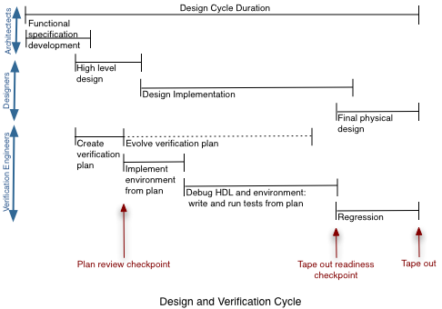
Evolution of the Verification Plan
Continuously
updated
Design and Verification follow the “Waterfall” flow
Dr. Meeta Yadiv, ASIC Verification, North Carolina State University Fall 2007 Source: Will, Goss, Roesner: Comprehensive Functional Verification: Elsevier
Notes:
The verification plan is an evolving document. The document is updated as details are fleshed out as the project progresses. The changes could be because of architectural changes or because of missing items found in the design or due to verification methodology updates.
The design and verification cycle follow the waterfall flow. The key stages of the cycle are
Functional Specification development
High level design
Verification plan
These stages determine the project schedule and development cycle. The other stages can be overlapped to save time.
The plan review checkpoint is a key milestone in a project as it allows for key players to “sync up”. The review ensures that:
The design adheres to the interface protocols
Functional models have the correct behavior
The verification plan is complete
The verification plan is the foundation for implementing the verification environment hence the review should occur before any verification code is written. Failure to review the verification plan can result in wasted time and effort. The plan should be continuously reviewed and updated especially if the specifications evolve. In addition there should be reviews at all key milestones such as:
ready to move to the next level
Tape out readiness check
Following this process puts the verification plan and execution in lock step with the design cycle thus reducing the overall design risk.
Another aspect to consider is integration of hierarchical levels of verification plans into one cohesive plan. Different verification engineers will have their own verification plans, these plans should be integrated to ensure all functions are covered.

Slide 17
Verification Plan Exercise
Write a verification plan for an ALU with:
Asynchronous active high input reset
Input clock
4-bit signed inputs, A and B
5-bit registered signed output C
4 opcodes
Add
Sub
bitwise invert input A
reduction OR input B
Notes:
Check reset value of C
Apply all permutations of max pos, max neg, and 0 to the add and subtract opcodes
Apply 0 and all 1’s to A for bitwise invert input A opcode. Set B to non-all 0 and non-all 1.
Apply 0, all 1’s, and walking 1’s to B for ReductionOR_B opcode. Set A to a value that will yield the opposite result.
Apply more inputs. How many?
Apply inputs so that C is all 1. Reset
Did anyone say to randomize inputs A and B or the opcode?

Slide 18
1.3 Basic Testbench Functionality
Generate stimulus
Apply stimulus to DUT
Capture the responses
Check for correctness
Measure progress
Notes:
4) Check for correctness is a huge job. It could be a task that is called that the expected and actual values are passed. But this is tedius and difficult to maintain. It could be a golden model and you just run your model and the golden model in parallel or something in between.
5) Progress can be measured by noting functional coverage. It can be done automatically or manually by checking off the tests in your test plan.

Slide 19
1.4 Directed Testing
Most (all) probably specified directed testing in their test plan
Steady progress
Little up-front infrastructure development
Small design changes could mean massive test changes
Notes:
Popular with managers
For example, on the last verification project I worked on there was a design change that took 1 hour but it took me 3 days to change all the tests.
If the design complexity doubles the verification effort doubles. Not acceptable. Need better than linear progress.

Slide 20
Verification Exercise
Write a self-checking testbench to verify your ALU. Assume the following encoding of the opcodes.
Opcode | Encoding
add | 2’b00
sub | 2’b01
bitwise invert input A | 2’b10
reduction OR input B | 2’b11
Notes:
See Chap1_Verification_Guidelines/homework_solution for solution

Slide 21
1.5 Methodology Basics
Our verification environments will use the following principles
Constrained random stimulus
Functional coverage
Layered testbench using transactors
Common testbench for all tests
Test-specific code kept separate from testbench
Notes:
It’s not hard to create lots of random stimulus. But not all of it is valid. Need to constrain the randomness
To see if the randomness is doing anything useful
Don’t twiddle bits at the bus level like for example writing a RAM. Assert CS, wait a clock, assert addr/data/we, wait a clock, deassert signals, wait a clock deassert CS. Put this in a task write(input [7:0] data, addr) begin
@(negedge clk);
CS = 1;
@(negedge clk);
D = data; A = addr; WE = 1;
@(negedge clk);
WE = 0;
@(negedge clk);
CS = 0;
endtask
To leverage the testbench and not have to re-write it multiple times
To keep the testbench uncluttered and easy to maintain
Random testing takes more upfront work but the progress is better than linear.
A random testbench is more extensible. For example, what if we widened the bit widths of the ALU by 1 bit? A random testbench requires minimal changes. A directed testbench requires massive changes.

Slide 22
1.7 What should you randomize?
Much more than data
Device configuration
Environment configuration
Protocol exceptions
Errors and violations
Delays
Test order
Seed for the random test
Notes:
Think about all the ways you can configure a processor, cell phone chip, etc
Your testbench mimics the environment your device operates in. the processor is connected to memory, video chips, etc. Need to test all the ways this environment can be configured.
For example, what happens if an I2C command fails to complete or an AHB/PCI/SCSI bus aborts? Does the device lock up?
It’s easy to design a device that works when there are no errors. Need to test error conditions like invalid operations. There is always the debate of how much hardware to implement to protect the user from himself. In a low power chip or where the firmware is supplied by the device supplier not much. For a device that the general public can program, need lots.
Send in stimulus at different rates. For example, back to back reads, back to back writes. read immediately followed by write, etc.
For regression testing where you run many tests randomize the order they are run to eliminate any test order dependencies.
Use a different seed so that the test changes every time it’s run.

Slide 23
$random
Available since Verilog 1995.
$random creates a 32-bit signed random number.
If your range is a power of 2 use implicit bit selection
If your range is not a power of 2 use modulus (%).
Example: generate a random addr between 0 and 5
New to SystemVerilog is $urandom and $urandom_range
Unless your code changes the random generation will be the same. Use a seed to change the generation
logic [3:0] addr;
addr = $random;
addr = $unsigned($random) % 6;
$urandom_range(5,0);
integer r_seed = 2;
addr = $unsigned($random(r_seed)) % 6;
Notes:
1) addr = $random % 6; // Range of remainder is between -5 and 5 since the value returned by $random is signed. The lower 4-bits of -5 is 1011 which is 11 unsigned. The lower 4-bits of -1 is 1111 which is 15 unsigned. What we need to do is cast this # to an unsigned value before the modulus. There are a number of ways to do this. The LRM suggest enclosing $random in the concatenation operator but doesn’t explain why. Concatenation will convert a signed value to an unsigned value. A more explanatory way to do this is use the $unsigned operator.
2) $urandom is used exactly like $random except the result is unsigned.
3) $urandom_range uses as arguments (max val, min val). There is no mention in the LRM of how to pass a seed to $urandom_range.
4) It’s important to that a “random” simulation can be repeated. How else would you debug it?
If the seed or code is not changed every subsequent run will be the same. If you want every run to be different need to change the seed.

Slide 24
1.8 Functional Coverage
How do you know your random testbench is doing anything useful?
Functional coverage measures how many items in your test plan have been tested.
For ALU Example:
Have all opcodes been exercised?
Have operands taken values of max pos, max neg, 0?
Have all permutation of operands been exercised?
Functional coverage can be collected manually or by writing SystemVerilog coverage statements.
Notes:
It could only be randomly testing a small part of your design.

Slide 25
1.8.1 Feedback from Functional Coverage
Tests might need to be modified or additional tests written due to feedback from functional coverage.
Notes:
1) The Driver is the part of the testbench that drives the input of the DUT
2) The Monitor is the part of the testbench that observes the output of the DUT.
3) From the coverage assertions the stimulus, i.e. your tests, can be modified on the fly.
For example, for our ALU, if the number of times the operands have equaled max pos has reached a threshold, reduce the probability that that the operands will equal max pos again.
We’ll talk about this much more in later classes.

Slide 26
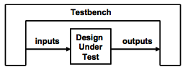
1.9 Testbench Components
Testbench wraps around the Design Under Test
Generate stimulus
Capture response
Check for correctness
Measure progress through coverage numbers
Features of an effective testbench
Reusable and easy to modify for different DUTs <- Object oriented
Testbench should be layered to enable reuse
Flat testbenches are hard to expand.
Separate code into smaller pieces that can be developed separately and combine common actions together
Catches bugs and achieves coverage quickly <- Randomize!
Notes:
Layering refers to abstracting away details. For example instead of manipulating pins to create a memory read create a memory read task. Then create another layer of higher level tasks that use your memory read task, for example, a DMA. Keep abstracting to higher level tasks.
Partition your code into simple easy to understand/maintain blocks.
Remember that any device your DUT talks to must be emulated in your testbench. For example, if your device is a USB device (i.e. a slave) you’ll need to emulate a USB host (i.e. master). This is where verification IP comes into play. Buy a model of a USB host instead of building your own.

Slide 27
1.10 Layered Testbench
Flat testbench
Layered testbench
//Write 32’hFFFF to 16’h50
@(posedge clk);
PAddr <= 16’h50;
PWData <= 32’hFFFF;
PWrite <= 1’b1;
PSel <= 1’b1;
// Toggle PEnable
@(posedge clk);
PEnable <= 1’b1;
@(posedge clk);
PEnable <= 1’b0;
task write(reg[15:0] addr,
reg [31:0] data);
@(posedge clk);
PAddr <= addr;
PWData <= data;
PWrite <= 1’b1;
PSel <= 1’b1;
// Toggle PEnable
@(posedge clk);
PEnable <= 1’b1;
@(posedge clk);
PEnable <= 1’b0;
endtask
Notes:
This is an example of a write transaction on an AMBA APB bus (AMBA peripheral bus) and would be the first attempt at abstracting away pin level stimulus through layering.
The flat testbench is tedius, error prone, and hard to maintain. What if the address or data width changed? Or if you wanted to change the timing?
A layered testbench is resuable and extendable. Call this task from your testbench with the data and address you choose. This is also called testing at the transaction level.

Slide 28
1.10.2 Signal and Command Layers
Signal Layer
DUT and all pin level connections
Command Layer
Driver converts low level commands to inputs of DUT
Assertions look at I/O or internal signals of DUT
Monitor converts outputs of DUT to low level transaction results
Notes:
1) The first layer is the command layer. It abstracts the I/O pins of the DUT into the low level commands
2) The write task in the last slide would be in the driver.
3) A task that collects the results of a read would be in the monitor.

Slide 29
1.10.3 Functional Layer
Agent
Breaks down higher level commands into low level commands
Informs the Scoreboard of commands sent to the DUT
Scoreboard
Predicts the results of the commands
Checker
Compares result predicted by scoreboard with the result collected by the Monitor
Notes:
For example:
1) The Agent could break a DMA command into low level writes and reads.
2) The Scoreboard will predict the result of each low level command. For example, if the DUT was a memory controller it would keep track of all the reads and writes so it could predict the results of the next read.
3) The Checker compares the predicted result from the Scoreboard and the actual result from the Monitor.

Slide 30
1.10.4 Scenario Layer
Generator
Breaks down a scenario into high level commands
Scenario examples for an MP3 player
play music from storage
download new music
adjust volume
change tracks, etc.
Notes:
1) The functional layer is driven by the generator in the scenario layer.
2) At this point we have all the blocks that define our testbench environment. The testbench environment does not change for individual tests.

Slide 31
1.10.5 Test Layer and Functional Coverage
Test block determines:
What scenarios to run
Timing of scenarios
Random constraints
Functional Coverage
Measures progress of tests
Changes throughout project
Notes:
1) This is the full testbench.
2) Functional coverage measures the progress of all tests in fulfillign the verification plan requirements. The functional coverage code changes throughout the project as the various criteria complete. This code is constantly being modified, and thus it is not part of the test independent environment.
3) You might need less or more layers in your testbench. If your DUT has many protocol layers use a testbench layer for each protocol.
For our MP3 example:
Test a turn-on of the MP3 player.
The Test will generate the following scenarios, hit power button, select track, adjust volume.

Slide 32
1.12 Simulation Environment Phases
Build
Generate DUT configuration and environment configuration
Build testbench environment
Reset the DUT
Configure the DUT
Run
Start environment
Run the test
Wrap-up
Sweep
Report
Notes:
1) Build
Generate DUT configuration – Might be random, might be directed.
Build testbench environment – In SystemVerilog testbench components can be created on the fly. For example, if the configuration of the DUT chose 3 bus drivers allocate/initialize them here.
Reset the DUT
Configure the DUT – Might require loading the DUT config regs
2) Run – The phase where the test actually runs.
Start environment -Perhaps initializing all the blocks in the environment?
Run the test – Exectute all the scenarios specified by the Test. Use a timeout checker to fail a test that takes too long.
3) Wrap-up
Sweep – Wait for the final transactions to drain out of the DUT and be processed by the monitor. Sweep the testbench for lost data. Is there still expected data in the scoreboard? Why didn’t a corresponding transaction get reported by the monitor?
Report – Create a final report on whether the test passed or failed. Delete functional coverage info if test failed. You didn’t successfully test a function if the result was incorrect.

Slide 33
1.13 Maximum Code Reuse
Put your effort into your testbench not into your tests.
Write 100’s or 1000’s of directed tests or far fewer random tests.
Use directed test to cover missed functional coverage
Notes:
An ASIC I designed/verified a few years ago required about 150 directed tests. I wish I could redo the verification environment.

Slide 34
1.14 Testbench Performance
Directed tests run quicker than random tests
Random testing explores a wide range of the state space
Simulation time is cheap
Your time is not
Avoid visually verified tests
Test maintenance can be a huge effort
Notes:
Avoid visually verified tests – Create a self checking testbench
The most common reason your tests need to be change is due to a spec change. Would you rather change a bunch of tests or a single scoreboard that predicts the results?

Slide 35
Black/White/Grey Box testing methods
Blackbox verification
Use I/O only for determining bugs
Difficult to fully verify and debug
Whitebox verification
Use I/O and signals in the DUT for determining bugs
Easy to debug
Greybox verification
A hybrid of blackbox and white box verification
Notes:
1) A golden model can be a matlab, SystemVerilog, SystemC model of the DUT or you could be the golden model. For example, the checkers you wrote for the ALU testbench is the receiver and you are the golden model because you tell the checkers what the expected value is. This is a what you think of when you think of verification. Lots of work creating the golden model.
2) White box verification methods use monitors and assertions exclusively to determine correctness. The monitors and assertions observe the input and output of the DUT as well as internal signals. Whitebox verification methods on a netlist is difficuly because the signals in the DUT might be gone or renamed. Lots of work to create the monitors and assertions.
3) Graybox is most typically used. Most of our testbenches will look like this.

