Slide 1
Chapter 9 Functional Coverage Topics
Functional coverage is
Functional coverage is not
Functional coverage strategies
Collecting coverage with covergroups
Coverage options
Bin manipulation
Transition coverage
Cross coverage
Monitoring coverage during simulation
Notes:
What functional coverage is.
What functional coverage is not
Functional coverage strategies when code coverage or functional coverage is lacking.
Basics of collecting coverage with covergroups
Coverage options that drive collection coverage or make the reports easier to read
Bin manipulation like naming and excluding
Transition coverage that track events over time
Cross coverage that collects coverage on the intersection of coverage points
Monitoring coverage during simulation so the testbench can be steered into areas not covered, required for coverage driven verification.

Slide 2
Functional Coverage is:
A measure of which design features have been exercised.
You’ve already performed functional coverage manually
But how do you know if your new random testbench tests these design features?
What if the designer disables a design feature?
BurstWriteTest
.
.
.
BurstReadTest
.
.
.
WriteReadTest
.
.
.
.....
Notes:
For example, for a memory controller that supports bursting reads/writes have I tested that? For a processor have all the opcodes have been executed?
With directed testing the coverage is implicit in the tests, once the BurstWriteTest is complete you’ve covered that design feature. The author calls this implicit coverage because the coverage is implicit in the test.
Perhaps your random testbench isn’t capable of doing burst writes/reads or writes followed by reads? How do you know?
I don’t use the word break because perhaps the design still functions, just not in the mode you think. For example what happens if the designer breaks burst writes. The design still writes but not in a burst manner. Will the testbench catch this? Hard to say. With manual functional coverage you should go back when the design is complete and review each and every test to make sure it still does what it is supposed to. Yeah, right.

Slide 3
Functional Coverage is not
Code coverage
Cannot be automatically determined from the design
Functional coverage goals:
Test loading of register with d = 0 and d=1
Test resetting of register with q=0 and q=1
......
Easy to obtain 100% code coverage on this model
Impossible to obtain 100% functional coverage
module dff(output logic q, input logic clk, d, reset);
always @(posedge clk or negedge reset) begin
q<=d;
end
endmodule
Notes:
Functional coverage is not code coverage
Cannot determine functional coverage requirements directly from the design because the design might not match the spec.
As an example lets consider the faulty model for a Flip-flop
Lets define some functional coverage goals
Test that the flip flop can load both 0’s and 1’s
Test that the flop flop can reset when the flip-flop contains either 0 or 1.
Probably more coverage goals needed. Change d when clock is stable. Flip-flop shouldn’t change
Easy to obtain 100% code coverage on this model since all you have to do is assert a positive edge on clk.
Impossible to obtain 100% functional coverage since the reset is broken.

Slide 4
Functional Coverage Verifies Tests Implement Test Plan
Notes:
No feedback path back to test plan. How do you know the tests actually implemented the test plan? Imagine you are verifying a 10M gate ASIC with 100’s of verification people spread across the world speaking different languages. How you know engineer X in country Y did what he/she said he/she would do? Need a way to track functional coverage automatically. Functional coverage and a simulator that tracks functional coverage will accomplish this for you.

Slide 5
Functional Coverage is a metric for Verification Completeness
Indicates actions required to approach 100% functional coverage
Test Plan
Constrained Random
Tests
Many runs
different seeds
Add
constraints
Directed
Tests
Functional
Coverage
Minimal Code
Modifications
Identify
holes
Notes:
I hesitate to say Functional Coverage determines when verification is complete but it is close
From the testplan the constrained random tests are written.
Run the random tests many times with different seeds.
Analyze results using functional coverage
Have holes? Possibly make minimal code modifications and add constraints to steer testbench into different design space regions.
Still have holes? Write a few directed tests
To complete the picture the functional coverage feeds back to the test plan.

Slide 6
9.2 Functional Coverage Strategies
Gather information, not data
Consider a 1K fifo.
What design features do you want to collect coverage on?
Only measure what you are going to use.
Measuring completeness
Need more FC points,
Including corner cases
Good coverage:
Check bug rate
High
Functional Coverage
Is design complete?
Low
Start of Project
Low
High
Code Coverage
Notes:
The book uses the example of a 1K fifo. Do you want to collect functional coverage that every location has been read/written? That the read/write indices have taken on every possible value? Think about what you would do to visually verify a fifo. You’d write a value and read a value, fill the fifo, empty the fifo, read when empty, and write when full. Also, probably want to make sure the write/read indices wrap properly. If you try every combination of read/write pointer, you have 1,000,000 points. Not practical. Instead of data, think of design features.
Functional coverage takes time in terms of writing functional coverage directives and simulator overhead. Would you want to analyze a coverage report that covers if every fifo location has been read/written or that the read/write indices have taken on every possible value?
Tries to answer the eternal question of when is verification done.
Low code coverage and low functional coverage – Design isn’t complete and neither is your testbench
low code coverage and high functional coverage – Not exercising the design properly and your verification plan is out of date so your functional coverage is out of date. Has the spec been updated?
high code coverage and low functional coverage – Does design implement all specified functionality? Does the coverage need to be updated?
high code coverage and high functional coverage – Your goal. Check bug rate at this point. Is it low? More importantly when you find bugs are they found deliberately or is it a combination of states/inputs you didn’t anticipate. This indicates you don’t know the design well enough.

Slide 7
9.3 Simple Functional Coverage Example
program automatic test(busifc.TB ifc);
class Transaction;
rand bit [31:0] data;
rand bit [ 2:0] port;
endclass
Transaction tr;
covergroup CovPort;
coverpoint tr.port;
endgroup
initial begin
CovPort ck;
ck = new();
repeat (32) begin
@ifc.cb;
tr = new();
`SV_RAND_CHECK(tr.randomize);
ifc.cb.port <= tr.port;
ifc.cb.data <= tr.data;
ck.sample();
end end endprogram
Notes:
Additions to collect functional coverage are in red.
Lets collect coverage on the port to make sure all ports are being tested.
program automatic test(busifc.TB ifc);
class Transaction;
rand bit [31:0] data;
rand bit [ 2:0] port; // Eight potential port numbers
endclass
Transaction tr; // Needs to be defined before the covergroup.
covergroup Covdst;
coverpoint tr.dst; // Measure coverage on the port. Note that coverage collection is on the object, not the class.
endgroup
initial begin
Covdst ck;
ck = new(); // Instantiate the cover group
tr = new();
repeat (32) begin // Run a few cycles
assert(tr.randomize); // Create a transaction
ifc.cb.dst <= tr.dst; // and transmit
ifc.cb.data <= tr.data; // onto interface
ck.sample(); // Gather coverage
@ifc.cb; // Wait a cycle
end
end
endprogram

Slide 8
Questa Coverage Results
VSIM>coverage report -verbose
# COVERGROUP COVERAGE:
# ---------------------------------------------------------------
# Covergroup Metric Goal/Status
# At Least
# ---------------------------------------------------------------
# TYPE /top/test/CovPort 100.0% 100 Covered
# Coverpoint CovPort::#coverpoint__0# 100.0% 100 Covered
# covered/total bins: 8 8
# bin auto[0] 5 1 Covered
# bin auto[1] 7 1 Covered
# bin auto[2] 3 1 Covered
# bin auto[3] 4 1 Covered
# bin auto[4] 2 1 Covered
# bin auto[5] 4 1 Covered
# bin auto[6] 3 1 Covered
# bin auto[7] 4 1 Covered
Notes:
Command to collect coverage on the command line for Questa is: coverage report –verbose
Note that 8 bins were created which correspond to the 8 possibilities on DUT input dst.
All 8 bits are listed as auto which means it was automatically created. Bins can be explicitly defined by the user.
The goal is 100% coverage which means dst equaled 0-7.
The 2nd column lists how many times each bin (i.e. the dst) was hit. These columns (don’t consider the first 8) add up to 32 which is the range on the repeat.
3rd column is the goal/status. Goal is 1. Also the string “Covered” is listed. It will say ZERO if not covered.
Lets see how to collect coverage in the GUI and then look at the new coverage constructs in this example.

Slide 9
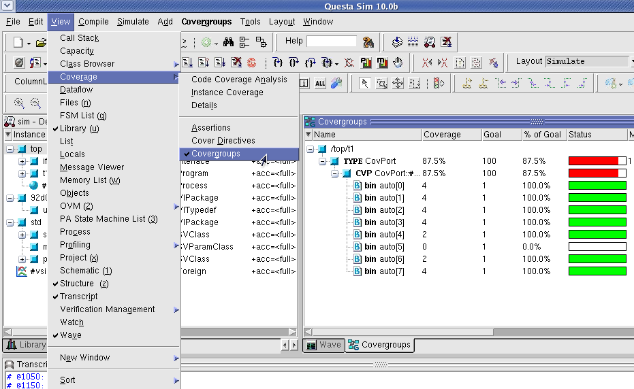
Coverage Results in the Questa GUI
Notes:
1) In questasim do View->Coverage->Covergroups
2) As you can see you get 8 coverage bins and nice color bars to see if your test hit the coverage goal of 100% Coverage column says how many times the bin was covered.
3) Note that this example does not correspond with the example in the previous slides. I want to show you what 0% or sub 90% coverage looks like. You can vary what coverage crieria puts a result in the “red” zone.

Slide 10
9.4 Anatomy of a Cover Group
A covergroup can be defined in a package, module, program, interface, or class.
Needs to be instantiated using new()
Contain:
A clocking event
1 or more coverage points
Cross coverage between coverage points
Optional formal arguments
Coverage options
Recommendations
Use clear names for covergroups
Don’t define a covergroup in a data class.
Label the coverpoints
Notes:
Where the covergroup is defined restricts what it can collect coverage on. Define covergroup in a class, can only collect coverage on class or embedded class members.
A clocking event that indicates when coverage is to be collected. If not defined in the covergroup use the sample() construct as in the example.
A set of coverage points, i.e. what you are going to collect coverage on.
Cross coverage between coverage points. This collects coverage on the intersection of 2 or more coverage points. For the example if we collected cross coverage on data and port we’d know for example when port = 1 and data = 5; As you can imagine cross coverage is very expensive and can create many coverage bins. Generally don’t want cross coverage on data.
Optional formal arguments passed in through the constructor new.
Coverage options to control and regulate how coverage data are structured and collected. Examples are weights, goals, collection on a instance or module basis, auto_bin_max .
Use clear names for covergroups since there could be hundreds of these in a coverage report. Use a name that can be easily referenced back to a requirement in the test plan.
Don’t define a covergroup in a data class like a transaction due to the overhead of creating possibly thousands of transaction objects and carrying coverage information with it.
Label the coverpoints which we’ll see an example of in a few slides.

Slide 11
9.4.1 Defining a Covergroup in a Class
class Transactor;
Transaction tr;
mailbox #(Transaction) mbx;
covergroup CovPort;
coverpoint tr.port;
endgroup
function new(input mailbox #(Transaction) mbx);
CovPort = new();
this.mbx = mbx;
endfunction
task run();
forever begin
mbx.get(tr);
@ifc.cb;
ifc.cb.port <= tr.port;
ifc.cb.data <= tr.data;
CovPort.sample();
end
endtask
endclass
Notes:
Additions to collect functional coverage are in red.
class Transactor;
Transaction tr; // Declare a handle to a transaction class
mailbox #(Transaction) mbx; // Declare a handle to a mailbox
covergroup CovPort;
coverpoint tr.Port;
endgroup
function new(input mailbox #(Transaction) mbx);
CovPort = new(); // Instantiate covergroup in the custom constructor.
this.mbx = mbx; // Set mailbox handle defined in the class to equal the mailbox handle passed into the constructor so the they both point to the same mailbox.
endfunction
task main;
forever begin
mbx.get(tr); // Get next transaction
@ifc.cb; // Advance to next clock edge defined in clocking block, cb.
ifc.cb.port <= tr.port; // Send port into DUT via <interface>.<clocking block> from transaction
ifc.cb.data <= tr.data; // Send data into DUT via <interface>.<clocking block> from transaction
CovPort.sample(); // Gather coverage
end
endtask
endclass
Note that no handle to CovPort was declared. If the covergroup is defined in a class, you do not make a separate name when you sample it. Just use the original covergroup name.

Slide 12
9.5 Triggering in a Cover Group
Covergroup is triggered from:
A sample directive from procedural code
A blocking expression in the covergroup
CovPort.sample();
color_t color;
covergroup g1 @(posedge clk);
coverpoint color;
endgroup
event trans_ready;
covergroup CovPort @(trans_ready);
coverpoint ifc.cb.port;
endgroup
Notes:
Like we saw in the last example
A covergroup blocking expression can NOT be a wait. It can be:
@(event)
@(signal)
@(posedge signal)
@(negedge signal)

Slide 13
Exercise 1
For the code below, write a covergroup to collect coverage on the test plan requirement: “All ALU opcodes must be tested”.
Assume the opcodes are valid on the positive edge of signal clk.
typedef enum {ADD, SUB, MULT, DIV} opcode_e;
class Transaction;
rand opcode_e opcode;
rand byte operand1;
rand byte operand2;
endclass
Transaction tr;
Notes:
See Chap_9_Functional_Coverage/exercise1 for complete solution.
covergroup CovCode @ifc.cb; //If using an interface, @(posedge clk) if the clock is available.
coverpoint tr.opcode;
endgroup
Coverage is collected just before events in the pre-poned region we talked about when going over clocking blocks. So for posedge clock the opcode is sampled just before the posedge of clock.

Slide 14
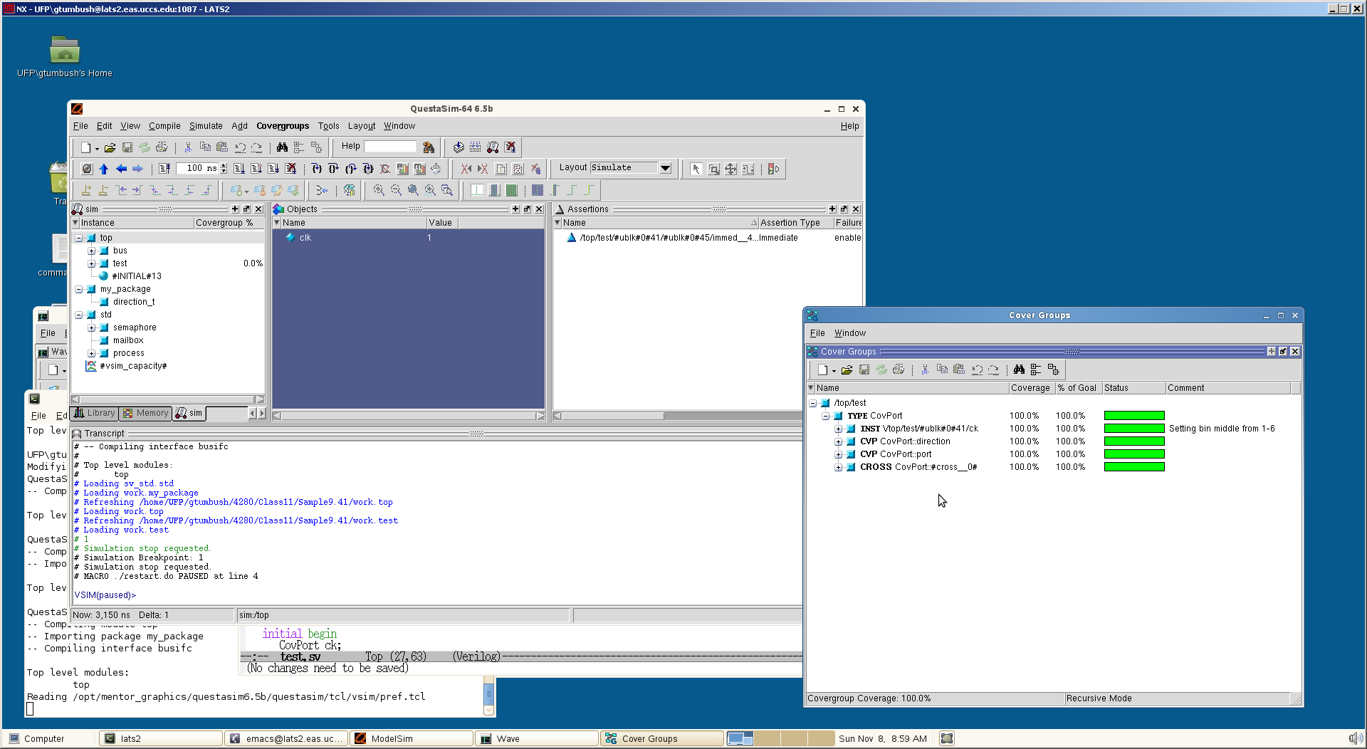
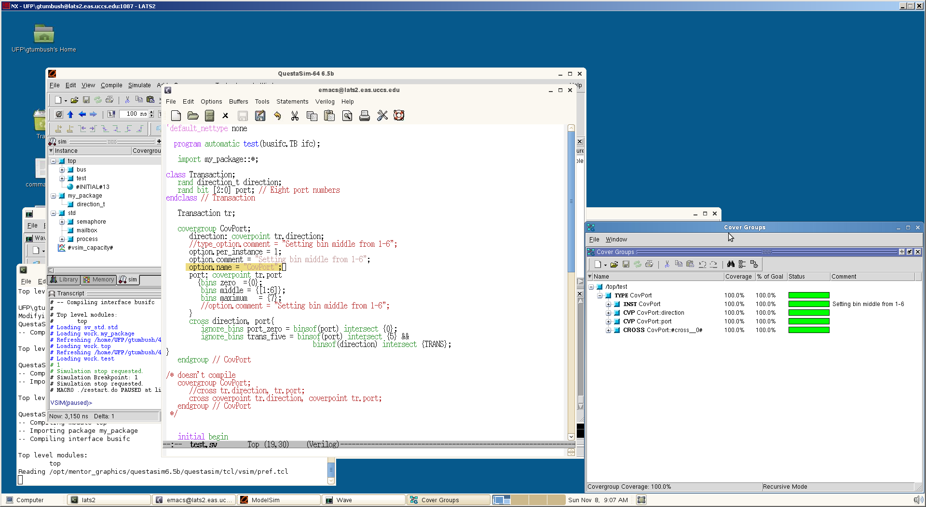
9.9 Coverage Options
Per-instance coverage
Cover group comment
Name
auto_bin_max
weight
option.per_instance = 1;
option.comment = "Setting bin middle from 1-6";
option.name = "CovPort";
Notes:
Need to talk about coverage options before we continue since some of them are required. 2 types of options, those that are specific to an instance of a covergroup and those that specify an option for the covergroup type as a whole. Options can be put into covergroups, coverpoints, and crosses.
If your testbench instantiates a coverage group multiple times, by default all the coverage data from the instances will be combined. To keep track of coverage for each instance separately set this variable to 1.
Comments make your coverpoints easier to understand. Note that I had to set the per-instance option as indicated by INST in the report.
By default a unique name for each instance is automatically generated by the tool. However, note that the covergroup instance name ck is now gone. Your choice.
auto_bin_max and weight which we’ll talk about later.

Slide 15
9.6 Data Sampling
Bins are automatically created for cover points
For an n-bit expression, 2^{N} bins are created.
The maximum number of bins can be reduced by setting the auto_bin_max option.
covergroup CovPort;
option.auto_bin_max = 2;
coverpoint tr.port;
endgroup
default is 64
# Covergroup Metric Goal/ Status
# At Least
# ------------------------------------------------------------
# TYPE /top/test/CovPort 100.0% 100 Covered
# Coverpoint CovPort::#coverpoint__0# 100.0% 100 Covered
# covered/total bins: 2 2
# bin auto[0:3] 19 1 Covered
# bin auto[4:7] 13 1 Covered
Notes:
Bins are automatically created for cover points as indicated by the bin auto in the coverage report.
For an n-bit expression, 2^{N} bins are created so for our 3-bit port coverpoint 2³ =8 bins are created. The range is called the domain of the cover point.
The maximum number of bins can be reduced by setting the auto_bin_max option. The default is 64. If the # of bins required is > than the default the ranges are divided into auto_bin_max bins.
For example, if the number of bins in the example we are using is reduced to 2 coverage will be collected on port = 0:3 and 4:7

Slide 16
9.6.4 Sampling Expressions
Expressions in coverpoints are allowed
But check the report for the correct # of bins.
len16 coverpoint creates 16 bins
len32 coverpoint creates 32 bins
class Packet;
rand bit [2:0] hdr_len;
rand bit [3:0] payload_len;
rand bit [3:0] kind;
endclass
Packet p;
covergroup CovLen;
len16: coverpoint (p.hdr_len + p.payload_len);
len32: coverpoint (p.hdr_len + p.payload_len + 5'b0);
endgroup
Notes:
len16: coverpoint (p.hdr_len + p.payload_len); collects coverage on the total packet length (payload + hdr). len16 is an optional label
len32: coverpoint (p.hdr_len + p.payload_len); collects coverage on the total packet length (payload + hdr+5’b0). len32 is an optional label
len16 coverpoint creates 16 bins because the largest variable in the expression: payload + hdr is 4-bits wide, 2^4=16, so 16 bins
len32 coverpoint creates 32 bins because the largest variable in the expression: payload + hdr+5’b0 is 5-bits wide, 2^4=32, so 32 bins
Is either of these correct? No since header length ranges from 0:7 and payload length ranges from 0:15 the range is 0 to 7+15=22 so 23 bins so len16 doesn’t have enough bins and len32 has too many bins. Auto creation of bins only works when the expected # of bins is a power of 2. We’ll fix this in the next slide.

Slide 17
9.6.4 Sampling Expressions (cont)
Explicitly specify bins if expected # of bins is not a power of 2
covergroup CovLen;
len: coverpoint (p.hdr_len + p.payload_len + 5'b0)
{bins len[] = {[0:22]}; }
endgroup
# Covergroup Metric Goal/ Status
# At Least
# ----------------------------------------------------
# TYPE /top/test/CovLen 100.0% 100 Covered
# Coverpoint CovLen::len 100.0% 100 Covered
# covered/total bins: 23 23
# bin len[0] 7 1 Covered
# bin len[1] 17 1 Covered
.......
# bin len[21] 12 1 Covered
# bin len[22] 9 1 Covered
Notes:
Define the # of bins to be 23. This is the appropriate amount. Need to add 5’b0 so that the addition operation is made with 5 bits of precision or else only 16 bins will be created and no compile error will result.

Slide 18
9.6.6 Naming the cover bins
Define ranges for coverpoints and name the ranges
covergroup CovKind;
coverpoint p.kind {
bins zero = {0};
bins lo = {[1:3], 5};
bins hi[] = {[8:$]};
bins misc = default; }
endgroup
# TYPE /top/test/CovKind 100.0% 100 Covered
# Coverpoint CovKind::#coverpoint__0# 100.0% 100 Covered
# covered/total bins: 10 10
# bin zero 48 1 Covered
# bin lo 252 1 Covered
# bin hi[8] 61 1 Covered
....
# bin hi[15] 70 1 Covered
# default bin misc 174 Occurred
Notes:
1) kind is a 4-bit value
covergroup CovKind;
coverpoint p.kind {
bins zero = {0}; // 1 bin for kind==0
bins lo = {[1:3], 5}; // 1 bin for values 1:3, 5
bins hi[] = {[8:$]}; // 8 separate bins: 8...15. Can use $ for upper and lower limits. The [] operator on the bin name specifies separate bins. Very important if you want 8 separate bins, not just 1 bin for whom the coverage count will increment whenever kind = 8 to 15
bins misc = default; // 1 bin for all the rest
} // No semicolon
endgroup

Slide 19
Exercise 2
Expand the last exercise to cover the test plan requirement, “Operand1 shall take on the values maximum negative (-128), zero, and maximum positive (127).” Define a coverage bin for each of these values as well as a default bin. Label the coverpoint operand1_cp.
typedef enum {ADD, SUB, MULT, DIV} opcode_e;
class Transaction;
rand opcode_e opcode;
rand byte operand1;
rand byte operand2;
endclass
Transaction tr;
Notes:
See Chap_9_Functional_Coverage/exercise2 for complete solution.
covergroup CovCode @ifc.cb;
operand1_cp: coverpoint tr.operand1{
bins max_neg = {-128};
bins zero = {0};
bins max_pos = {127};
bins misc = default;
}
endgroup

Slide 20
9.6.7 Conditional Coverage
Use iff to add a condition to a cover point
Use stop()/start() to halt/resume collection of coverage
covergroup CoverPort;
coverpoint tr.port iff (!bus_if.reset);
endgroup
initial begin
CovPort ck = new();
#1ns ck.stop();
bus_if.reset <= 1;
#100ns bus_if.reset = 0;
ck.start();
...
end
Notes:
1) coverpoints are enabled or on by default
2) Assuming port is a member variable in object pointed to by tr.
covergroup CoverPort;
coverpoint tr.port iff (!bus_if.reset); // Don’t gather coverage when reset==1 so stray triggers are ignored
endgroup
initial begin
CovPort ck = new(); // Instantiate cover group
// Reset sequence stops collection of coverage data
#1ns ck.stop(); // the #1 doesn’t do anything as far as coverage is concerned. It just happens to be in the example to give the reset a positive edge at 1ns
bus_if.reset <= 1;
#100ns bus_if.reset <= 0; // End of reset. A negative edge at 100ns.
ck.start(); // Start collecting coverage again.
...
end

Slide 21
9.6.8 Creating Bins for enumerated types
For enumerated types, a bin is created for each value
To group multiple values in a single bin, define your own bins.
typedef enum {INIT, DECODE, IDLE} fsmstate_e;
fsmstate_e pstate, nstate;
covergroup CovFSM;
coverpoint pstate;
endgroup
covergroup new_bin;
coverpoint pstate {
bins non_idle = {INIT, DECODE};
bins misc = default;
}
endgroup
Notes:
1) For enumerated types a bin is created for each value so for this example 3 bins would be created.
2) To group multiple values in a single bin define your own bins so for this example 2 bins would be created, 1 with INIT and DECODE in it and 1 with the reset (i.e. IDLE).

Slide 22
9.6.9 Transition Coverage
Up to this point only considered static coverage.
Can specify transition coverage
Can specify transitions of any length.
covergroup CovPort;
coverpoint tr.port{
bins zero_one = (0 => 1);
bins zero_two = (0 => 2);
bins zero_to_two = (0 => 1), (0 => 2);
bins zero_to_two_alt = (0=>1,2);
}
endgroup
Equivalent
bins zero_one_two = (0=>1=>2);
bins zero_one_one_two = (0=>1=>1=>2);
bins zero_one_one_two_alt = (0=>1[*2]=>2);
Not Equivalent
Equivalent
Notes:
1) Up to this point only considered static coverage, i.e. what is the value when the sample occurs?
2) Can specify transition coverage, i.e. what is the value across multiple samples?
3) bins zero_one = (0 => 1); // how many times has the port =0 on one sample and the next sample was 1?
4) bins zero_two = (0 => 2); // how many times has the port =0 on one sample and the next sample was 2?
5) bins zero_to_two = (0 => 1), (0 => 2); // How many times has the port = 0 on one sample and transitioned to either 1 or 2 on the next sample. The value from bins zero_one = (0 => 1); and bins zero_two = (0 => 2); added together should equal this.
6) bins zero_to_two_alt = (0=>1,2); // is equivalent.

Slide 23
9.6.10 Wildcard States and Transitions
Suppose we want to collect coverage on port being even or odd
Or use wildcard keyword
covergroup CovPort;
coverpoint tr.port[0]{
bins even = {1'b0};
bins odd = {1'b1};
}
endgroup
covergroup CovPort;
coverpoint tr.port{
wildcard bins even = {3'b??0};
wildcard bins odd = {3'b??1};
}
endgroup
{3'bXX0};
{3'bXX1};
or
or
{3'bZZ0};
{3'bZZ1};
Notes:
The first example would accomplish this by examining the least significant bit of port, i.e. port[0] because we can specify collection on ranges of bits of port
Another option is to use the wildcard keyword. Any X, Z, or ? in the expression is treated as a wildcard for 0 or 1.
These are 2 other options since Z, X, ? are equivalent.
Note that if the # of bits specified to wildcard is less, for example, odd={3’bZ1} the results are same, essentially z padding.

Slide 24
9.6.11 Ignoring Values
Suppose, due to the design, port will never exceed the value 5
One solution is to create a custom bin
Another solution is to use the ignore_bins construct.
covergroup CovPort;
coverpoint tr.port{
bins zero_to_five[] = {[0:5]};
}
endgroup
covergroup CovPort;
coverpoint tr.port{
ignore_bins hi = {6,7};
}
endgroup
Notes:
Suppose due to the design 3-bit port will never exceed the value 5 which means the coverage will never exceed 75% because port[0]-port[5] will covered but port [6] and port [7] will not. How do you get around this?
One solution is custom coverage bins. Specify a range from 0 to 5 to collect coverage on.
Another solution is to allow auto bins to be created and use the ignore_bins construct.

Slide 25
9.6.12 Illegal Bins
If certain ranges of a variable are illegal (you think!) define them as illegal.
covergroup CovPort;
coverpoint tr.port{
bins zero_to_five[] = {[0:5]};
illegal_bins no_hi = {6,7};
}
endgroup
or
covergroup CovPort;
coverpoint tr.port{
ignore_bins hi = {6,7};
illegal_bins no_hi = {6,7};
}
endgroup
Notes:
Useful to check if your testbench or design is not doing what you think it is or with your bin definitions
Two options to solving this problem.
Create a custom bin for port = 0:5 and declare an illegal bin for port = 6,7
Declare a ignore bin for port = 6,7 so coverage is not collected on it and an illegal bin to raise an error if port = 6 or 7 is encountered.
Illegal bins can be used with both custom bins and ignored bins
If an illegal bin is encountered an error is printed to the transcript window but the simulation keeps running.
# ** Error: (vsim-8565) Illegal state bin got covered at value='b110. The bin counter for the illegal bin '\/top/test/#ublk#0#22/ck .#coverpoint__0#.hi' is 1.
#

Slide 26
Exercise 3
Expand the last exercise to cover the following test plan requirements:
“The opcode shall take on the values ADD or SUB” (hint: this is 1 coverage bin).
“The opcode shall take on the values ADD followed by SUB” (hint: this is a second coverage bin).
“Opcode must not equal DIV” (hint: report an error using illegal_bins).
Label the coverpoint opcode_cp.
typedef enum {ADD, SUB, MULT, DIV} opcode_e;
class Transaction;
rand opcode_e opcode;
rand byte operand1;
rand byte operand2;
endclass
Transaction tr;
Notes:
See Chap_9_Functional_Coverage/exercise3_4 for complete solution.
opcode_cp: coverpoint tr.opcode{
bins add_sub = {ADD, SUB};
bins add_then_sub = (ADD=>SUB);
illegal_bins no_div = {DIV};
}

Slide 27
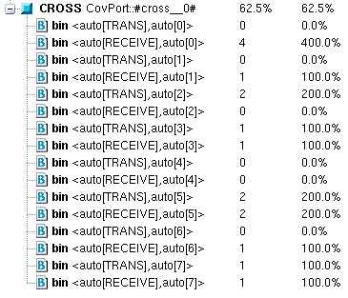
9.7 Cross Coverage
Cross coverage collects coverage on the intersection of 2 or more coverage points.
typedef enum {TRANS, RECEIVE} direction_e;
class Transaction;
rand direction_e direction;
rand bit [2:0] port;
endclass
covergroup CovPort;
cross tr.direction, tr.port;
endgroup
covergroup CovPort;
direction: coverpoint tr.direction;
port: coverpoint tr.port;
cross direction, port;
endgroup
Notes:
Suppose for class Transaction we want to collect cross coverage on direction and the port. With cross coverage I can determine for example, how many times port 5 has transmitted.
Might be tempted to do cross tr.direction, tr.port;
However, need to label the individual coverpoints and then do a cross on the labels. This doesn’t work either: cross coverpoint tr.direction, coverpoint tr.port;
You can see how cross coverage can get very expensive very quickly particularly when crossing with anything of more than a few bits. Crossing two 4-bit numbers creates 256 bins (2^4 * 2^4) = 256

Slide 28
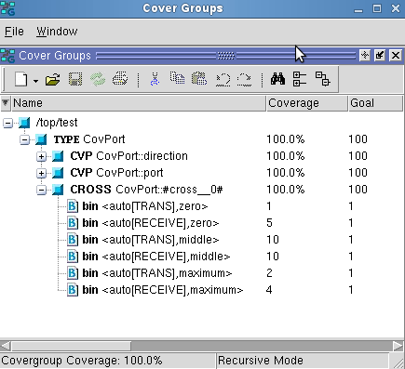
9.7.2 Labeling Cross Coverage Bins
To reduce the # of bins, create custom bins
covergroup CovPort;
direction: coverpoint tr.direction;
port: coverpoint tr.port{
bins zero ={0};
bins middle = {[1:6]};
bins maximum = {7};
}
cross direction, port;
endgroup
bins misc = default;
Notes:
In this example get 6 bins, 3 for coverpoint label port * 2 for coverpoint label direction=6
Interestingly enough if I create a default bin like bins misc = default; instead of creating a middle bin I don’t collect coverage on port = 1 through 6.

Slide 29
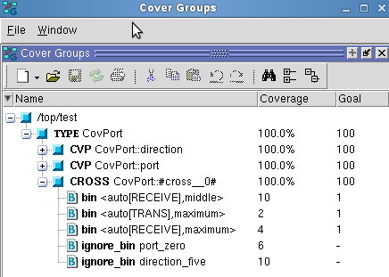
9.7.3 Excluding Cross Coverage Bins
As before use ignore_bins to reduce the # of cross coverage bins
Use binsof & intersect to specify cross coverage bins to ignore
covergroup CovPort;
direction: coverpoint tr.direction;
port: coverpoint tr.port {
bins zero ={0};
bins middle = {[1:6]};
bins maximum = {7};
}
cross direction, port{
ignore_bins port_zero = binsof(port) intersect {0};
ignore_bins port_0 = binsof(port.zero);
ignore_bins trans_five = binsof(port) intersect {5} &&
binsof(direction) intersect {TRANS};
} endgroup
Equivalent
Notes:
As before use ignore_bins to reduce the # of bins
ignore_bins port_zero = binsof(port) intersect {0}; will ignore the intersection of port=0 and any value of direction.
ignore_bins trans_five = binsof(port) intersect {5} && binsof(direction) intersect {TRANS}; will ignore the intersection of any bin that has port=5 in it and the direction = transmit.
Notice that the only bins left are receive middle, transmit max, and receive max.
It was surprising to me that ignoring any value in a bin (in this case 5) will ignore the entire bin (in this case middle).

Slide 30
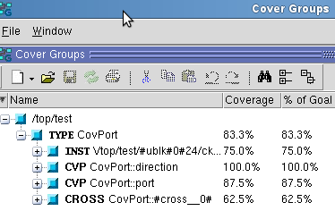
9.7.4 Excluding Cover Points from the Total Coverage Metric
Suppose you define a cover point just to be used for cross coverage
Use weight to ignore the coverage contribution of this cover point.
covergroup CovPort;
option.per_instance = 1;
direction: coverpoint tr.direction;
port: coverpoint tr.port
{option.weight = 0;}
cross direction, port
{option.weight = 2;}
endgroup
Notes:
1) For example, you want to report total cross coverage on the port and direction but not on the port or to give certain coverage more weight.
2) Weight can be set at the covergroup level, to specify the weight of this covergroup instance for computing the overall instance coverage of the simulation.
3) If set at the coverpoint (or cross) syntactic level, it specifies the weight of a coverpoint (or cross) for computing the instance coverage of the enclosing covergroup.
4) Need to set the per_instance option so that coverage for each coverpoint is considered in the total coverage #.
5) Instance Coverage = ((coverage of cross)*2 + coverage of direction * 1)/3 = (62.5%*2+100%)/3=75% Note that coverage of port is not included in this calculation because the weight is 0.
NOTE: Default weight is 1. Weights cannot be set on a bin by bin basis only on a coverpoint.

Slide 31
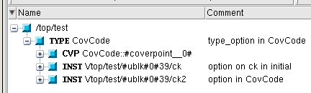
type_option vs option
type_option.<option> specifies an option for the covergroup
option.<option> specifies an option for an instance of the covergroup
covergroup CovCode;
coverpoint tr.opcode;
option.per_instance = 1;
type_option.comment = "type_option in CovCode";
option.comment = "option in CovCode";
endgroup
initial begin
CovCode ck, ck2;
ck = new();
ck2 = new();
tr = new();
ck.option.comment = "option on ck in initial";
....
end
Notes:
Some options like strobe and merge_instances can only be set by type_option.<option>
Some options like per_instance, auto_bin_max, etc can only be set by option.<option>
Other options like weight, comment, etc can be set by either and impact the covergroup or an instance of the covergroup.
As can be seen from this example:
A comment set using type_option is set on the covergroups itself, in this case CovCode
A comment set using option in the covergroup is set on all instances of the covergroup, in this case ck2
However, an comment set using option can be overridden by specific instances, in this case ck
Similar behavior with weight and others.

Slide 32
Exercise 4
Expand the last exercise to:
Collect coverage on the test plan requirement, “The opcode shall take on the values ADD or SUB when operand1 is maximum negative or maximum positive value.”
Weight the cross coverage by 5
typedef enum {ADD, SUB, MULT, DIV} opcode_e;
class Transaction;
rand opcode_e opcode;
rand byte operand1;
rand byte operand2;
endclass
Transaction tr;
Notes:
See Chap_9_Functional_Coverage/exercise5 for complete solution.
Collect coverage on ADD and SUB bin being max or min -> implies cross coverage.
To review, the bins that were created in Exercise 2 and 3 are:
Exercise 2:
4 operand1_cp bins:
bins max_neg = {-128};
bins zero = {0};
bins max_pos = {127};
bins misc = default; // ignored in cross
Exercise 3:
3 opcode_cp bins:
bins add_sub = {ADD, SUB};
bins add_then_sub = (ADD=>SUB);
illegal_bins no_div = {DIV};
If we simply cross opcode_cp and operand1_cp get the following 6 bins:
{max_neg, add_sub}, (zero, add_sub}, {max_pos, add_sub}, {max_neg, add_then_sub}, (zero, add_then_sub}, {max_pos, add_then_sub},
Want to ignore {zero, add_sub} and all {*, add_then_sub} for a total of 4 ignored bins, leaving 2 bins
2 bins left: {add_sub, max_neg} and {add_sub, max_pos}
// Removes bins {add_sub, zero} and {add_then_sub, zero}
opcode_operand1: cross opcode_cp, operand1_cp {
// ignore_bins operand1_zero = binsof(operand1_cp.zero); // Ignore operand1 = 0
// or
ignore_bins operand1_zero = binsof(operand1_cp) intersect{0}; // Ignore operand1 = 0
// Removes bins {*, add_then_sub}
ignore_bins opcode_add_then_sub = binsof(opcode_cp.add_then_sub); // Ignore opcode = add_then_sub
// But not this since it does not compile with a not very descriptive syntax error.
ignore_bins opcode_add_then_sub = binsof(opcode_cp) intersect{ADD=>SUB};
option.weight = 5;
}

Slide 33
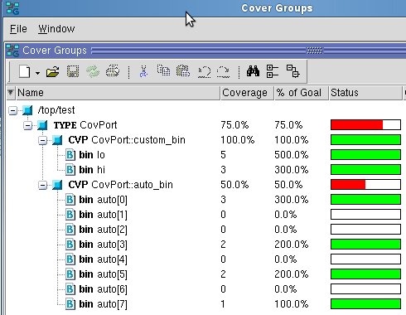
9.8.1 Pass Cover Group Args. by Value
Reuse covergroups by passing in arguments to new();
covergroup CovPort(int mid);
custom_bin: coverpoint tr.port
{bins lo = {[0:mid-1]};
bins hi = {[mid:$]};
}
auto_bin: coverpoint tr.port;
endgroup
initial begin
CovPort cp;
cp = new(5);
end
Notes:
In this way I can define custom bins without changing the covergroup.
In this example I’ve defined two bins one from 0 to mid-1 and another from mid to the max
I’m also defining another coverpoint and letting the tool autocreate the bins.
Instantiate the covergroup and pass in 5 as the mid value. 2 bins are created, 0 to 4 and 5 to 8. Note that there is no default so not passing in a value is a compile error.
As you can see bin 0-4 (lo) has 5 hits and 5-8 (hi) have 3 hits which correlates to the auto created bins.

Slide 34
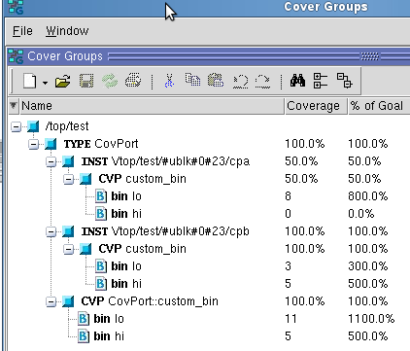
9.8.2 Pass Cover Group Args. by Ref.
To make covergroups even more generic pass args by reference
covergroup CovPort(ref bit [2:0] port, input int mid);
option.per_instance = 1;
custom_bin: coverpoint port
{bins lo = {[0:mid-1]};
bins hi = {[mid:$]};
}
endgroup
initial begin
CovPort cpa, cpb;
tr = new();
cpa = new(tr.port_a, 6);
cpb = new(tr.port_b, 2);
end
Notes:
Need to pass port in by reference or else the only value of port collected will be the value when new is called.
I’ve added another port to my class, so now have port_a and port_b
tr= new is just constructing the transaction object which is not shown.
Note that all of port_a’s values were between 0 and 5 while for port_b 3 were 0 and 1 and 5 were between 2 and 7.
If I didn’t set the per_instance option I would have only gotten a report of the total coverage bin.

Slide 35
9.11 Measuring Coverage Statistics During Simulation
Evaluate coverage statistics during simulation to:
Quit the simulation
Change constraints
Evaluate how simulation is progressing
initial begin
forever begin
repeat (4) @ifc.cb;
$display("%t: Instantiation total coverage is %f", $time,
ck.get_coverage());
$display("%t: Covergroup total coverage is %f", $time,
CovPort::get_coverage());
$display("%t: Instantiation Dir x port coverage is %f", $time, ck.dir_port.get_coverage());
$display("%t: Covergroup Dir x port coverage is %f", $time, CovPort::dir_port.get_coverage());
end
end
Notes:
Once you’ve reached your coverage goals quit
If the coverage isn’t increasing or is sufficient in one area change the constraints on the fly
See if the coverage is increasing.
Every 4 clock cycles display some coverage
Total coverage on an instance basis
total coverage on a covergroup basis
Labeled cross coverage with dir_port on an instance basis
Labeled cross coverage with dir_port on a covergroup basis

Slide 36
Changes to Questa Covergroups between 6.5b and later versions
In Questa 6.5b and older the bins for a covergroup were displayed by opening up a covergroup in the covergroups window. Now, in later versions they are not. How do I go back to the old functionality?
merge_instances=1: Coverage is computed by merging instances together as the union of coverage of all instances.
Bins required
merge_instances=0: Coverage is computed as the weighted average of instances.
Bins not required
type_option.merge_instances = 1;
vsim –cvg63
Notes:
1) To do this must calculate bins. This was the default in the 2007 LRM
2) To do this do not need to calculate bins. This is the default in the 2009 LRM
which Questasim started supporting sometime between 6.5b and 6.6b.
3) To see bins need to go back to old functionality by either setting type_option.merge_instances = 1; in every covergroup or using the vsim –cvg63 option to vsim

Slide 37
Exercise 5
Assuming that your covergroup is called CovCode and the instantiation name of the covergroup is ck expand the last exercise to:
Display the coverage of coverpoint operand1_cp referenced by the instantiation name
Display the coverage of coverpoint opcode_cp referenced by the covergroup name
typedef enum {ADD, SUB, MULT, DIV} opcode_t;
class Transaction;
rand opcode_t opcode;
rand byte operand1;
rand byte operand2;
endclass
Transaction tr;
Notes:
$display("%t: Coverpoint ck.operand1_cp coverage is %f", $time, ck.operand1_cp.get_coverage());
$display("%t: Covergroup CovCode::opcode_cp is %f", $time, CovCode::opcode_cp.get_coverage());

