Slide 1
How to use the MicroBlaze Micro Controller System (MCS) from LabVIEW 2017
using the National Instruments PXIe-6592R High-Speed Serial Instrument Board
Xilinx Part: xc7k410tffg900-2
by John Stratoudakis

Slide 2
Github: https://github.com/JohnStratoudakis/LabVIEW_Fpga/tree/master/05_MicroBlaze_Mcs/01_MicroBlaze_Mcs_GPIO WordPress: http://fpganow.com/index.php/2017/06/23/how-to-use-the-microblaze-micro-controller-system-from-labview/

Slide 3
See more at fpganow.com Get help at wallstreetfpga.com

Slide 4
Section 1 – Vivado 2015.4

Slide 5
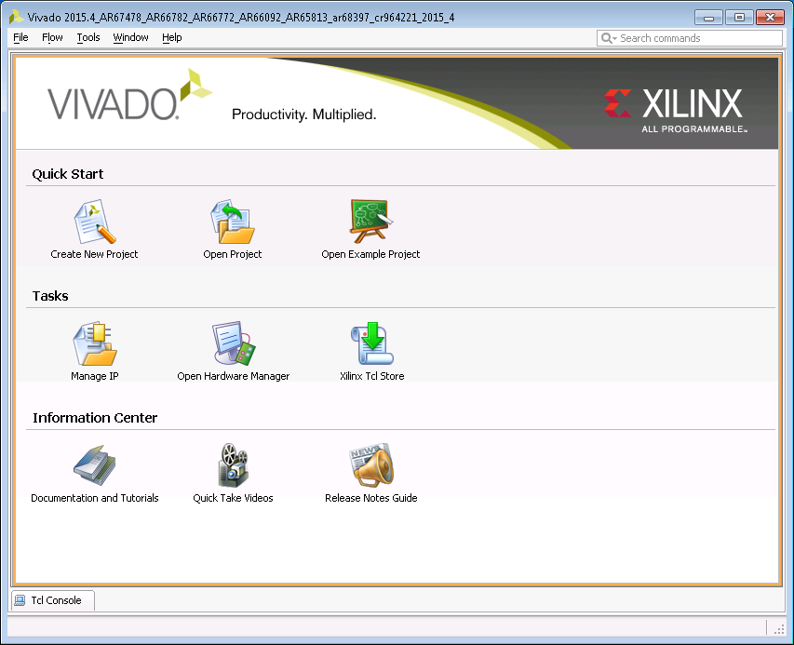

Slide 6
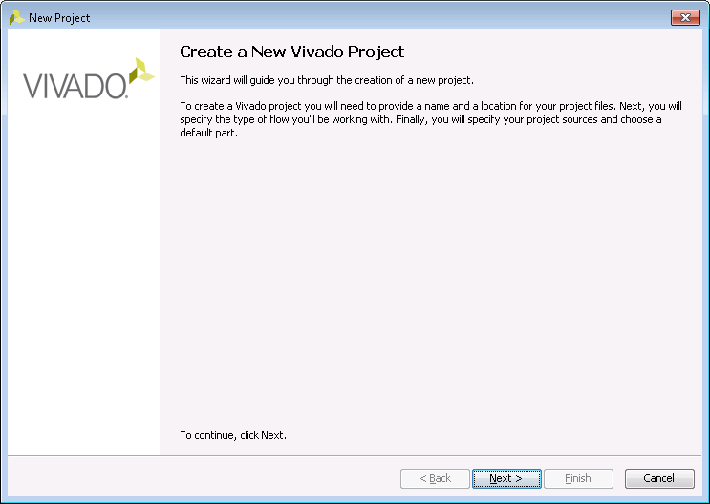

Slide 7
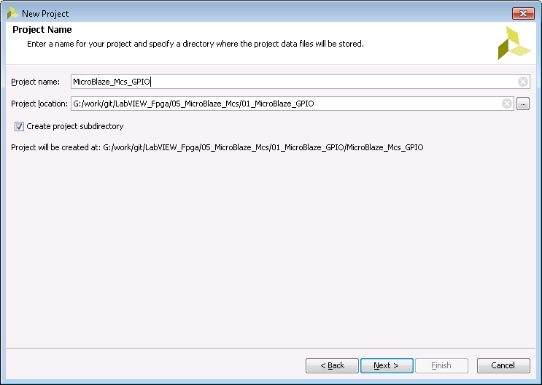

Slide 8
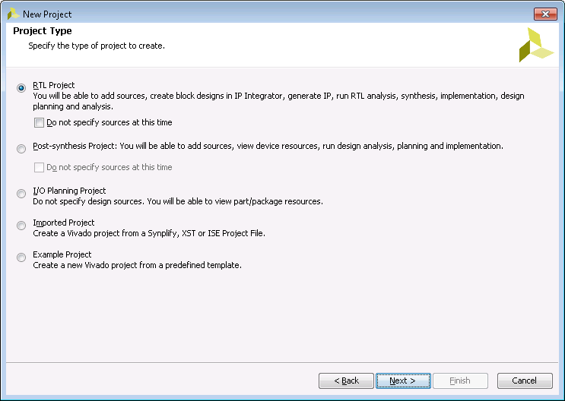

Slide 9
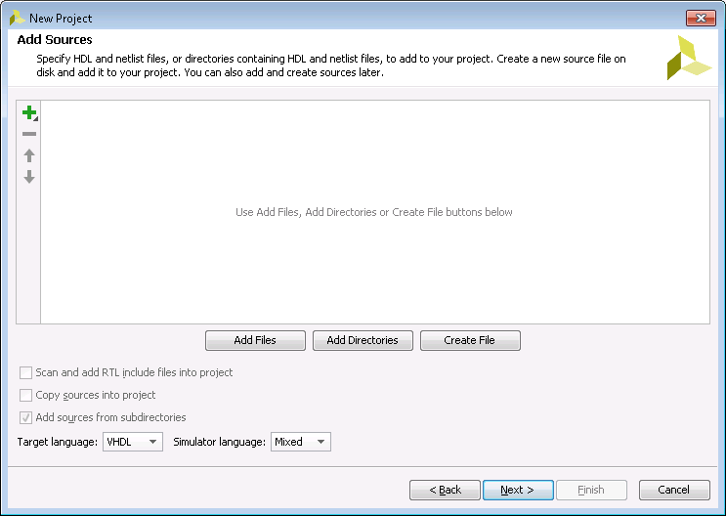

Slide 10
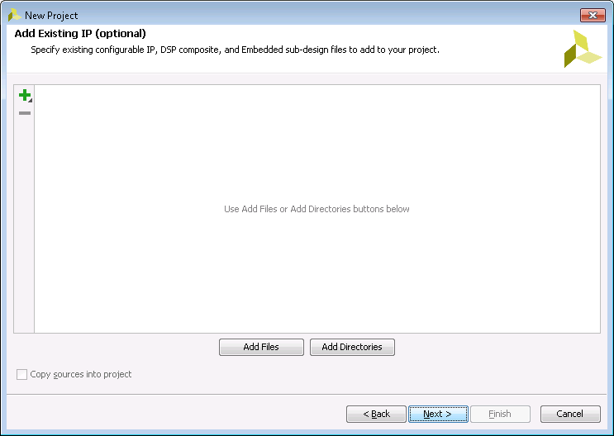

Slide 11
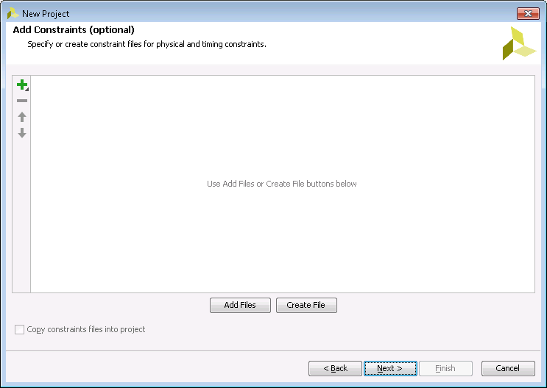

Slide 12
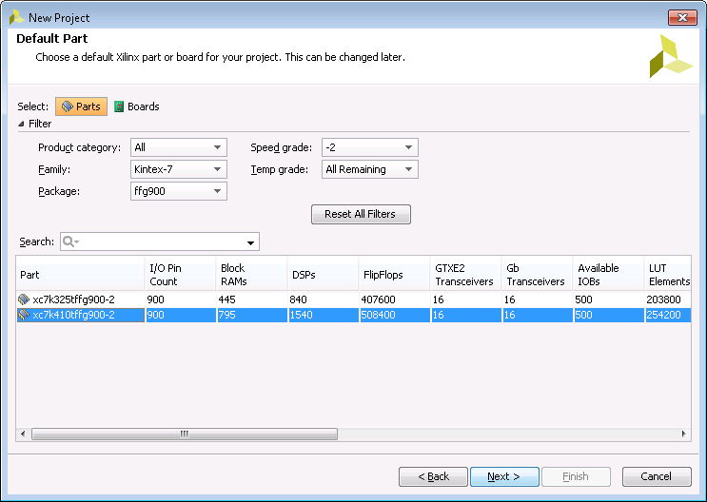

Slide 13
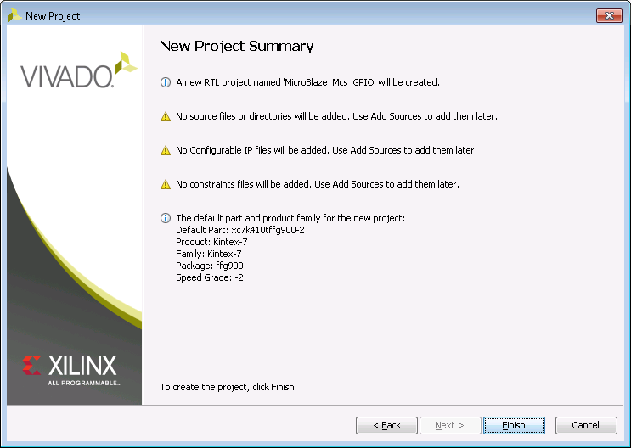

Slide 14
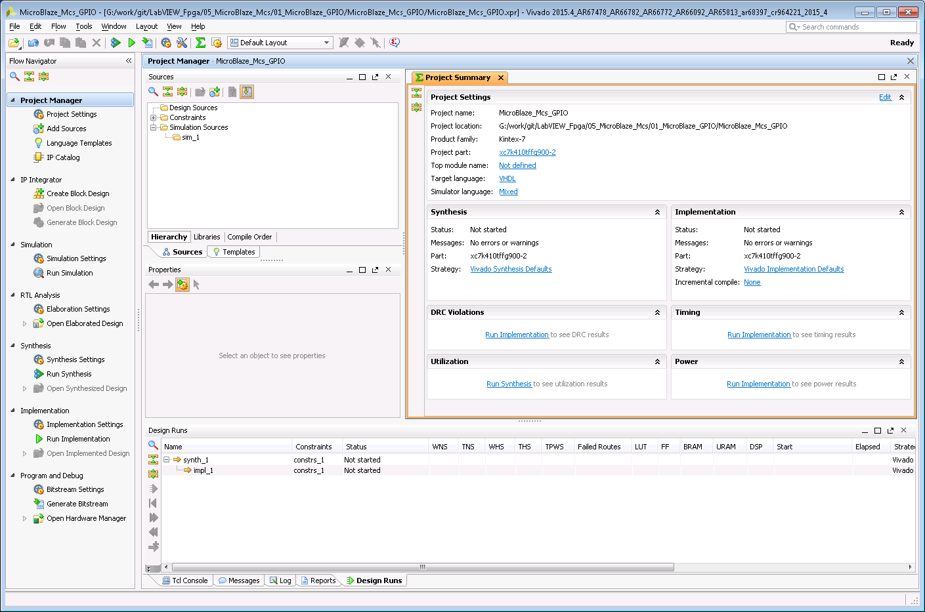

Slide 15
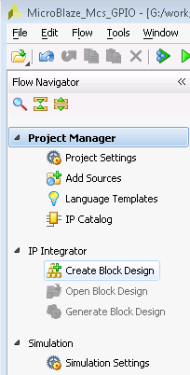

Slide 16
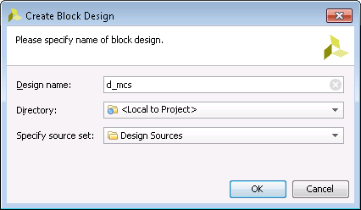

Slide 17
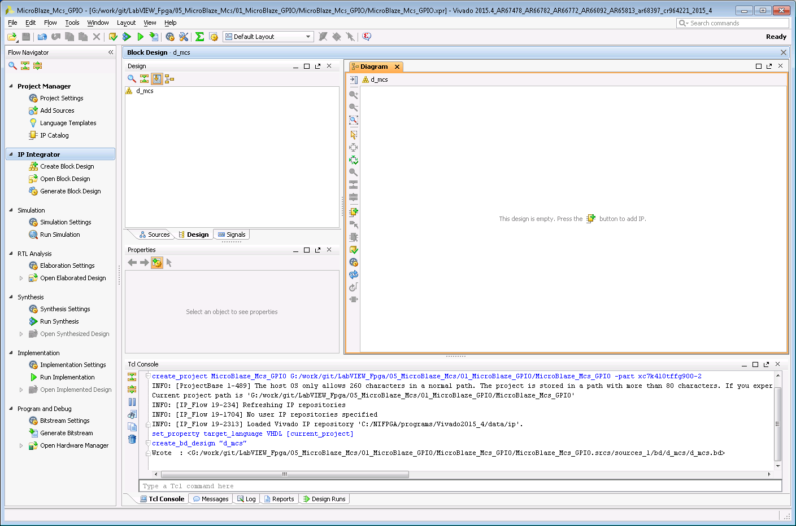

Slide 18
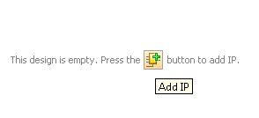

Slide 19
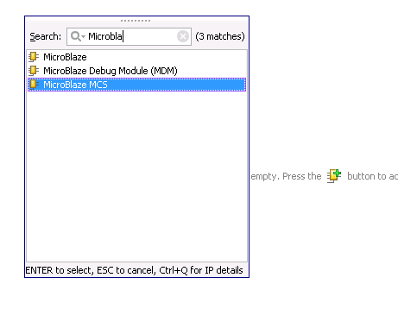

Slide 20
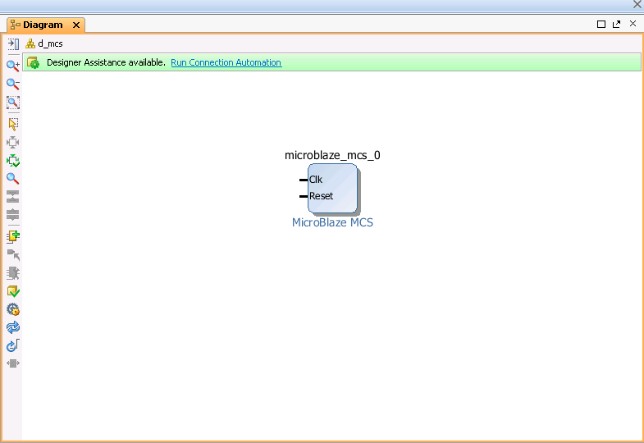

Slide 21
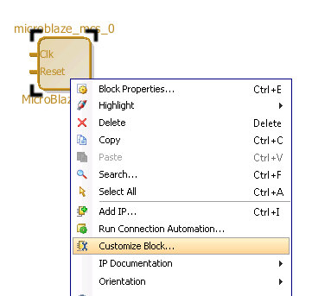

Slide 22
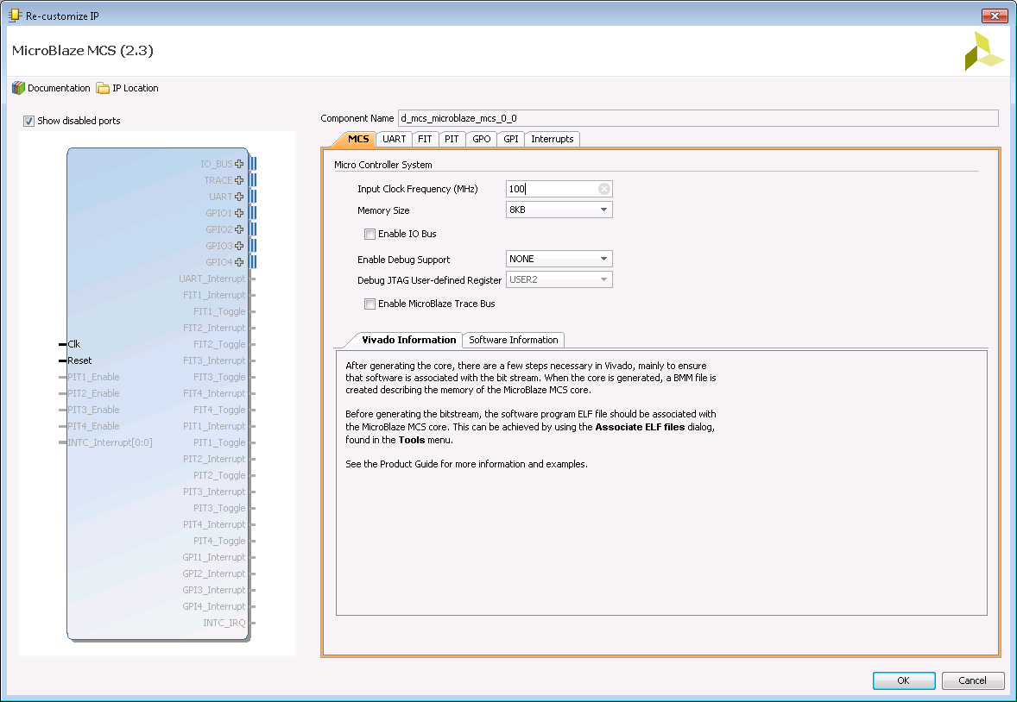

Slide 23
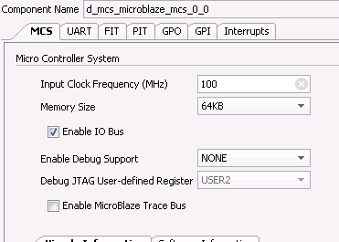

Slide 24
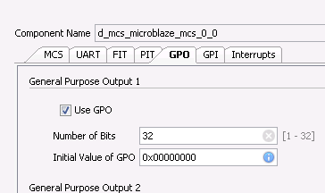

Slide 25
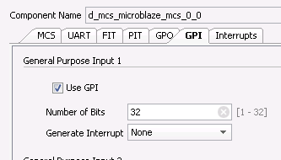

Slide 26
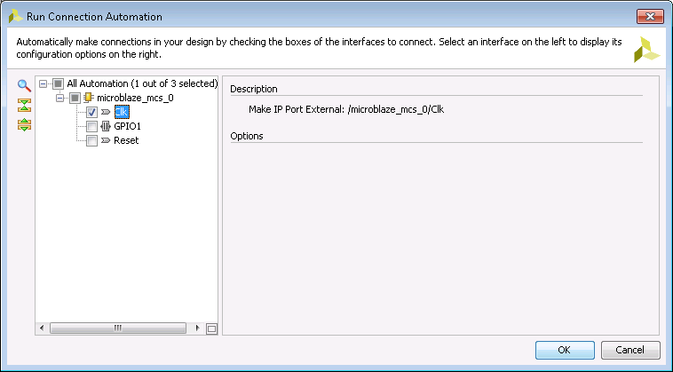

Slide 27
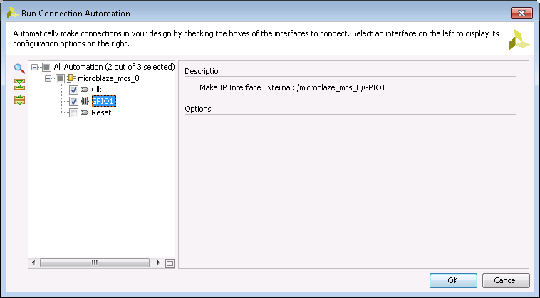

Slide 28
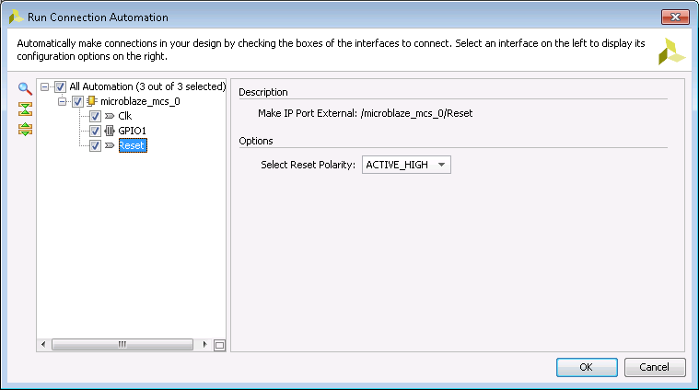

Slide 29
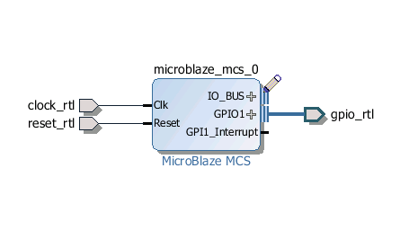

Slide 30
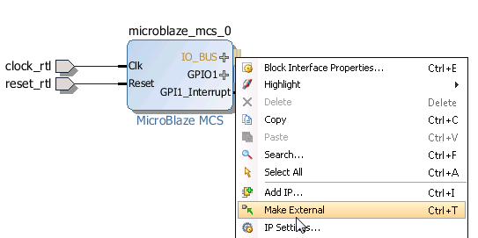

Slide 31
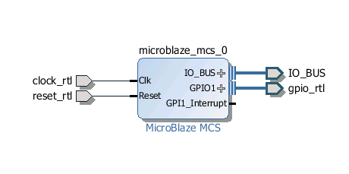

Slide 32
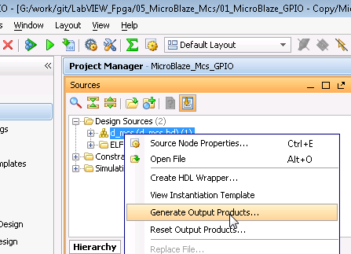

Slide 33
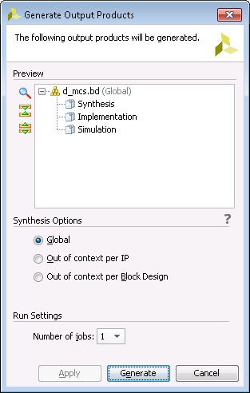

Slide 34
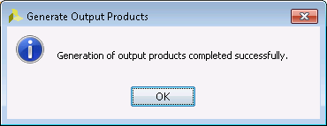

Slide 35
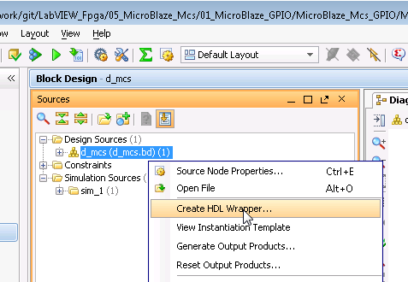

Slide 36
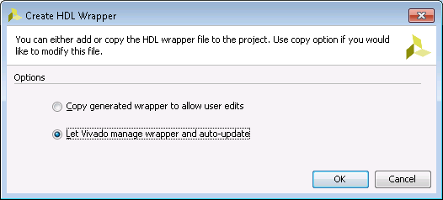

Slide 37
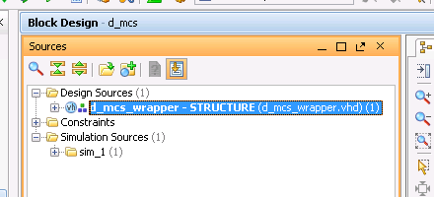

Slide 38
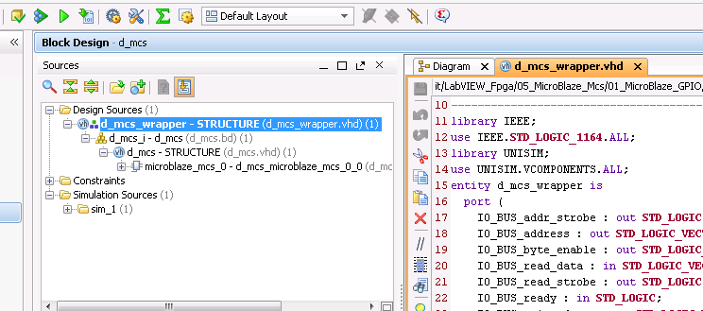

Slide 39
Section 2 – Xilinx SDK
by John Stratoudakis

Slide 40


Slide 41
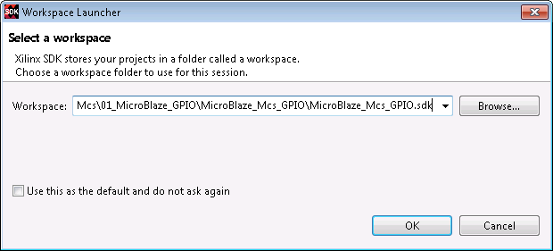

Slide 42
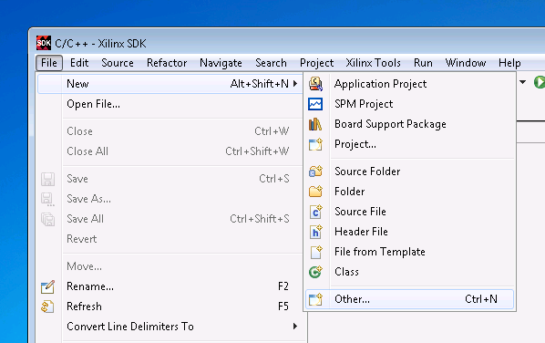

Slide 43
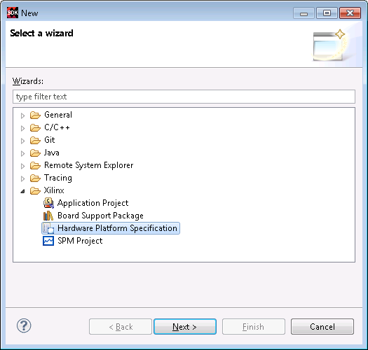

Slide 44
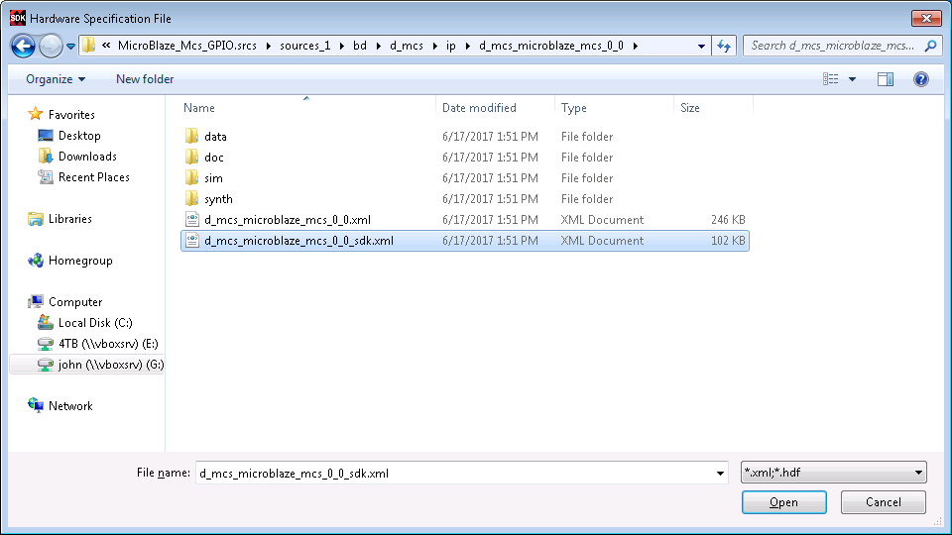

Slide 45
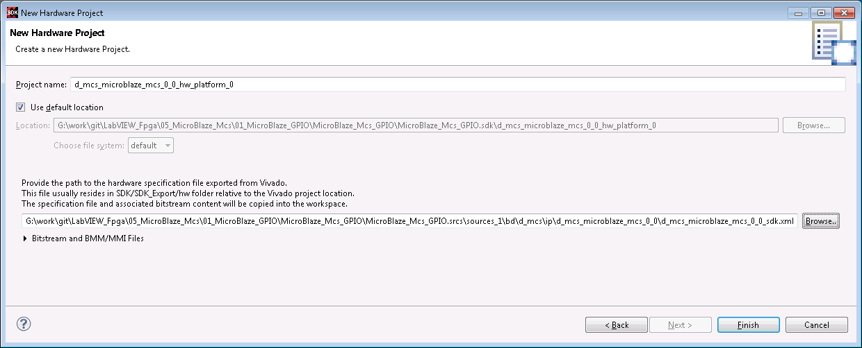

Slide 46
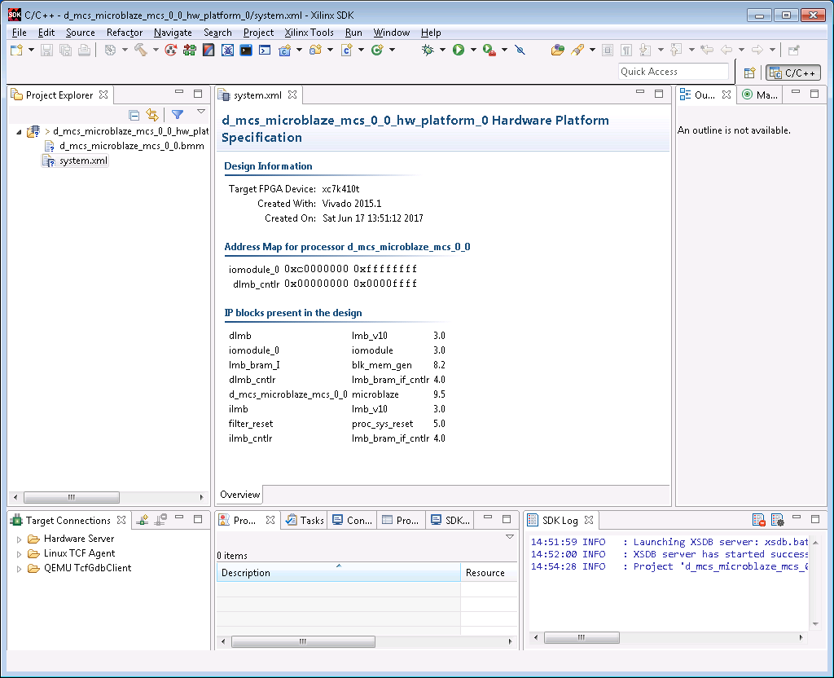

Slide 47
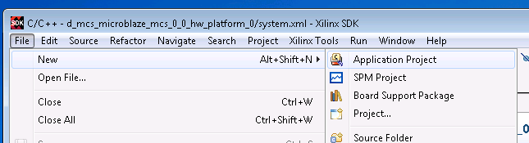

Slide 48
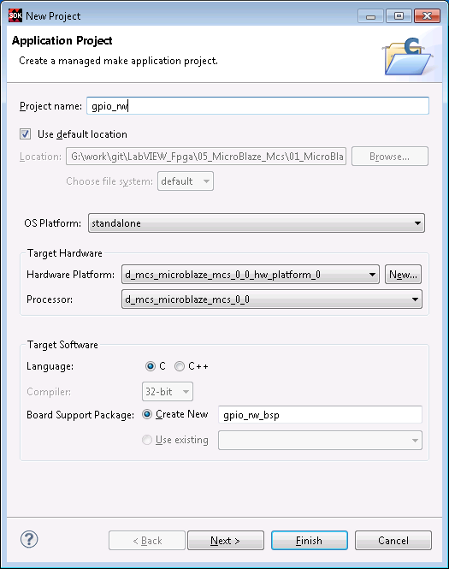

Slide 49
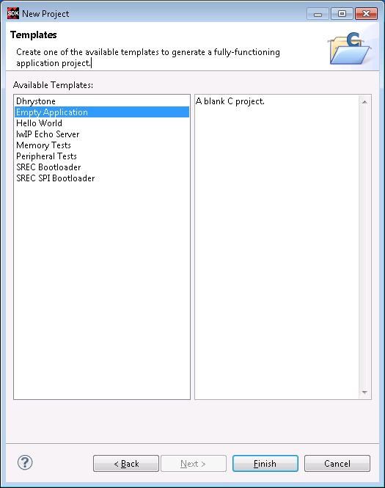

Slide 50
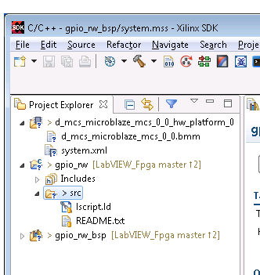

Slide 51
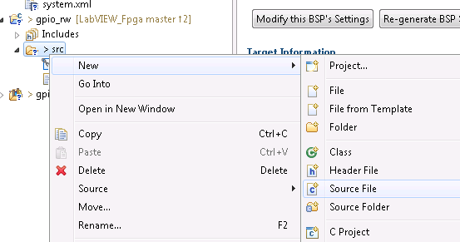

Slide 52
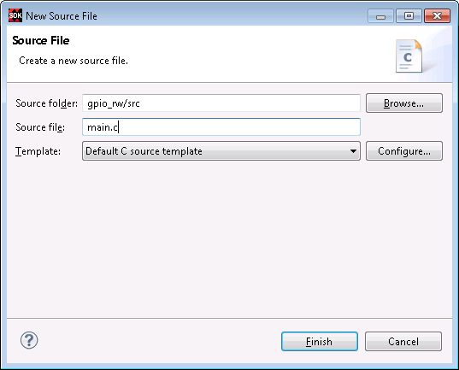

Slide 53
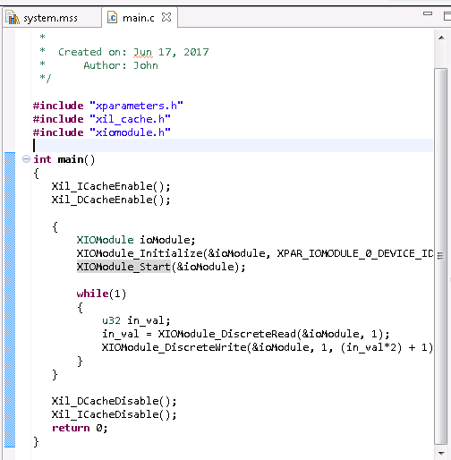

Slide 54
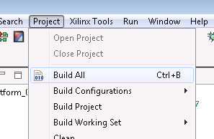

Slide 55
Section 3 – Vivado Part 2

Slide 56
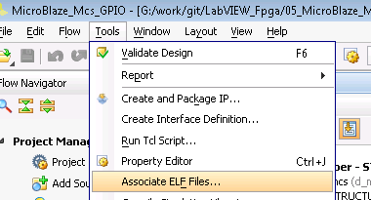

Slide 57
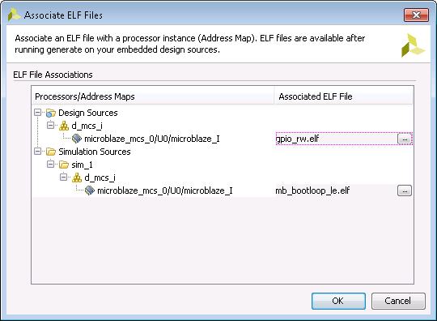

Slide 58


Slide 59


Slide 60


Slide 61


Slide 62


Slide 63


Slide 64
Section 4 – LabVIEW 2017 FPGA

Slide 65


Slide 66


Slide 67


Slide 68


Slide 69


Slide 70


Slide 71


Slide 72


Slide 73


Slide 74


Slide 75


Slide 76


Slide 77


Slide 78


Slide 79


Slide 80


Slide 81


Slide 82


Slide 83


Slide 84


Slide 85


Slide 86


Slide 87


Slide 88


Slide 89


Slide 90


Slide 91


Slide 92


Slide 93


Slide 94


Slide 95


Slide 96


Slide 97


Slide 98


Slide 99


Slide 100


Slide 101


Slide 102


Slide 103


