Slide 1
PS
PL
200 MHz
MISC
AES Engine
Zynq
Clock and Reset
ID Regs
-IV
-Mode
-Key
-Status
AES
GCM
DMA
FIFO
(BRAM)
AXIS config
Memory (DDRx)
FIFO
(BRAM)
ECB
AXI4-LITE
AXI4-STREAM
Ctrl Data
Raw Data

Slide 2
AES ECB
50Mhz TBD
200Mhz TBD
50Mhz TBD domain as example
This is the domain the rest
of the system is running at.
There is a cross domain fifo
and ram to send data to engine
Wait upto 14*2 clk cycles before next cipher output when switching modes, currently estimating the engine will use approx. 2000 LUT’s (this doesn’t include the control logic for mode selection, but this is negligible) which is around 0.5% of the xczu9eg-ffvb1156-2-e on the zcu102 board i.e. Plenty of space to implement this entire implementation using LUTRAM. This will require three separate key expansion modules for each mode because each mode has a slightly different process. Key expansion will consist of asynchronous logic but the output will be registered on each round.
Keys
From red CPU
In this configuration the worst case scenario delay to first cipher text output would be approx. 115ns in AES256 mode
Best case scenario is approx. 95ns, in AES128 mode as this increases the rounds and therefore increase number of pipeline stages.
After initial pipeline delay the data rate will be approx. 25.6Gb/s for all three modes
running at 200Mhz, this needs to be verified during timing analysis.
If timing is an issue then clock frequency's can be reduced to meet slack and any other violations
We can set the speed lo or high using generic RATE = LO OR HI
This will synthesise the engine to duty cycle the data to pipeline for each round or to send 128 bit in once every 10,12,14 rounds depending on the whether its 128,192 or 256 which is also a generic as this affects the key expansion(duty cycle)
AES128
AES192
Key_data (AESn:0)
AES256
Key Expansion(LUT RAM)
roundkey (127:0)
mode config
Config data = 1st (127:0) after Tlast falling edge
Rounds 1 to n-1
Round n
IV
AES128 : 10 rounds
AES192 : 12 rounds
AES256 : 14 rounds
Mode (1:0)
Expanded key 0
Expanded key n-1
Expanded key n
50Mhz TBD
Status (1:0)
DONE, FAULT etc TBD ask software what they want
Plain text
AXIS
Tdata (127:0)
SBOX
(LUT RAM)
SBOX (LUT RAM)
Cipher text
AXIS
XOR
Left shift rows
Mix columns
XOR
Left shift rows
XOR
data(127:0)
Tdata (127:0)
FIFO
Double flop any small vectors or single bits for status etc. Synchronous resets throughout design
FIFO
The S-box is approx. 2Kb in size, therefore LUTRAM will be utilised as the use of BRAMs would be wasteful
Use cross domain FIFO’s
AES128 : 25.6 Gb/s
AES192 : 25.6 Gb/s
AES256 : 25.6 Gb/s
Aux signals
Tvalid
data
Tready
Clock cycle
Tlast
Asynchronous Logic
Syncronous Logic

Slide 3
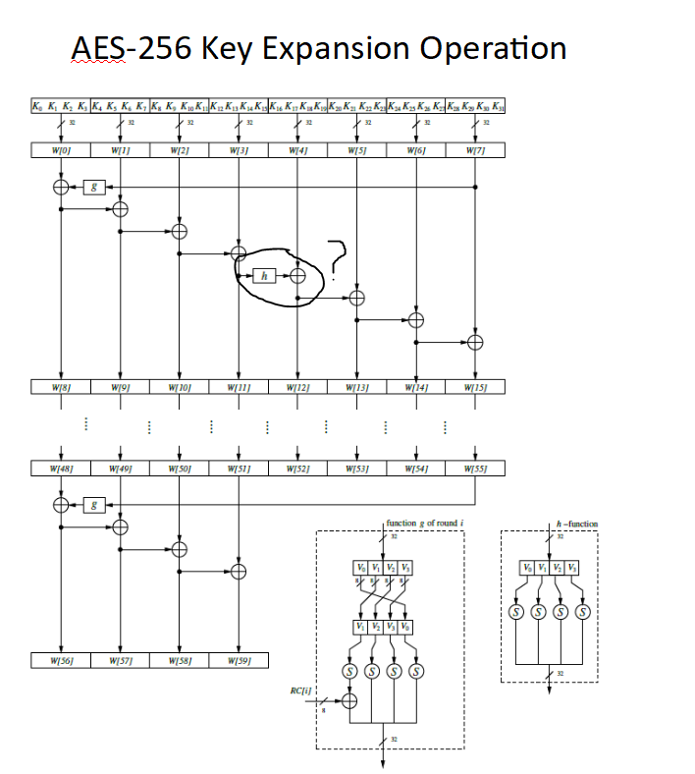
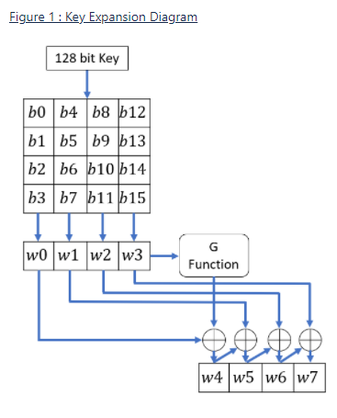
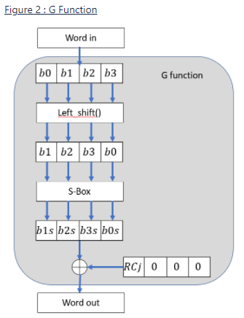
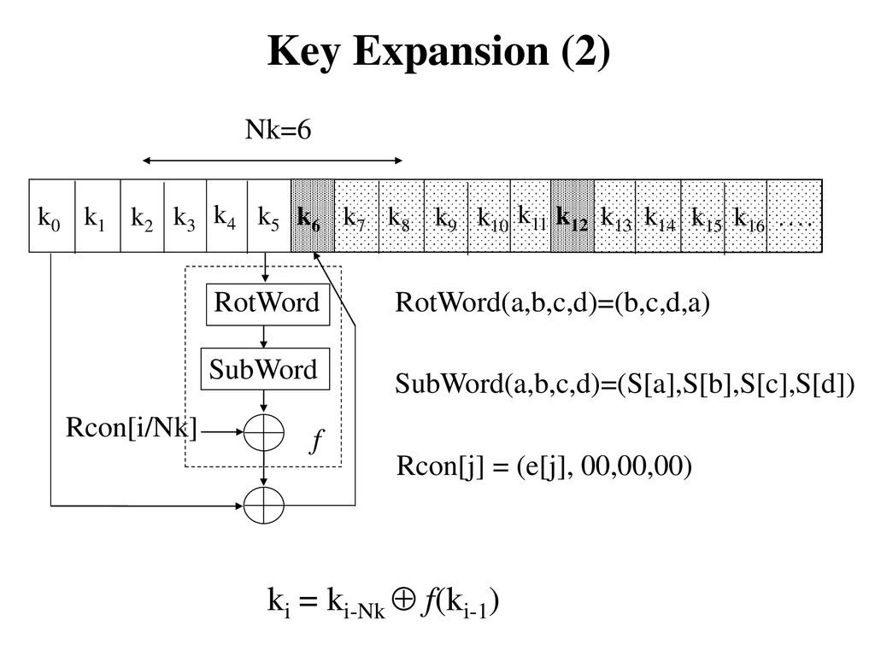
Key expansion https://confluence.ncipher.com/display/FPGA/AES+Key+Expansion
AES128
AES192
Rconst: 01 02 04 08 10 20 40 80 1B 36 6C D8 AB 4D 9A 2F 5E BC 63 C6 97 35 6A D4 B3 7D FA EF C5

Slide 4
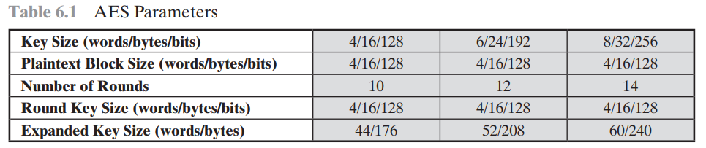
KEY Expansion
In AES algorithm, in the key schedule, Why does the expansion of a 256 bit key need an extra application of the S-box, unlike the expansion of 128 bit and 192 bit keys ?
And here is what happens when you take out the extra SubBytes:
AES-128 takes a 128-bit key, produces 11 128-bit subkeys out of it with a cryptographically weak function, and uses them in 10 internal rounds. It can be said that the full key is reused 10 times.
AES-192 takes a 192-bit key, produces 13 128-bit subkeys out of it (or, equivalently, 9 192-bit subkeys), and uses them in 12 rounds. The full key is reused 8 times.
AES-256 takes a 256-bit key, produces 15 128-bit subkeys (or 8 256-bit ones) and uses them in 14 rounds. The full key is reused 7 times.
Therefore, AES-128 uses its key more intensively, and AES-192 and AES-256 -- less intensively. However, only very specific cryptanalytic attacks may exploit this property. For example, related-key attack can break the entire AES-256, but can not break the full AES-128. By ''break'' we mean that it is possible to produce ``similar'' ciphertexts from ''similar'' plaintexts on some particular key pairs. However, the related keys are rarely seen in practice, so this property is not much relevant to the actual security of AES.
To conclude, AES-256 can be considered weaker than AES-128 in a very specific setting only, and this setting is unlikely to occur in practice.
00 00000000 00000000 00000000 00000000
01 00000000 00000000 00000000 01000000
02 637c6362 637c6362 637c6362 637c6362
03 637c6362 637c6362 637c6362 627c6362
04 c9d6739b aaaa10f9 c9d6739b aaaa10f9
05 c9d6739b aaaa10f9 c9d6739b abaa10f9
06 50b4df55 fa1ecfac 33c8bc37 9962acce
07 50b4df55 fa1ecfac 33c8bc37 9862acce
08 dbf275cc 21ecba60 12240657 8b46aa99
09 dbf275cc 21ecba60 12240657 8a46aa99
10 358c2f70 14609510 06449347 8d0239de
11 56f04c12 771cf672 6538f025 ef7e5abc
12 5053dcee 443349fe 4277dab9 cf75e367
13 9985af75 ee995907 8ba1a922 64dff39e
14 5b1042a3 1f230b5d 5d54d1e4 92213283
It has to do with the alignment between the size of cipher the key and the size of a round key. Since a 256-bit key is twice the size of a round key, the nonlinearity of the key schedule would be aligned to every other block, and that is bad.
Here is an example of the round keys generated by the key schedule for a key (hex bytes) of value 0000000000000000000000000000000000000000000000000000000000000001:
00 00000000 00000000 00000000 00000000
01 00000000 00000000 00000000 01000000
02 637c6362 637c6362 637c6362 637c6362
03 fb10fbaa fb10fbaa fb10fbaa fa10fbaa
04 cf51a96f ac2dca0d cf51a96f ac2dca0d
05 6ac88f7d 91d874d7 6ac88f7d 90d874d7
06 c131c8f9 6d1c02f4 a24dab9b 0e606196
07 c11860ed 50c0143a 3a089b47 aad0ef90
08 a19db82e cc81bada 6ecc1141 60ac70d7
09 118931e3 414925d9 7b41be9e d191510e
10 0aa339ef c6228335 a8ee9274 c842e2a3
11 f9a5a9e9 b8ec8c30 c3ad32ae 123c63a0
12 ea6ad234 2c485101 84a6c375 4ce421d6
13 d0cc541f 6820d82f ab8dea81 b9b18921
14 173c1ad3 3b744bd2 bfd288a7 f336a971
It can be seen as far as round 9 the round keys are still extremely linear, and because the sbox application is performed every other round key, 3 of the 4 subkeys for the round keys are identical to a neighboring round key up to the 9th round, and the 4th only differs by a 4 bit maximum.

Slide 5
AES engine config logic
Tlast = ‘1’
S2
AESMode = data_i(0:0)
IV = data_i(97:1)
S1
Tlast = falling_edge
RST = ‘0’
Clk cnt = 1
S0
RST = ‘1’
RST_i = ‘1’

Slide 6
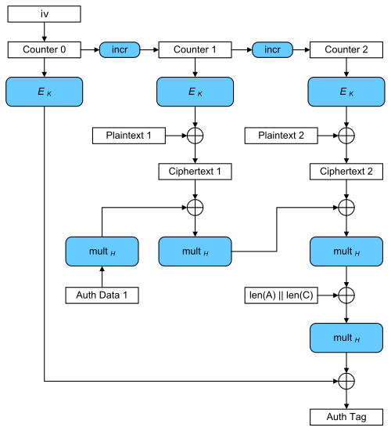
GCM

