Slide 1
Adaptive Honeypot
🔍 Honeypot Simulation
Controller
🤖 Gemini AI Agent
An AI-Driven Observe → Decide Act → Evaluate Loop for Simulated Cyber Threat Response
📊 Live Dashboard
KK · ENGR-202C · UCLA
Notes:
[0:00–0:20] OPENING — 20 seconds
"Hi everyone. I'm KK, and for my ENGR-202C project I built an Adaptive Honeypot Controller — an AI system that autonomously detects, deceives, and learns from cyber attackers in real time.
The core problem: traditional honeypots are static. They sit and wait, and experienced attackers recognize them quickly. What if the honeypot could think and adapt on its own? That's exactly what this system does."

Slide 2
The Problem & Our Goal
Traditional honeypots are passive — they observe but can't adapt.
Static Configuration
Our Goal
Fixed rules can't respond to evolving attacker behavior
▸ Simulate realistic attacker behavior across 6 threat phases
▸ Deploy an autonomous agent that reacts in real time
▸ Use Gemini AI for intelligent, context-aware decisions
▸ Fall back to rule-based logic when AI is unavailable
▸ Track memory, deception artifacts, and scoring over time
No Persistent Memory
Each session starts fresh — attack patterns go unlearned
Manual Response Only
Human intervention is required to change strategy mid-session
Notes:
[0:20–0:45] PROBLEM & GOAL — 25 seconds
"There are three fundamental gaps in static honeypots. Fixed configurations can't respond to evolving tactics. No memory means every session starts blind — patterns go unlearned. And any strategy change requires a human in the loop.
Our goal was to close all three gaps: simulate realistic multi-phase attackers, deploy an autonomous agent that reacts in real time, and build a memory layer so the system gets smarter with every cycle."

Slide 3
System Architecture
Three-layer design: Simulation → Agent → Dashboard
🛡️ SimulatedHoneypot
🤖 HoneypotAgent
📊 Streamlit Dashboard
Core simulation engine
Autonomous decision maker
Real-time visualization
▸ Manages attacker state machines
▸ Tracks 6 attack phase transitions
▸ Deploys deception artifacts
▸ Calculates risk & engagement scores
▸ Reads honeypot status each cycle
▸ Queries Gemini API with full context
▸ Falls back to rule-based logic
▸ Maintains AgentMemory (deque, 100)
▸ Live phase pie chart & score trends
▸ Attacker cards with risk indicators
▸ Cycle trace & memory inspection
▸ Export JSON trace & status
→
→
Notes:
[0:45–1:15] ARCHITECTURE — 30 seconds
"The system has three layers. The SimulatedHoneypot manages concurrent attackers, tracks phase transitions, and deploys deception artifacts like fake endpoints and honeytokens.
The HoneypotAgent is the brain — it calls Google's Gemini API each cycle to reason about the best response, and falls back to rule-based logic if the API is unavailable.
Connecting them is an AgentMemory layer — a rolling window of 100 experiences that tracks success rates per action and blocks the agent from repeating failed strategies."

Slide 4
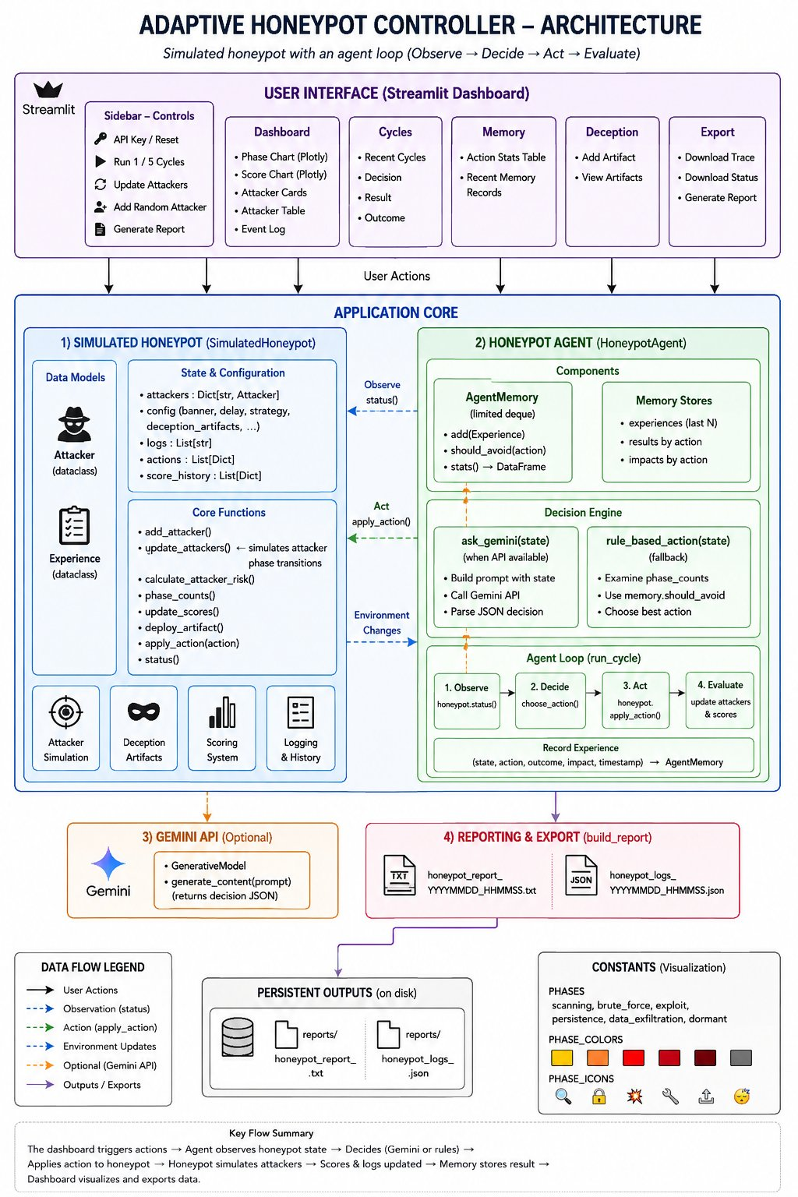
Architecture Diagram
✅ Verified against source code
Simulated honeypot with an agent loop: Observe → Decide → Act → Evaluate
Key Components
Data Flow
🛡️ SimulatedHoneypot
→ User Actions
Manages attackers, config, artifacts, scoring
Sidebar triggers run_cycle(), add_attacker()
🤖 HoneypotAgent
- → Observe
Gemini API + rule-based fallback per cycle
agent reads honeypot.status()
🧠 AgentMemory
– → Act
100-exp deque; tracks avoidance logic
apply_action() mutates config
📊 Streamlit UI
·· → Env Updates
5 tabs: Dashboard, Cycles, Memory, Deception, Export
update_attackers() steps state machines
✨ Gemini API
≈ → Gemini
gemini-3.5-flash; optional, graceful fallback
ask_gemini() → parse JSON decision
📁 Reporting
➜ Outputs
.txt report + .json logs → reports/
Reports & logs saved to reports/
Notes:
[1:15–1:35] ARCHITECTURE DIAGRAM — 20 seconds
"Here's the full system at a glance. The Streamlit dashboard sits at the top, feeding user actions down to the Application Core. On the left, the SimulatedHoneypot handles state and configuration. On the right, the HoneypotAgent runs the four-step loop: Observe via honeypot.status(), Decide via choose_action(), Act via apply_action(), and Evaluate by updating scores and storing the experience in AgentMemory.
The Gemini API is optional — the system degrades gracefully to rules if it's unavailable."

Slide 5
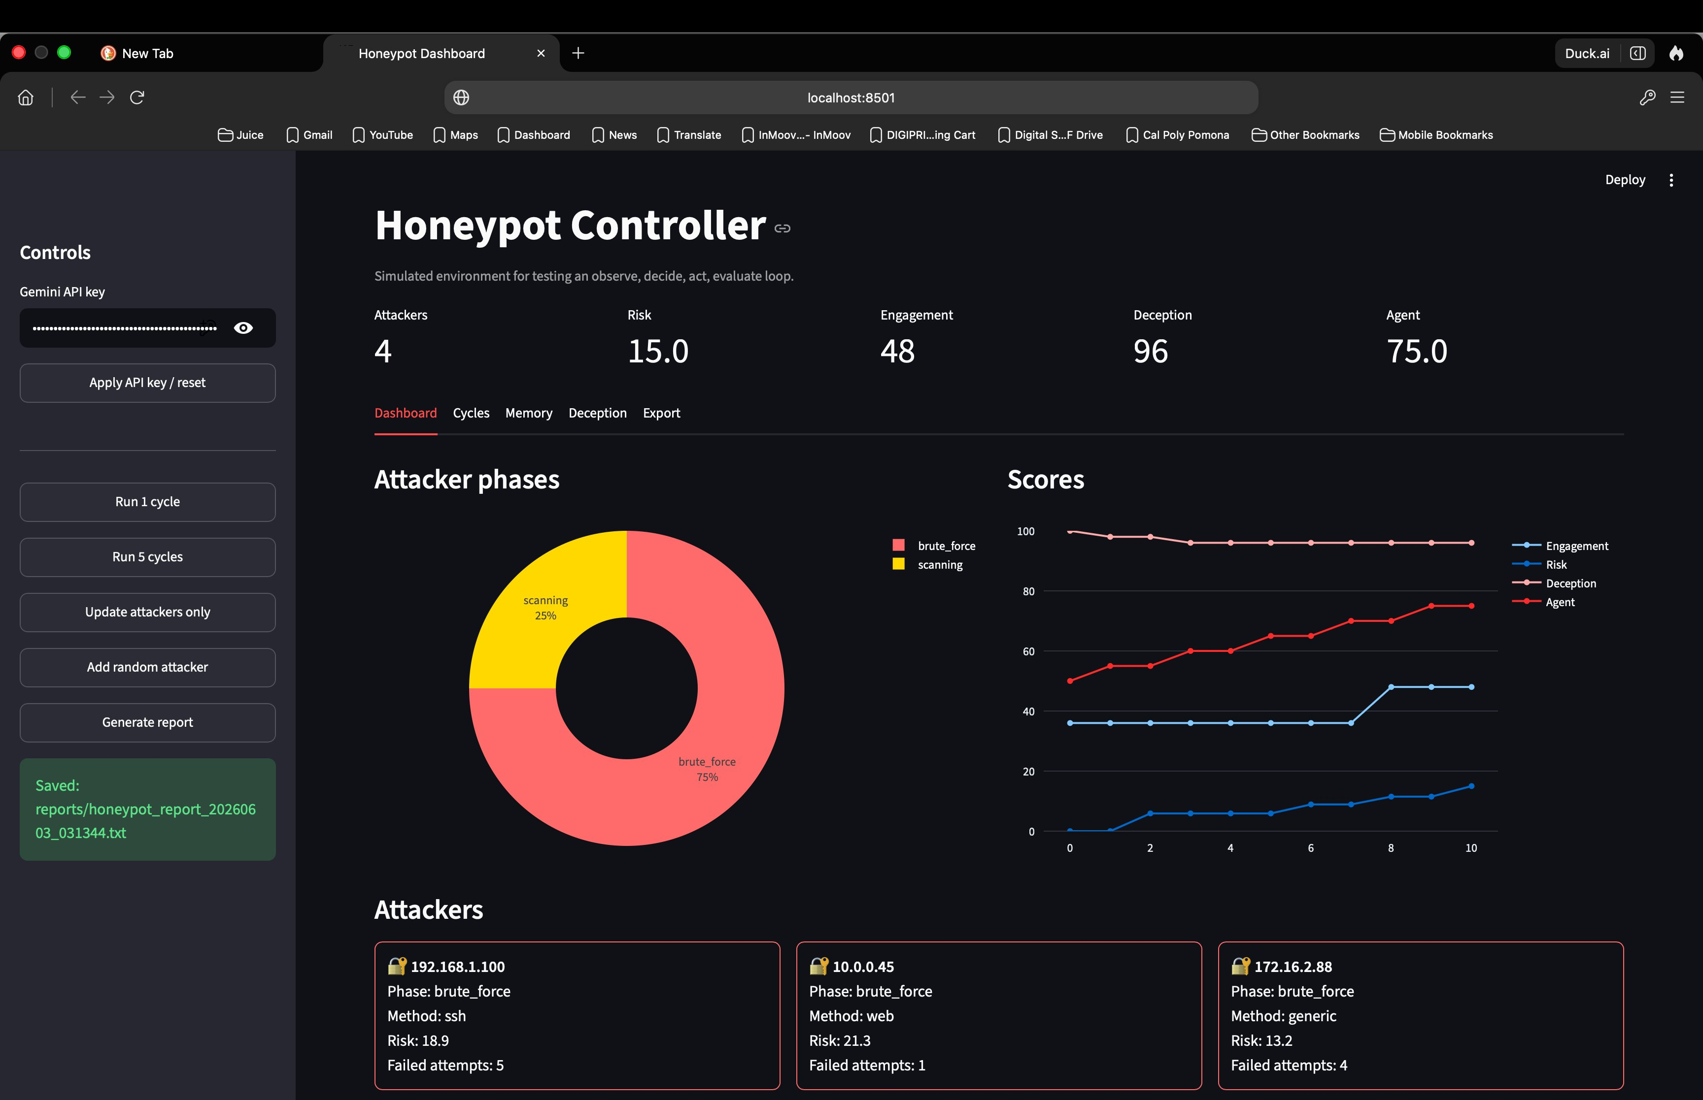
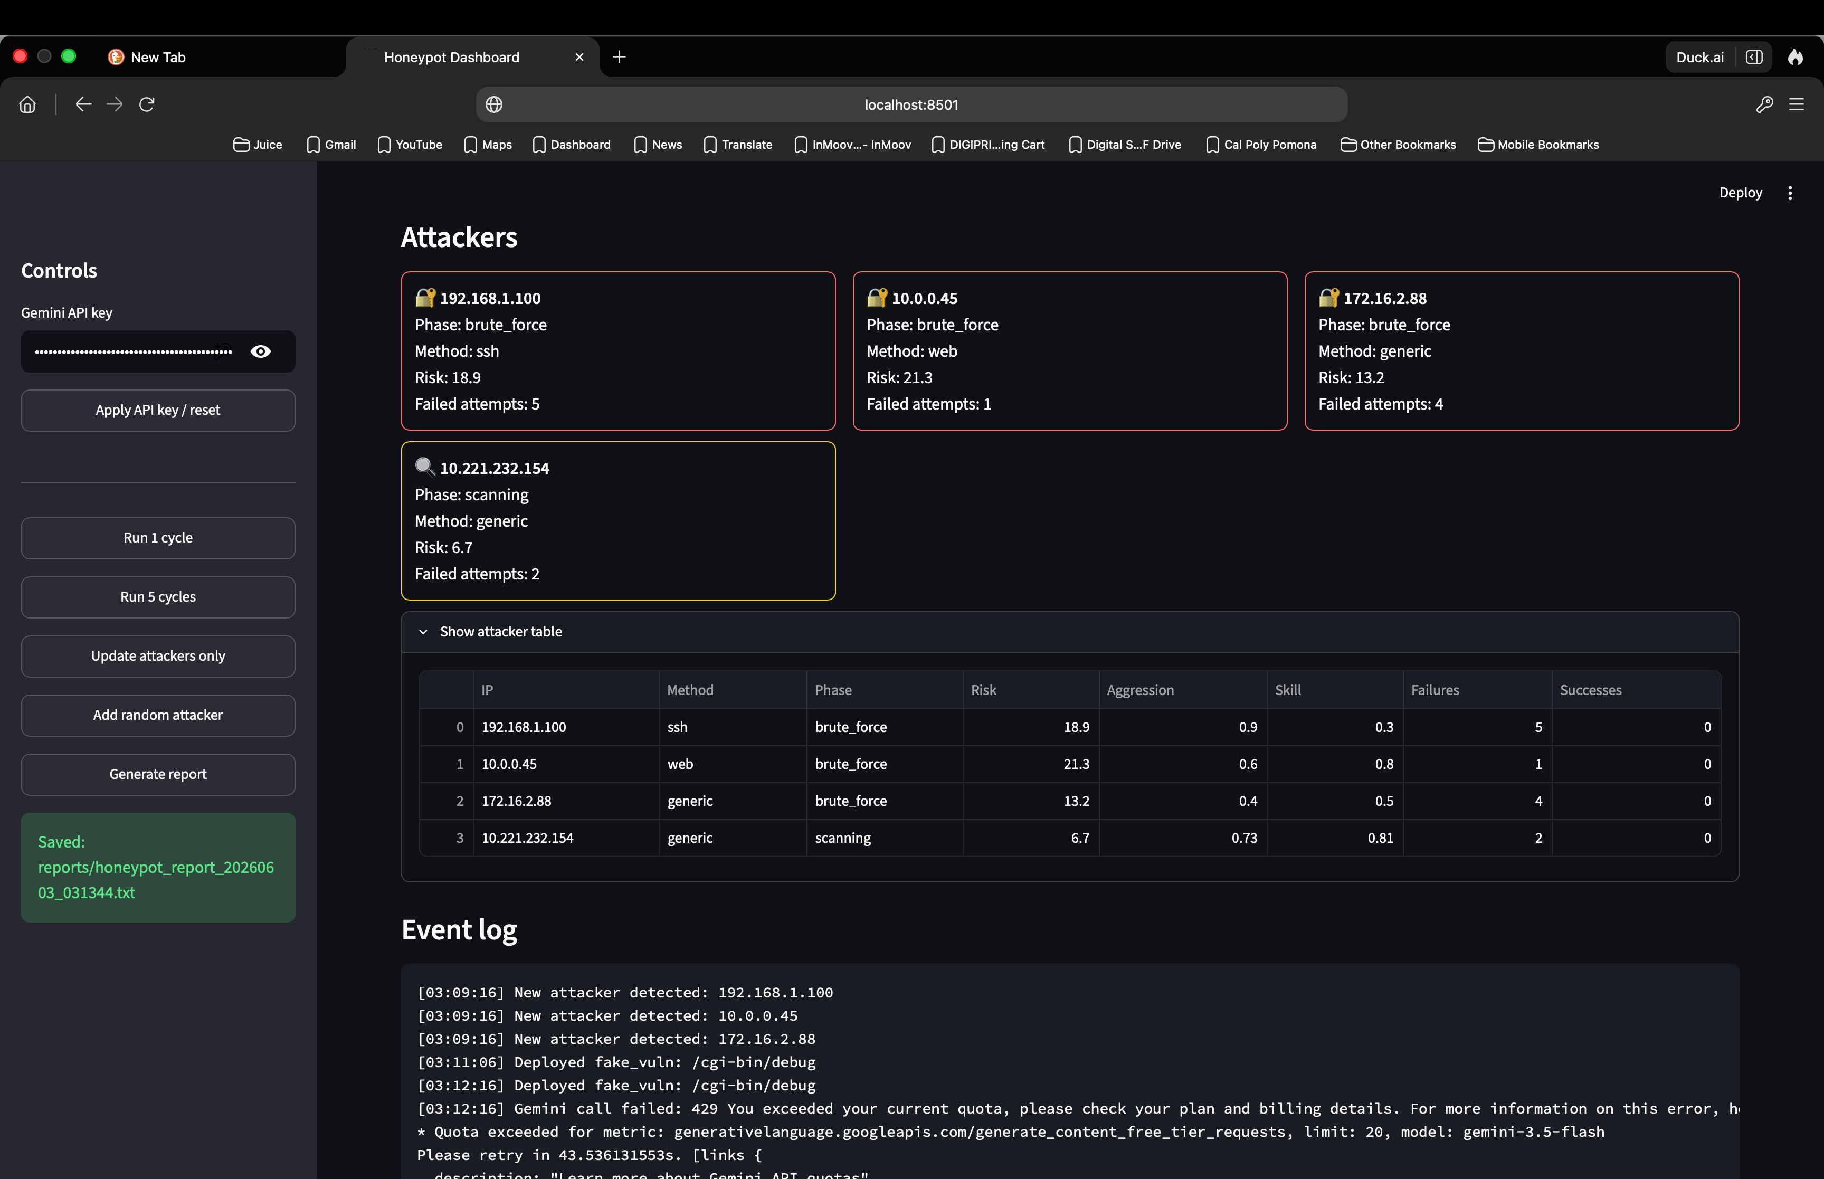
Live Demo
Streamlit dashboard running at localhost:8501
📊 Dashboard — Attacker Phases & Scores
🗂️ Attacker Table & Event Log
Notes:
[1:35–2:30] LIVE DEMO — 55 seconds
"Here's the dashboard running live. On the left you can see the attacker phase pie chart — at this point three attackers are active, 75% in brute_force phase and 25% still scanning. The score chart on the right shows the Agent score climbing as cycles run, while Risk stays managed.
On the right screenshot you can see the attacker table — four IPs tracked with individual risk scores, aggression, and skill ratings. Below that is the event log showing real-time decisions: the agent deployed a fake_vuln endpoint at /cgi-bin/debug when exploit behavior was detected, and you can see the Gemini API quota being hit and the system falling back to rule-based logic automatically — exactly the graceful degradation we designed for."

Slide 6
Attack Phases & Agent Loop
Attacker State Machine
Agent Decision Loop
🔍 Scanning
OBSERVE
Initial probe — low risk
1
Read attacker phases & honeypot config
🔐 Brute Force
Password attacks begin
DECIDE
2
💥 Exploit
Gemini API → rule-based fallback
Vulnerability targeting
🔧 Persistence
ACT
3
Backdoors & foothold
Apply: delay / fake_vuln / honeytoken
📤 Data Exfiltration
Data theft in progress
EVALUATE
4
💤 Dormant
Store experience, update scores
Waiting to re-activate
Notes:
[2:30–3:15] PHASES & AGENT LOOP — 45 seconds
"Attackers move through six phases — from low-risk Scanning all the way to Data Exfiltration. The agent's response escalates with them.
During Brute Force, it increases login delay to slow down password attacks. During Exploit, it deploys a fake vulnerable endpoint to trap the attacker. During Persistence and Exfiltration, it drops a honeytoken — fake credentials that trigger an alert the moment they're touched.
The four-step loop runs every cycle: Observe the phase distribution, Decide the best action using Gemini or rules, Act by mutating the honeypot config, then Evaluate by recording the outcome in memory. If an action fails more than 60% of the time, the memory system flags it as avoidable — the agent literally learns from its mistakes."

Slide 7
Results & Takeaways
6
4
100
4
Attack Phases Simulated
Agent Actions Available
Memory Exp. Capacity
Dashboard Tabs
✅ What Worked Well
🔧 Future Improvements
▸ Agent adapted strategy to attacker phase in real time
▸ Brute force → login delay; exploit → fake endpoints
▸ Deception artifacts influenced attacker progression
▸ Memory layer prevented redundant repeated actions
▸ Dashboard gave clear visual insight into all activity
▸ Add real log integration (SSH / web server logs)
▸ Persist agent memory across app restarts
▸ Replace heuristic scoring with RL-based rewards
▸ Expand Gemini prompt with richer context window
▸ Multi-honeypot coordination & attacker clustering
Notes:
[3:15–4:00] RESULTS & TAKEAWAYS — 45 seconds
"To summarize: the agent managed 6 attack phases, executed 4 distinct response actions, maintained 100 experiences in its rolling memory, and surfaced everything across 4 dashboard tabs.
What worked well: the agent correctly distinguished concurrent attackers with different behaviors, adapted strategy as phases escalated, and memory-based avoidance prevented it from repeating failed actions.
Honest limitations: Gemini API latency runs 2–3 seconds per call — too slow for production. The agent can be over-reactive to single anomalous events before a pattern is established. And memory resets on restart — cross-session persistence is the top next improvement.
If I had more time I'd add a local LLM fallback for speed and implement persistent memory across sessions. Thank you — happy to take questions."

