Slide 1
Paris Perfume
New Design Site @2019

Slide 2
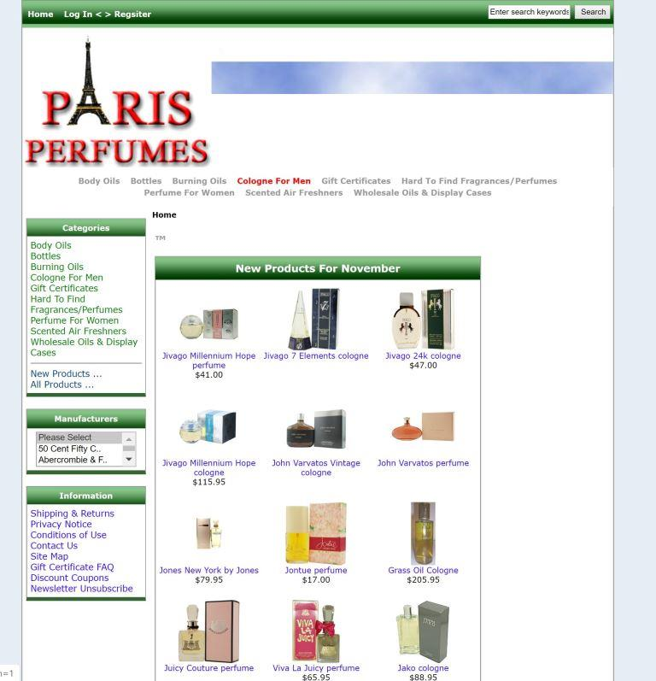
Old Paris Perfume Website

Slide 3
Paris Perfume Data Flow
Home Page
Home
Profile
My Shops
Products
Checkout
Sign in
Delete user
Create Shop
Create Products
Payments
Sing out
Edit Shop
Edit Product
Invoice
Create Acct
Search

Slide 4
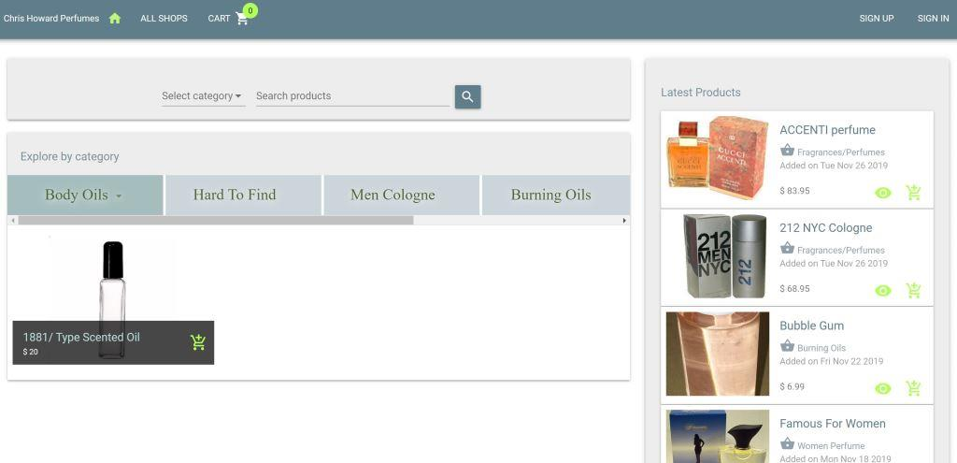
Default Page

Slide 5
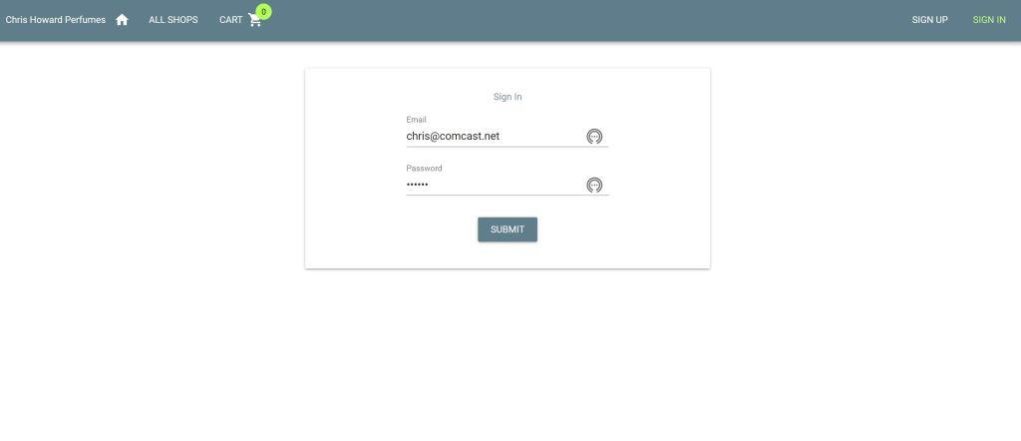
Sing in

Slide 6
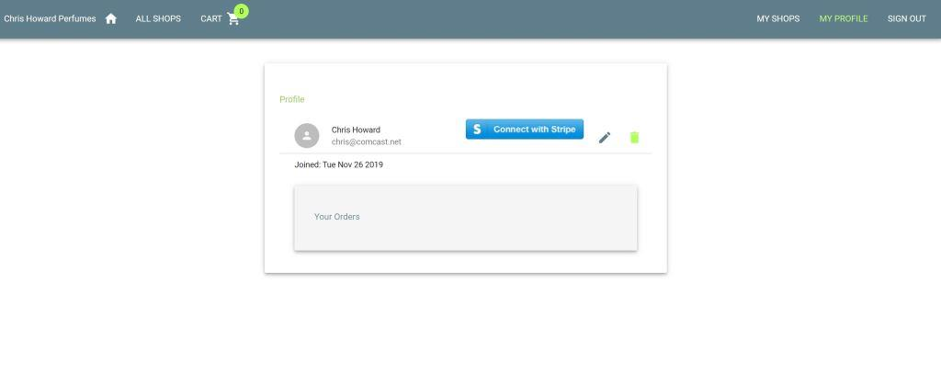
Sing in Active

Slide 7
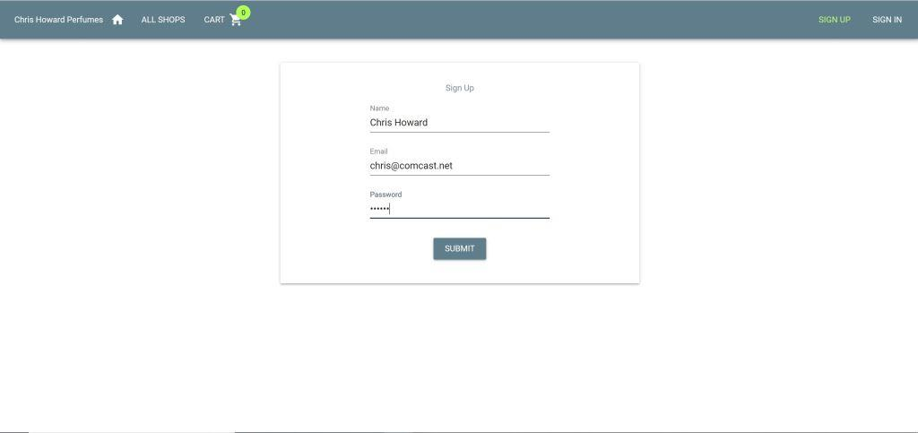
Sing up

Slide 8
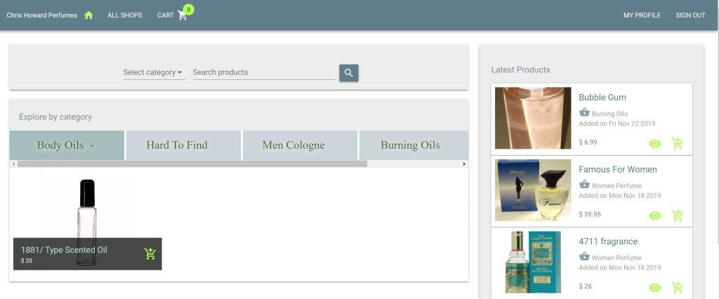
Sing in Inactive

Slide 9
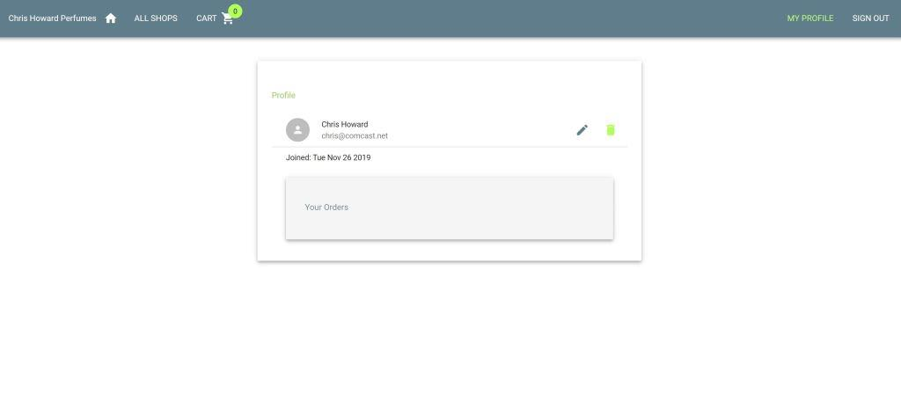
Profile

Slide 10
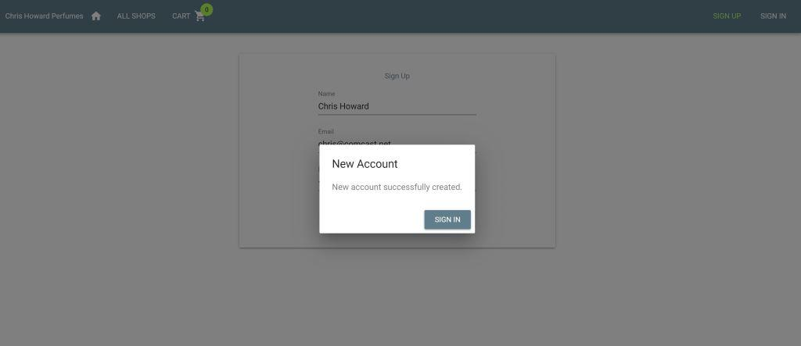
New Account Created

Slide 11
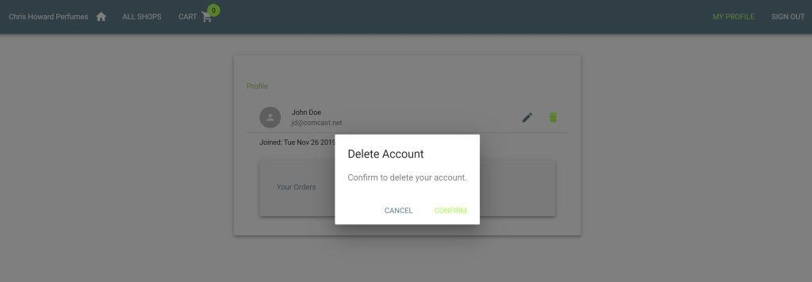
Delete Account

Slide 12
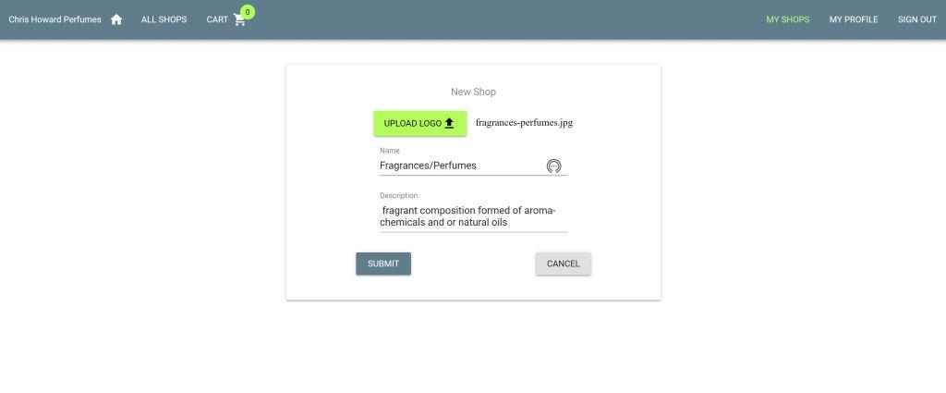
Create New Shop

Slide 13
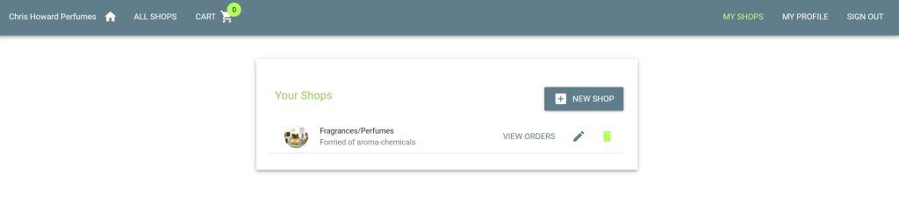
New Shop

Slide 14
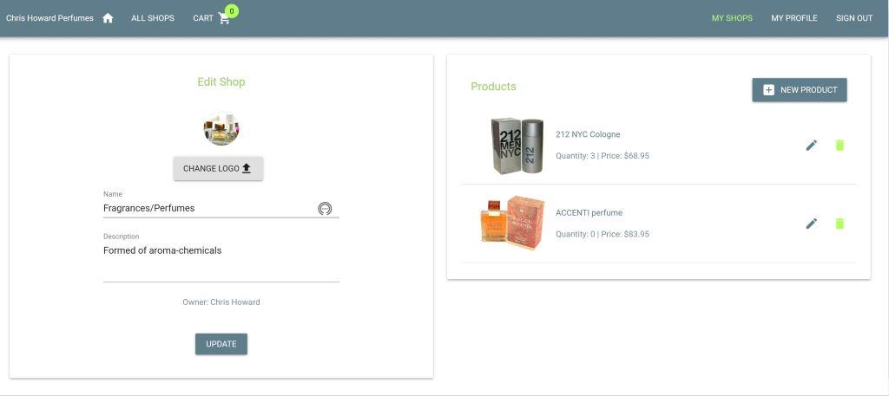
New Products

Slide 15
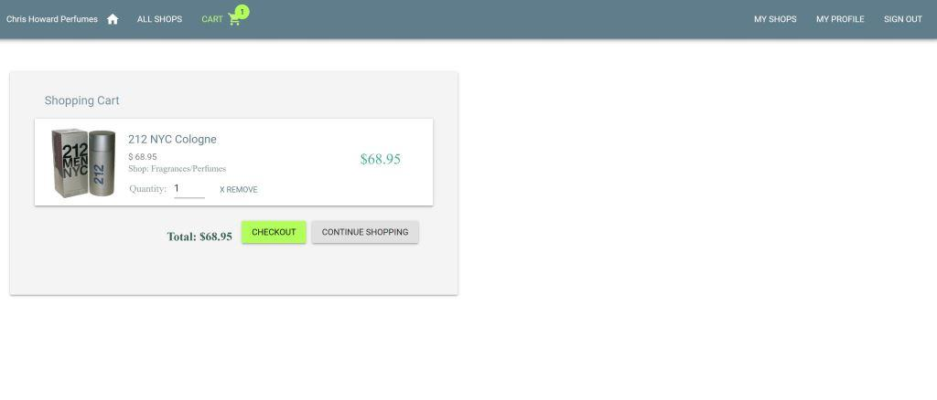
Order

Slide 16
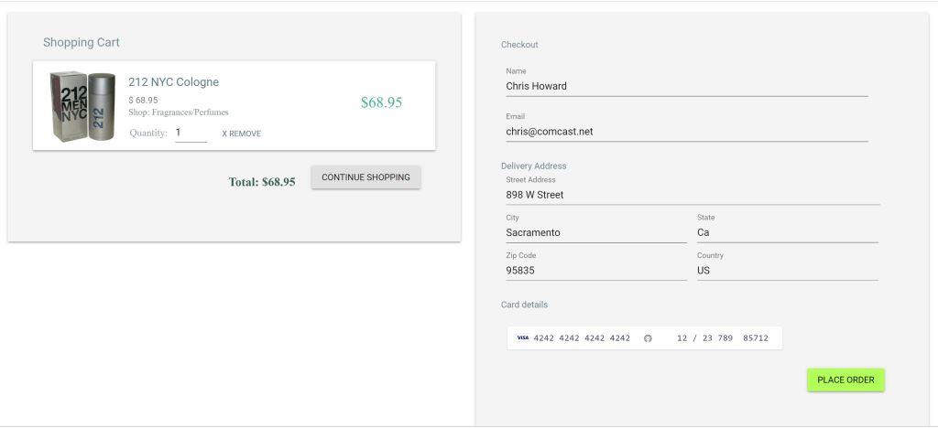
Check out

Slide 17
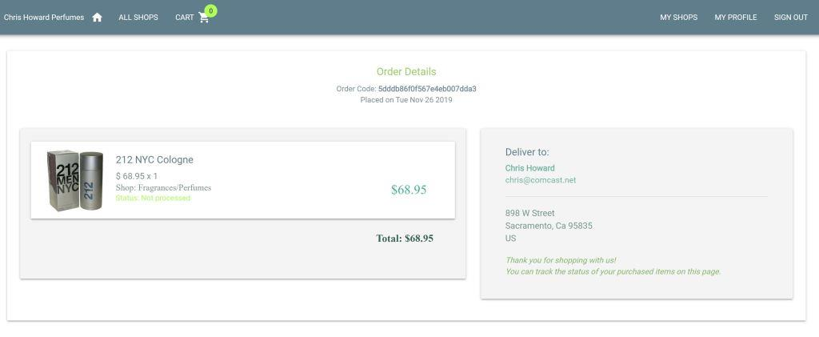
Order Detail

