Slide 1
Omics Integration
Transcriptomics & Proteomics
Technical considerations and possible avenues to identify co-regulated biological processes
DDEA Proteomics Course

Slide 2
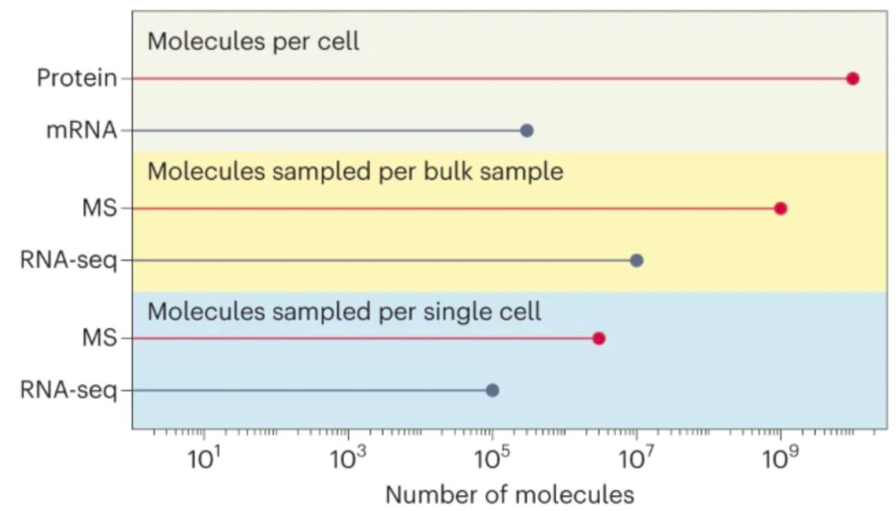


Low Correlation Between Transcriptomics and Proteomics
Post-transcriptional regulation
mRNA content is not directly predictive of protein abundance. Extensive regulation occurs between transcription and translation.
Different temporal dynamics
mRNA is transcribed in bursts with short half-lives. Proteins are more stable; they accumulate and turn over on longer timescales.

Slide 3
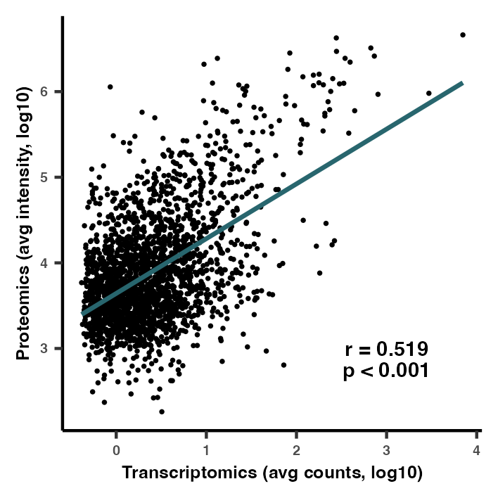
Modest mRNA–Protein Correlation Across the Proteome of Single Muscle Fibers
Feature correlation is not homogeneous
In human single fibers, it appears some features are well correlated, while most features show little to no correlation: The mRNA-protein associations are feature-dependent

Slide 4
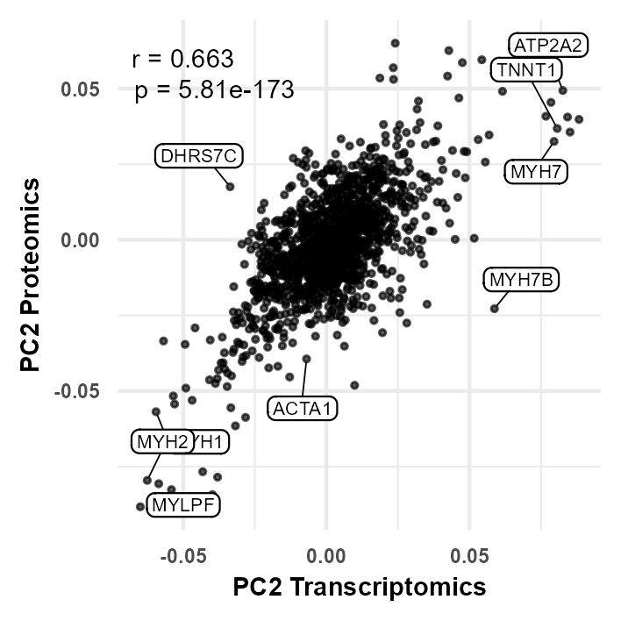
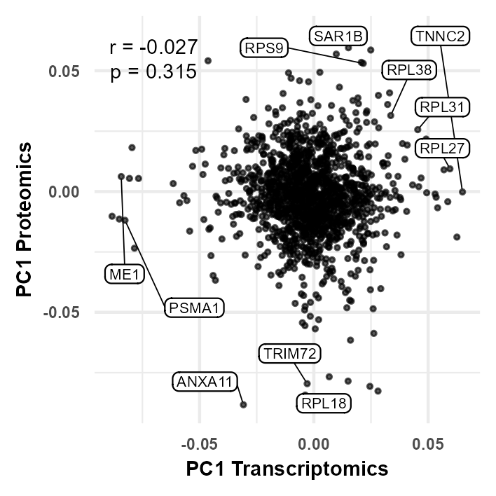


Certain Biological Processes Can Be Aligned
PC2 loadings align (r = 0.663) — fiber type is transcriptionally driven
PC1 loadings do NOT align (r = −0.027) — not transcriptionally regulated

Slide 5
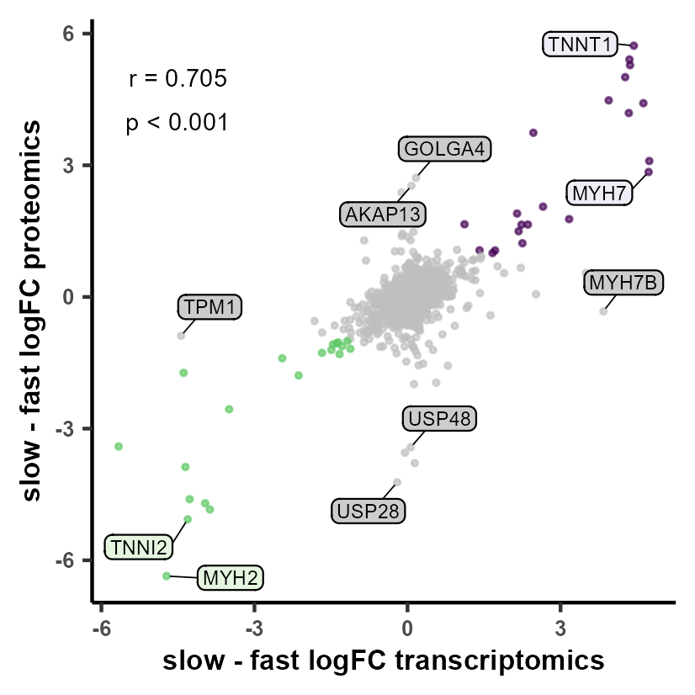



Log2FCs Are Directly Comparable Between Technologies
Standardized units
Both platforms express fold change as log2(condition A / condition B). This makes them directly comparable regardless of absolute abundance levels.
Strong agreement for fiber-type markers
Slow-fiber proteins (MYH7, TNNT1) and fast-fiber proteins (MYH2, TNNI2) align tightly across both platforms (r = 0.705, p < 0.001).
Divergence could identify post-transcriptional regulation
Proteins that are highly regulated post-transcriptionally (e.g. TPM1) show large proteomics changes with little mRNA change.
Purple = concordant up; green = concordant down; grey = discordant. Discordant points are candidates for post-transcriptional regulation.

