Slide 1

Phishing
By Yegor Kharitonchik

Slide 2
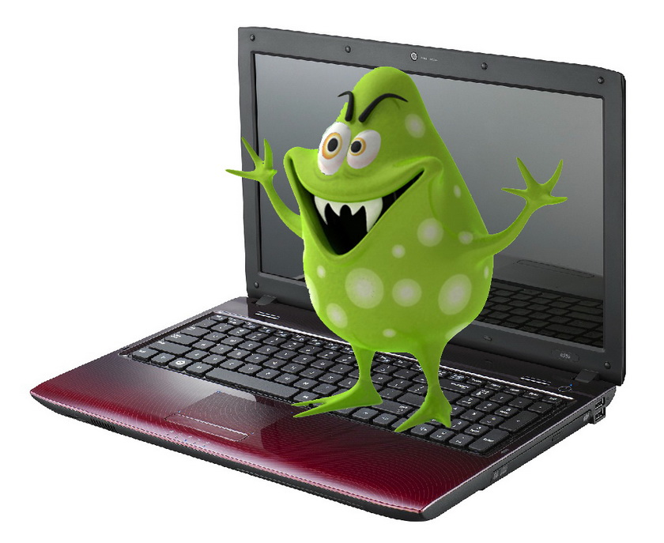
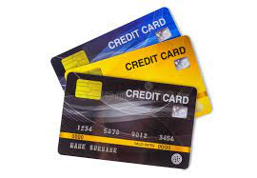


What is it?

Slide 3





Types

Slide 4
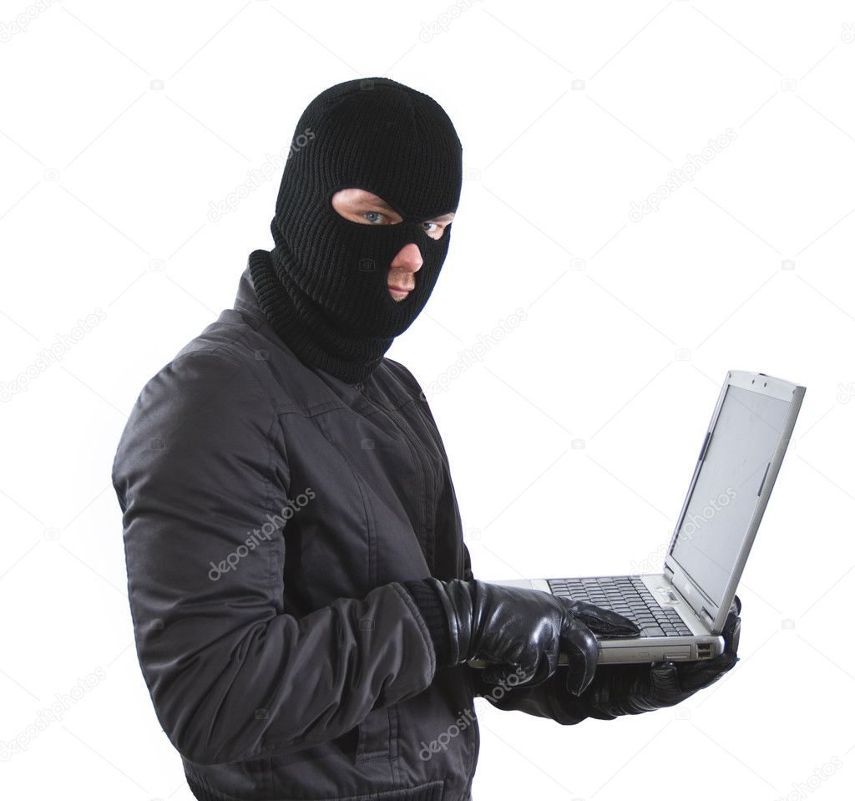
See it so you don’t click it.
Does it contain an offer that’s too good to be true?
Does it include language that’s urgent, alarming, or threatening?
Is it poorly crafted writing riddled with misspellings and bad grammar?
Is the greeting ambiguous or very generic?
Does it include requests to send personal information?
Does it stress an urgency to click on an unfamiliar hyperlinks or attachment?
Is it a strange or abrupt business request?
Does the sender’s e-mail address match the company it’s coming from? Look for little misspellings like pavpal.com or anazon.com.

Slide 5

Information list
https://staysafeonline.org/resources/phishing/
https://terranovasecurity.com/what-is-phishing/

