Slide 1

If People Were Data
How to Think About Modern Migration Infrastructure
Frodo Podschwadek
Academy of Sciences and Literature | Mainz
© metamorworks / iStock

Slide 2
2
If People Were Data
Digital Data
and Migration

Slide 3
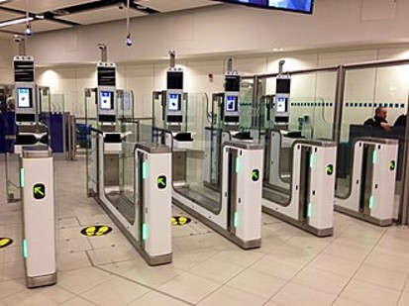
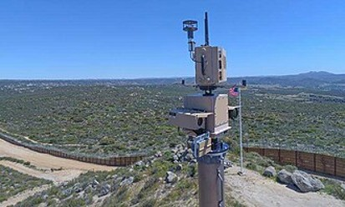
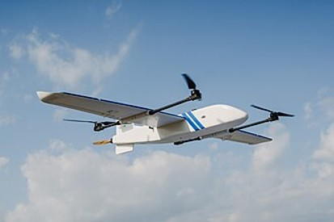
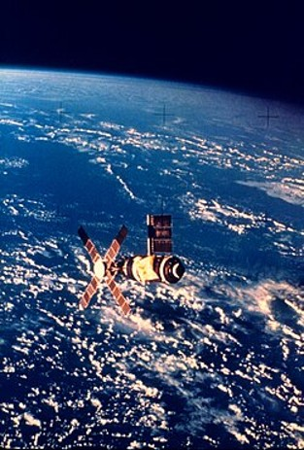
3
If People Were Data

Slide 4
4
If People Were Data

Slide 5
5
If People Were Data

Slide 6
6
If People Were Data
digital migration
infrastructure

Slide 7
7
If People Were Data
domestic
borders

Slide 8
8
If People Were Data
dataveillance
‘the systematic use of personal data systems in the investigation or monitoring of the actions or communications of one or more persons’ (Clarke 1988)

Slide 9
9
If People Were Data
dataveillance
‘the systematic use of personal data systems in the investigation or monitoring of the actions or communications of one or more persons’ (Clarke 1988)
datafication
representation of (often social role-based) aspects of persons as data for administrative and political purposes

Slide 10
10
If People Were Data
Thinking About
Infrastructure

Slide 11
11
If People Were Data

Slide 12
12
If People Were Data

Slide 13
13
If People Were Data
‘Now it can be shown that there is an increasing class of machine actions, where the traditional ways of responsibility ascription are not compatible with our sense of justice and the moral framework of society because nobody has enough control over the machine’s actions to be able to assume the respon-sibility for them. These cases constitute what we will call the .’ (Matthias 2004)
responsibility gap

Slide 14
14
If People Were Data

Slide 15
15
If People Were Data
THOR HAMMER
Company Ltd

Slide 16
16
If People Were Data

Slide 17
17
If People Were Data
U.S. Robots and
Mechanical Men, Inc.

Slide 18
18
If People Were Data
variants of responsibility gaps
regarding
culpability
moral accountability
public accountability
active responsibility
(Santoni De Sio & Mecacci 2021)

Slide 19
19
If People Were Data
‘Because many different officials contribute in many ways to decisions and policies of government, it is difficult even in principle to identify who is morally responsible for political outcomes. This is what I call the .’ (Thompson 1980)
problem of many hands

Slide 20
20
If People Were Data
The Input-Process-Output
Model

Slide 21
21
If People Were Data
The IPO model
Input
Process
Output

Slide 22
22
If People Were Data
The IPO model in software engineering
Input
Process
Output
some sort of data
does exactly the specified
things with the data
some other sort of data

Slide 23
23
If People Were Data
The IPO model in applied ethics/political philosophy
Input
Process
Output

Slide 24
24
If People Were Data
The IPO model in applied ethics/political philosophy:
one approach
Input
Process
Output
principles, policies,
guidelines, intentions,
strategies etc
we don’t need/
want to know
effects on people

Slide 25
If People Were Data
The IPO model in applied ethics/political philosophy:
another approach
Input
Process
Output
principles, policies,
guidelines, intentions,
strategies etc
inconvenient specifics
about technology and
how it is used
effects on people

Slide 26
26
If People Were Data
The IPO model in applied ethics/political philosophy:
modelling details
Input
Process
Output
policies for fairer and
more efficient
immigration management
a new AI product
more correctly classified
refugees, better resource
allocation

Slide 27
27
If People Were Data
The IPO model in applied ethics/political philosophy:
modelling details
Input
Process
Output
policies for fairer and
more efficient
immigration management
a new AI product
more correctly classified
refugees, better resource
allocation
operators

Slide 28
28
If People Were Data
The IPO model in applied ethics/political philosophy:
modelling details
Input
Process
Output
policies for fairer and
more efficient
immigration management
a new AI product
more correctly classified
refugees, better resource
allocation
operators

Slide 29
29
If People Were Data
The IPO model in applied ethics/political philosophy:
modelling details
Input
Process
Output
policies for fairer and
more efficient
immigration management
a new AI product
more correctly classified
refugees, better resource
allocation
operators

Slide 30
30
If People Were Data
Self-Sovereign Identity
for Refugees
An IPO Application Example

Slide 31
31
If People Were Data
Self-sovereign identity (SSI)
user-controlled and decentralised forms of digital identification
based on blockchain technology
discussed in ‘Self-Sovereignty for Refugees? The Contested
Horizons of Digital Identity’, M. Cheesman 2022

Slide 32
32
If People Were Data
Blockchain-based distributed ledger

Slide 33
33
If People Were Data
Competing logics of SSI
neutrality of technology
capacities of refugees
state monopoly on identify verification
economic models around digital identity

Slide 34
34
If People Were Data
SSI: Input
UNHCR registration protocols
UN Sustainable Development Goal 16.9
SSI
economic interests
technological design specifications
migration and asylum policies of host states

Slide 35
35
If People Were Data
SSI: Process
SSI
Input
Output
false information
unexpected or even
harmful consequence
information becomes
permanent and immutable

Slide 36
36
If People Were Data
SSI: Process
SSI

Slide 37
37
If People Were Data
SSI: Output
Normative output
legal recognition
access to rights
political status
SSI
Technical output
verified digital credential
on a blockchain

Slide 38
38
If People Were Data
SSI: Output
SSI
Weyland-Yutani
IdentiCorp PLC

Slide 39
39
If People Were Data
The End

Slide 40
40
If People Were Data
Bibliography
Büchi, Moritz, Noemi Festic, and Michael Latzer. 2022. ‘The Chilling Effects of Digital Dataveillance: A Theoretical Model and an Empirical Research Agenda’. Big Data & Society 9 (1): 205395172110653. https://doi.org/10.1177/20539517211065368.
Carter, J. Adam. 2026. ‘Who Acts When the Machine Decides? Intentional Action and Agentic AI’. Inquiry, June 13, 1–33. https://doi.org/10.1080/0020174X.2026.2685308.
Cheesman, Margie. 2022. ‘Self-Sovereignty for Refugees? The Contested Horizons of Digital Identity’. Geopolitics 27 (1): 134–59. https://doi.org/10.1080/14650045.2020.1823836.
Clarke, Roger. 1988. ‘Information Technology and Dataveillance’. Communications of the ACM 31 (5): 498–512. https://doi.org/10.1145/42411.42413.
Danaher, John. 2022. ‘Tragic Choices and the Virtue of Techno-Responsibility Gaps’. Philosophy & Technology 35 (2): 26. https://doi.org/10.1007/s13347-022-00519-1.
Dijstelbloem, Huub. 2021. Borders as Infrastructure: The Technopolitics of Border Control. The MIT Press. https://doi.org/10.7551/mitpress/11926.001.0001.
Goodin, Robert E. 1992. ‘If People Were Money...’ In Free Movement, edited by Brian Barry and Robert E. Goodin. Pennsylvania State University Press.
Han, Sung Jun. 2025. ‘The Question of AI and Democracy: Four Categories of AI Governance’. Philosophy & Technology 38 (2): 83. https://doi.org/10.1007/s13347-025-00904-6.
Matthias, Andreas. 2004. ‘The Responsibility Gap: Ascribing Responsibility for the Actions of Learning Automata’. Ethics and Information Technology 6 (3): 175–83. https://doi.org/10.1007/s10676-004-3422-1.
Meneses Gutierrez, Mitxy Mabel. 2023. ‘Researching the Mexico-US Border: A Tale of Dataveillance’. Journal of Global Ethics 19 (3): 347–58. https://doi.org/10.1080/17449626.2023.2271005.
Narita, Kaelynn. 2023. ‘An Infrastructural Approach to the Digital Hostile Environment’. Journal of Global Ethics 19 (3): 294–306. https://doi.org/10.1080/17449626.2023.2272773.
Santoni De Sio, Filippo, and Giulio Mecacci. 2021. ‘Four Responsibility Gaps with Artificial Intelligence: Why They Matter and How to Address Them’. Philosophy & Technology 34 (4): 1057–84. https://doi.org/10.1007/s13347-021-00450-x.
Thompson, Dennis F. 1980. ‘Moral Responsibility of Public Officials: The Problem of Many Hands’. American Political Science Review 74 (4): 905–16. https://doi.org/10.2307/1954312.
Van Dijck, Jose. 2014. ‘Datafication, Dataism and Dataveillance: Big Data Between Scientific Paradigm and Ideology’. Surveillance & Society 12 (2): 197–208. https://doi.org/10.24908/ss.v12i2.4776.

Slide 41
41
If People Were Data
Images
Titel slide: © metamorworks / iStock
Passport gates: CC-BY-SA 3.0, Elliott Killingbeck / Wikimedia Commons
Surveillance tower: public domain, CBP Photography / Wikimedia Commons
Drone: CC-BY-SA 4.0, Prima Mandana / Wikimedia Commons
Satellite: public domain, NOAA / Wikimedia Commons

Slide 42
42
If People Were Data
Script and slides are available at:
https://github.com/fpodschwadek/if-people-were-data-passae-2026

