Slide 1
F`Software Framework A Small Scale Component Framework for Space
Jet Propulsion Laboratory,
California Institute of Technology
1/18/2018
© 2009-2017 California Institute of Technology. Government sponsorship acknowledged.
Any commercial use must be negotiated with the Office of Technology Transfer at the California Institute of Technology.
The research was carried out at the Jet Propulsion Laboratory, California Institute of Technology,
under a contract with the National Aeronautics and Space Administration.
This software has been approved for open source release under NTR #49404.

Slide 2
What is F`?
F` Flight Software Framework
Targeted for instruments, CubeSats and other smaller platforms
Currently baselined for JPL Sphinx Leon3 Avionics SOC
A component-based architecture as well as a software framework to support it
Uses the concept of software components
Designed from the ground up to be compact and reusable
Includes framework, code generators, build tools, Command/Telemetry GUI, and unit test environment
Designed to make it easier for developers to concentrate on mission-specific logic rather than common implementation patterns.

Slide 3
Where is it being used?
Development
Developed under JPL technology exploration task (2013)
Matured under a number of JPL projects (2014-2017)
Using established JPL flight processes/analysis tools
Flew on RapidScat (2014-2016)
Radar experiment on ISS
Very stable with no reported software bugsf
Flying on Asteria (Cubesat)
Asteroid detection technology demonstrator
In development for:
Mars Helicopter Technology Development
Lunar Flashlight (Cubesat)
NEAScout (Cubesat)
Available on GitHub
Reference example can be run on Linux, MacOS, Cygwin and most embedded ARM processors (e.g. Raspberry Pi)
https://github.jpl.nasa.gov/FPRIME/fprime-sw.git

Slide 4
F`: A Reusable Component Architecture
Consists of components (behaviors) and ports (interconnections for data)
Components are not dependent on other components, so can be easily reused.
Components to fulfill different requirements (simulation vs. actual) can be substituted, even at run time.
Components can have generic roles (commanding, telemetry, storage) which are not dependent on specific applications.
1
2
2
1
3
3
1
2
3

Slide 5
F`: A Framework for quick development
F` provides a C++ framework and code generator that encapsulates:
Thread management
Inter-Process communication (IPC)
Commanding
Telemetry
Parameters
Developer specifies common patterns in simple XML.
Code generator generates boiler-plate code.
Developer concentrates on domain-specific code.
Framework invokes user code automatically
Component
2
1
3
Port 1
Port 2

Slide 6
F`: A Framework for reuse
Over time, a library of reusable components are being built:
For common facilities:
Rate group management
Command dispatching/sequencing
Telemetry storage
Ground interfaces
For specific hardware platforms:
Device drivers
Radios
GNC devices
Operating system adaptations
A reusable ground system can be used
Framework has uniform data representations
Can be adapted to existing ground systems
Runs on JPL multi-mission ground system
Python-based lightweight ground system is provided with code

Slide 7
F`: A Portable Framework
Code base is in portable, embedded C++
Has abstraction layer for OS facilities such as:
Threads
Synchronization
Files
Time
Data products are stored and transmitted in a portable representation
Allows interaction with ground system no matter the processor architecture
Has been run on the following processor architectures:
X86, PPC, ARM, MSP430, Leon3
Has been run on the following OSes:
VxWorks, RTEMS, Linux, MacOS, Cygwin, Raspberry Pi Raspbian
Very compact
Framework classes ~1K compiled

Slide 8
F`: A Framework for testing
F` components are decoupled from each other, so unit testing is easier
F` code generator generates counterpart test component that can be connected.
Test component “knows” the interfaces, commands, and telemetry
Tester can invoke generated C++ functions to exercise component interfaces, commands.
Telemetry automatically decoded and stored for checking in test component.
Component
2
1
3
Port 1
Port 2
Test Component

Slide 9
F`: A Flight-ready Framework
In 2015-2016, C&DH components were taken through flight software processes
Design, coding and testing reviews with LARS tools and code coverage
Design and code reviewed by peers
Code scrubbed by static analyzers (e.g. Coverity)
100% coverage except certain assertions (default switch, etc)
Delivered with repeatable automated unit tests
Includes:
Rate Groups
Command handling
Command Sequencer
Telemetry Processing
Parameter storage
Event handling
File Uplink/Downlink
Telemetry Database
Health Monitor
File Manager
Socket “Ground” interface

Slide 10
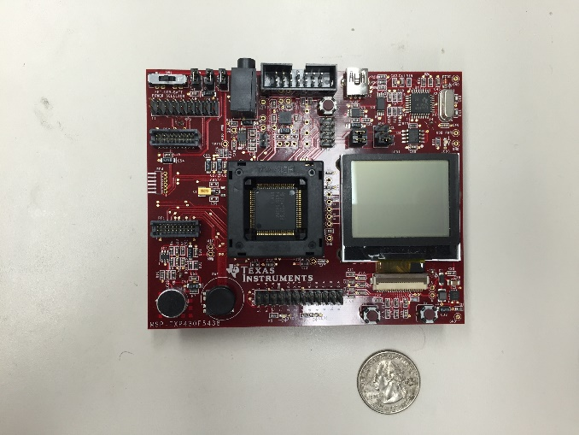
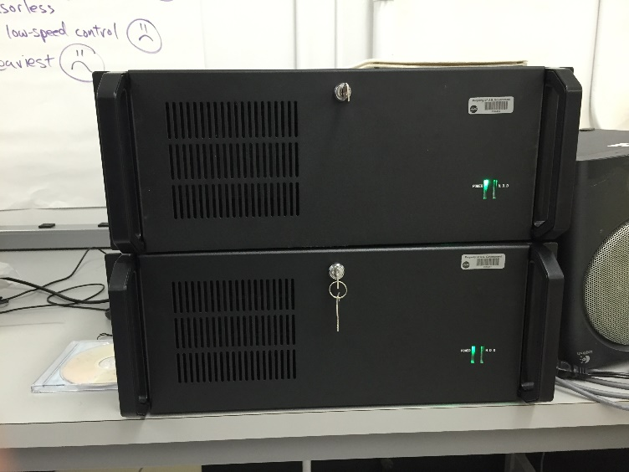
Both Ends of the Scale
TI MSP430 Microcontroller
24K RAM
64K Flash
Rack Mount PC
Quad-core Xeon
8GB RAM
Hard disk

