Slide 1
F` Software Framework A Small Scale Component Framework for Space
Jet Propulsion Laboratory,
California Institute of Technology
10/3/2020
© 2009-2020 California Institute of Technology. Government sponsorship acknowledged.
ALL RIGHTS RESERVED. acknowledged.
This software has been approved for open source release under NTR #49404.

Slide 2
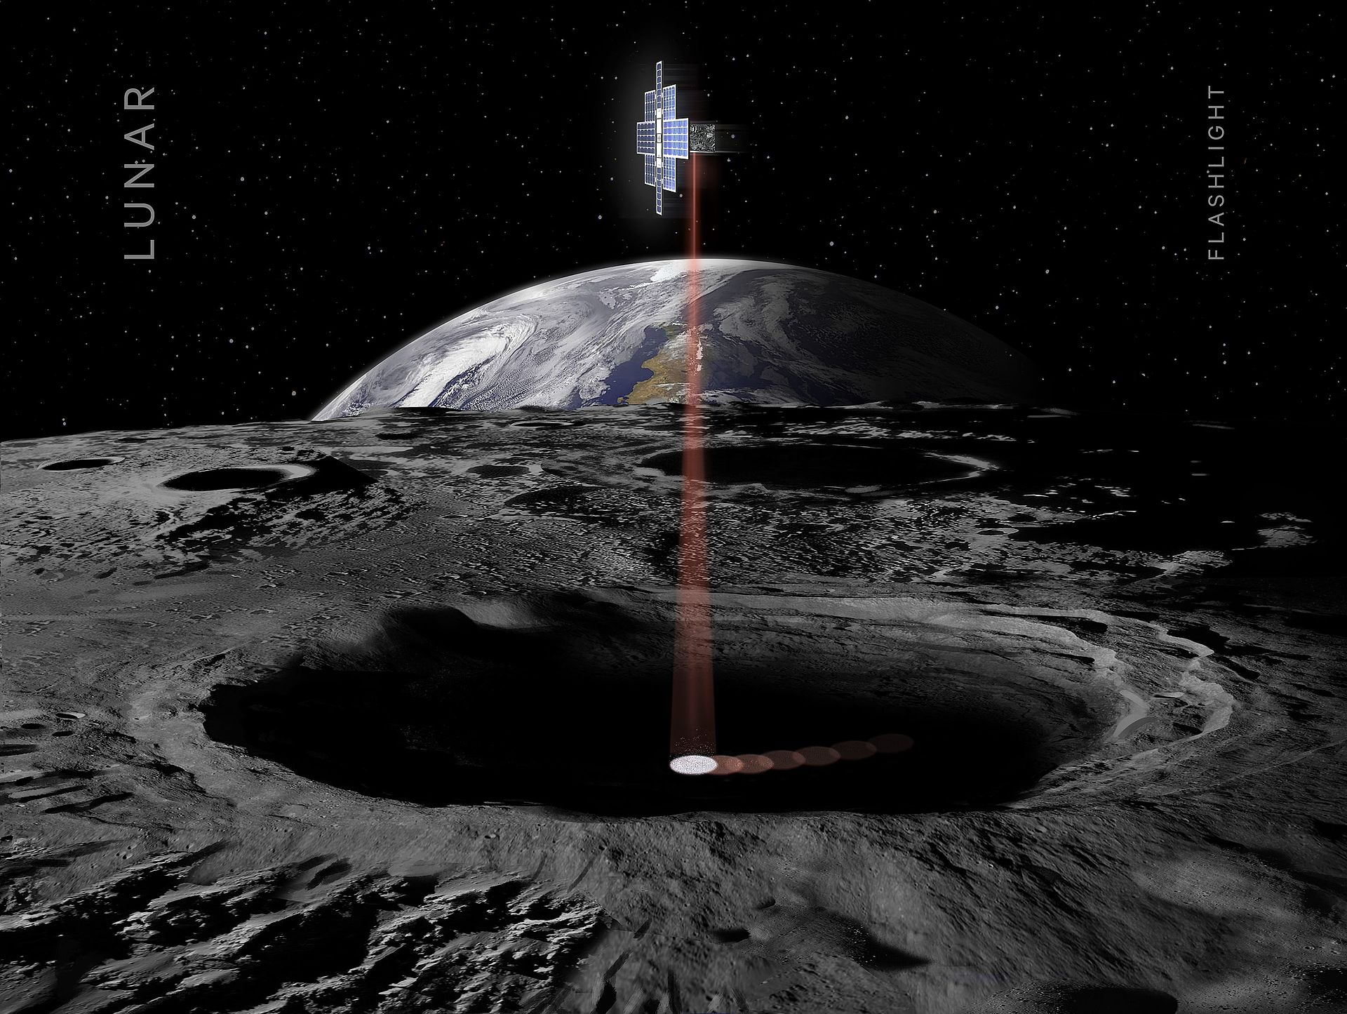
What is F´?
Embedded Systems Framework
Flight Software for Small-Scale Projects
Cubesats, Deployables, Instruments
Provides:
Framework Autocoder
Standard Components and Abstractions
Modeling, Testing, and Basic Ground Support
Credit: NASA – 2015

Slide 3

Why F´?
Standard Components and Abstractions
Flight Heritage
Designed For Modularity and Reuse
Compact Code, Efficient Implementation
Scalability Features
Unit Testing Framework
Credit: JPL/NASA – Artist’s Concept

Slide 4
Background
F` was developed as part of a technology development task at JPL
Explore new flight hardware
Explore new software approaches
Targeted at smaller projects like instruments, Cubesats, and Smallsats
Sparser processor resources
Lower amounts of memory, storage, and processor computing power
Microcontrollers, small embedded processors, radiation-hardened avionics
Clusters of interconnected processors
Goals were to show:
Goal | Explanation
Reusability | Frameworks and adaptations readily reusable
Modularity | Decoupled and easy to reassemble
Testability | Components easily isolated for testing
Adaptability | Should be adaptable to new contexts and bridge to inherited
Portability | Should be portable to new architectures and platforms
Usability | Should be easily understood and used by customers
Configurability | Facilities in the architecture should be scalable and configurable
Performance | Architecture should perform well in resource constrained contexts. Should be very compact.

Slide 5
F`: A Component Architecture
Definition: The F` Component Architecture is a design pattern based on an architectural concept combined with a software architectural framework.
Not just the concepts, but framework classes and tools are provided for the developer/adapter.
Implies patterns of usages as well as constraints on usage.
Centered around the concept of “components” and “ports”
Uses code generation to produce code to implement common framework patterns and facilities
Developer specifies in XML (soon to develop DSL)
Developer writes implementation classes to implement interfaces.
Component
Component
Component

Slide 6
Characteristics of Components
Encapsulates behavior
Components are not aware of other components
Localized to one compute context
e.g. physical processor, user process, etc
Interfaces are via strongly typed ports
Ports are formally specified interfaces
There are no direct calls to other components
Context where software threads run
Where flight/ground commands, telemetry and parameters are defined
Component
2
1
3
Port 1
Port 2

Slide 7
Characteristics of Ports
Encapsulates typed interfaces in the architecture.
Implemented as C++ class with one interface method
Point of interconnection in the architecture
Ports are directional; there are input and output ports
Direction is direction of invocation, not necessarily data flow. Ports can retrieve data
Ports can connect to 3 things:
Another typed port
Call is made to interface method on attached port
A component
Incoming port calls call component registered callback
A serialized port
Port serializes call and passes as data buffer (more to come)
All arguments in the interface are serializable, or convertible to a data buffer. There are built-in types supported by the framework; developer can write custom types. (see later slides)
Ports can have return values in limited cases
Only able to return data when component has synchronous interface (see definition later)
Serializable connections are defined as only output data flow
Pointers/references are allowed for performance reasons
User beware!
Multiple output ports can be connected to a single input port, but only one port connection for each output port.
Component
2
1
3
serialize()

Slide 8
A Component Topology
Components are instantiated at run time
They are then connected via ports into a Topology, or a specific set of interconnected components
There are no code dependencies between components, just dependencies on port interface types
Alternate implementations can easily be swapped
Simulation versions, alternate drivers, etc.
Component 1
Component 2
2
2
1
1
3
3
Port 1
Port 2
Port 1
Port 2
Port 1
Port 2
2
1
3
Component 3

Slide 9
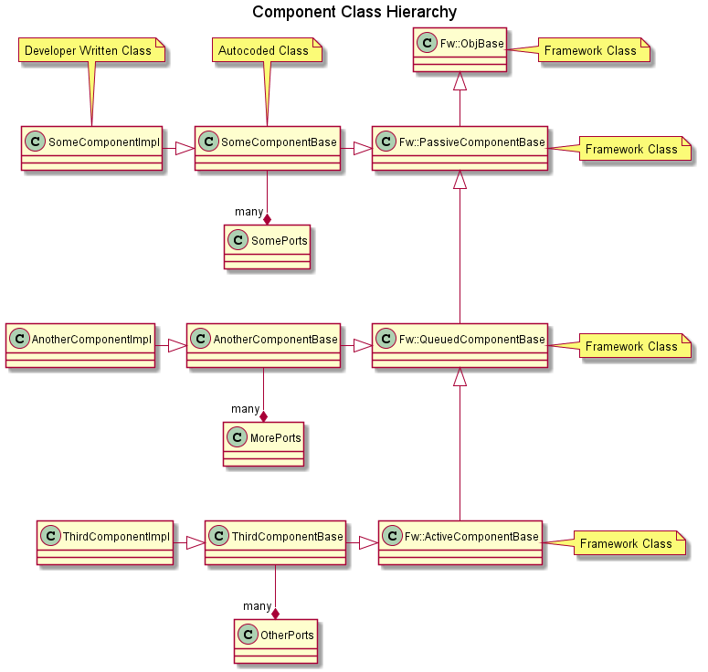
Component Type Hierarchy
Hierarchy consists of:
core framework classes
generated classes that implement architecture features
Developer written classes that implement interface handlers and project-specific logic

Slide 10
Component Types
User specifies type of component in XML. Types are:
Passive Component
No thread
Input port interface calls are made directly to implementation class handler methods on the thread of the caller of the input port.
Queued Component
No thread, adds a message queue
Asynchronous port calls are placed on component message queue.
Implementation class calls method in base class on the thread of another caller to dispatch any messages pending in the queue.
Active Component
Component has thread of execution as well as queue
Thread dispatches port calls from queue as it executes based on thread scheduler
Calls to output port are on thread of implementation functions
Thread making call is dependent on port type (see next slide)

Slide 11
Port/Component Characteristics
The way incoming port calls are handled is specified by the component XML.
Input ports can have three attributes:
Synchronous – port calls directly invoke derived functions without passing through queue
Guarded – port calls directly invoke derived functions, but only after locking a mutex shared by all guarded ports in component
Asynchronous – port calls are placed in a queue and dispatched on thread emptying the queue.
A passive component can have synchronous and guarded ports, but no asynchronous ports since there is no queue. Code executes on the thread of the calling component.
A queued component can have all three port types, but it needs at least one synchronous or guarded port to unload the queue and at least one asynchronous port for the queue to make sense. Code executes on the thread of the caller.
An active component can have all three varieties, but needs at least one asynchronous port for the queue and thread to make sense. Code executes on the thread of the caller or component depending on port type.
Developer needs to be aware of how all the different call kinds interact (e.g. reentrancy)
Output ports are invoked on the thread of handlers by calling methods in the generated base class.
Code Generated Active Base Class
port1()
Task
port2()
Asynchronous
func4()
Synchronous
port3()
Guarded
virtual func1()=0
handler3()
{…}
handler2()
{…}
handler1() {…
func4()
}
Developer Written Implementation Class

Slide 12
Serialization
Serialization is a key concept in the framework
Definition: Taking a specific set of typed values or function arguments and converting them in an architecture-independent way into a data buffer
Asynchronous port calls and commands and their arguments are serialized and placed on message queues in components
Commands, telemetry, and parameters are specified as serializables for transport to and from ground software
User can use built-in types or define complex types in XML and code generator will generate serializable classes that are usable internally as well as interfaces to and from ground software
User can also implement arbitrary serializable types with a set of required methods and the framework automatically handles them

Slide 13
Serialization Ports
A special optional port that handles serialized buffers
Takes as input a serialized buffer when it is an input port, and outputs a serialized buffer when it is an output port.
Can be connected to *any* typed port (almost).
For input port, calling port detects connection and serializes arguments
For output port, serialized port calls interface on typed port that deserializes arguments
Not supported for ports with return types
Useful for generic storage and communication components that don’t need to know type
Allows design and implementation of C&DH (command and data handling) components that can be reused.
Comp1
Typed port
Serialized port
Comp2
Serialized port
Typed port
Comp3

Slide 14
Commands, Telemetry, Events and Parameters
The code generator provides a method of implementing commands, telemetry, events (AKA EVRs), and parameters for interface with a ground system.
Component XML specifies arguments and types.
Data for service is passed in serialized form.
The generated code decodes serialized commands and invokes implementation handlers with the correct arguments. Telemetry and events are emitted by calling typed functions from implementation code.
Port types for flight/ground interface are defined in normal XML, so they can be used by the code generator for implementing component-level handlers or generically by other components used to implement flight/ground functions.

Slide 15
Commands
Component command XML specifies:
Opcode, mnemonic, and arguments
Arguments can be any built-in type or developer defined enumeration
Synchronization attribute
Sync, async, or guarded
Same meaning as ports
Async can specify message priority
Implementation class implements handler for each command
Base class deserializes arguments from argument data buffer
Implementation class reports a command status when done
Can be immediately in handler or deferred until command is complete later
Component must report a status to clear command dispatcher tracking and advance sequences
Autocoder automatically adds ports for registering commands, receiving commands and reporting an execution status.

Slide 16
Events
Component event XML specifies:
ID, name, severity and arguments
Arguments can be any built-in type or XML complex type
Can define enumerations
Format specifier string
Used by ground software and optional on-board console to display message with argument values
Follows C format specifier syntax
Code generated base class provides method to call for each event with typed arguments
Provides stronger type checking at compile time than MER/MSL EVR macros
Called by implementation class
Automatically time-tags event at moment of method invocation
Code generator automatically adds ports for retrieving time tag and sending event
Two independent ports for sending events
A binary version with serialized arguments for transport to ground software
A text port that sends a string version of the event (using the format specifier) that can be sent to a console
Can be globally disabled via architecture configuration macros to save execution time and code space

Slide 17
Telemetry
Component telemetry XML specifies channels that have:
ID, name, and data type
Data type can be any built-in type or external XML complex type
Can define enumerations
Format specifier string
Used by ground software and optional on-board console to display message with argument values
Code generated base class provides function to call for each channel with typed argument
Called by implementation class
Code generator automatically adds ports for retrieving time tag and sending channelized data

Slide 18
Parameters
Parameters are traditional means of storing non-volatile state
Framework provides code generation to set and save, but developer must write a component to load and save parameters from a particular non-volatile storage
File-based implementation provided with distribution
Component XML specifies parameters that have:
ID, name, and data type
Data type can be any built-in type
Can define enumerations
Optional default value
In the event the parameter cannot be retrieved, assigns default value to parameter
Code generator generates commands for setting and saving parameter values
Code generator generates optional overridable virtual method for providing notification to implementation class when values are updated.
Code generator automatically adds ports for retrieving and saving parameters
When parameters are saved by commands at the component level, the “save” port sends the parameter value to the storage component. The storage component is responsible for when and how to save parameter value
During initialization, a public method in the base class is provided to load the parameters and store copies in private component data
Code generated base class provides function to call for each parameter to retrieve stored copy
Implementation class can call whenever parameter value is needed
Implementation class cannot modify the parameter value, only commands can

Slide 19
Core Components
A set of core components has been matured over the lifetime of F’
Some subjected to JPL class B flight processes
Reviews, inspections, full coverage unit tests and static code analysis
Some contributed back to F’ core repository by projects
Provides out-of-the box implementations so that projects don’t have to start from the beginning
Common command and data handling components
Flight/ground interface components
Drivers
Helper components

Slide 20
Command Dispatcher (Svc/CmdDispatcher)
Command dispatcher is an active component
Components register their command opcodes
Command dispatcher receives buffer from ground or sequencer containing command and arguments
Command opcode is extracted, and opcode lookup is made
Component is invoked to execute commands it registered
Component responds with completion status (pass, fail) when command complete
buffer
CmdDispatcher
Mod1
command
OC
register
status
ModN
status

Slide 21
Command Sequencer (Svc/CmdSequencer)
Command sequencer loads file from file system
Sends command and waits for response for each command in the file
A failed response terminates the sequence, successful response moves to the next command
Active component
CmdSequencer
Command
Dispatcher
1. command
2. status
File

Slide 22
Channelized Telemetry (Svc/TlmChan)
Telemetry database has double-buffered array of telemetry buffers
Component writes updated value with time tag to telemetry database component
Telemetry database writes value to active buffer
Run port is called periodically by rate group. Swaps active buffer
Run call copies updated values to downlink
Active component
TlmChan
Component
run
value
downlink
time
1. write()
active
Time
Component

Slide 23
Event Log (Svc/ActiveLogger)
Component sends time-tagged event to Event Log component
Event log component places event on message queue. Thread of Event Log component then sends downlink packet with event
FATAL event immediately invokes FATAL handler port on thread of calling component for special handling if desired
Active component
Component
ActiveLogger
3. event
4. downlink
Msg Q
2. time
Fatal
1. event()
Time
Component

Slide 24
Parameter Database (Svc/PrmDb)
Parameter Database loads file containing parameters from file system during initialization
Initialization subsequently calls loadParameters() on all components with parameters.
Commands to components can update and set parameter values via port call to parameter manager
Manager can save updated values to file system via command
loadParameters()
PrmDb
Component
get parameter
set parameter
Parameter set/save commands
File

Slide 25
Rate Group (Svc/ActiveRateGroup)
Rate group is a array of run() ports
Gets a call to asynchronous run port driven by project specific timing component
Calls ports in order
Since is a list of run ports, doesn’t know (or care) which destinations are in active components or not
Rate Group is an active component
Active
Rate
Group
run()
run()
active
run()
….
run()
run()

Slide 26
Polymorphic Database (Svc/PolyDb)
Used to pass values around internally between components
Uses Fw/PolyType class to allow a range of types to be stored
Enforces value type written is value type read
Stored as an array accessed by integer index
Project assigns meaning to values stored with index
PolyDb
Component 1
get
set
Component 2

Slide 27
Buffer Management (Svc/BufferManager)
Manages a pool of buffers for components
Allocated at startup
Variable sized buffers
FIFO based storage
Component gets() a buffer, uses it, and then sends() it when complete
Buffer lifetimes managed as a system issue
BufferManager
get()
send()

Slide 28
File Downlinking (Svc/FileDownlink)
Sends the contents of a file to the ground system when commanded
Gets buffers from BufferManager
FileDownlink
Downlink
send()
BufferManager
get()
File

Slide 29
File Uplinking (Svc/FileUplink)
Gets the contents of a file from the ground system
Uplink sends buffer with file contents
Returns buffers to BufferManager
FileUplink
Uplink
send()
get()
send()
BufferManager
File

Slide 30
Multi-node
Hub pattern
Hub is a component with multiple serialization input and output ports
Typed ports on calling components are connected to serialized ports (see earlier slides)
Each hub instance is responsible for connecting to a remote node
Input port calls are repeated to corresponding output ports on remote hub
Single point of connection to remote node, so central point of configuration for transport.
Node 1
Node 2
Producer
Component1
Hub
Hub
Consumer
Component1
Producer
Component2
Consumer
Component2
Transport (Socket, ARINC Channel, UART, IPC)

Slide 31
Typical F´ Application Architecture
Application
Component
Manager
Component
Manager
Component
Driver
Components
Driver
Components
Notes:
Typically applications are layerd.

Slide 32
Code Scaling
Framework code is very compact
Generated code is also compact
Demo application for TI microcontroller was about 15K
Native type sizes can be configured
e.g. some microcontrollers have 16-bit/8-bit only support
Features can be added or removed depending on resources
Object naming
Port execution tracing
Serialization of ports
Single node systems don’t always need
This is not data serialization but the use of serialized ports
Object naming/registry
Component connection tracing
Text logging
For bare-metal (i.e. no OS) processors, there is an OS emulation layer that allows reused of components with message queues and threads

Slide 33
Status
Deployed on:
RapidScat (ISS radar experiment)
Asteria
Mars Helicopter
Lunar Flashlight
NeaScout
DOD Testbed
Future Projects (In proposal process)
MSH (Mars Science Helicopter)
Cold Arm
OWLs
Various university projects
Has been ported to:
Linux, MacOS, Windows (Cygwin), VxWorks, ARINC 653, RTEMS, Bare Metal (No OS)
Snapdragon, PPC (RAD750), Leon3, x86, ARM (e.g. Raspberry Pi), MSP430
Mature set of C&DH components
Following flight processes such as code inspections, static analysis, and full-coverage unit testing
Avionics Platforms:
Sphinx
Sabertooth

Slide 34
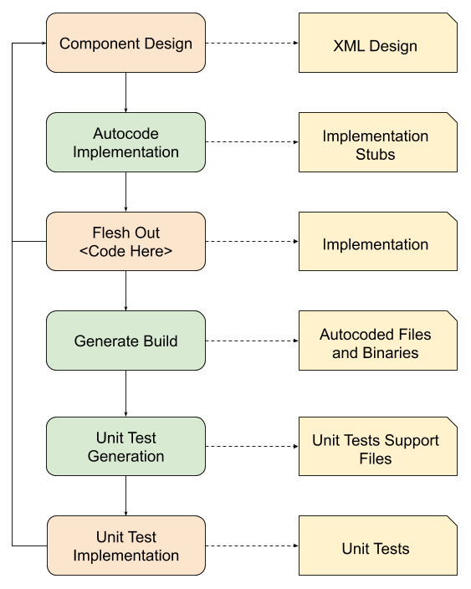
Advantages of the F´ Architecture
Autocoding:
Component stubs and UTs
Communication mechanics
Rapid Development:
Rapidly swap components
Multiple topologies and organizations
Standard Tooling:
Application design tools
System testing tools
Standard patterns and best practices at application level

Slide 35

Open Source and F´
F´ Software Repository:
https://github.com/nasa/fprime
F´ Community Repositories:
https://github.com/fprime-community
F´ Internal Repository:
https://github.jpl.nasa.gov/FPRIME/fprime-sw
F´ Small Sat Introduction:
https://digitalcommons.usu.edu/smallsat/2018/all2018/328/
© 2009-2020 California Institute of Technology. Government sponsorship acknowledged.
The research was carried out at the Jet Propulsion Laboratory, California Institute of Technology,
under a contract with the National Aeronautics and Space Administration.
This software has been approved for open source release under NTR #49404.
Credit: NASA/KSC

