Slide 1
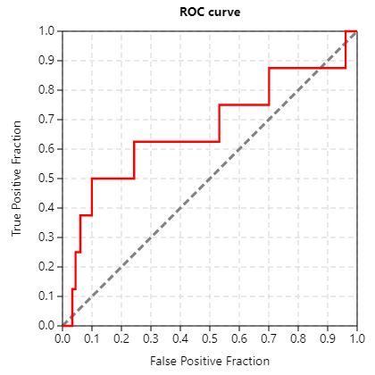
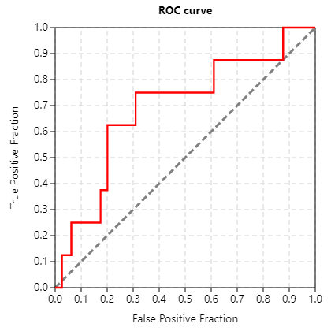
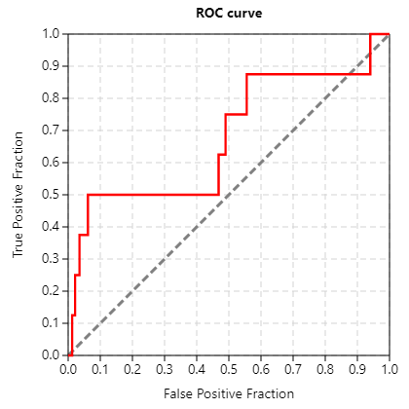
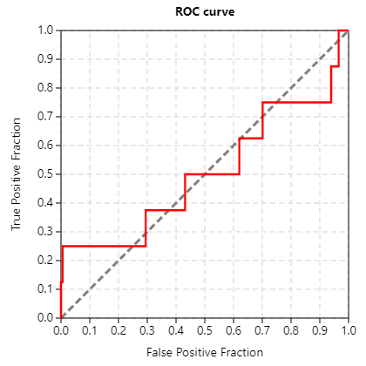
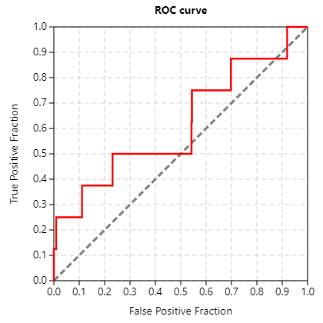
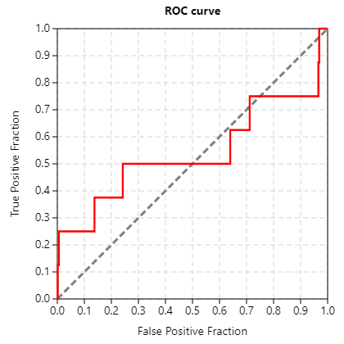
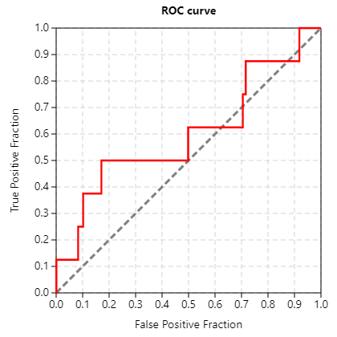
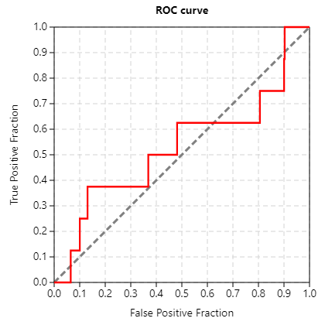
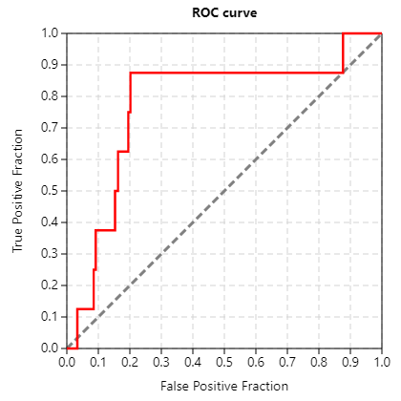
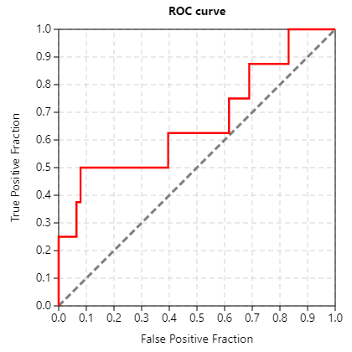
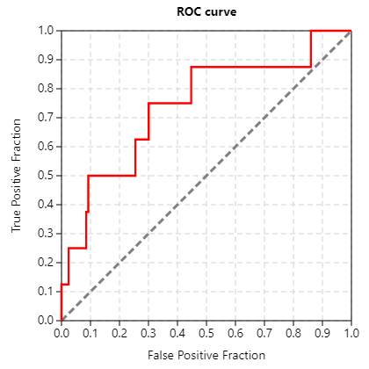
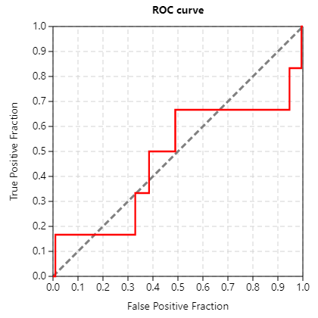
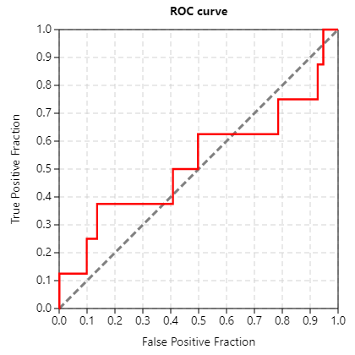
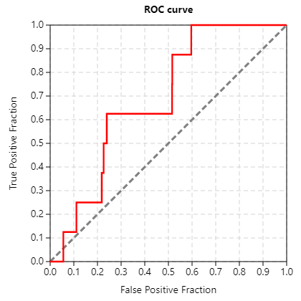
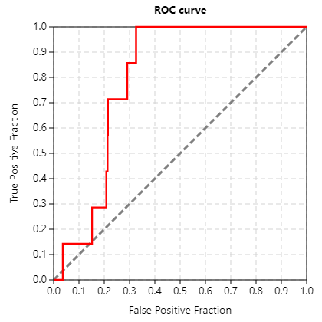
CDK5_GLIDE
1ung_08_08
1ung_nowat_1_08
1ung_nowat_08_08
1ung_1_08
1unl_1_08
1unl_08_08
1unl_nowat_1_08
1unl_nowat_08_08
3o0g_1_08
3o0g_08_08
3o0g_nowat_1_08
3o0g_nowat_08_08
4au8__1_08
4au8_08_08
4au8_nowat_1_08
4au8_nowat_08_08

Slide 2
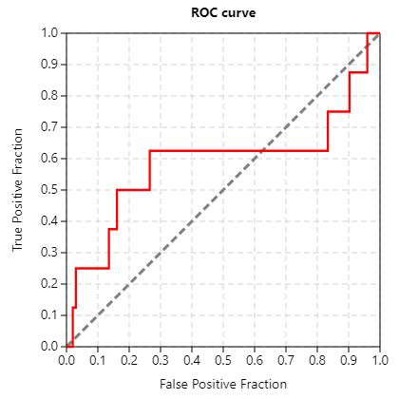
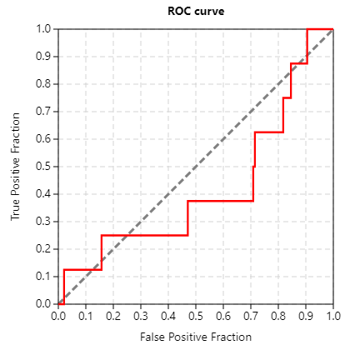
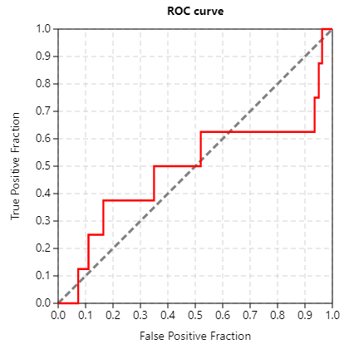
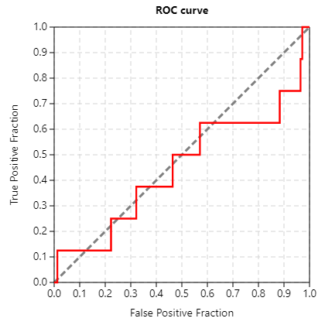
CDK5_VROCS
vrocs_1unl
vrocs_1ung
vrocs_3o0g
vrocs_4au8

Slide 3
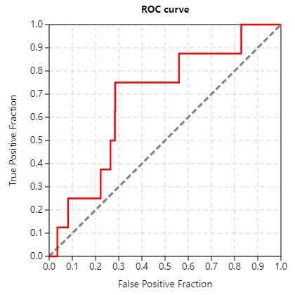
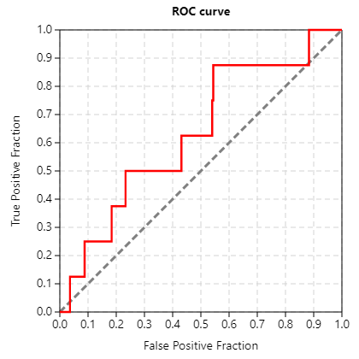
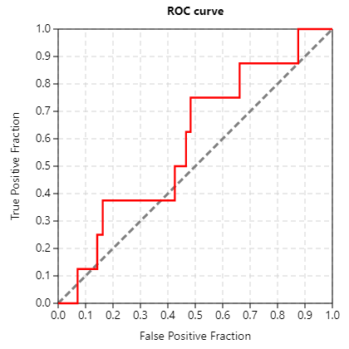
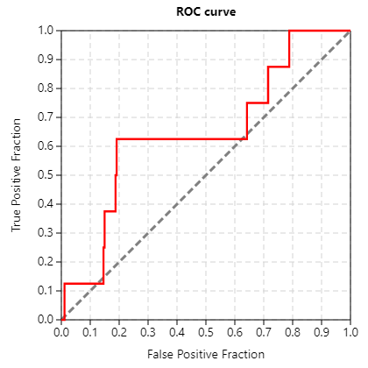
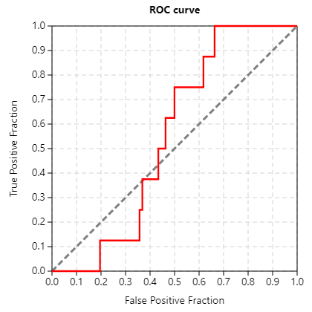
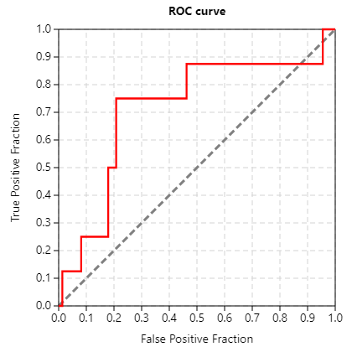
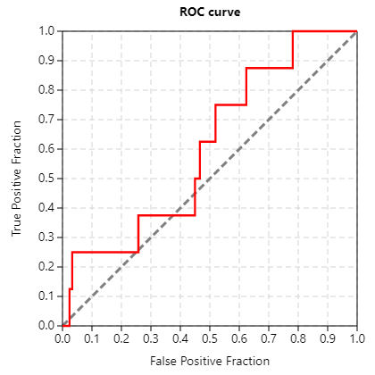
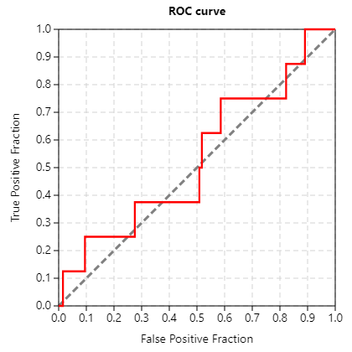
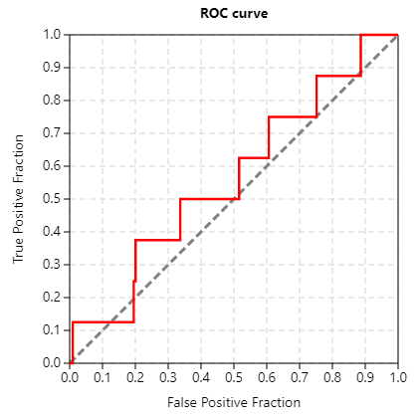
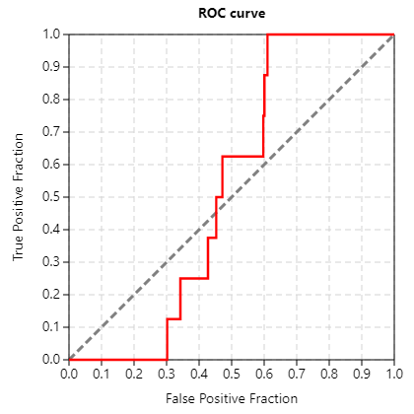
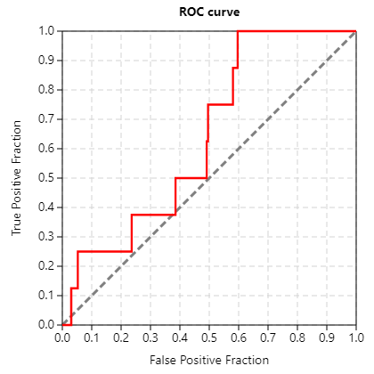
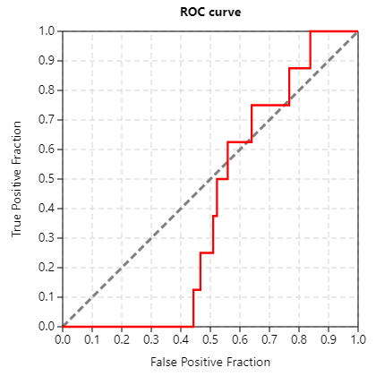
CDK5_CANVAS
1ung, 1unl
fpdend_screen_1ung_cdk5
fplinear_screen_1ung_cdk5
fpmaccs_screen_1ung_cdk5
fpmol_screen_1ung_cdk5
fpradial_screen_1ung_cdk5
fptop_screen_1ung_cdk5
fpdend_screen_1unl_cdk5
fplinear_screen_1unl_cdk5
fpmaccs_screen_1unl_cdk5
fpmol_screen_1unl_cdk5
fpradial_screen_1unl_cdk5
fptop_screen_1unl_cdk5

Slide 4
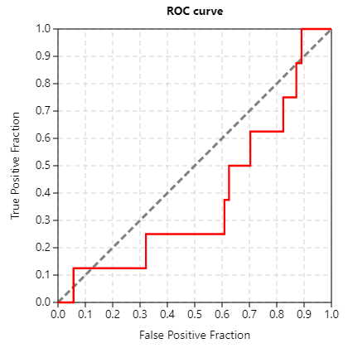
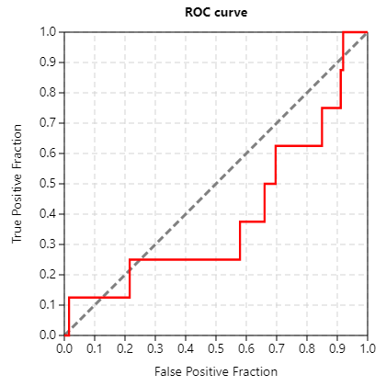
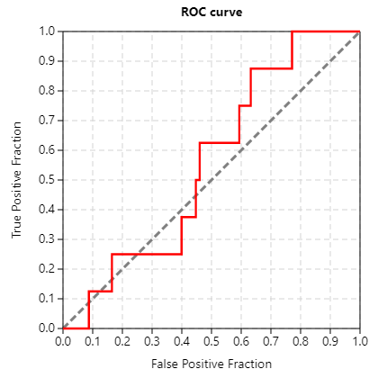
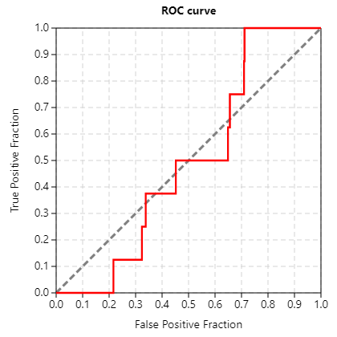
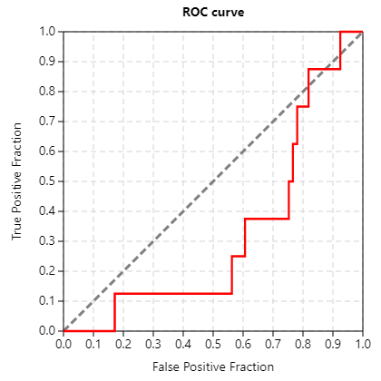
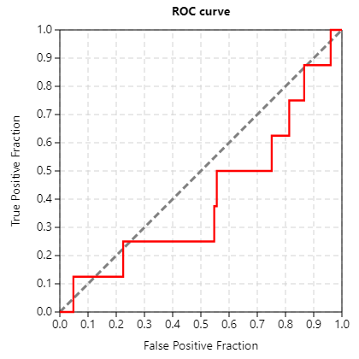
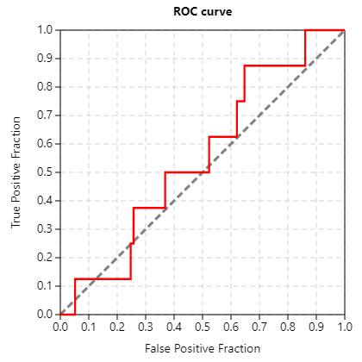
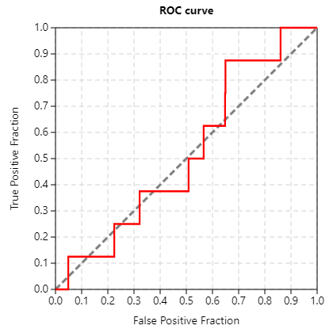
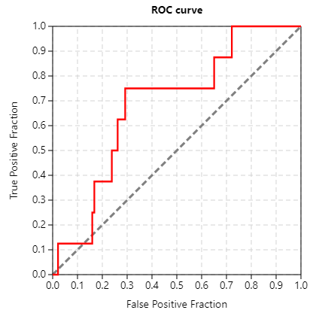
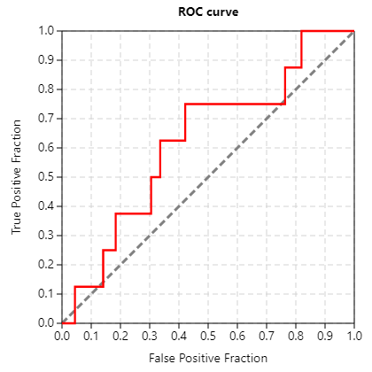
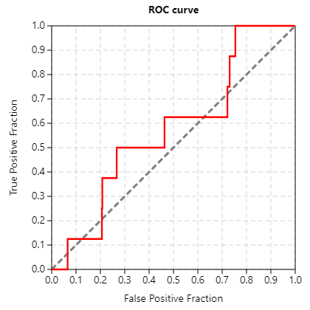
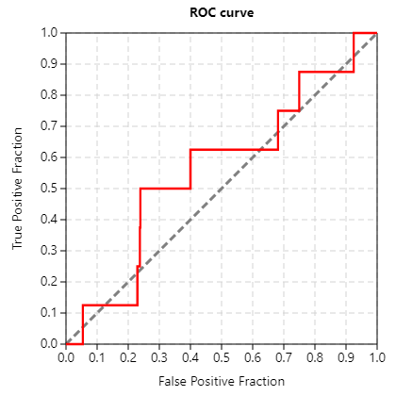
CDK5_CANVAS
3o0g, 4au8
fpdend_screen_3o0g_cdk5
fplinear_screen_3o0g_cdk5
fpmaccs_screen_3o0g_cdk5
fpmol_screen_3o0g_cdk5
fpradial_screen_3o0g_cdk5
fptop_screen_3o0g_cdk5
fpdend_screen_4au8_cdk5
fplinear_screen_4au8_cdk5
fpmaccs_screen_4au8_cdk5
fpmol_screen_4au8_cdk5
fpradial_screen_4au8_cdk5
fptop_screen_4au8_cdk5

Slide 5
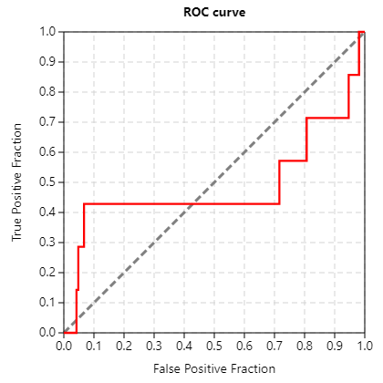
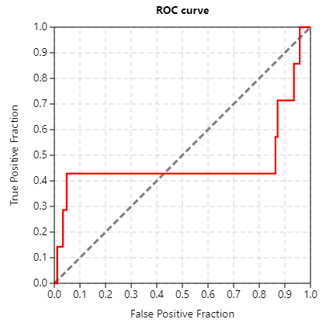
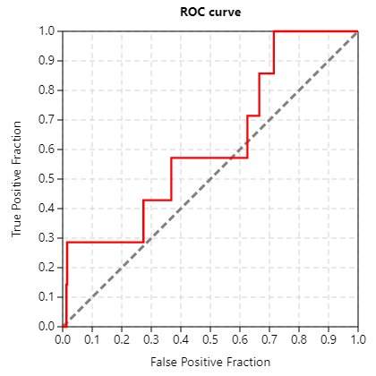
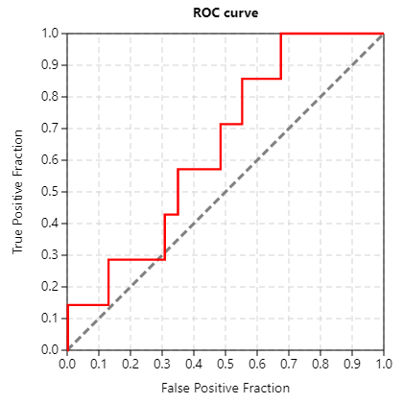
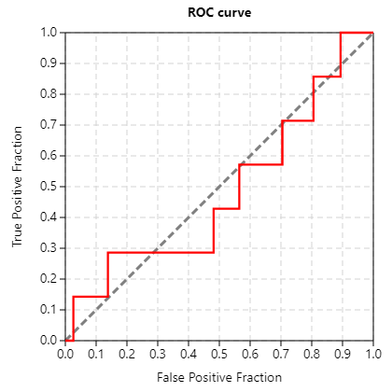
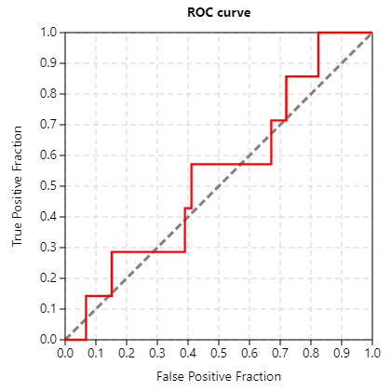
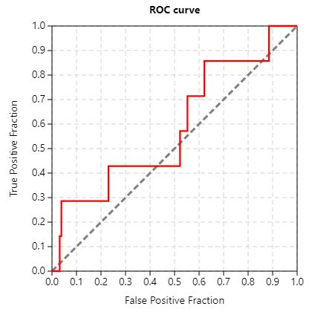









GSK3b_GLIDE
1q5k_1_08
1q5k_08_08
1q5k_nowat_1_08
1q5k_nowat_08_08
1q41_1_08
1q41_08_08
1q41_nowat_1_08
1q41_nowat_08_08
4afj_1_08
4afj_08_08
4afj_nowat_1_08
4afj_nowat_08_08
4pte_1_08
4pte_08_08
4pte_nowat_1_08
4pte_nowat_08_08

Slide 6




GSK3b_VROCS
vrocs_1q5k
vrocs_1q41
vrocs_4afj
vrocs_4pte

Slide 7












GSK3b_CANVAS
1q5k, 1q41
fpdend_screen_1q5k_gsk3b
fplinear_screen_1q5k_gsk3b
fpmaccs_screen_1q5k_gsk3b
fpmol_screen_1q5k_gsk3b
fpradial_screen_1q5k_gsk3b
fptop_screen_1q5k_gsk3b
fpdend_screen_1q41_gsk3b
fplinear_screen_1q41_gsk3b
fpmaccs_screen_1q41_gsk3b
fpmol_screen_1q41_gsk3b
fpradial_screen_1q41_gsk3b
fptop_screen_1q41_gsk3b

Slide 8












GSK3b_CANVAS
4afj, 4pte
fpdend_screen_4afj_gsk3b
fplinear_screen_4afj_gsk3b
fpmaccs_screen_4afj_gsk3b
fpmol_screen_4afj_gsk3b
fpradial_screen_4afj_gsk3b
fptop_screen_4afj_gsk3b
fpdend_screen_4pte_gsk3b
fplinear_screen_4pte_gsk3b
fpmaccs_screen_4pte_gsk3b
fpmol_screen_4pte_gsk3b
fpradial_screen_4pte_gsk3b
fptop_screen_4pte_gsk3b

Slide 9















CK1_GLIDE
3uzp_1_08
3uzp_08_08
3uzp_nowat_1_08
3uzp_nowat_08_08
4hgt_1_08
4hgt_08_08
4hgt_nowat_1_08
4hgt_nowat_08_08
4kb8_nowat_1_08
4kb8_nowat_08_08
4kb8_1_08
4kb8_08_08
4twc_1_08
4twc_08_08
4twc_nowat_1_08
4twc_nowat_08_08

Slide 10




CK1_VROCS
vrocs_3uzp
vrocs_4hgt
vrocs_4kb8
vrocs_4twc

Slide 11












CK1_CANVAS
3uzp, 4hgt
fpdend_screen_3uzp_ck1
fplinear_screen_3uzp_ck1
fpmaccs_screen_3uzp_ck1
fpmol_screen_3uzp_ck1
fpradial_screen_3uzp_ck1
fptop_screen_3uzp_ck1
fpdend_screen_4hgt_ck1
fplinear_screen_4hgt_ck1
fpmaccs_screen_4hgt_ck1
fpmol_screen_4hgt_ck1
fpradial_screen_4hgt_ck1
fptop_screen_4hgt_ck1

Slide 12












CK1_CANVAS
4kb8, 4twc
fpdend_screen_4kb8_ck1
fplinear_screen_4kb8_ck1
fpmaccs_screen_4kb8_ck1
fpmol_screen_4kb8_ck1
fpradial_screen_4kb8_ck1
fptop_screen_4kb8_ck1
fpdend_screen_4twc_ck1
fplinear_screen_4twc_ck1
fpmaccs_screen_4twc_ck1
fpmol_screen_4twc_ck1
fpradial_screen_4twc_ck1
fptop_screen_4twc_ck1

Slide 13
















DYRK1a_GLIDE
3anr_1_08
3anr_08_08
3anr_nowat_1_08
3anr_nowat_08_08
4mq1_1_08
4mq1_08_08
4mq1_nowat_1_08
4mq1_nowat_08_08
4ylk_1_08
4ylk_08_08
4ylk_nowat_1_08
4ylk_nowat_08_08
5a4t_1_08
5a4t_08_08
5a4t_nowat_1_08
5a4t_nowat_08_08

Slide 14




DYRK1a_VROCS
vrocs_3anr
vrocs_4mq1
vrocs_4ylk
vrocs_5a4t

Slide 15












DYRK1a_CANVAS
3anr, 4mq1
fpdend_screen_3anr_dyrk1a
fplinear_screen_3anr_dyrk1a
fpmaccs_screen_3anr_dyrk1a
fpmol_screen_3anr_dyrk1a
fpradial_screen_3anr_dyrk1a
fptop_screen_3anr_dyrk1a
fpdend_screen_4mq1_dyrk1a
fplinear_screen_4mq1_dyrk1a
fpmaccs_screen_4mq1_dyrk1a
fpmol_screen_4mq1_dyrk1a
fpradial_screen_4mq1_dyrk1a
fptop_screen_4mq1_dyrk1a

Slide 16












DYRK1a_CANVAS
4ylk, 5a4t
fpdend_screen_4ylk_dyrk1a
fplinear_screen_4ylk_dyrk1a
fpmaccs_screen_4ylk_dyrk1a
fpmol_screen_4ylk_dyrk1a
fpradial_screen_4ylk_dyrk1a
fptop_screen_4ylk_dyrk1a
fpdend_screen_5a4t_dyrk1a
fplinear_screen_5a4t_dyrk1a
fpmaccs_screen_5a4t_dyrk1a
fpmol_screen_5a4t_dyrk1a
fpradial_screen_5a4t_dyrk1a
fptop_screen_5a4t_dyrk1a

