Slide 1
GAM PHI INTERNAL PROJECT
HCSR04 MODULE
18 April 2023

Slide 2


1
1
HCSR04
2
EB TRESOS CONFIGURATION
CONTENT
3
WIRING DIAGRAM
4
CODE IMPLEMENTATION
© Copyright FPT Software – Level of Confidentiality

Slide 3
01. HCSR04

Slide 4
HCSR04 INFORMATION
This internal project’s ECU1 will utilize two (2) HC-SR04 Ultra Sonic Sensor
Operation of HCSR04 Ultrasonic Sensor: Set the trigger pin of the sensor high for at least 10us, the sensor will then automatically send a pulse that will bounce back if a boundary is hit. The bounced back signal will be received by the echo pin, which you need to read. The time at which the echo pin is high is directly proportional to how far the boundary is.
For more information about the HCSR04: click here!

Slide 5
02. EB TRESOS CONFIGURATION

Slide 6
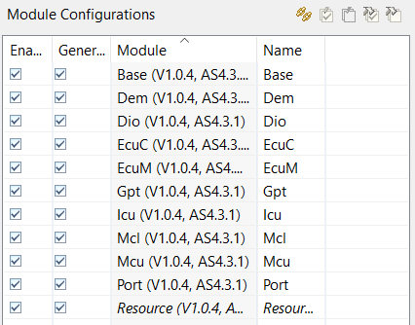
MODULE CONFIGURATION
The HCSR04 module rely on the configuration of the following modules.

Slide 7
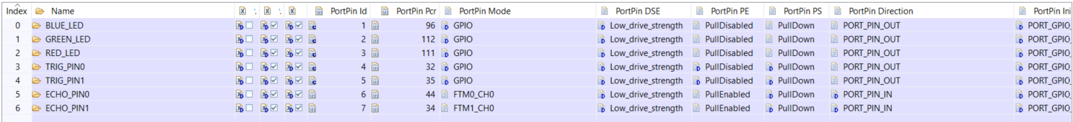
PORT AND DIO MODULE CONFIGURATION
The onboard LEDs, which are utilized for testing and verification purposed are configured as GPIO outputs.
The pins where the trigger pins of the respective HCSR04 is also configured as GPIO outputs.
The pins where the echo pins of the respective HCSR04 is also configured as inputs but in the mode of different FTM channels as they will be used for reading the time elapsed of the timer which serves as basis for distance calculation.

Slide 8
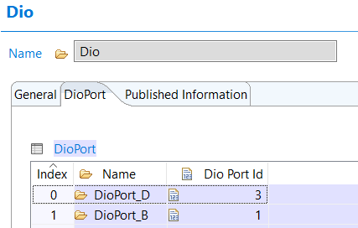
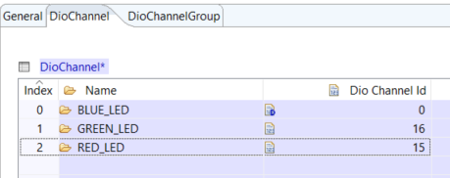
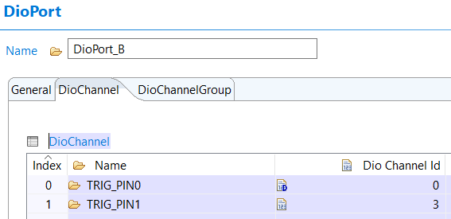
PORT AND DIO MODULE CONFIGURATION
On Port B the connections include the trigger pins for HCSR04-0 and HCSR04-1.
Two DIO ports are configured as the project will utilize pins in port B and port D.
On Port D the connections include the onboard LEDs.
ECHO pins are not explicitly configured in the DIO module.

Slide 9
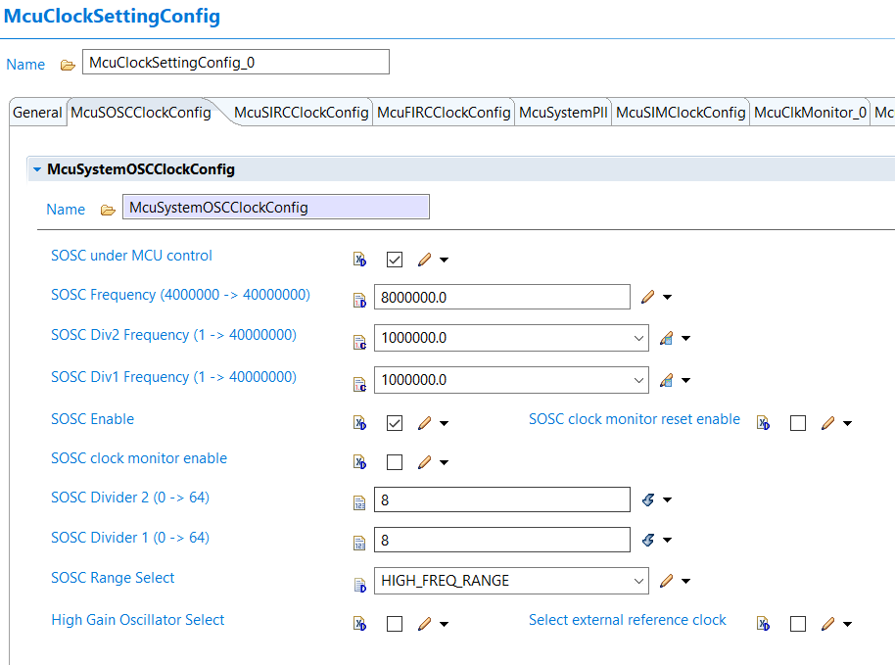
MCU MODULE CONFIGURATION
This project will utilize the SOSC as reference for the GPT and ICU configurations
Both divider 1 and divider 2 will be set to 8.
With 8 as divider, the SOSC frequency of 8MHz would be rescaled to 1MHz each.
A frequency of 1MHz will ensure that the return value of the clocks that has the SOSC as reference will be in microseconds.

Slide 10
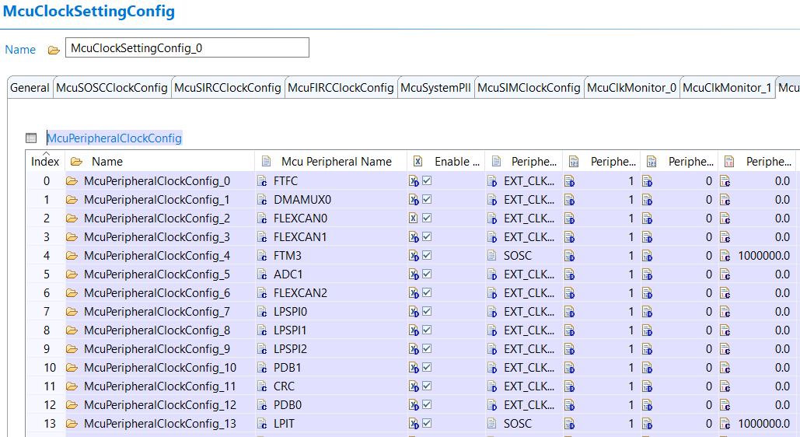
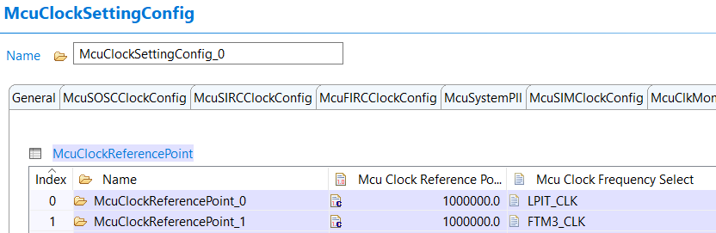
MCU MODULE CONFIGURATION
Under McuPeripheralClockConfig, configure the peripherals used in the project (FTM3 and LPIT).
Enable the peripheral clock and set the clock source to SOSC and auto calculate the clock frequency.
Add two(2) McuClockReferencePoint which refers to the previously configured LPIT_CLK and FTM3_CLK as sources

Slide 11
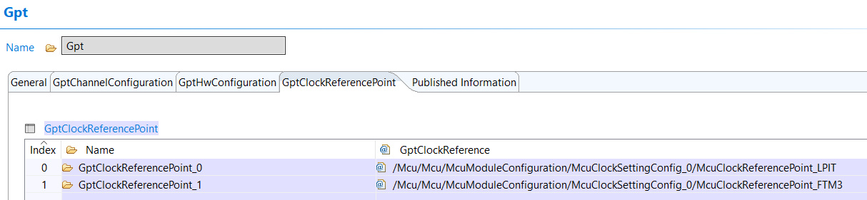
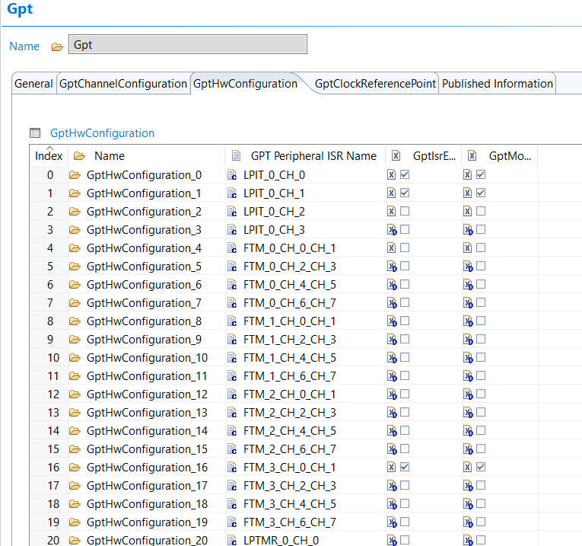
GPT MODULE CONFIGURATION
To utilize the references enabled in the MCU module, add two (2) GptClockReferencePoint and using the McuClockReferencePoint configured previously.
Under the GPT Hardware Configuration, enable the interrupts and module use for LPIT_0 Channel 0 and 1, and for the FTM_3_CH_0_CH_1

Slide 12
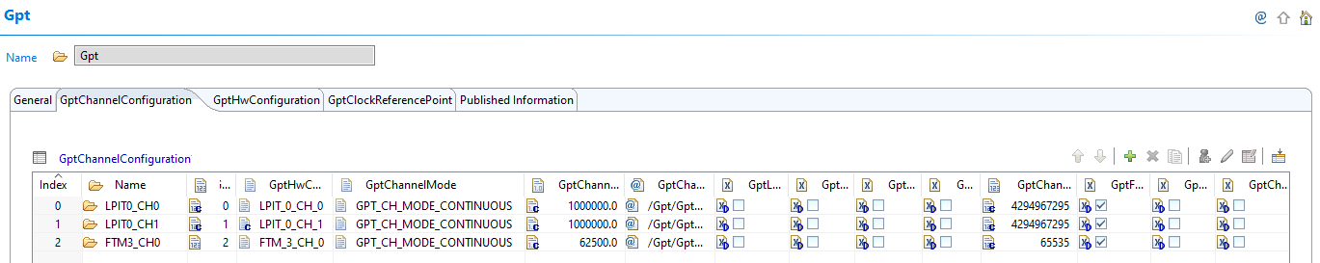
GPT MODULE CONFIGURATION
Three LPIT0 Channels will be used as timers to get the distance for three HCR04 sensor and one FTM3 Channel to send data periodically.
Configure the LPIT0 Channels 0 and 1. Set the channels to continuous mode, the clock source reference to GptClockReferencePoint_0(LPIT_CLK), and auto calculate the maximum tick value to the maximum value allowed by the reference clock.
Configure the FTM3_CH0. Set the channel to continuous mode, the Clock Source Reference to GptClockReferencePoint_1(FTM3_CLK). Since this utilizes an FTM as a reference, we need to enable the clock source and set it to external clock and set the prescaler to 16 to get the ChannelTickFrequency of 62500. Enable the GptNotification as Gpt_NotificationFTM3_CH0.

Slide 13
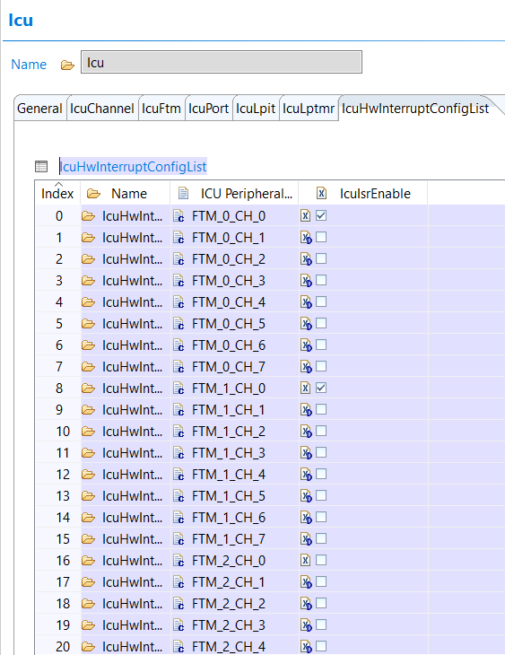
ICU MODULE CONFIGURATION
Under the ICU Module’s Hardware Interrupt Configuration List, enable the Interrupt Service Routine for FTM_0, FTM_1 and FTM_2. This allows the module to run this service routines when called. This is used to detect signal and generate an interrupt to start and stop our timer to calculate the distance.

Slide 14
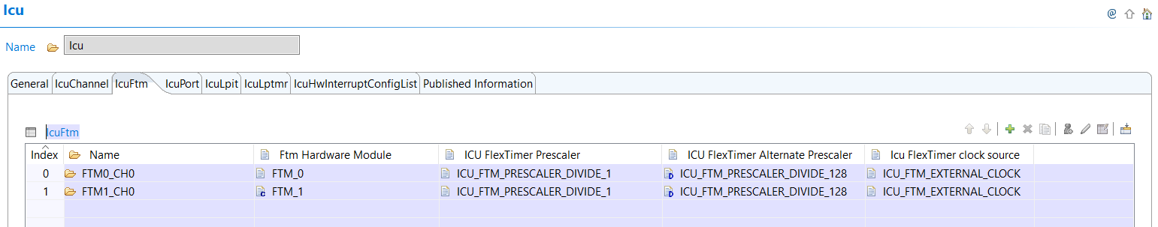
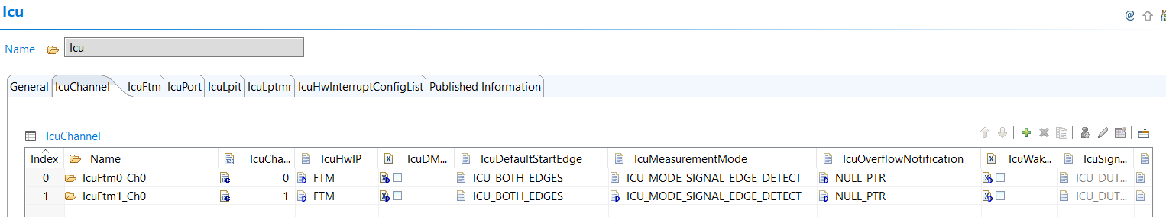
ICU MODULE CONFIGURATION
Under the ICU Module we need to configure IcuFtm and IcuChannel.
Icu module is necessary if you want to have input capture functionalities in a pin.
Configure ICU FTM with corresponding hardware module as previously configured. The FlexTimer Prescaler should be set to 1 and the clock source should be set to external clock.
The ECHO_PINs which were configured for FTM functionalities in the port module will be configured as ICU_MODE_SIGNAL_EDGE_DETECT and set to ICU_BOTH_EDGES for its measurement mode. What it does is, trigger an interrupt whenever a high or low edge is detected in the pin.

Slide 15
03. WIRING DIAGRAM

Slide 16
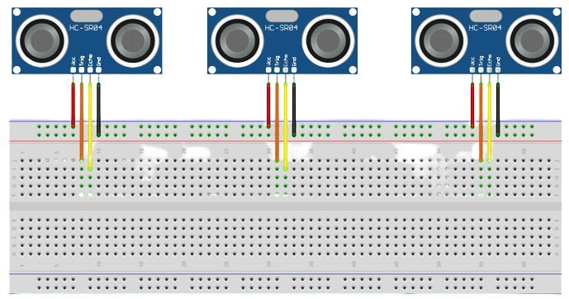
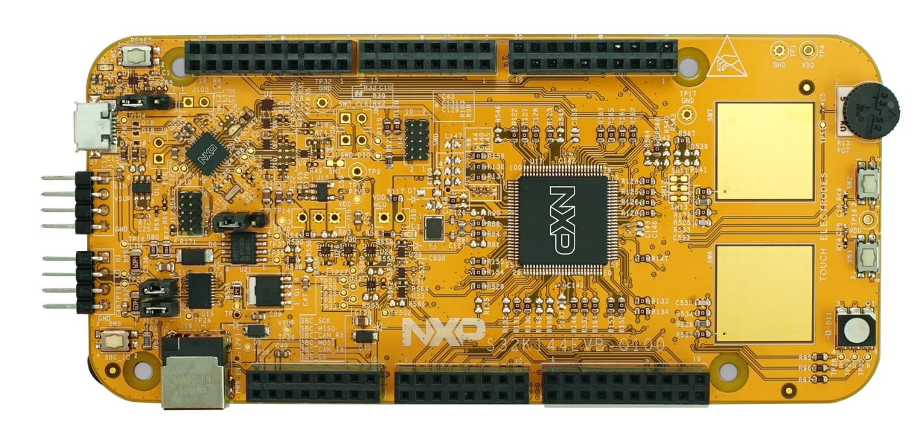
WIRING DIAGRAM
HCSR04 (Front)
HCSR04 (Rear)
PIN NAME | PIN ID
HCSR04(0)
TRIG0 | PTB0
ECHO0 | PTB12
HCSR04(1)
TRIG1 | PTB3
ECHO1 | PTB2
HCSR04(2)
TRIG2 | PTD11
ECHO2 | PTD10

Slide 17
04. CODE IMPLEMENTATION

Slide 18
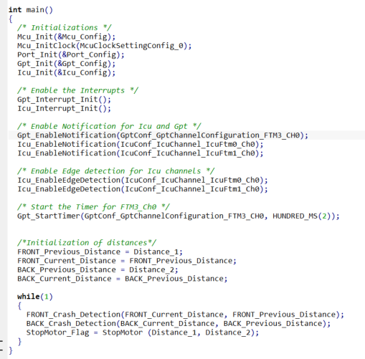
MAIN FUNCTION
This block of code initializes all the modules used in the program. The modules used and initialized on this part includes MCU, MCU Clocks, Port, GPT, and ICU modules.
These lines of code call on the function to initialize the interrupts for the GPT and ICU

Slide 19
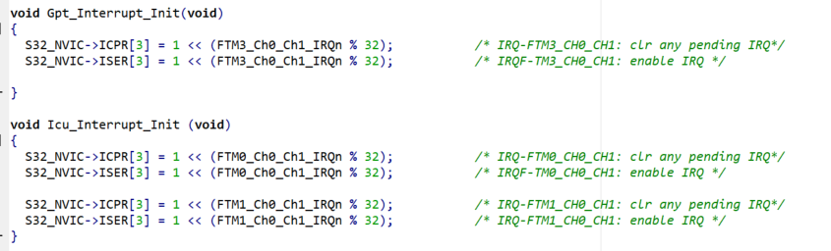
INTERRUPT FUNCTIONS
This function is used to initialize the interrupt functionality of the FTM3_CH0_CH1.
This function is used to initialize the interrupt functionality of the echo pins assigned to their respective FTM Channels to be used for reading the sensors.

Slide 20
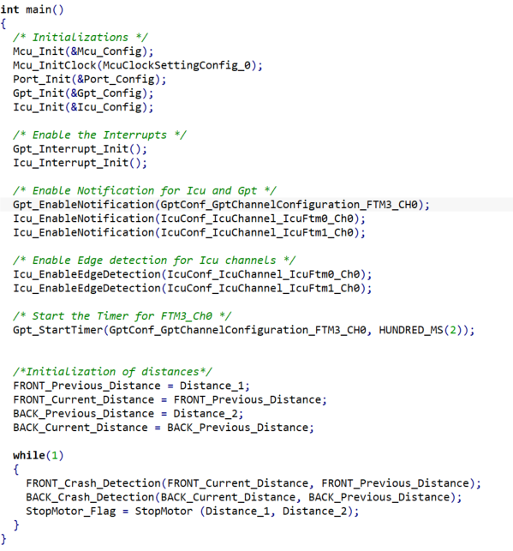
MAIN FUNCTION
These lines of code enable the notification function for the configured GPT on FTM3_CH0 and configured ICUs on FTM0 and FTM1. This allows the enable GPT and ICU channels to generate interrupts.
These lines of code allows the ICU module to generate interrupts when the configured edges occurs on the input signal, in this case it will generate interrupt on both the rising edge and the falling edge of the input signal.
This starts the GPT on FTM3_CH0 with a timeout value of 200ms. Which allows the said channel to enable the sending of trigger signal every 200ms.

Slide 21
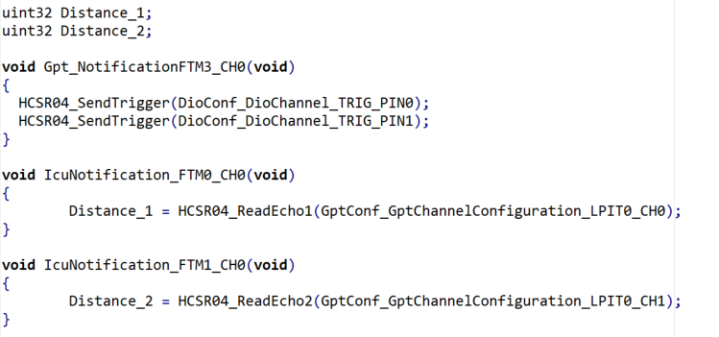
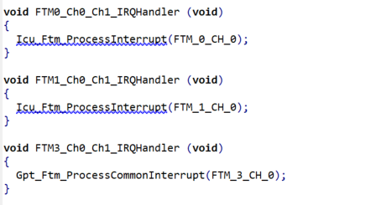
GPT AND ICU NOTIFICATION FUNCTIONS
Each of this handlers are called whenever an interrupt corresponding to each echo pins occur. The Process Interrupt function is responsible for calling the respective notification functions associated with each channel.
The functions above are the notification functions of each configured channel. These are the functions called by the Process Interrupt functions.
The Gpt_NotificationFTM3_CH0 is responsible for sending the trigger signal from the HCSR04.
The notification for each ICU channel is responsible for reading the signal from the HCSR04 and storing it into respective variables.

Slide 22
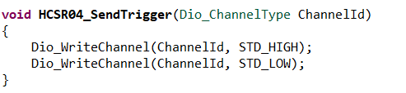
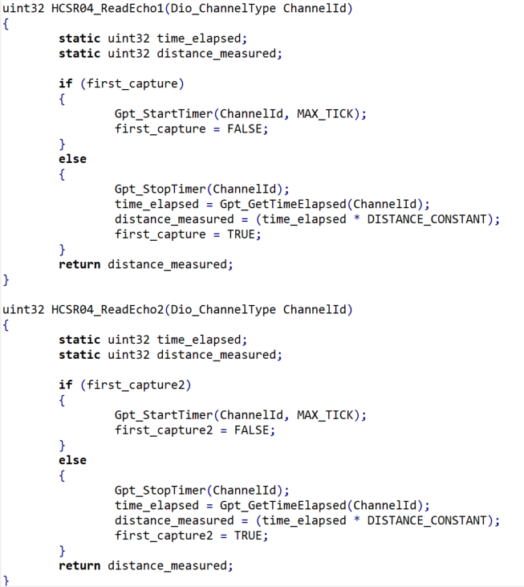

HCSR04 FUNCTIONS
This function takes a channel ID as a parameter and allows the HCSR04 to send its trigger signal. The trigger signal is sent by setting the pin high and then pulling it low. That channel ID corresponds to the trigger pin of the HCSR04 as configured.
This function takes a channel as a parameter and returns the distance travelled by the signal sent. The channel parameter corresponds to the LPIT timer channel was configured. This function start the LPIT timer once a rising edge is detected from the echo pin and stops the timer when falling edge is detected. This function returns the distance value by getting the time elapsed from when the timer was started when a rising edge was detected and when the timer was stopped when the falling edge was detected. The time elapsed is then multiplied and divided using the constants given in the HCSR04 data sheet.
The function for each HCSR04 is explicitly stated to avoid the signal interfering with each other.

Slide 23
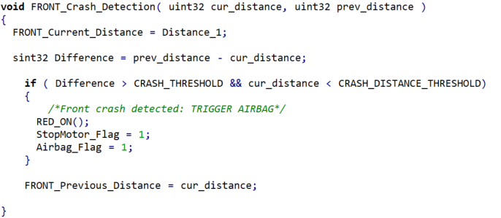
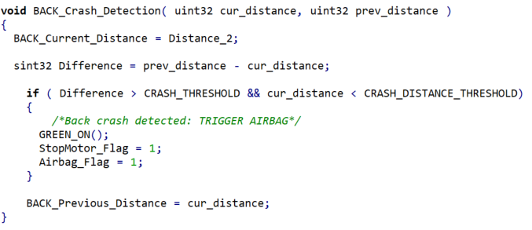
AIRBAG LOGIC FUNCTIONS
This function checks if the difference of the previously measured and current distance of the front HCSR04 is greater than that of the set threshold and if it is within the crash distance threshold, if the said conditions are met, this event is then classified as a crash event an both StopMotor_Flag and Airbag_Flag is set to 1.
This function checks if the difference of the previously measured and current distance of the rear HCSR04 is greater than that of the set threshold and if it is within the crash distance threshold, if the said conditions are met, this event is then classified as a crash event an both StopMotor_Flag and Airbag_Flag is set to 1.

Slide 24
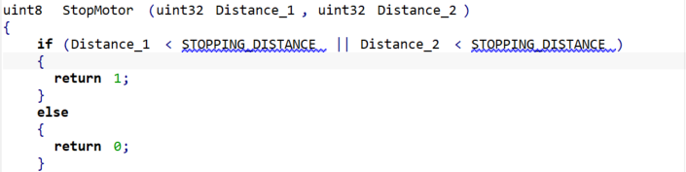
AIRBAG LOGIC FUNCTIONS
This function checks if the distance measured by both front and rear HCSR04 is less than that of the set STOPPING_DISTANCE and returns 1 or 0 as specified. This changes the value of the StopMotor_Flag inside the main function.

Slide 25
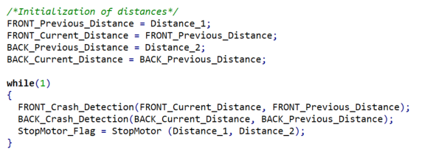
MAIN FUNCTION
This part of the main function initializes the variables utilized for the setup of the airbag logic.
This part also contains the infinite while loop which repeatedly calls on the functions to check if there is a crash happening and if there is a change in the state of the StopMotor_Flag so corresponding messages and actions could take place.
The flag variables are the ones being sent to through the CAN communication protocol towards modules that would utilize these information.

Slide 26
THANK
YOU.

