Slide 1
GAM PHI INTERNAL PROJECT
Ili9341 TFT LCD Display Module
May 9 2023

Slide 2
1
1
Input Documents
2
Module Overview
CONTENT
3
SPI Module Dependencies
4
EB Tresos Configuration
5
Code Implementation
© Copyright FPT Software – Level of Confidentiality

Slide 3
01. Input documents

Slide 4
INPUT DOCUMENTS
The following documents is used for building the SPI display driver:
No. | Document Name | Version
1. | AUTOSAR_SWS_SPIHandlerDriver.pdf | 4.3.1
2. | AUTOSAR_SRS_SPIHandlerDriver.pdf | 4.3.1
3. | AUTOSAR_MCAL_SPI_IM.pdf | 4.3.1
4. | AUTOSAR_MCAL_SPI_UM.pdf | 4.3.1
5. | ILI9341.pdf | 1.11
6. | S32K-RM.pdf | Rev. 13

Slide 5
02. Module Overview

Slide 6
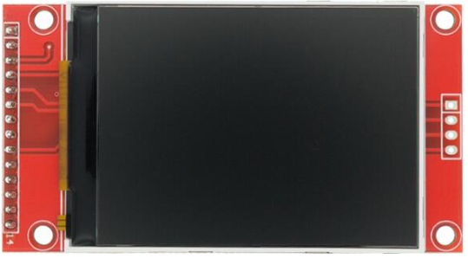
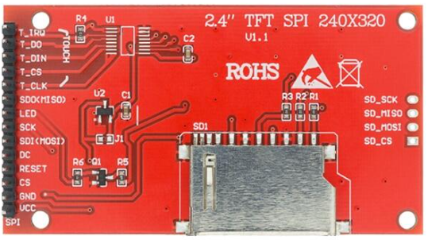
MODULE OVERVIEW
The ILI9341 is a 262144-color single-chip SOC driver for a TFT liquid crystal display with resolution of 240x320 dots (RGB), comprising a 720-channel source driver, a 320-channel gate driver, 172800 bytes GRAM for graphic display data of 240x320 dots (RGB), and power supply circuit.
It supports parallel 8-/9-/16-/18-bit data bus MCU interface, 6-/16-/18-bit data bus RGB interface and 3-/4-line serial peripheral interface (SPI).
As per the internal project requirement, the module will be used to display the direction and speed of the car by displaying LEFT, RIGHT, STOP, FORWARD, REVERSE, and the speed in kilometres per hour(kph). The DIO and Port module is also required to indicate whether we want to send command or data to the SPI display module since it needs input from RST and DC pins.

Slide 7
MODULE OVERVIEW
As per the internal project requirement, the module will be utilized to display the direction and speed of the car by displaying LEFT, RIGHT, STOP, FORWARD, REVERSE, and the speed in kilometres per hour(kph).
The DIO and Port module is also utilized on the S32k144 evaluation board because the display module require input from pins RST and DC.
The RST pin is used to reset the display. To reset the display, set the RST pin to high first, then set it to low and transmit a null data 0x00 or a NULL_PTR, then set the pin again to high.

Slide 8
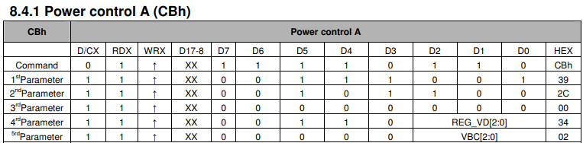
MODULE OVERVIEW
The DC or Data/Command pin is used to indicate whether we will transmit a data or command to the SPI display module.
When the DC line is low, the data received by the display module is interpreted as command.
If the DC line is high, the data received by the module is interpreted as data. Data represents as arguments to a command.
To better understand this, here is an example of sending data and command to the display for setting the Power control A. This step is part of the display initialization.
Set the DC line to low and send the 0xCB command to tell the display module that we are sending a command for Power control A. Next, set the DC line to high and send the following parameters 0x39, 0x2C, 0x00, 0x34 and 0x02 to set Power Control A to defaults. We can modify its setting by setting the REG_VD[2:0] and VBC[2:0] to other values found on the display datasheet.

Slide 9
03. SPI Module Dependencies

Slide 10
SPI Module Dependencies
MCU - is required to use System Clock when clock source is used as Peripheral clock
source to generate Spi baudrate and delay values.
Resource - The RESOURCE module is used to select microcontroller’s derivatives.
DET - is required for signalling the development error detection (parameters out of
range, null pointers, etc).
DEM - is required for signalling the production error detection (hardware failure, etc).
MCL - is required when DMA option is used or FlexIO peripheral is used for Spi module.
ECUC - The ECUC module is used for ECU configuration. MCAL modules need ECUC
to retrieve the variant information.

Slide 11
Other AUTOSAR Modules Used
BASE - The BASE module contains the common files/definitions needed by all MCAL
modules.
DIO - Dio module is used for controlling simple Digital I/O – General Purpose I/O.
PORT - The PORT module is used to configure the port pins with the needed modes,
before they are used by the DIO module.

Slide 12
04. EB Tresos Configuration

Slide 13
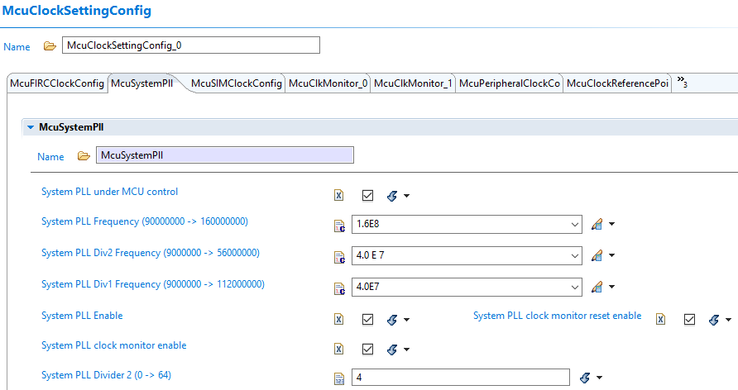
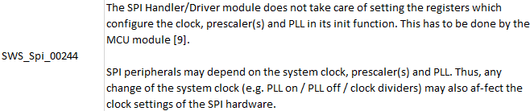
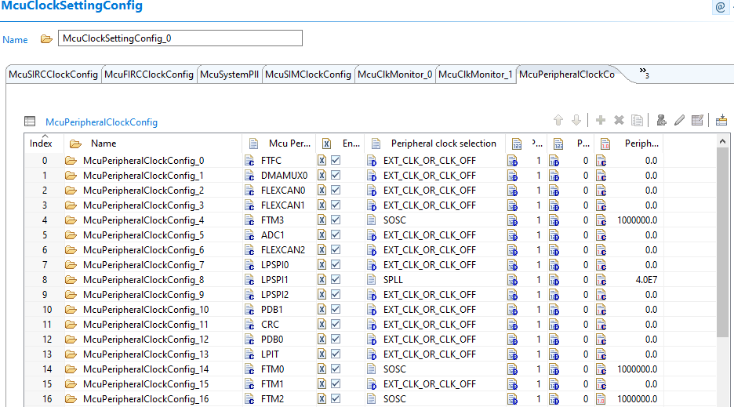
EB Tresos Configuration
The SPI Driver Configuration is based on the following specification for configuring its clock source:
I referred to the S32K144’s reference manual to pick a clock source for the LPSPI module and chose SPLLDIV2_CLK and set its frequency to 40Mhz. That is to avoid conflict with other modules that needs to have a specific frequency to function correctly.

Slide 14
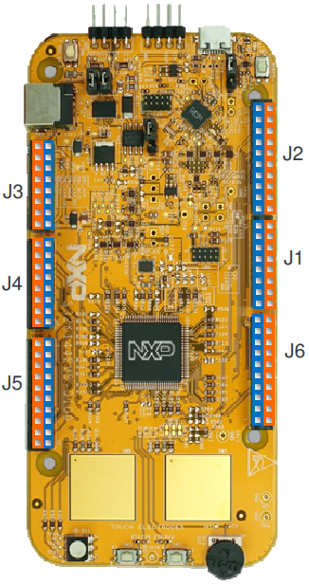
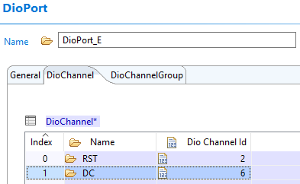
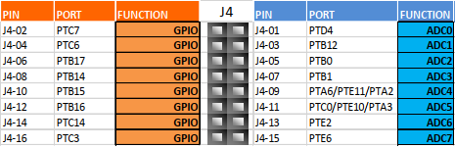
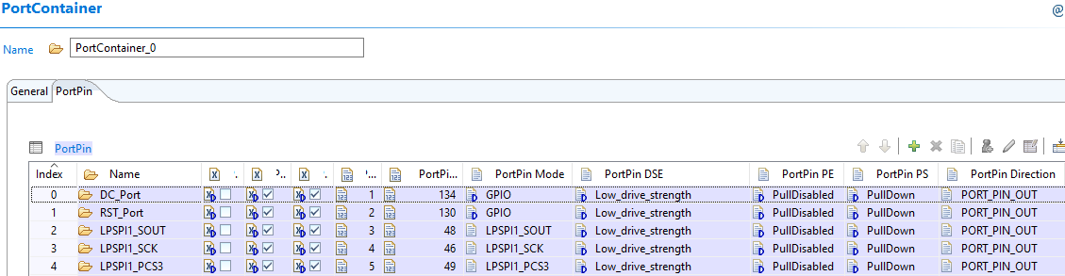
EB Tresos Configuration
DIO Port E pins 2 and 6 is utilized for the RST and DC pins for the SPI display module.
Port B pins 17, 14, and 16 is utilized for the ChipSelect, SerialClock, and
MOSI(Master Out Slave In).
The PortPin Direction should be set to PORT_PIN_OUTPUT

Slide 15
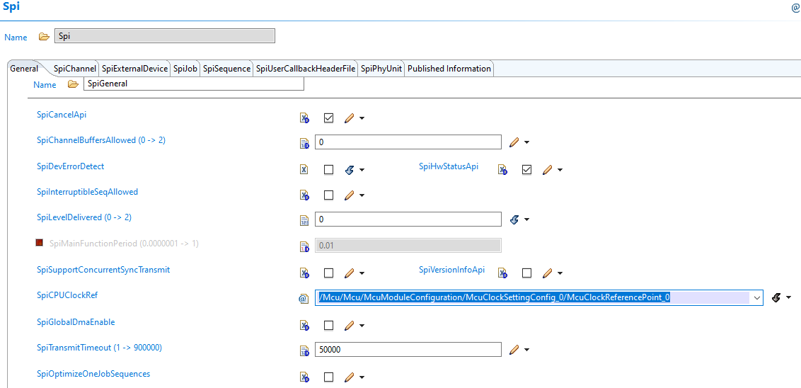
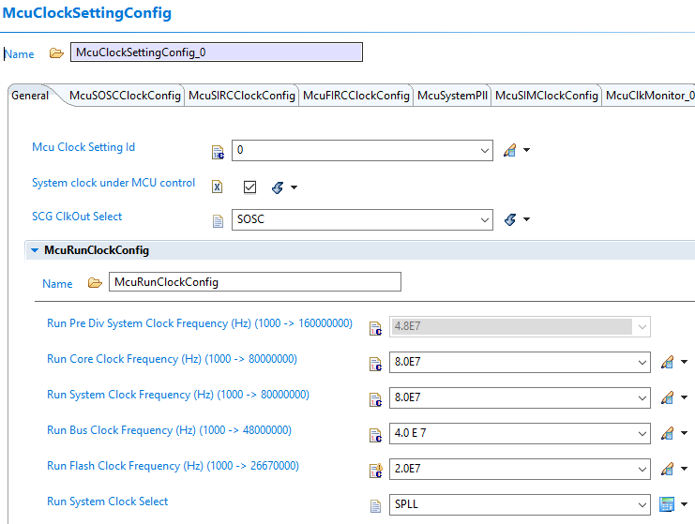
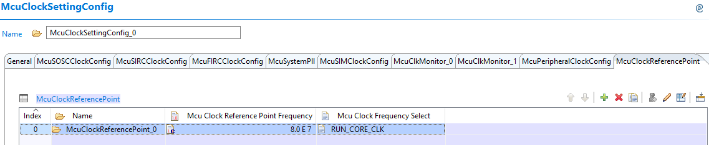
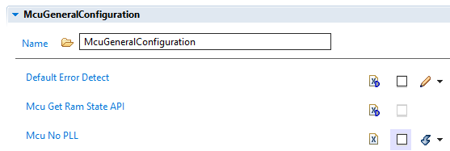
EB Tresos Configuration
Set SPI McuClockReferencePoint:
SPLL is selected on Run System Clock (SCG_RCCR[SCS]), therefore the McuClockReferencePoint_0 frequency is at 80Mhz
Mcu No PLL is also unchecked to use the SPLL. This parameter shall be set True, if the H/W does not have a PLL.

Slide 16
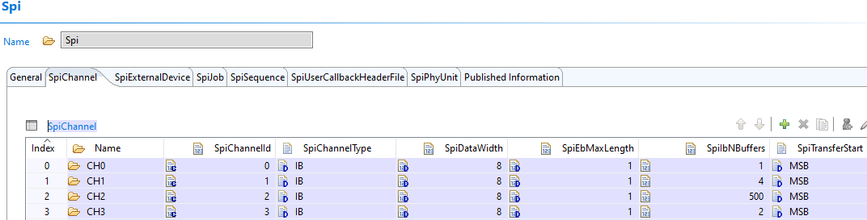
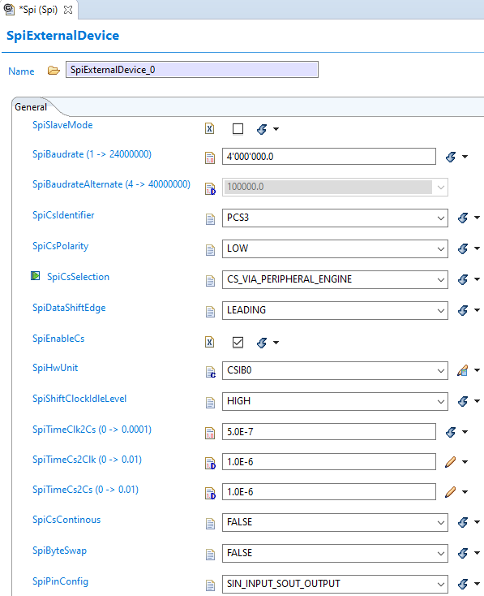
EB Tresos Configuration
SpiChannels have 4 channels set with the same data width since the SPI display module only accepts 8-bit of data.
However, there are four different data buffers used this is in relation to the code implementation.
SpiExternalDevice:
The SpiBaudrate is set to a specific frequency, in this configuration the frequency is set to 4Mhz. This indicates the minimum to maximum baudrate that the SPI device have.
The SpiCsIdentifier is set to PCS3 because on the port module we used LPSPI_PCS3.
The SpiCsSelection is set to CS_VIA_PERIPHERAL_ENGINE. SWS_Spi_00370 is the reference of this configuration.
SpiCsPolarity is set to active low if during data transmission.
SpiDataShiftEdge is set to Leading, this means CPHA is set to 1.
SpiEnableCs is also checked. This parameter enables or not the Chip Select handling functions.This parameter is closely linked to Job.If This parameter is True,then chip select is asserted andif False No chip select is asserted.
SpiPinConfig is set to SIN_INPUT_SOUT_OUTPUT which means SIN(MISO) is used for input data and SOUT(MOSI) is used for output data.

Slide 17
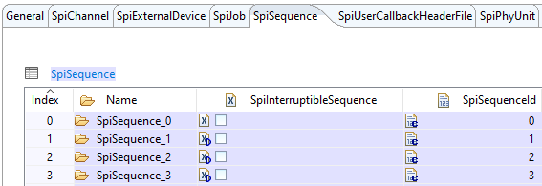
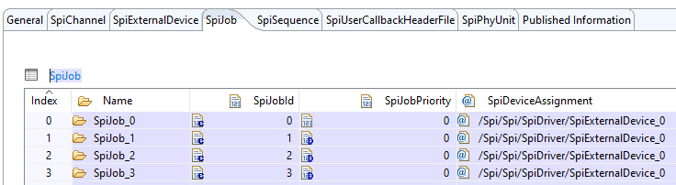
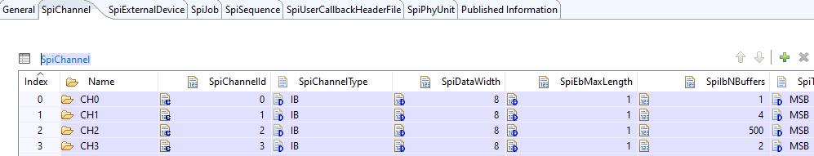
EB Tresos Configuration
SpiSequence_0 contains SpiJob_0 and SpiJob_0 contains CH0
This means One Sequence, One Job, One Channel is used in this configuration.
Spi_WriteIB, Spi_SyncTransmit calls for a sequence transmission with only one job composed of one channel.
Therefore:
CH0 → SpiJob_0 → SpiSequence_0
CH1 → SpiJob_1 → SpiSequence_1
CH2 → SpiJob_2 → SpiSequence_2
CH3 → SpiJob_3 → SpiSequence_3

Slide 18
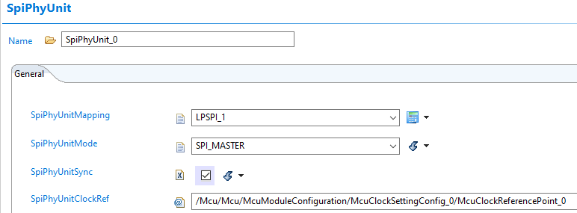

EB Tresos Configuration
- SpiPhyUnitMapping is set to LPSPI_1 since the project utilizes LPSPI1.
- SpiPhyUnitMode is set to SPI_MASTER. The data is going to be transmitted the S32k144 board to the SPI display module that serves as a slave device. This is also in reference to the specification:
SpiPhyUnitSync is checked because the configuration is used for Synchronous transmission only which is LEVEL 0 is used. And also referenced to SWS_Spi_00108.

Slide 19
05. Code Implementation

Slide 20
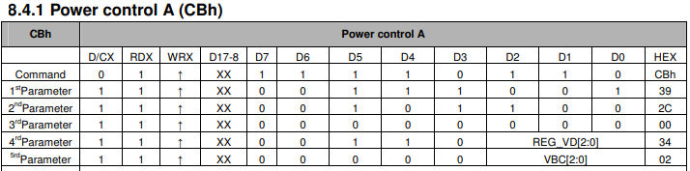
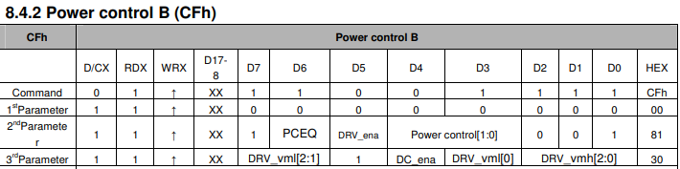
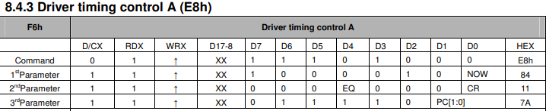
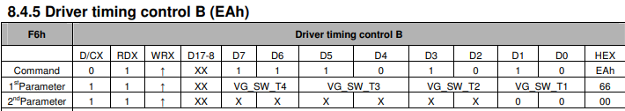
Code Implementation
FUNC(void, AUTOMATIC) INIT_DISPLAY(void)
{
EN_DISPLAY();
RESET_DISPLAY();
/*Perform Software Reset*/
WRITE_COMMAND(0x01);
/*Power Control A*/
WRITE_COMMAND(0xCB);
WRITE_DATA(0x39);
WRITE_DATA(0x2C);
WRITE_DATA(0x00);
WRITE_DATA(0x34);
WRITE_DATA(0x02);
/*Power Control B*/
WRITE_COMMAND(0xCF);
WRITE_DATA(0x00);
WRITE_DATA(0xC1);
WRITE_DATA(0x30);
/*Driver Timing Control A*/
WRITE_COMMAND(0xE8);
WRITE_DATA(0x85);
WRITE_DATA(0x00);
WRITE_DATA(0x78);
/*Driver Timing Control B*/
WRITE_COMMAND(0xEA);
WRITE_DATA(0x00);
WRITE_DATA(0x00);
…
The function initializes the display by sending various Command and data as parameters based on the SPI display module’s register.

Slide 21
Code Implementation
/*Reset Display*/
FUNC(void, AUTOMATIC)RESET_DISPLAY(void)
{
/* uint8 Null_Data = 0x00; */
Dio_WriteChannel((Dio_ChannelType)DioConf_DioChannel_RST, STD_LOW);
Spi_WriteIB(SpiConf_SpiChannel_CH0, NULL_PTR);
Spi_SyncTransmit(SpiConf_SpiSequence_SpiSequence_0);
Dio_WriteChannel((Dio_ChannelType)DioConf_DioChannel_RST, STD_HIGH);
}
/*Enable display*/
FUNC(void, AUTOMATIC) EN_DISPLAY(void)
{
Dio_WriteChannel((Dio_ChannelType)DioConf_DioChannel_RST, STD_HIGH);
}
The function resets the display by setting the RST pin to LOW and sending a null data 0x00 or NULL_PTR and setting the RST pint to HIGH.
The function enables the display by setting the RST pin to HIGH.
/*Send Command*/
FUNC(void, AUTOMATIC) WRITE_COMMAND(uint8 Send_Command)
{
Dio_WriteChannel((Dio_ChannelType)DioConf_DioChannel_DC, STD_LOW);
Spi_WriteIB(SpiConf_SpiChannel_CH0, &Send_Command);
Spi_SyncTransmit(SpiConf_SpiSequence_SpiSequence_0);
}
/*Send Data*/
FUNC(void, AUTOMATIC) WRITE_DATA(uint8 Send_Data)
{
Dio_WriteChannel((Dio_ChannelType)DioConf_DioChannel_DC, STD_HIGH);
Spi_WriteIB(SpiConf_SpiChannel_CH0, &Send_Data);
Spi_SyncTransmit(SpiConf_SpiSequence_SpiSequence_0);
}
The function is called to be able to transmit a data as command to the SPI display module. The DC pin is set to Low.
The function is called to be able to transmit a data as command parameter to the SPI display module. The DC pin is set to High.

Slide 22
Code Implementation
/*Set coordinates on screen*/
FUNC(void, AUTOMATIC) SET_ADDRESS(uint16 x1, uint16 y1, uint16 x2, uint16 y2)
{
uint8 buffer[4];
buffer[0] = x1 >> 8;
buffer[1] = x1;
buffer[2] = x2 >> 8;
buffer[3] = x2;
WRITE_COMMAND(0x2A);
WRITE_BUFFER(buffer, ADDRESS_BUFFER);
buffer[0] = y1 >> 8;
buffer[1] = y1;
buffer[2] = y2 >> 8;
buffer[3] = y2;
WRITE_COMMAND(0x2B);
WRITE_BUFFER(buffer, ADDRESS_BUFFER);
WRITE_COMMAND(0x2C);
}
The function SET_ADDRESS sets the coordinates on the screen, where the text or an object will be displayed. Command 0x2A sets the column address or X coordinates start and end address x1 and x2. Command 0x2B sets the page address or y coordinates start and end address y1 and y2. This sends the data contents with the specific buffer which is of size 4. This will use the element CH1 on the SpiChannel container on EB Tresos.

Slide 23
Code Implementation
/*Write to specific buffer size and transmit*/
FUNC(void, AUTOMATIC) WRITE_BUFFER(uint8 *buffer, uint8 bufferType)
{
Dio_WriteChannel((Dio_ChannelType)DioConf_DioChannel_DC, STD_HIGH);
if (bufferType == ADDRESS_BUFFER)
{
Spi_WriteIB(SpiConf_SpiChannel_CH1, buffer);
Spi_SyncTransmit(SpiConf_SpiSequence_SpiSequence_1);
}
else if (bufferType == BIG_BUFFER)
{
Spi_WriteIB(SpiConf_SpiChannel_CH2, buffer);
Spi_SyncTransmit(SpiConf_SpiSequence_SpiSequence_2);
}
else if (bufferType == COLOR_BUFFER)
{
Spi_WriteIB(SpiConf_SpiChannel_CH3, buffer);
Spi_SyncTransmit(SpiConf_SpiSequence_SpiSequence_3);
}
else
{
;
}
}
The function WRITE_BUFFER will send the data and different buffer sizes. Functions SET_ADDRESS, DrawColorBurst, DrawPixel will pass different values of which bufferType to use.
ADDRESS_BUFFER value is 1 and will send the buffer contents using SpiChannel CH1
BIG_BUFFER value is 2 and will send the buffer contents using SpiChannel CH2
COLOR_BUFER value is 3 and will send the buffer contents using SpiChannel CH3

Slide 24
Code Implementation
FUNC(void, AUTOMATIC)DrawText(const char *str, const uint8 font[], uint16 X, uint16 Y)
{
isClearText = FALSE;
uint8 charWidth; /* Width of character */
uint8 fOffset = font[0]; /* Offset of character */
uint8 fWidth = font[1]; /* Width of font */
while (*str)
{
DrawCharacter(*str, font, X, Y);
/* Check character width and calculate proper position */
uint8 *tempChar = (uint8 *)&font[((*str - 0x20) * fOffset) + 4];
charWidth = tempChar[0];
if (charWidth + 2 < fWidth)
{
/* If character width is smaller than font width */
X += (charWidth + 2);
}
else
{
X += fWidth;
}
str++;
}
}
The function DrawText will draw a string of text on the SPI display module. This also sets the flag isClearText to false to indicate that we are not clearing a text on the screen.

Slide 25

CONTACT US
FPT Cau Giay Building, Duy Tan Street, Dich Vong Hau Ward, Cau Giay District, Hanoi City, Vietnam Tel.: +84 (24) 3 768 9048 Fax: +84 (24) 3 768 9049
Contact Person: Mr/Ms.ABC Head of ABC
Email: abc@fpt-software.com

