Slide 1
Neural Machine Translation by Jointly Learning to Align and Translate
By Dzmitry Bahdanau, Kyunghyun Cho, Yoshua Bengio
Yiran “Lawrence” Luo
Notes:
‹#›

Slide 2
Overview
Machine Translation how-to and previous approaches
RNN-search top-down
RNN-search key component (Gated Recurrent Unit)
Performances

Slide 3
Machine Translation Basics
Source language -> Interlingua -> Target Language
Ultimate goal: finding the best translation sentence Y given a source sentence X.
Y* = argmax_{Y}[P(Y|X)]
= argmax_{Y}[P(X|Y)P(Y)/P(X)] = argmax_{Y}[P(X|Y)P(Y)]
3. Language Model: Gives how likely a sentence exists in the language
4. Word Embedding: To represent words as real number vectors. (# dimension = # features)
5. BLEU is a standard measurement of the quality of translation, based on references made by human. The larger percentage, the closer to golden standard.
Notes:
BLEU: precision of overlapping n-grams in both machine translation and golden standard.

Slide 4
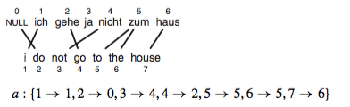
Previous Approaches: Word Alignment / Mapping
P Koeln. 2010
IBM Alignment Models 1-5 create initial word alignments of increasing complexity and accuracy from sentence pairs.
Parameters estimated by Maximum Likelihood or EM.
Notes:
Model 1: lexical translation
Model 2: additional absolute alignment model
Model 3: extra fertility model
Model 4: added relative alignment model
Model 5: fixed deficiency problem.

Slide 5
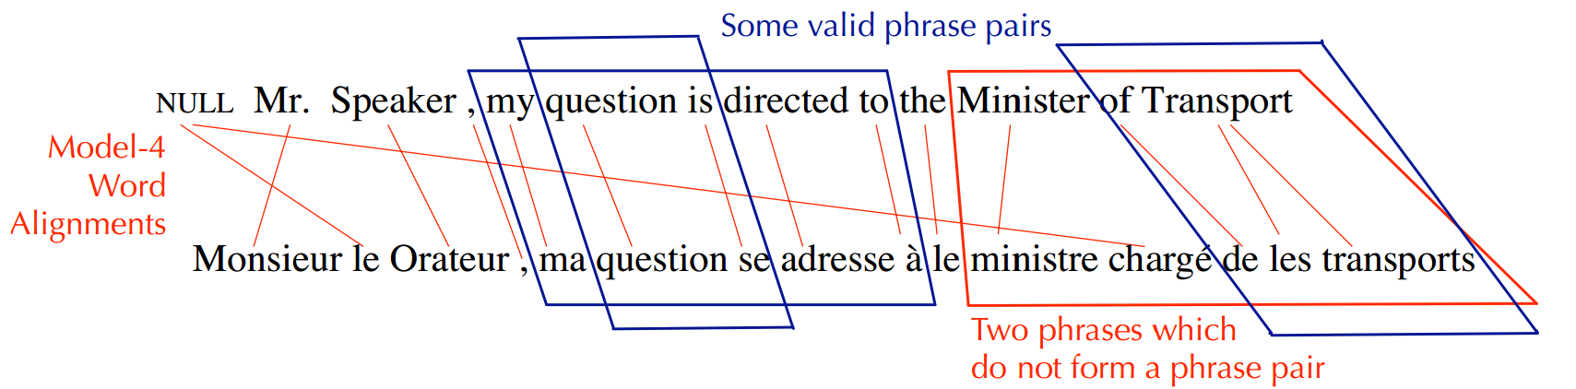
Previous Approaches: Phrase Based SMT
W. Byrne, 4F11
Using IBM word alignments create phrase alignments and a phrase translation model.

Slide 6
Problems with Previous Approaches
Highly memory intensive
Initial alignment makes conditional independence assumption. Subcomponents are tuned separately.
Word and phrase translation models only count co-occurrences of surface form – don’t take word similarity into account
Bad at handling far-away contexts
etc...

Slide 7
Neural Machine Translation
The translation problem is expressed as a probability P(Y|X)
Equivalent to P(</s>, y_{n}, y_{n-1}, …, y₀ ,<s> | </s>, x_{m}, x_{m-1}, …, x₀ ,<s>) -> a word sequence conditioned on another word sequence.
Create an RNN architecture where the output of on RNN (Decoder) is conditioned on another RNN (Encoder).
During both encoding and decoding we will consider about contexts.
We connect them using a joint alignment and translation mechanism.
Results in a single well-connected gestalt Machine Translation model which can generate candidate translations sequentially.

Slide 8
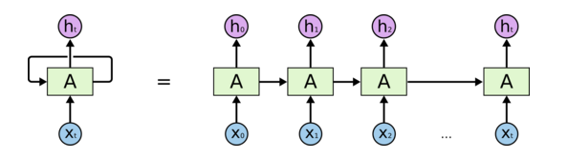
RNN, Unfolded
Ref: Chris Olaf. Understanding LSTM Networks
Generating a sequence of outputs by using the same parameters in the NN chunk multiple times

Slide 9
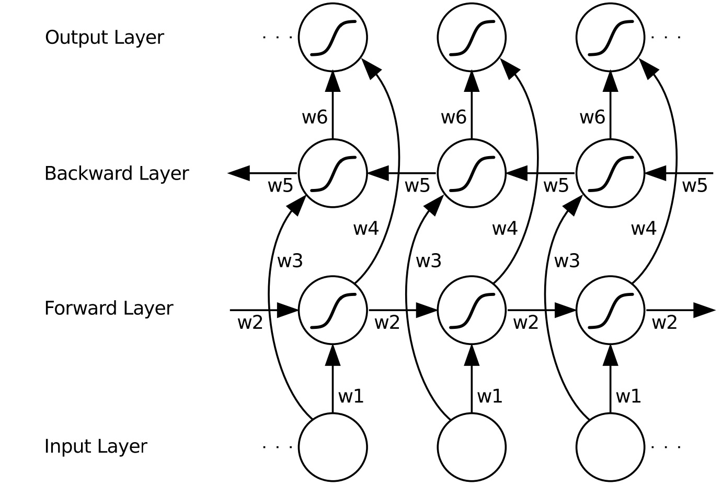
Bidirectional RNN, Unfolded

Slide 10


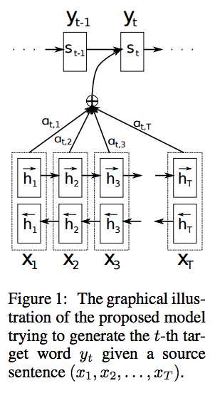
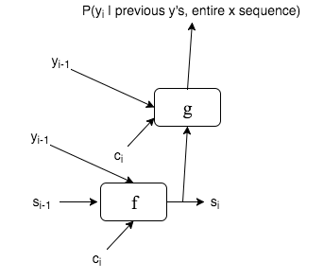
Neural Machine Translation: Decoder
The decoder is a one-direction RNN.
What happens at generating word y_{i}:
We have a context vector c_{i} that holds all context info for generating the next candidate word.
Figure 1
c_{t}
Notes:
g is a nonlinear, potentially multi-layered, function

Slide 11

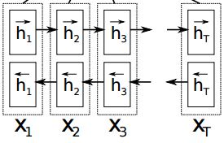
Neural Machine Translation: Encoder
The encoder is a bi-direction RNN.
Or two stacked one-direction RNNs with shared input and, in this case, concatenated output (called annotation).
Figure 1
c_{t}
Notes:
g is a nonlinear, potentially multi-layered, function

Slide 12

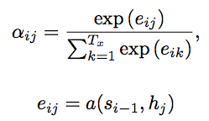
Neural Machine Translation: Context Vector and Alignment Model
What happens at generating word y_{i} (pos #i on Decoder’s side)
Context vector is the weighted sum of all annotations.
The annotation weight vector for c_{i} is determined by both
annotations and s_{i-1}, through an alignment model a.
e_{ij} scores how well the inputs around position j
and the output at position i match
Figure 1
c_{t}
Brings better performance??
Notes:
g is a nonlinear, potentially multi-layered, function

Slide 13
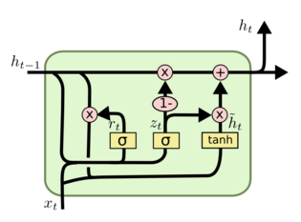
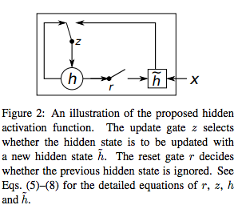
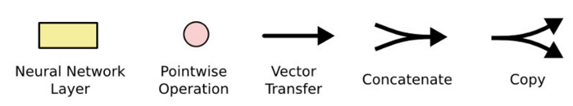
RNN Unit Chunk: Gated Recurrent Unit
A simplified version of LSTM Unit. Used in both Encoder (x2) and Decoder (x1).
Ref: Chris Olaf. Understanding LSTM Networks
Ref: Cho et al, 2014. Learning Phrase Representations using RNN Encoder–Decoder for Statistical Machine Translation

Slide 14
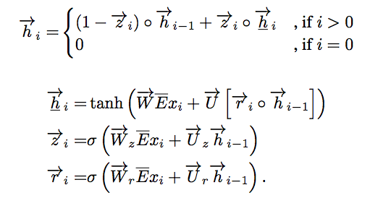
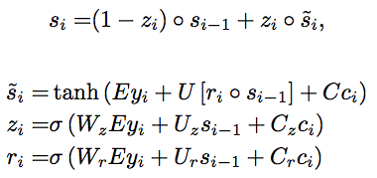
RNN Unit Chunk: Gated Recurrent Unit
A simplified version of LSTM Unit. Used in both Encoder (x2) and Decoder (x1).
Encoder (one-way annotation):
Ref: Chris Olaf. Understanding LSTM Networks
Decoder (the f function):
Notes:
E ∈ R m×Tx is the word embedding matrix. −→W , −→Wz, −→Wr ∈ R n×m, −→U , −→U z, −→U r ∈ R n×n are weight matrices. m and n are the word embedding dimensionality and the number of hidden units, respectively. σ(·) is as usual a logistic sigmoid function.

Slide 15
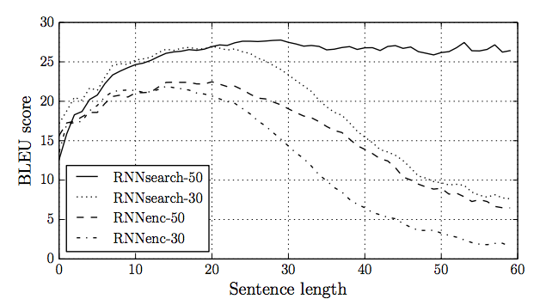
NMT English to French Translation Performance
First trained with 30-word sentences, and then with 50-word sentences.
Infrequent words are replaced with a [UNK] token.
Notes:
348M word reduced English French corpora, news-related.
First trained with 30-word sentences, and then with 50-word sentences.
RNNenc does not have the middle alignment model

Slide 16
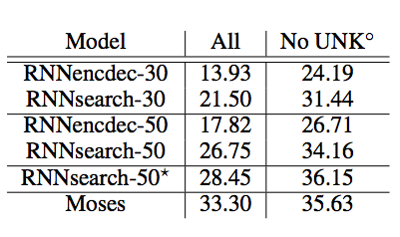
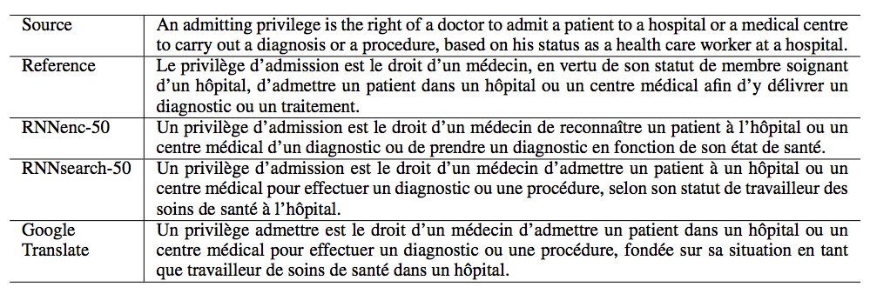
NMT English to French Translation Performance
Notes:
SDG 80 minibatch
RNNSearch-50* trained longer until stopped improving
No UNK = only trained with the 30000 known words

Slide 17
What are good of NMT?
End-to-end differentiable, trained using SGD with cross-entropy error function.
Encoder and Decoder learn to represent source and target sentences in a compact, distributed manner
Does not make conditional independence assumptions to separate out translation model, alignment model, re-ordering model, etc…
Learns translation and joint alignment in a semantic space, not over surface forms.
Conceptually easy to decode.
Fewer parameters – more memory efficient.
New benchmark for NN based MT researches.
etc…

Slide 18
Potential of Improvements
Already a Coverage-based NMT, prevents over-translation
Still English-French, or English-Chinese, due to huge reserves of corpora?
What about English-Japanese, from SVO to SOV
And others….

Slide 19
Additional References
Chris Olaf. Understanding LSTM Networks. http://colah.github.io/posts/2015-08-Understanding-LSTMs/
K. Cho, et al. (2014). ”Learning Phrase Representations using RNN Encoder-Decoder for Statistical Machine Translation”.
P. Koehn. (2010). Statistical Machine Translation.
W. Byrne, Engineering Part IIB: Module 4F11 Speech and Language Processing. Lecture 12. http://mi.eng.cam.ac.uk/~pcw/local/4F11/4F11_2014_lect12.pdf
Y. Bengio, et al. (2003). “A neural probabilistic language model”. Journal of Machine Learning Research, No. 3.

