Slide 1

Aligning to Generate Dialogs Applying Seq2seq Techniques in Conversation Systems
Yiran ”Lawrence” Luo
Mentor: Lijun Mei, Yipeng Yu Manager: Shaochun Li
IBM China Research Lab

Slide 2
Main Objectives
Current methods for conversation models in industry rely heavily on logics and can be increasingly complex.
Automatically generate comprehensible conversations based upon given constraints.
Not a genuine open domain chat-bot, but task-oriented conversation system.
It means each task is a standalone circumstance, with its own context and background information. Much easier to implement and straightforward for business purposes.
Seq2seq comes with the edge for contextual information to align up sentences.
Hi! How are you?
Hi Neo. We have got two pills.
I’m good! And you?
I take the red one.
Same here. ☺
Good. You will wake up in Zion.

Slide 3
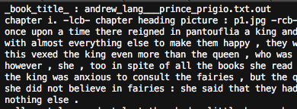
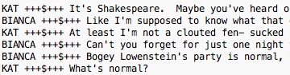
Challenges
不计免赔是所有的险种都包含了，比如说开车不小心刮蹭了一下，那保险公司在定责任的时候会有一个15%是自己的
就按去年的续
好的，那就按照总金额5200的给您续，对吧?
对
好的，根据北京保险行业协会要求，我们给您发送了一个手机验证码以确认身份信息采集，请您收到后输入手机验证码
Source: Facebook Children’s Book Test (back) and
Cornell’s Movie-Dialogs Corpus (front)
Source: PICC sample cases
We don’t have much available task-specific data
Open domain data come with lots of noise
We may indefinitely approach our target, but may never reach the exact words
Hard to evaluate accuracy. Language is flexible, not quantitative. (BLEU score?)

Slide 4
Brief Pipeline Overview
Input Sequence
Embedding Model
(Word2vec, Sentence2vec)
Dialog Model (Seq2seq
w/ Attention)
Seq of words
Input vectors
Output vectors
Seq of words
Output
Sequence

Slide 5
Keyword Sequence
Background: user_id = 11001
Sent[0] = “给我增加5000的划痕险吧”
Keyword_sent[0] = [“@增加”, “5000”,”划痕险”]
API[0] = [“@增加: (划痕险, 5000)”]
How: Such as taking out all nouns and pronouns,
As well as some key verbs such as “is” “are” or “defines”
w/ NLTK POS tagger or NLC
Keyword filter
Some keywords are marked as intents that are passed to knowledge model
Intents are also keywords, but they are also the key components of the knowledge model.
Notes:
Add concrete examples from PICC demos

Slide 6
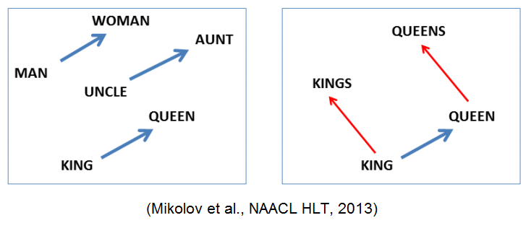
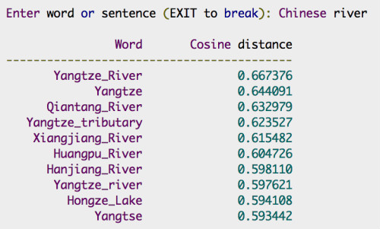
Word Embedding – Word2Vec
Tool: Word2vec – converting natural words into arbitrarily dimensioned vectors, which is what Neural Networks understand.
Words with similar meanings are close to each other.
This vector space may express similar word relations using a single vector.
word2vec_model[‘good’] = array(
[0.11111, 0.22222, … , -0.11111])
Source: http://jxieeducation.com/2016-06-13/Document-Similarity-With-Word-Movers-Distance/

Slide 7
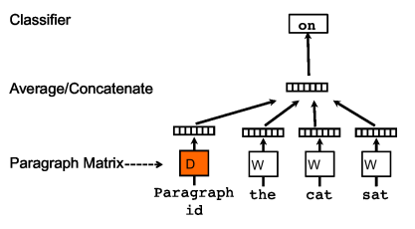
Word Embedding – Sentence2Vec
Synthesize word vectors in a sentence into ONE SINGLE VECTOR
Le & Minikov. Distributed Representations of Sentences and Documents

Slide 8
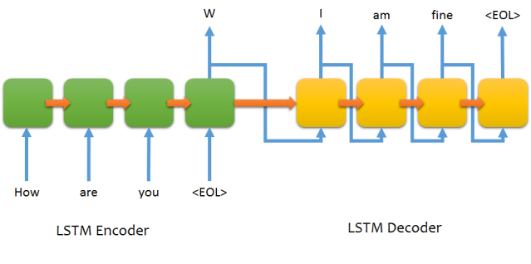
Core Approach: Seq2seq
Sentence2
Context info
About Input
Words here have all
been embedded
to vectors.
Sentence1
This is a simplistic seq2seq model on aligning up two sentences.
In this case, each output from the encoder’s iterations is dropped.

Slide 9
Core Approach: Seq2seq + Attention
Sentence2
E
Words here have all
been embedded.
Words here have all
been embedded
to vectors.
How , she asked , are you? <eol>
E
Sentence1
Attention is introduced to enhance the local contextual relevance with the previous sentence.
In this case, each output from the encoder’s iterations is relevance weight.
The encoder can be a bi-directional LSTM, but in our case it makes few difference.
Notes:
Find specific example for using attention

Slide 10
Seq2seq Experiment Alignment
Sentence[0]
Sentence[1]
Sentence[2]
Train_In:
Dialog Model Seq2seq
Train_Out:
Sentence[1]
Sentence[2]
Sentence[3]
Since few task-oriented dialog data is available at hand, we simulate such a conversation scenario with open domain data. Test sentences are selected from a single story (as a task frame) and we align up every two neighboring sentences while training the Seq2seq model.

Slide 11
Fast Convergence Innovation*
Sort of inspired by reinforcement learning.
We aim for a somewhat overfit result anyway.
If we find a good-looking alignment pair (partial or not), we train the pre-trained seq2seq model with this very pair for multiple epochs.
(Optional) Also we take the very good-looking output sequence into the embedding model and make sure we will output more of such good examples in future.
In = [The knight asked …]
Train Dialog Model
with In and Out heads
Dialog Model Seq2seq
Hmm, Input and the actual Output make sense altogether…
Expected = [Replied the queen…]
Out = [Said the Elizabeth…]

Slide 12
Seq2seq Experiment Specs
Word2vec w/ Facebook Children’s Book Test corpus.
Sentenence2vec w/ Cornell Movie Dialog Corpus
Test set size: 2k~ sentences, Training set size: 30k~ sentences.
In English, all lowercase, punctuation with “,”, “.” and “”” only.
In Word2vec test, sentences are padded with “.” to unify the length.
4-layer NN, word vector dimension 100, hidden layer dimension 200, single GPU, 40+ epochs.
Implemented with gensim (embedding), Theano, Keras (NN) and CUDA (GPU acceleration)

Slide 13
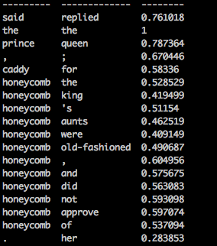

Word2Vec Tests
output target cos-similarity
output target similarity
Evaluated by average cosine similarity as well as by human judgment.
Achieved high similarity while aligning short sentences, but not so well at aligning long sentences so far.

Slide 14
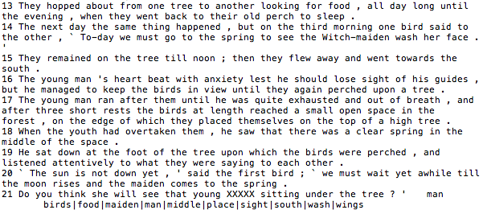
Limits of Word-based Seq2seq Alignment
Only approaching our target but may never reach the exact target.
The reason why many researchers do “filling the blanks” tests.
We aim for overfitting given a specific task / scenario.
Can’t alter contents for specific users.
Too few the parameters and too trivial the differences.
LSTM reuses its parameters in iterations. Currently roughly 100k in our model.
May suffer from long sentences. Sentences must be padded before putting into models.
Max sentence length is 251 words. May have to align “I do .” with “Yes . . . . ... .”

Slide 15
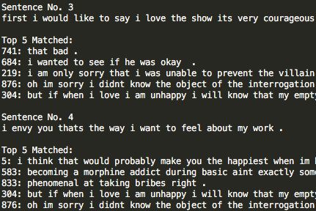
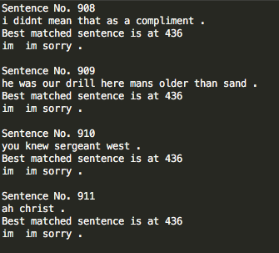
Sentence2Vec Tests
MSE Loss = 0.02, 20 epochs
Largely variant answers.
MSE Loss = 0.001, 50+ epochs
Converged to an “almighty” answer.

Slide 16
What’s Next?
We’ve been ignoring those that carry dependent information, such as variable values. And we need to trace how those intent keywords flow in conversations.
不计免赔是所有的险种都包含了，比如说开车不小心刮蹭了一下，那保险公司在定责任的时候会有一个15%是自己的
就按去年的100%续
好的，那就按照总金额5200的给您续，对吧?
对
好的，根据北京保险行业协会要求，我们给您发送了一个手机验证码以确认身份信息采集，请您收到后输入手机验证码

Slide 17
Future Works – Knowledge Model
Intent (out\in) | Int_1 | … | @增加 | …
Int_1 | {kw_5:0.4,Action3 kw_1:0.1,Action1} | … | {} | …
… | … | … | … | …
@险种 | {} | … | {刮痕险:0.8,Action1,人身险:0.2,Action2} | …
@增加 | {} | … | {} | …
… | … | … | … | …
Action1(“@增加”=(“5000”,”划痕险”))
Qin = “@增加”,
Qout = “@险种”
Action_{out} = argmax_{Action}P(Ac | Intent_{in,} Intent_{out})
Assume we know exactly about Intents.

Slide 18
Future Works – Knowledge Model
Intent (out\in) | Int_1 | … | @增加 | …
Int_1 | {kw_5:0.4,Action2 kw_1:0.1,Action1} | … | {} | …
… | … | … | … | …
@险种 | {} | … | {刮痕险:0.83,Add, 人身险:0.17,Delete} | …
@增加 | {} | … | {} | …
… | … | … | … | …
Add(“@增加”=(“5000”,”划痕险”))
Qin, Qout = “@增加”,
“@险种”
Update the probabilities after receiving a query. (Knowledge learning process)
The knowledge model itself is an adjacency matrix.

Slide 19
Seq2seq Dialog with Knowledge Model
Client
Server
Sent[0] = “Xxxx xxx xxx xx ?”
[kw_1, en_5=“$%”, kw_10, … ]
Dialog Model (Seq2seq
+Attn)
Know-ledge Model
Keyword filter
[kw_3, kw_6, en_4=“”, … ]
Query = {“en_5”:”$%”}
[kw_3, kw_6, en_4=“yyy”, … ]
Sent[1] = “YYY YYYY Y yyy YYY .”
Sent[2] = “ … “
...
Sentence template

Slide 20
Thank you!

