Slide 1
Early Career and Engagement IG Early Career Networking Meeting

Slide 2
Agenda
Introduction to ECEIG
Lightning Talks
3’ minutes per person, maximum 1 slides (strictly enforced)
Brief, elevator-pitch description of own research
Relevance to RDA
What are your expectations for ECEIG
Discussion within ECEIG
Point A: Describe our goals for ECEIG: GitHub, Slack, Mentoring
Point B: Mentoring program.
Short self intro of mentors in the room
Wrap-up - Next steps

Slide 3
Bit of the history so far…
There is an unquestionable need of a dedicated space for engaging RDA members who are at the beginning stages of their careers
A place of discussion and engagement
A way of attracting more people
It’s a win-win situation:
People at the beginning stage have their own unique talents and strengths that will strengthen RDA and increase openness
Early career researchers will benefit from the breadth and depth of RDA expertise and share ideas
A dedicated BoF was conducted at P8 (Denver, CO Sep 2016) and a charter was drafted around X’mas 2016
many thanks to Devan, Kishun, Neema, Tannu, Anne, Kathy and all contributors so far!

Slide 4
Aims of the Interest Group
Target audience:
RDA community newcomers
Early and Mid Career scientists
Overall Aim:
provide a continuously evolving entry and focal point for our target audience
provide a focal point for the various RDA-related fellowships and early career programs, and
produce a set of recommendation documents to advise the corresponding diverse research communities

Slide 5
Goals
For each involved community, produce documents on:
How to better engage early career scientists and professionals from diverse communities with little experience in the values and solutions offered by RDA.
How to connect the continuously evolving scientific domains and communities with existing RDA IGs/WGs.
How to develop and document the best practices in communicating the values of RDA to each of the involved communities.
How to support the RDA Early Career Fellowship programme, both in terms of documentation and guidance, as well as through potential membership of Fellows in this group.

Slide 6
Objectives of ECE IG
Focus on Early Career Researchers and Professionals because they need the most support
Establish a volunteer-based mentoring progamme
Network across domains to establish an interdisciplinary network of peers
Provide a space for people who have more experience with RDA to pass on knowledge and lessons learned to Early Career Researchers and Professionals
Create a social outlet specifically for Early Career Researchers and Professionals
Notes:
The ECEIG has five primary objectives. First, we aim to focus on early career researchers and professionals because we believe they need the most support. Second, we aim to develop a volunteer-based mentoring program for early career researchers and professionals who desire it. Third, we want to help early career researchers and professionals to network across domains helping them to establish an interdisciplinary network of peers. Fourth, we want to provide a space for people who have experience with RDA to pass on knowledge and lessons learned to early career researchers and professionals. And fifth, we want to create a social outlet specifically for early career researchers and professionals. Since obtaining endorsement from TAB, we have been focusing specifically on objectives 2, 4, and 5. I’ll begin talking about what we’ve done for objective 4 and then will talk about what we’ve done for objectives 2 and 5.

Slide 7
Objective #4
We have setup the following channels of communication:
a GitHub repository for maintaining documents with advice/lessons/guidelines as well as receiving continuous feedback and edits in the form of issues https://github.com/fpsom/rda-eceig
a dedicated Slack group for live communication within the community, with specialized channels for specific issues (such as Plenary events, or domain-specific questions) https://rda-eceig.slack.com/
Additionally we are considering to establish a YouTube channel with short videos and webinars for knowledge exchanges
Notes:
To help facilitate objective 4, which involves providing a space for people who have experience with RDA to pass on knowledge and lessons learned to early career researchers and professionals, we have set up two communication channels that we envision will be used during plenaries but will also help sustain communication between plenaries, which is a major challenge. These efforts are designed to address the whole “How do we stay connected between plenaries?” issue. The first communication channel we’ve created is a GitHub repository for maintaining documents with advice, lessons learned, and guidelines. We have also created the GitHub repository as a means for receiving continuous feedback in the form of issues. The second communication channel is a dedicated Slack group for live communication within the community, which spealized channels for specific issues, such as plenary events or domain-specific questions. Additionally, we are considering establshing a YouTube channel with short videos and webinars to further support knowledge exchange. We are exploring all of these mechanisms to try to find what might work best for early career researchers and professionals.

Slide 8
Objective #2
Two approaches for the mentoring programme:
an ad-hoc based approach, where mentorship is provided through communication in the Slack channel (which can be either person specific, i.e. a private channel, or global),
a formal mentorship programme, where we will maintain a spreadsheet of mentors-mentees, together with the duration of the mentorship and the particular goals and outcomes.
The first approach feels more organic and may better attract volunteers, but the second can be better applicable to existing programmes such as the RDA-US Fellowship program.
Notes:
To help facilitate objective 2, involving establishing a volunteer-based mentoring program, we are considering two approaches. The first is an ad-hoc based approach where mentorship is provided through communication in the Slack channel, which can be either person-specific in a private channel or global. The second approach is a more formal mentorship programe, where we will maintain a spreadsheet of mentors and mentees, together with the duration of the mentorship and the particular goals and outcomes. What we’d like to know from you all is which type of mentorship model you’d prefer. We want to develop to focus our efforts on the type of mentorship you really want. Are there questions?

Slide 9
ECEIG Mentoring programme (1/2)
Guidelines for mentors
Attend ECEIG sessions at RDA Plenaries to provide feedback and comments to early career professionals and other participants.
Join discussions through the dedicated Slack group.
Respond promptly to questions from early career people on slack, that are i. relevant to your expertise and/or ii. relevant to RDA operations in general.
Be open to having meetings (virtual or otherwise) with ECEIG members following up on discussions through Slack, if you are able.

Slide 10
ECEIG Mentoring programme (2/2)
Guidelines for mentees
Attend ECEIG sessions at RDA Plenaries and participate in session activities.
Join discussions through the dedicated Slack group - ask questions to either the general channel or to topic-specific channels.
When asking a question try to be as specific as possible so that the right person can address it.
Promote your work and your interests.
Be an active member of the ECEIG.

Slide 11
Current list of mentors
1 | Peter McQuilton | BioSharing Registry: connecting data policies, standards & databases in life sciences WG
2 | Jay Pearlman | Brokering Framework Working Group
3 | Jörg Geiger | RDA/NISO Privacy Implications of Research Data Sets IG
4 | Ruth Duerr | Preservation e-Infrastructure IG
5 | Lynn Yarmey | Director of RDA/US Community Development, RDA Secretariat
6 | Sarah Jones | HATII
7 | <your name here ☺>

Slide 12
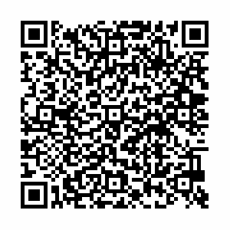
How to Join the Discussion
Join ECEIG
https://www.rd-alliance.org/groups/early-career-and-engagement-ig
Join the Slack group – the invitation link is this →
Monitor the documents and information in the GitHub repository.
https://github.com/fpsom/rda-eceig

Slide 13
Future Steps
Structures and ideas are all in place, so we need:
Engagement from everyone!

Slide 14
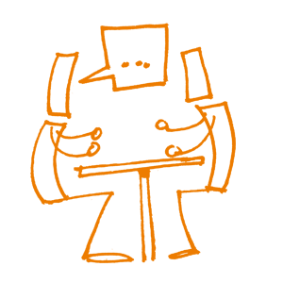
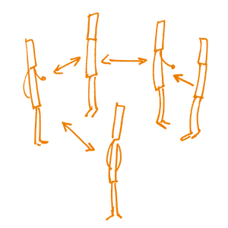
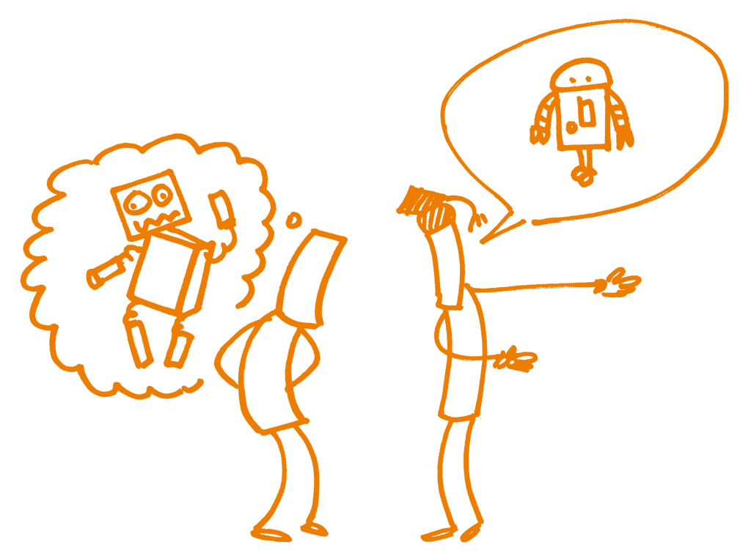
Thanks!

