Slide 1

FAIR data stewardship RDA-AMA, Sept 18th 2019
Christine Staiger
Coordinator Data Stewardship

Slide 2
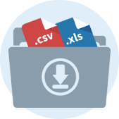

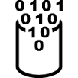






Data – Where is the problem
?
Notes:
Disclaimer: I will hint at problems for researchers and point out solutions for first quick gains. But there are still larger to make!
Data intensive research is complicated, not only a research challenge but also an administrative challenge.
You start as a researcher with some data on your PC and run some analysis
Once the analysis becomes too complicated you have to move to a compute service with e.g. more memory, more cpus
So you copy your data over
Results will be transferred back. If you continue working on your data and start the computation later again you need to know whether the data on the compute server is still up to date. That is still feasible.
If computations take a very long time, the resulting data is very valuable and you want to make sure that you do not accidentally overwrite it and you would like to keep it safe for later
Actually the same is true if you receive data from a device like a genome sequencer or a telescope which you cannot reproduce (easily)
This data you also want to analyse
Some colleague likes to work and collaborate with you on your data
Share data
The colleague starts his own computations and enriches the data with other data, in any case he changes the data and wants to share the data again with you
Finally, after some time and iterations of processing of data you arrive at a publication *Yay*
Reproducible research: But which data to publish, how to link to the intermediate steps, …

Slide 3
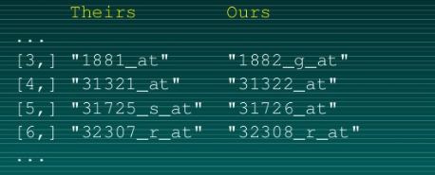
The dangerous side of improper data handling
The importance of being reproducible, Keith Baggerly:
Goal: reproduce a study on how cancer patients respond to chemotherapy
Errors found (after publication and clinical trials based on that study)
Mislabeling of 43 out of 95 patients
Shift in gene array (list), wrong gene names associated with their experimental expression value
https://retractionwatch.com/2011/05/04/the-importance-of-being-reproducible-keith-baggerly-tells-the-anil-potti-story/

Slide 4
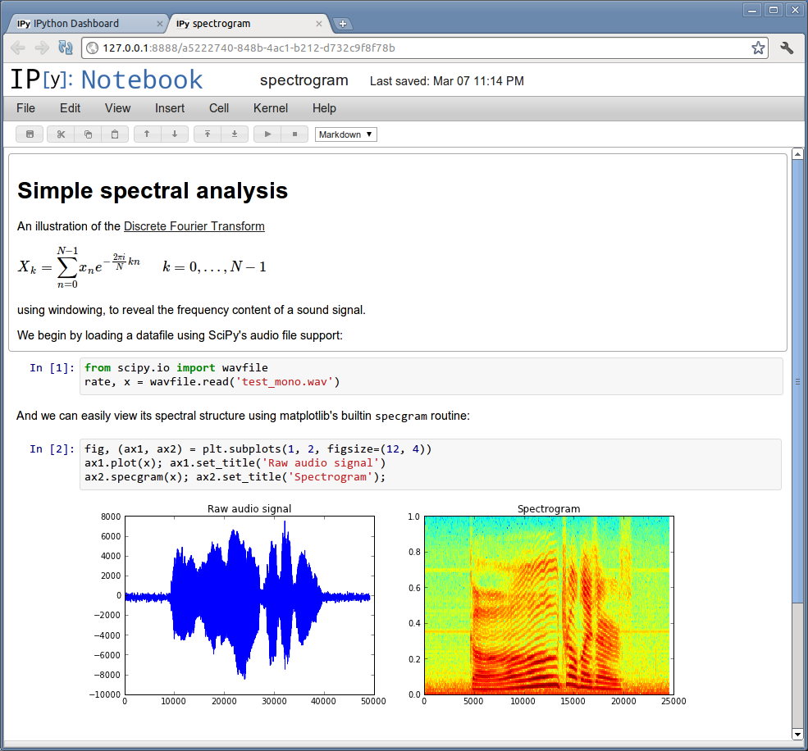
The dangerous side of improper data handling
Finding errors is time costly for the original producer of research results and for others
Clinical trials on real patients started before retraction of the paper
Even though doubts have been communicated no further investigation by authors or editor
It took years until study was retracted
We need a culture shift in how to address scientific mistakes
Make it easy to reproduce your analysis by documenting code
http://arogozhnikov.github.io/2016/09/10/jupyter-features.html

Slide 5
Why good data management – the selfish approach!
Do you still understand the data and analysis you have done yesterday or half a year ago? You are the first to reuse your own data!
How much time does it cost you to find (the right version of) data you produced at the beginning of a project?
Assume someone would like to collaborate with you on your data. How much time does it cost you to explain what the data contains and how it was generated?
Most communication and sharing of data is still done by mail. What if your mail address is outdated because you have a new position?
Notes:
Why should a researcher join such an ambitious goal to carry out good data management and follow the FAIR principles?

Slide 6
Some practical recommendations
Notes:
This happens if you come from the same field but do not agree on metadata standards

Slide 7
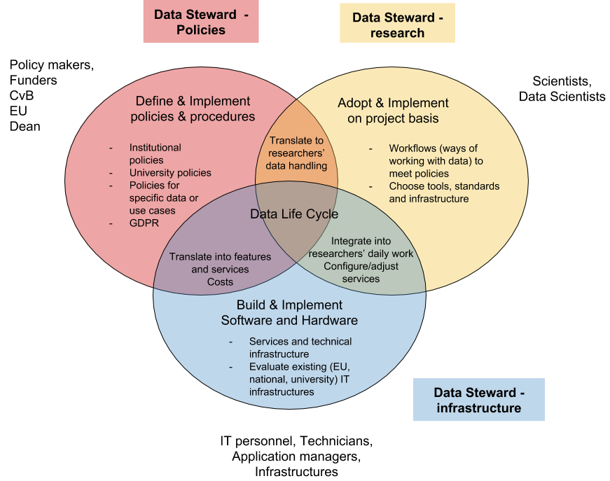
FAIR Data Stewardship - The solution?

Slide 8
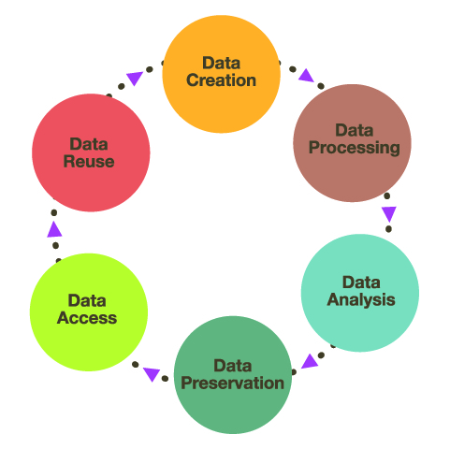
The data life cycle – describing research phases
Regard the data life cycle as a tool which describes research phases and transitions between research phases
For different research phases researchers might need different tools to handle data
Policies:
Describe what should happen with data within a phase
Describe transitions between phases
Notes:
The data life cycle is a tool.
Quickly walking through the life cycle:
- Data creation: Creating new raw data like questionnaires, microscope images, sequencing data, …
- Data processing and Data analysis: target two different stages on how data is dealt with
- Processing: e.g. cleaning data, enriching with external data bases,
bringing data into the right format for further analysis
- Data analysis: interpretation of data
- Both usually need some compute infrastructure and programs or code which work on the data.
- Data preservation: Preserve data and information for a long period of time, valuable data,
data which takes a long time to reproduce or which cannot be reproduced at all
- Needs also some annotation to understand in the future
- Access: where is data stored, who has access for how long, access can be given at different
levels (publishing vs sharing)
- Reuse of data: in which state does data need to be such that others can reuse them, who are these others? How can you make your data accessible and reusable even a long time after you finished your work?

Slide 9
The data life cycle – Transitions
Regard the data life cycle as a tool which describes research phases and transitions between research phases
Use to define transitions that are important in your own data project.
Use as visualization to write a data management plan!
Notes:
An example of which transitions might be needed. The data life cycle can help you to better define what should be stated in a data management plan.

Slide 10
The FAIR principles - describing the data’s states
The data must be Findable. It should be possible to find a suitable data set for a research project based on what it contains.
The data must be Accessible. A description should exist of how the data can be obtained. And there should be guarantees that this will still work after years.
The data should be Interoperable. It should be structured in a way that is well described, maybe even self-described. References to values and methods (SOPs) should be unambiguous.
Obviously, we want to ultimately make the data Reusable. This requires that the data is well enough described so that it is clear how it was obtained. Also, it requires that the licensing actually permits the reuse.

Slide 11
The FAIR principles – questions to address
FAIR principles work on three dimensions:
FAIR for human beings
FAIR for machines
FAIR taking into account legal requirements
To which extend does data need to be FAIR in each of the phases of the data life cycle?
For whom does data need to be FAIR in the single phases and what should happen during the transition?
What does it mean for a researcher to follow the FAIR principles throughout the whole data life cycle?

Slide 12
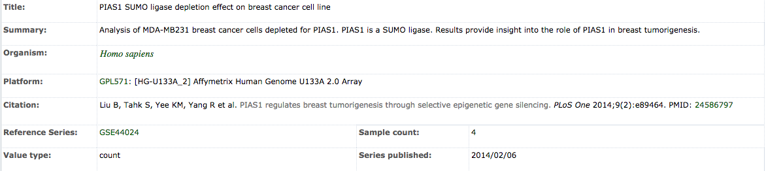
The FAIR principles, digital objects and infrastructures
PID
Data
Metadata
Persistent Identifier: reference and identify object, either metadata or data object
Synchronise PID, Data and Metadata during creation, maintenance, update and deletion of a digital object!
A data infrastructure offers services which consider and serve the whole data object.
C Staiger, S Bendoukha, EUDAT Summer School 2017, Data discoverability and PIDs

Slide 13
The FAIR principles – What does it mean for the data life cycle
A lot of extra work for a scientist
Notes:
Store and maintain many different versions of data
Link data and its derived data and maintain these links and annotate what the links mean
Annotate data according to (community) standards such that others can understand → provenance metadata
Transfer or extend metadata to match several metadata standards
A repository or a database for data and metadata publishing might expect different metadata and follow different standards than what is used in computational pipelines

Slide 14
Data stewardship – what’s that?
DTL defines data stewardship as:
Responsible planning and executing of all actions on digital data before, during and after a research project, with the aim of optimizing the usability, reusability and reproducibility of the resulting data.
Data stewards help researchers to maintain their data
Data stewards maintain data even if researchers left the institute

Slide 15
Defining FAIR Data Stewards
https://doi.org/10.5281/zenodo.3243910
Notes:
Supporting researchers, policy makers and IT personnel to work together.
Glue between those different stakeholders

Slide 16
Data stewards – bridging stakeholders
Data steward concludes:
Policies require to create a data publication at the end of each project
Funder requires that each file should be labelled with a persistent identifier
Data steward implements:
Data model which defines a data model based on collections and members of collections for the project
Processes and ways of handling data such that it is known which file belongs to which collection
Data steward selects:
Existing data services which support the data model and the researchers in handling their data
Features which need to be implemented into existing services

Slide 17
Do we need data stewards?
Who will interface between policy makers, researchers and IT specialists?
Is data management so simple that researchers can integrate it easily into their work? How much time does it cost?
How many relationships between data assets need to be managed and for how long?
Data Stewards are the glue between the three stakeholders: policy makers, researchers and IT and infrastructure providers

Slide 18
?
https://doi.org/10.5281/zenodo.2585691
https://doi.org/10.5281/zenodo.3243910

Slide 19
Some practical recommendations
Plan your data and its maintenance walking along the data life cycle employing a data management plan tool
Have good practices of annotating data and code
Standardised metadata
Ontologies
Technologies to express data models and metadata, README files for data and code
DON’T FORGET ABOUT THE RAW DATA AND FILES! Repositories store data files and metadata in a structured way (e.g. Zenodo)
Choose a data repository which supports your data and metadata, identify candidate repositories at the beginning of your research
Notes:
I mentioned repositories so often now let’s have a look at what they offer.

