Slide 1
Early Career and Engagement IG Early Career Networking Meeting

Slide 2
Agenda
Update on the IG charter and feedback from community
Strategies to keep fellows together during plenaries
Previous fellows experiences
Discussion on next steps and strategies

Slide 3
Bit of the history so far…
There is an unquestionable need of a dedicated space for engaging RDA members who are at the beginning stages of their careers
A place of discussion and engagement
A way of attracting more people
It’s a win-win situation:
People at the beginning stage have their own unique talents and strengths that will strengthen RDA and increase openness
Early career researchers will benefit from the breadth and depth of RDA expertise and share ideas
A dedicated BoF was conducted at P8 (Denver, CO Sep 2016) and a charter was drafted around X’mas 2016
many thanks to Devan, Kishun, Neema, Tenna, Anne, Kathy and all contributors so far!

Slide 4
Aims of the Interest Group
Target audience:
RDA community newcomers
Early and Mid Career scientists
Overall Aim:
provide a continuously evolving entry and focal point for our target audience
provide a focal point for the various RDA-related fellowships and early career programs, and
produce a set of recommendation documents to advise the corresponding diverse research communities

Slide 5
Goals
For each involved community, produce documents on:
How to better engage early career scientists and professionals from diverse communities with little experience in the values and solutions offered by RDA.
How to connect the continuously evolving scientific domains and communities with existing RDA IGs/WGs.
How to develop and document the best practices in communicating the values of RDA to each of the involved communities.
How to support the RDA Early Career Fellowship programme, both in terms of documentation and guidance, as well as through potential membership of Fellows in this group.

Slide 6
Going to specifics
This IG will complement existing efforts to support early career researchers by:
Attracting new people by attending / joining major events, both international, national and within organizations
Identifying the optimal connections between the Early Career scientists and existing RDA IGs and WGs, aiming to better guide and integrate these researchers to the best practices and guidelines of their particular fields.
Creating a compendium of persuasive arguments on why RDA would benefit disciplines and domains that currently are not well represented in RDA.
Having an internal process for continuously producing new topics for WGs and IGs based on the particular expertise and domains of newcomers

Slide 7
Long term Outcomes
Three key outcomes (per each engaged IG / discipline / Group):
A “live” document of key action points / WGs / IGs relevant in identified disciplines
Best practices in engaging Early Career people within RDA
A compendium of persuasive arguments on why RDA would benefit disciplines and domains that currently are not well represented in RDA.

Slide 8
Next steps
Our main goals for the first 12 months of the IG are to:
Conduct a survey to early-career groups and identify potential issues / fallbacks
Develop a process for identifying domains and disciplines that we want to attract to RDA and support
Identify and interact with relevant IGs (e.g., Chemistry Research Data IG, etc.)
Produce a draft compendium document and a best practices document

Slide 9
The proposed in-built mechanisms
The specific actions would include:
Asynchronous collaboration using google docs, a wiki, a dedicated forum and an electronic mailing list.
Feedback by the newcomers how the RDA is beneficial for them and how it can be improved
Recorded video sessions for future reference
Monthly telecoms / web conferences with planned agendas to discuss specific issues
Semiannual RDA Plenary meetings to hold sessions for face-to-face interactions amongst members and to inform other RDA members of its ongoing activities.

Slide 10
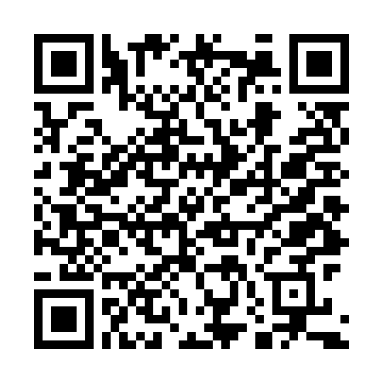
Future Steps
We have already compiled a first draft of the IG Charter, but we need
Feedback from everyone!
Link to Charter: https://goo.gl/SO7wE8

