Slide 1


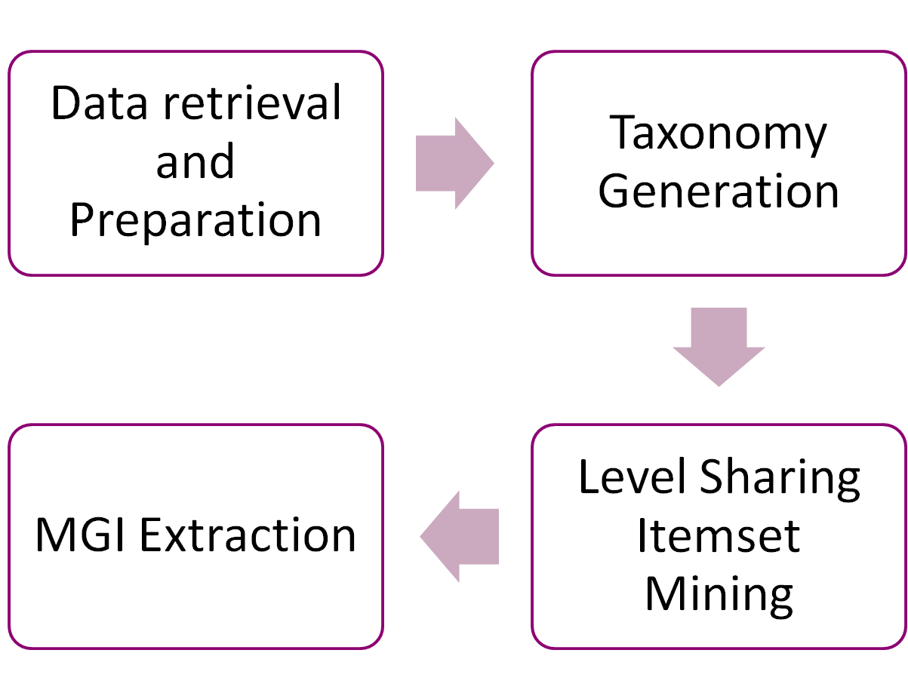

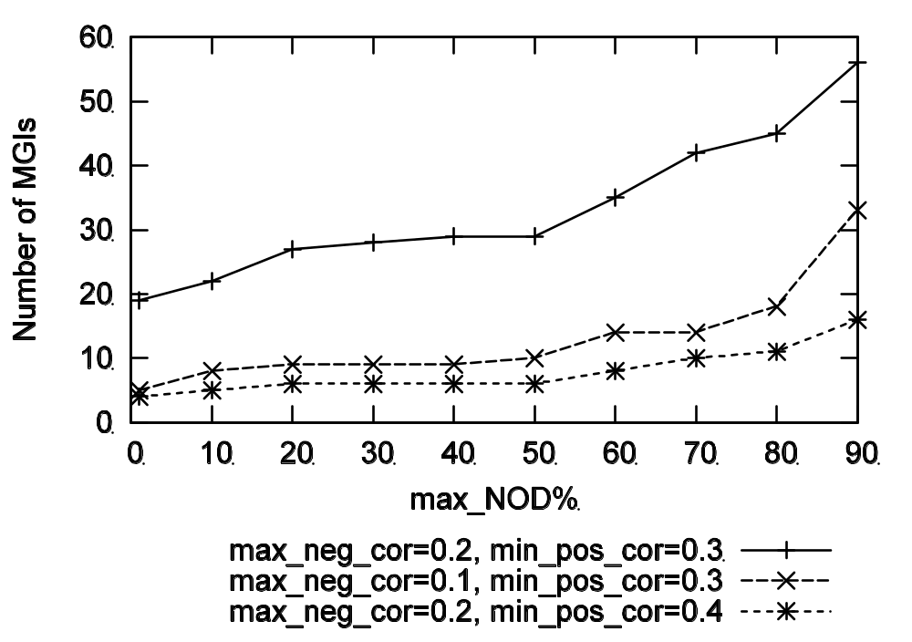
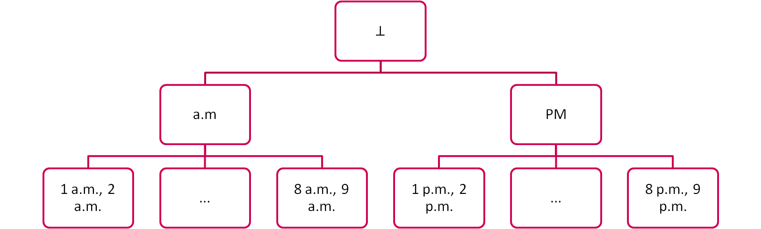
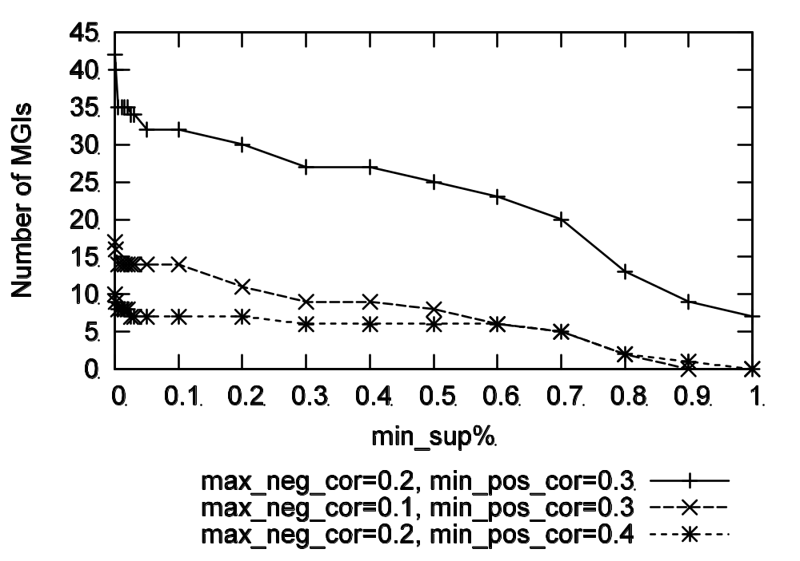
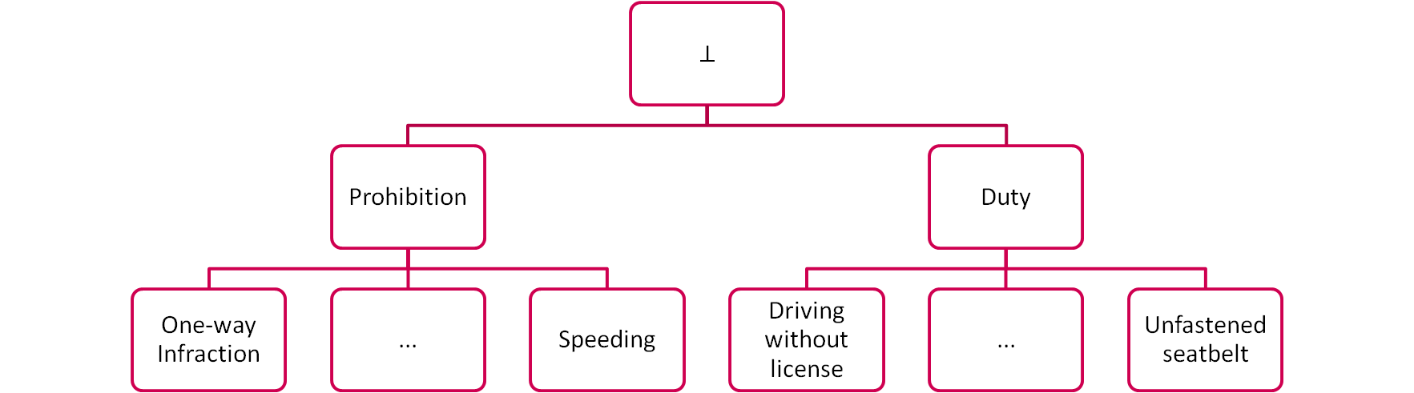
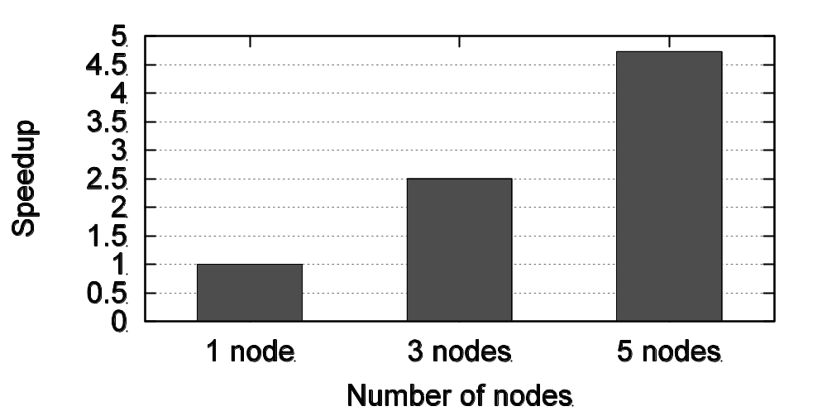
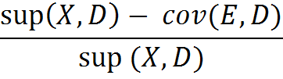
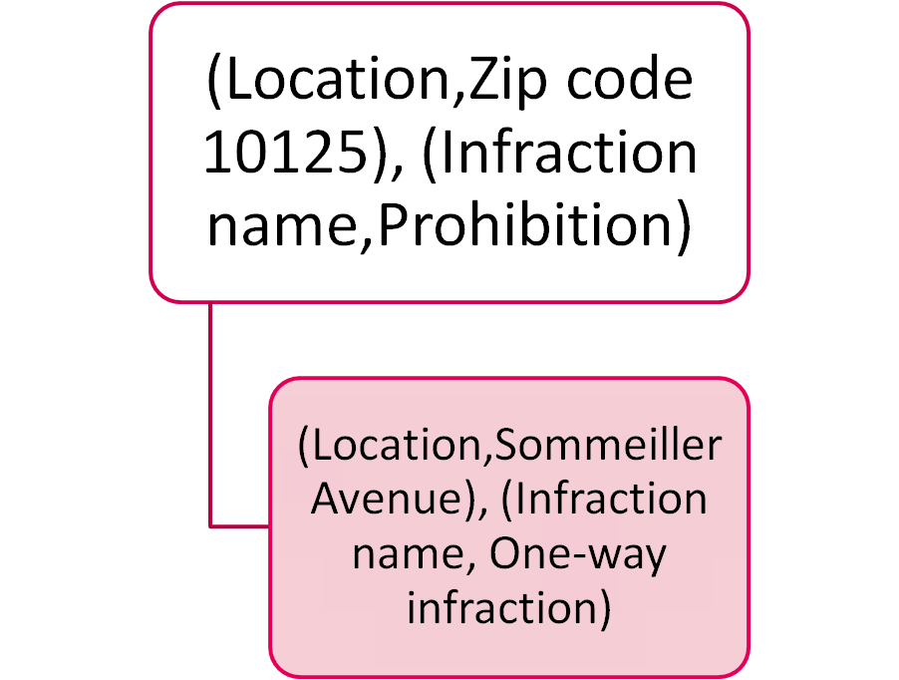
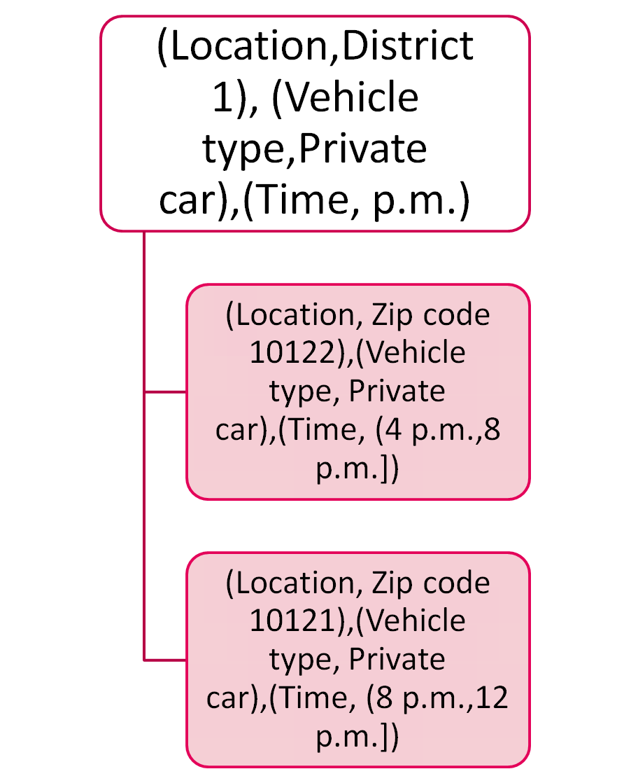
Misleading generalized itemset mining in the cloud
Elena Baralis, Luca Cagliero, Tania Cerquitelli, Silvia Chiusano, Paolo Garza, Luigi Grimaudo, Fabio Pulvirenti
Dipartimento di Automatica e Informatica
Politecnico di Torino
Torino, Italy
Email: {name.surname}@polito.it
Introduction
Framework
Evaluation
Generalized itemset mining entails the discovery of multiple-level patterns hidden in the analyzed data by exploiting analyst-provided taxonomies.
The most interesting high-level patterns are those with many contrasting correlations among items at different abstraction levels because they represent misleading situations.
MGI-CLOUD is a novel cloud-based service, to efficiently mine Misleading Generalized Itemsets, on a distributed computing environment.
As a case study, the system has been contextualized in a real-life scenario, i.e., the analysis of traffic law infractions committed in a smart city environment.
The MGI-CLOUD architecture provides a cloud-based service for discovering hidden and actionable patterns among potentially Big datasets
To efficiently cope with Big Data, the system implementation is distributed and most operations are mapped to the MapReduce programming paradigm.
Data retrieval and Preparation: Reports about daily infractions are collected in local data repositories.
Taxonomy Generation: real infraction datasets are equipped with taxonomies.
Level Sharing Itemset Mining: Aiming to mine the frequent itemsets, this task exploits a variation of the Hadoop-based itemset mining algorithm Parallel Frequent Patterns Growths (PFP), modified to extend the dataset, (integrating taxonomy information, “on the go”, storing the extended dataset into a compact FP-Tree structure).
MGI Extraction: : This job performs MGI mining on top of the frequent level-sharing itemsets.
We performed experiments on two real datasets:
AperTo dataset: open dataset, collects information about approximately 2 millions of traffic law infractions committed in the city of Turin over the 3-year period 2011-2013. (Infraction name, Vehicle type, Location, Date, and Time, 198 MB).
BigNetData dataset: relational network traffic dataset obtained by performing different capture stages on a backbone link of a nation-wide ISP in Italy. (192.56 GB, 413,012,989 records representing bi-directional TCP flows).
The set of MGIs, which represent anomalies/contrasting situations, remains easily manageable by domain experts for manual exploration.
Misleading Generalized
Itemset (MGI)
The mining task addressed by this work entails discovering from a Dataset all the MGIs for which the NOD value, a kind of interesting measure, is less than or equal to a maximum threshold max NOD.
MGIs are high-level (generalized) itemsets for which a relevant subset of frequent descendants have a correlation type in contrast to their common ancestor. MGIs can be interesting because the information provided by traditional high-level patterns becomes misleading under certain conditions.
The itemset correlation measures the strength of the correlation between its items. We have adopted Kulczynsky (Kulc) correlation measure.
Not Overlapping Degree (NOD) measures the degree of interest of a MGI X ⊲ E with respect to its corresponding traditional itemset version (X). The NOD of an MGI X ⊲ E is defined as:
The lower NOD value we achieve, the more significant the degree of overlapping between the contrasting low-level correlations in E and their common ancestor X becomes.
MGI Extraction
Conclusion
This step consists of a MapReduce job, as described in the following:
Map: for each level-sharing itemset I, the following two pairs (key, value) containing correlation statistics are emitted since an itemset can be a descendent or a parent of other itemsets. Two pairs are emitted because each itemset can be a descendant of an itemset and a parent of another one at the same time.
Reduce: local information about the itemsets are aggregated for itemsets, keeping only the itemsets in contrast to parent’s correlation type. Then, NOD values are computed.
MGI-Cloud is a cloud-based service for discovering Misleading Generalized Itemsets from Big Data equipped with taxonomies.
To cope with Big Data the architecture has been designed to run on a distributed Hadoop architecture.
A preliminary analysis of the applicability and
usefulness of the proposed architecture was conducted on real Big Data acquired in a smart city environment and related to traffic law infractions.
Optimize and extending the current Hadoop architecture as well as testing its applicability in other real-life contexts.

