Slide 1
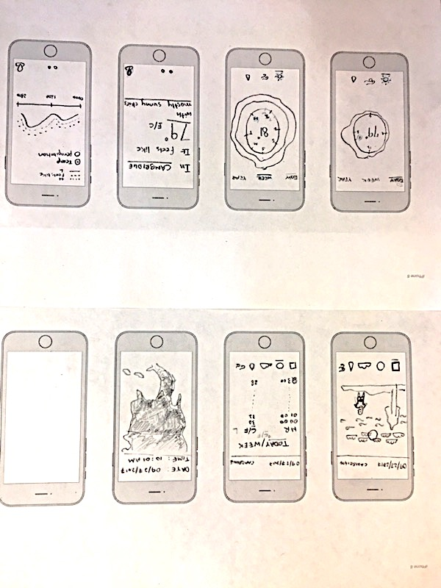
SEE YOUR DAY
Description:
Main screen: See a visual of the day
Brightness of the sun <> temperature
# of clouds in the sky <> cloud coverage
The wind direction and # of icons <> wind speed and wind bearing
The #of rain icons <> precipitation chance
4 representations of the ‘tree’ icon based on what season is it <> by date
8 representations of the human avatar wearing different clothes <> rain (yes, no) and temperature (summer, winter, fall, spring)
Detail screens: Click the bottom icons for details on temperature, cloud coverage, rain, and wind
Interactivity:
Change location
Change date
Click icons on the bottom for weather details
Data connections:
DarkSky API

Slide 2
HEAT MAP
Description:
One screen: A heat map of the world created using either apparent temperature or a # using temperature + cloud coverage. Zoom in to see extremely localized data
Options I’m considering: Add in wind and rain data
Interactivity:
Change date
Change time
Zoom in to a specific location
Data connections:
Google Maps API
DarkSky API

Slide 3
CIRCULAR VISUAL
Description:
A circular representation of the weather data. Choose your time period and the data type (temp, wind, rain). Each visual is represented using a huge number in a center of a circle with temporal data wrapped around.
E.g. for the day, you see a specific temperature number at the chosen hour. For the week, you see a specific avg. temp number at the chosen day (with high, low data wrapped around)
Interactivity:
Change data time period: day, week, year
Change data time period: hour within day, day within week, month within year
Change data type: temperature, wind, rain
Click icons on the bottom for weather details
Data connections:
DarkSky API

Slide 4
SIMPLE WEATHER
Description:
A simple representation of the weather data.
Main Screen: Only current temperature is shown as a number along with a short line describing wind, cloud coverage and rain conditions
Detail screen: See data for the week with high, low and apparent temperature or chance of perception
Interactivity:
Change location
Choose to see either temperature or precipitation for the week
Data connections:
DarkSky API

