Slide 1
Crypto Market Analysis

Slide 2
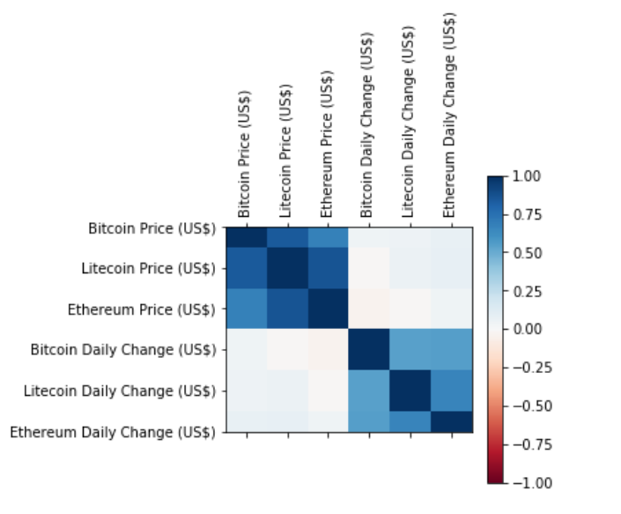

Slide 3
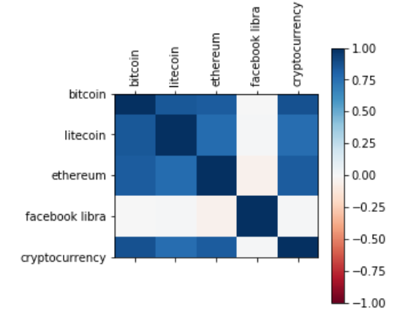

Slide 4
