Slide 1

Are You in the RIGHT Neighborhood?
Jeff Eickholt
Philip Wirth
Ruby Mittal

Slide 2
The 311 Houston Help and Information Helpline puts City government at your fingertips and you get answers, find the right person, or have your City service problem solved.
Houston citizens can call 311 or fill out an online form to report issue
Issues are logged when created and a due date is assigned; the closed date is logged when issue resolved
There are about 350,000 to 400,000 request each year

Slide 3
Top Issues (2017 – 2019)
Issue | Count | Day until Due(Avg) |  | Issue | Count | Day until Due(Avg)
Missed Garbage | 82,063 | 6 |  | Street Hazard | 32,746 | 10
Water Leak | 74,707 | 10 |  | Drainage | 28,840 | 30
Container Problem | 74,126 | 11 |  | Traffic Signal | 27,753 | 1
Sewer Wastewater | 66,549 | 1 |  | SWM Escalation | 26,293 | 5
Nuisance on Property | 57,571 | 254 |  | Traffic Signs | 23,198 | 16
Missed Recycling | 54,796 | 6 |  | Street Condition | 19,651 | 30
Missed Heavy Trash | 45,476 | 11 |  | Storm Debris Collection | 12,816 | 5
Water Service | 35,341 | 2

Slide 4
Analysis
Goal of Analysis: Identify factors that impact whether issue is closed by the due date or not
Factors Considered:
Type of Issue
Socioeconomic factors
Weather

Slide 5
Datasets
City of Houston 311 - https://www.houstontx.gov/311/
Census Bureau - https://www.census.gov/acs/www/data/
Weather Underground - https://www.wunderground.com/

Slide 6
Models
Target Variable: Not Closed by Due Date (1) vs. Closed (0)
Models Considered: Logistic Regress, KNN
Model Deployed: Logistic Regression

Slide 7
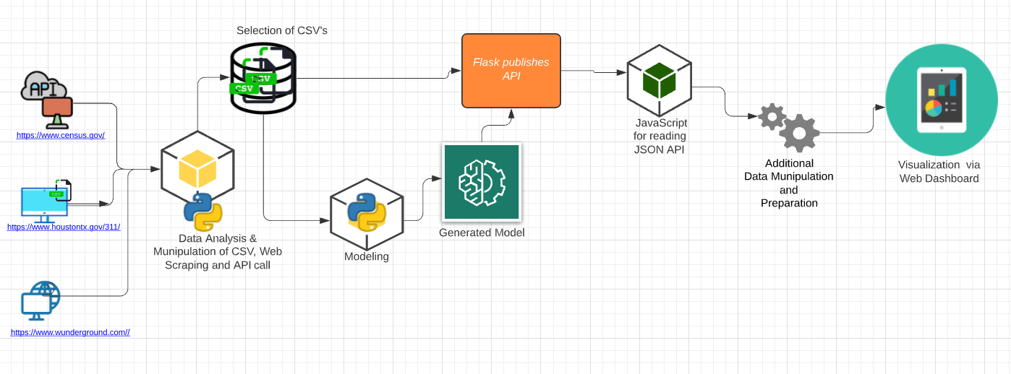
Flowchart

Slide 8
Conclusions
Little evidence that socioeconomic factors impact whether issue is closed by due date
Some evidence that rainfall does have some impact
Clear evidence that the type of issue has impact

Slide 9
Demo !!

Slide 10
Thank you Any Questions ??

