Slide 1

Are You in the RIGHT Neighborhood?
Jeff Eickholt
Philip Wirth
Ruby Mittal

Slide 2
The 311 Houston Help and Information Helpline puts City government at your fingertips and you get answers, find the right person, or have your City service problem solved. * * *

Slide 3
Database * * *

Slide 4
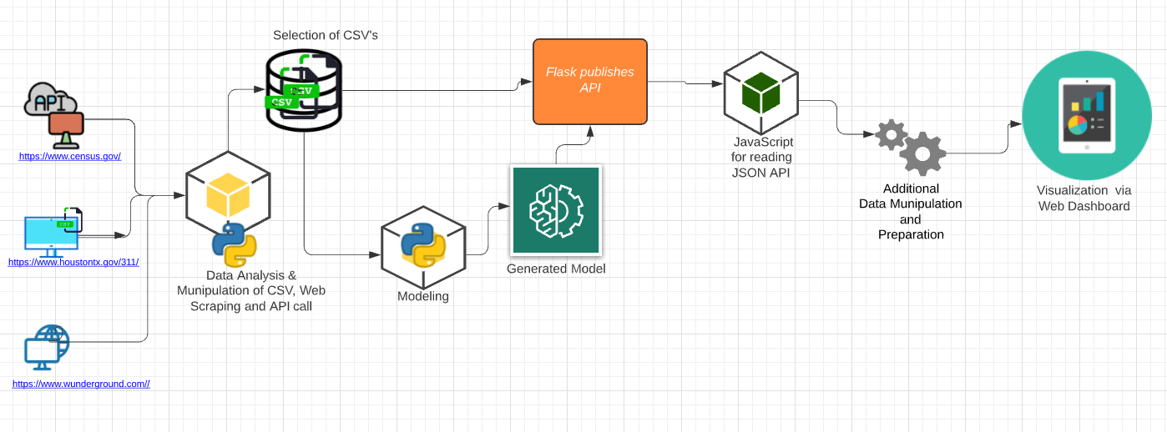
Flowchart

Slide 5
Demo !!

Slide 6
Thank you Any Questions ??

