Slide 1
Election Forecasting in Low Information Markets
Cliff Young and Neale El-Dash
May 15th, 2015
70th AAPOR Conference

Slide 2
Data Sparse
Unlike the US and Europe……
Most countries have “sparse data”
Few Polls and Elections to draw upon to estimate models

Slide 3
Small N-Size Problem!!!
Typically only….
Few Dozen polls
4-7 Elections

Slide 4
In the place of models, we often rely on polls in such countries……
However, they too can be misleading especially far out!!

Slide 5
Polls can be misleading far out
Time Before Election | Absolute Average Difference
 | U.S. Presidential | International Executive
One week | 1.7% | 3.2%
One month | 2.7% | 3.6%
Two months | 3.8% | 4.0%
Three months | 4.8% | 4.8%
Six months | 5.8% | 5.8%
Nine months | 6.9% | 6.4%
Twelve months | 7.9% | 6.8%
Source: 400+ polls across 45 countries (1980 to Present)

Slide 6
Forecasters, like us, are left without key tools in our election prediction toolbox

Slide 7
KEY QUESTION:
Can we develop a model to help us handicap elections even in low information markets?

Slide 8
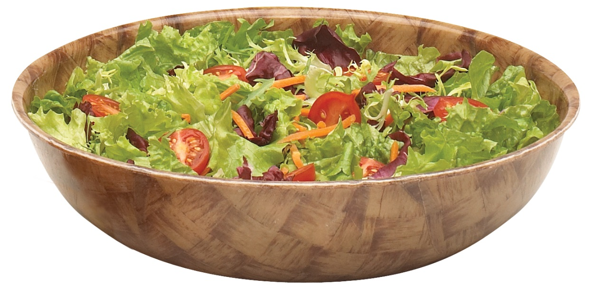
Yes, a model which aggregates across countries and elections contexts
Salad Approach

Slide 9
Key Data
450+ elections
National and State
Parliamentary and Presidential
37 countries
Key Variables: Approval ratings and Incumbency
Pr(victory) = Approval + Incumbency
Output: Probability of Government Candidate Winning

Slide 10
Key Data
Estimated using logistic regression
86% hit rate ➔ correctly predicts winner
72% pseudo R-square

Slide 11
Prob of Victory: Incumbency is King!
Lula 2006
Obama 2012
Dilma 2010
Sarkozy
2012
McCain 2008

Slide 12
Probs of Victory: by Approval and Incumbency
Approval | Probability of Victory
 | Incumbent | Successor
5 | 0% | 0%
10 | 1% | 0%
15 | 2% | 0%
20 | 4% | 0%
25 | 8% | 0%
30 | 19% | 1%
35 | 36% | 3%
40 | 58% | 6%
45 | 78% | 14%
50 | 90% | 28%
55 | 96% | 49%
60 | 98% | 71%
65 | 99% | 86%
70 | 100% | 94%
75 | 100% | 97%
80 | 100% | 99%

Slide 13
Key Data
Recent and Future Predictions:
Brazil Dilma ➔ 85%
Israel Netanyahu ➔ 72%
Nigeria Goodluck ➔ 45%
UK Cameron ➔ 78%
US (2016) ➔ Democrat prob of Victory 35%

