Slide 1
Electoral Forecasting Models: Heuristics, Polls, and Aggregation
Cliff Young, President Ipsos USPA
Washington, DC, 2015

Slide 2
Objectives
Initial considerations:
Overview
False positives and other biases
General forecasting approaches
Toolbox of forecasting techniques
Strengths and weakness of each model

Slide 3
Initial Considerations
Expert Judgment: No better than a 50/50 proposition!!!
Beware of false positives
Think Probabilistically
Triangulation

Slide 4
Overview of models
Heuristics
Polls
Polling Aggregation Models
Fundamentals Models
Combinatorial models

Slide 5
Heuristics

Slide 6
3 basic election types
Middling
Change
Continuity
Scenario favorable to the Opposition Candidate
Scenario favorable to the Government Candidate
Government Approval
Right track / wrong direction
Economic optimism
More Negative
Government Approval
Right track / wrong direction
Economic optimism
More Positive

Slide 7
Heuristic Models
Economy
Approval Ratings
Main Problems

Slide 8
Approval Ratings and Prob of Government Candidate Winning
Approval Rating | Probability of Victory
47 | 50,8%
48 | 53,5%
49 | 56,1%
50 | 58,8%
51 | 61,5%
52 | 64,2%
Young and Garman: 178 elections

Slide 9
Approval Ratings: Brazil 2014

Slide 10
Weights: Main Problems/Agenda Questions
Which one of these issues would you say is most important when
thinking about the current Presidential election campaign? (US 2012)
85% of elections are won by candidate perceived as strongest on main problem
Source: Ipsos poll October 2012

Slide 11
Average Month-to-month Correlation
Scenario Variables

Slide 12
Average Month-to-month Correlation
Scenario Variables

Slide 13
“Economy as Main Problem” and “Unemployment Rate”: 1946 to 2011
Correlation .80
Gallup 1946 to 2011
13

Slide 14
Single and Tracking Polls

Slide 15
Polls
Subject to Bias
Potential False Positives
But better than nothing, maybe!

Slide 16
Comparative Polling Accuracy
Time Before Election | Absolute Average Difference
 | U.S. Presidential | International Executive
One week | 1.7% | 3.2%
One month | 2.7% | 3.6%
Two months | 3.8% | 4.0%
Three months | 4.8% | 4.8%
Six months | 5.8% | 5.8%
Nine months | 6.9% | 6.4%
Twelve months | 7.9% | 6.8%

Slide 17
Tracking Poll: Brazil
Subject to Bias
Potential False Positives

Slide 18
Poll Aggregation Modeling

Slide 19
Poll Aggregation
Minimize Bias / Noise
Calculating Probabilities
Pr(victory) = # of Polls for Obama / Total number of polls
But still subject to electoral vagaries

Slide 20

Simple Poll Average

Slide 21
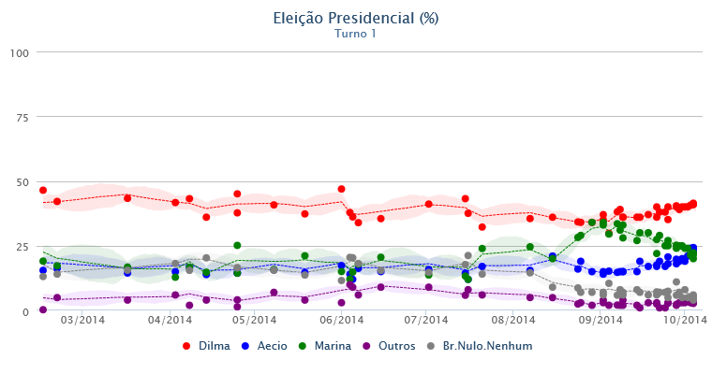
First Round: Brazil
Pr(Obama victory) = # of Polls for Obama / Total number of polls

Slide 22
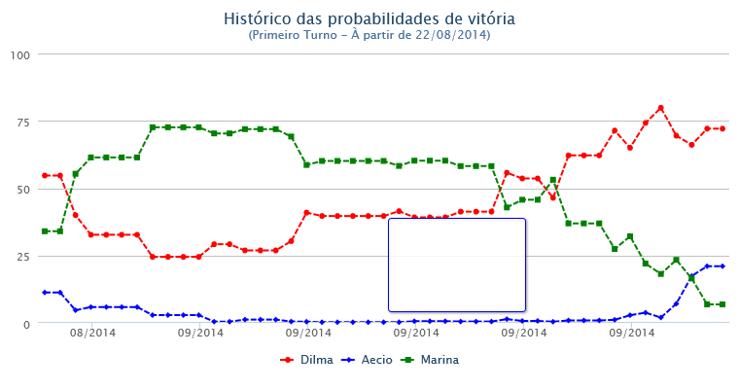
First Round: Prob of Victory
Pr(Obama victory) = # of Polls for Obama / Total number of polls

Slide 23
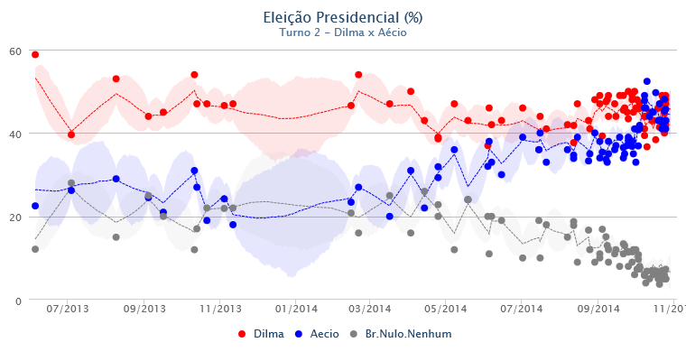
Second Round: Brazil
Pr(Obama victory) = # of Polls for Obama / Total number of polls

Slide 24
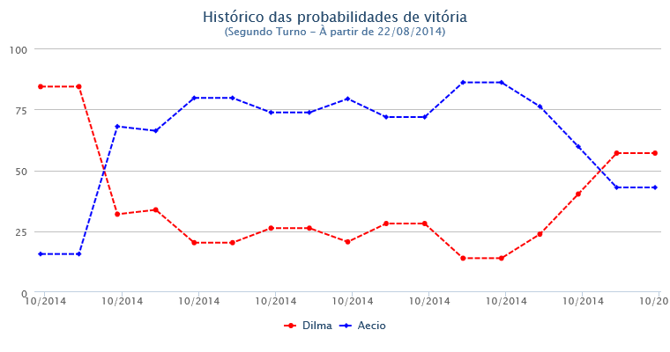
Second Round: Probabilities
Pr(Obama victory) = # of Polls for Obama / Total number of polls

Slide 25
Fundamentals Models

Slide 26
Fundamentals Models
Vote = Political + Economic

Slide 27
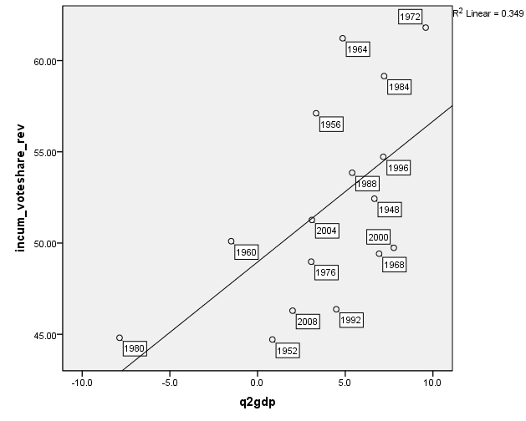
Vote by GDP: US Case

Slide 28
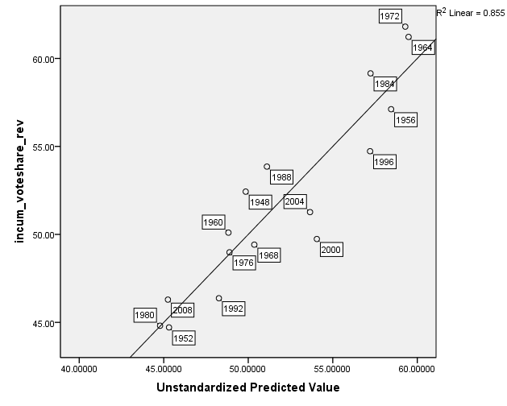
Vote by GDP, Approval, Incumbency: US Case

Slide 29
Fundamentals Models
Problem typically few elections to aggregate in most countries

Slide 30
Aggregation across election contexts

Slide 31
Young & Garman
Pr(victory) = Approval + Incumbency
Aggregated 250 elections
Can use in low information contexts

Slide 32
Young & Garman
Incumbents have an almost 3-fold (2.64) advantage over successors
3 basic election types

Slide 33
Election types by approval ratings
Continuity ➔ 55 or more
Middling ➔ 40-54
Change ➔ 39 or less

Slide 34
Probability of Government Candidate Winning by Election Type
Chaves 2012
Lula 2006
Dilma 2010
Zarkozy 2010
McCain/Serra

Slide 35
Estimated probabilities
Approval | Probability of Victory
 | Incumbent | Sucessor
5 | 0% | 0%
10 | 1% | 0%
15 | 2% | 0%
20 | 4% | 0%
25 | 8% | 0%
30 | 19% | 1%
35 | 36% | 3%
40 | 58% | 6%
45 | 78% | 14%
50 | 90% | 28%
55 | 96% | 49%
60 | 98% | 71%
65 | 99% | 86%
70 | 100% | 94%
75 | 100% | 97%
80 | 100% | 99%

Slide 36
Combinatorial Models

Slide 37
Two Basic Learnings from our model
Combine the best of each models
Fundamentals together with poll aggregation probability
Dilma ➔ 90% (Fundamentals)
Dilma ➔ 25% (Poll Aggregation)
Dilma ➔ 58% (Simple Average)
Triangulate

