Slide 1

sAOM
Software Engineering Web Project
K00237093, K00242939, K00243015, K00226039

Slide 2
Introduction
The Sullimar Academy of Music. Marketing as “Sullimar academy of Music” has been in business for the last 40 years and functions from a bricks and mortar organization located in Dublin Road, Limerick. The Senior Management have made a dedication in order to create an online presence/website for the Sullimar Academy of Music. The main aim of this project is to significantly convert the manual functions of the Sullimar Academy of Music to all virtual and online based functions as well as to provide Information about various courses, events, and buying books. This will be achieved by designing an online website which will cater to a wider range of audiences looking for different courses in music and different events compared to the current bricks and mortar school/college, thus increasing the businesses overall revenue, and also covering a greater geographical location as the organization will have an online presence.

Slide 3
Purpose of System
The purpose of this web application is to transform an existing business and its operation to a computerized system. The main objective is to change the existing daily operations of the organization to do multiple tasks that were previously done physically to being done remotely i.e., online.

Slide 4
Current System and Problems
At present, Sullimar Academy of Music (SAOM) operates on a Brick-And-Mortar type presence.
Some of the key problem areas that have been noted by SAOMs key representatives are:
Difficulty in keeping track of bookings – due to changes & cancellations inhouse and from clients.
Inefficient booking process with direct correlation to volume of bookings occurring over the phone.
Keeping track of installment-based payment schemes.
Application Forms delay due to current method of receiving through Post.
Cheques/Payments getting lost.
Invoices are not being fulfilled when Statements are issued due to PO’s being misplaced.
Locating examiners to oversee exams hosted in designated exam centers becoming inefficient and time consuming.

Slide 5
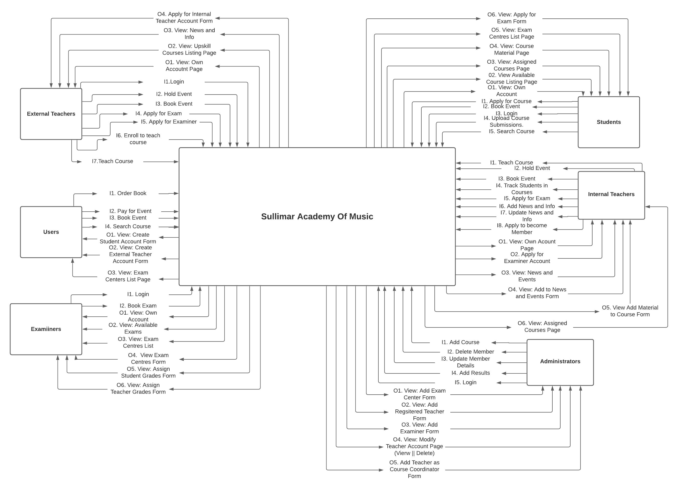
Context Diagram with Inputs and Outputs

Slide 6
List of Entities interacting with the System
Teacher from SOAM
Teachers from All -Around Ireland
Students
General Users
Admins/ Senior Management
Examiners

Slide 7
Purposed System Aim and Objective
The main aim and objective of the proposed system is:
To go fully virtual and online which will provide all the manual paper-based systems to be all accessed online
To keep track of all academy related information in a proficient and efficient manner.
The new proposed website/system would have all of the systems functions operating online such as booking events, ordering books, registering and applying for courses as well as providing different members of the academy to login and sign up to their related portals.
Each portal will contain related information depending on which user is logged in (i.e. Teacher, Students, Examiners etc.). The proposed system is also aimed to be fully administrated by the Admins/Senior Management.

Slide 8
Main Functional Requirements
Student Portal (internal functions within)
Admin Portal (internal functions within)
Shopping Cart (includes purchasing book and events)
Apply for Course
Apply for Exam
Login/Logout
Generate Various Types of Reports

Slide 9
Non Functional Requirements
Usability
Reliability
Performance
Supportability
Scalability
Security

Slide 10
Design Management
Overall Theme/Style: Modern, Clean and Fancy/Stylish
Colour Schemes: Bright White/Blue/Pink Colors
Page Banners/Graphics: hero image of music related pictures and typing text animation and graphics
Navigation: Top Bar with animation and responsive unordered list and breadcrumbs will be used as highlighted text to identify where the user wants to navigate to on the website. Link structures are sorted by different categories
Naming Conventions: Simple and descriptive tag/heading on the page

Slide 11
Thank You Any Questions!!!!

